Slide 1
CollaboratiVET Curriculum for VET teachers/trainers/educators
Module 7: Cultivating a Learning Community: Context-Specific Implementation in VET Field
Unit 3 - Technology Integration for Enhanced VET Learning Communities
Funded by the European Union. Views and opinions expressed are however those of the author(s) only and do not necessarily reflect those of the European Union or the European Education and Culture Executive Agency (EACEA). Neither the European Union nor EACEA can be held responsible for them.

Slide 2
Learning Objectives
By the end of this unit, participants will be able to:
Recognize and select appropriate technological tools that support and enhance collaborative learning in VET environments
Integrate technology into the VET curriculum to design and deliver collaborative learning experiences that are engaging and interactive
Critically assess how technology integration enhances collaborative learning practices and contributes to the achievement of group learning objectives
Identify and strategize to overcome challenges that technology may pose to collaborative learning, ensuring all VET learners can participate fully and equitably

Slide 3
Introduction
The role of technology
Acts as a facilitator for innovative teaching and learning methods.
Provides platforms for collaboration and communication among educators and learners.
Enhances access to industry-standard practices and resources.
Funded by the European Union. Views and opinions expressed are however those of the author(s) only and do not necessarily reflect those of the European Union or the European Education and Culture Executive Agency (EACEA). Neither the European Union nor EACEA can be held responsible for them.

Slide 4
Introduction
The Role of (New) Technology in VET
Digital transformation requires a general skill shift, with information and communications technology (ICT) playing a vital role in achieving the Sustainable Development Goals.
Modern workforce preparation entails regarding technology as a key factor in education instead of an extra, also emphasized by Bill Gates.
Education institutions and their staff must adapt their teaching strategies and materials to a technology-dependent learning environment.
As technology reshapes education, the role of teachers and trainers changes, emphasizing their pivotal role in integrating ICT.
Source: https://unevoc.unesco.org/home/ICT+in+TVET
Funded by the European Union. Views and opinions expressed are however those of the author(s) only and do not necessarily reflect those of the European Union or the European Education and Culture Executive Agency (EACEA). Neither the European Union nor EACEA can be held responsible for them.

Slide 5
Introduction
The Role of (New) Technology in VET
Source: https://unevoc.unesco.org/home/ICT+in+TVET
Funded by the European Union. Views and opinions expressed are however those of the author(s) only and do not necessarily reflect those of the European Union or the European Education and Culture Executive Agency (EACEA). Neither the European Union nor EACEA can be held responsible for them.

Slide 6
Introduction
The Role of (New) Technology in VET
The main advantage of ICT is its potential to globally connect and access education and training, inducing a global demand for up-to-date technological skills.
Fostering a culture of collaboration is essential for these VET systems to remain open and adaptable in a rapidly changing world.
Networking, both online and offline, is identified as a crucial resource for vocational students and the general public in today's fast-paced world of change.
Open Educational Resources (OER) can significantly enhance access to useful materials in vocational education.
Source: https://unevoc.unesco.org/home/ICT+in+TVET
Funded by the European Union. Views and opinions expressed are however those of the author(s) only and do not necessarily reflect those of the European Union or the European Education and Culture Executive Agency (EACEA). Neither the European Union nor EACEA can be held responsible for them.

Slide 7
Introduction
The Role of (New) Technology in VET
Technology as a Collaboration Enabler:
Enables real-time teamwork and project management, mirroring the collaborative nature of modern workplaces.
Offers virtual spaces where learners can engage in cooperative learning, breaking geographical barriers.
Supporting Personalized Learning:
Allows for adaptive learning experiences that cater to individual student needs and paces.
Assists in tracking progress and providing personalized feedback through learning analytics.
Bridging the Skills Gap:
Prepares learners for the digital competencies required in today's job market.
Connects academic learning with practical industry application through simulations and virtual labs.
Funded by the European Union. Views and opinions expressed are however those of the author(s) only and do not necessarily reflect those of the European Union or the European Education and Culture Executive Agency (EACEA). Neither the European Union nor EACEA can be held responsible for them.

Slide 8
Introduction
The Role of (New) Technology in VET
Fostering Continuous Professional Development:
Encourages lifelong learning and skill-updating for educators through online courses and professional networks.
Provides educators with tools to stay current with educational trends and industry advancements.
Source: https://youtu.be/b29HEC5WL9M?feature=shared
Funded by the European Union. Views and opinions expressed are however those of the author(s) only and do not necessarily reflect those of the European Union or the European Education and Culture Executive Agency (EACEA). Neither the European Union nor EACEA can be held responsible for them.

Slide 9
Benefits of Technology for Educators and Learners
Collaboration
Continuous Skill Development
Flexibility and Accessibility
Tools like Microsoft Teams and Google Workspace foster collaboration by allowing learners to work together on projects regardless of their physical location.
Educators can monitor group work more efficiently and facilitate collaboration outside of traditional classroom hours.
Online platforms offer learners and educators alike opportunities for continuous professional development and upskilling through courses and certifications.
Technology enables the ongoing acquisition of new competencies that are essential in the rapidly changing job market
Online resources and e-learning platforms provide learners the flexibility to study anytime, anywhere, broadening access to education
Funded by the European Union. Views and opinions expressed are however those of the author(s) only and do not necessarily reflect those of the European Union or the European Education and Culture Executive Agency (EACEA). Neither the European Union nor EACEA can be held responsible for them.

Slide 10
Benefits of Technology for Educators and Learners
Data-Driven Insights
Interactive Learning Experiences
Resources and Lifelong Learning
Educational technologies can track progress and generate data, offering educators valuable insights into learner performance and enabling informed interventions.
Technology, including simulations and gamification, makes learning more interactive and engaging, leading to higher retention of information.
A wealth of online resources, from MOOCs to webinars, supports continuous learning and professional development for both students and teachers.
Funded by the European Union. Views and opinions expressed are however those of the author(s) only and do not necessarily reflect those of the European Union or the European Education and Culture Executive Agency (EACEA). Neither the European Union nor EACEA can be held responsible for them.

Slide 11
Current Technological State of VET
Scarcity of information on technology use in Vocational Education and Training (VET) prompted an OECD survey in Estonia, Norway, and Scotland.
There are variations in technology use across VET institutions, reflecting differences in VET system structures and technology policies.
Digital tools like examinations, tests, assessments, and virtual meetings are widely used across all examined countries.
School information systems are prevalent in Norway and Estonia but less common in Scotland.
Robotics and simulators are more widespread in Norway and Estonia compared to Scotland.
Source: https://www.oecd-ilibrary.org/sites/eb90e4d8-en/index.html?itemId=/content/component/eb90e4d8-en
Funded by the European Union. Views and opinions expressed are however those of the author(s) only and do not necessarily reflect those of the European Union or the European Education and Culture Executive Agency (EACEA). Neither the European Union nor EACEA can be held responsible for them.

Slide 12
Innovative Technologies in VET
Learning Management Systems (LMS):
Platforms like Moodle and Blackboard streamline course management, content delivery, and assessment.
Virtual Reality (VR):
Immersive environments for hands-on practice in safe, controlled settings (e.g., VR simulations for trade skills or medical training).
Augmented Reality (AR):
Overlaying digital information onto the real world, useful for interactive learning experiences in fields like engineering or healthcare.
Artificial Intelligence (AI):
Personalized learning paths using AI algorithms, chatbots for learner support, and data analytics for tailoring learning experiences.
Funded by the European Union. Views and opinions expressed are however those of the author(s) only and do not necessarily reflect those of the European Union or the European Education and Culture Executive Agency (EACEA). Neither the European Union nor EACEA can be held responsible for them.

Slide 13
Innovative Technologies in VET
Mobile Learning Apps:
Accessible education on-the-go, supporting microlearning and just-in-time skill acquisition.
Collaboration Tools:
Software such as Microsoft Teams or Slack that promote communication and project collaboration.
Digital Workspaces:
Whiteboarding tools like Miro or Jamboard enable interactive idea sharing and group problem-solving.
Online Simulations:
Simulated work environments for practicing technical skills without the risk or cost of real-world trials.
E-portfolios:
Platforms for students to document and showcase their work, reflecting their skills and learning progress.
Funded by the European Union. Views and opinions expressed are however those of the author(s) only and do not necessarily reflect those of the European Union or the European Education and Culture Executive Agency (EACEA). Neither the European Union nor EACEA can be held responsible for them.

Slide 14
VR in Technical Education
Source: https://youtu.be/4wPkObKYpeE?feature=shared
Funded by the European Union. Views and opinions expressed are however those of the author(s) only and do not necessarily reflect those of the European Union or the European Education and Culture Executive Agency (EACEA). Neither the European Union nor EACEA can be held responsible for them.

Slide 15
Technology as a Tool for Industry Alignment
BRIDGING ACADEMIC AND INDUSTRY PRACTICES: TECHNOLOGIES LIKE SIMULATIONS AND PROJECT MANAGEMENT SOFTWARE HELP ALIGN CLASSROOM EXPERIENCES WITH REAL-WORLD INDUSTRY EXPECTATIONS.
REAL-TIME INDUSTRY FEEDBACK: UTILIZE DIGITAL PLATFORMS TO CONNECT STUDENTS WITH INDUSTRY PROFESSIONALS FOR MENTORSHIP AND FEEDBACK, ENSURING THAT CURRICULUM STAYS RELEVANT TO CURRENT INDUSTRY STANDARDS.
ENHANCING JOB READINESS: INCORPORATE INDUSTRY-STANDARD TECHNOLOGY TOOLS IN COURSEWORK TO FAMILIARIZE STUDENTS WITH THE TOOLS THEY’LL ENCOUNTER IN THEIR PROFESSIONAL LIFE.
CONTINUOUS SKILL ACQUISITION: LEVERAGE ONLINE LEARNING PLATFORMS FOR UP-TO-DATE TRAINING AND CERTIFICATIONS THAT ARE RECOGNIZED AND VALUED BY INDUSTRY PARTNERS.
DATA-DRIVEN CURRICULUM DEVELOPMENT: APPLY DATA ANALYTICS TO ALIGN THE VET CURRICULUM WITH THE EVOLVING NEEDS OF THE JOB MARKET, ADAPTING TO TRENDS HIGHLIGHTED BY LABOR MARKET INFORMATION SYSTEMS.
Funded by the European Union. Views and opinions expressed are however those of the author(s) only and do not necessarily reflect those of the European Union or the European Education and Culture Executive Agency (EACEA). Neither the European Union nor EACEA can be held responsible for them.

Slide 16
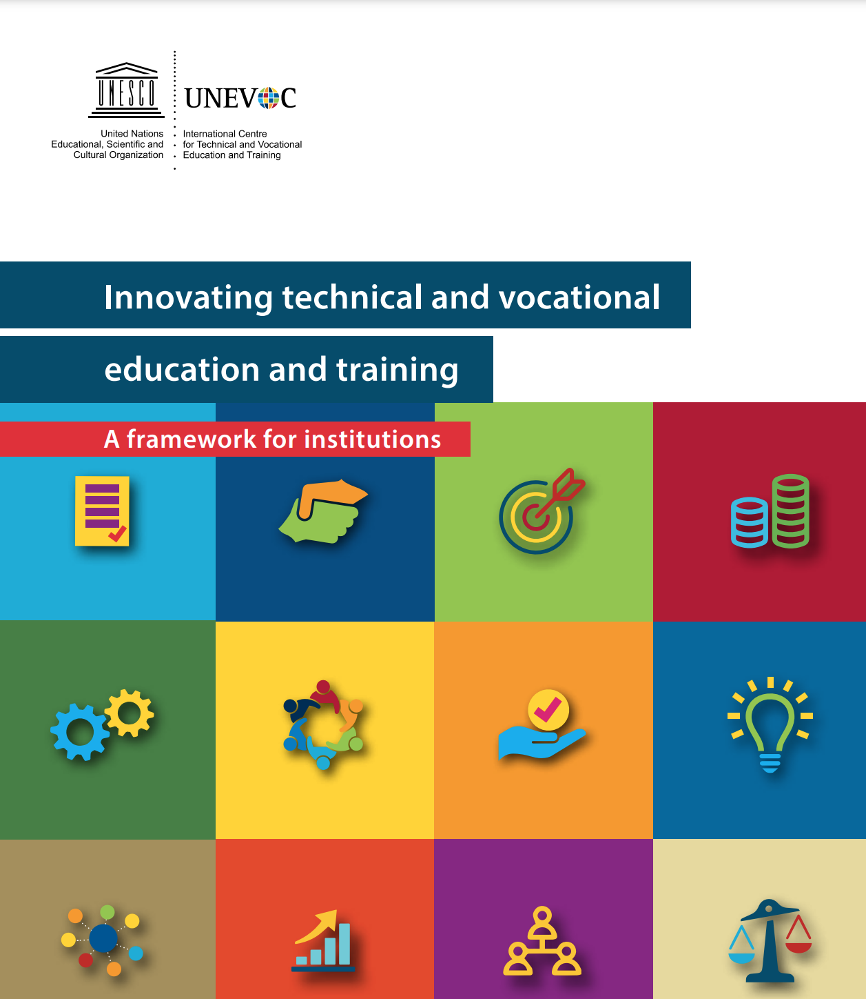
Implementing Tech in VET
Source: https://unevoc.unesco.org/pub/innovating_tvet_framework.pdf
Source: https://ec.europa.eu/social/BlobServlet?docId=23274&langId=en
Funded by the European Union. Views and opinions expressed are however those of the author(s) only and do not necessarily reflect those of the European Union or the European Education and Culture Executive Agency (EACEA). Neither the European Union nor EACEA can be held responsible for them.

Slide 17
Implementing Tech in VET – HOW?
Assessment & Planning
Conduct a comprehensive needs assessment: Engage with stakeholders to determine both the current resources and the technological needs of the VET community.
Identify integration goals: Set clear, measurable objectives for how technology should support the curriculum and enhance learning outcomes.
2. Selection & Acquisition:
Research and select appropriate tools: Choose technologies that are not only pedagogically sound but also user-friendly and cost-effective.
Consider future-proofing: Opt for scalable solutions that can adapt to future educational trends and technologies.
Funded by the European Union. Views and opinions expressed are however those of the author(s) only and do not necessarily reflect those of the European Union or the European Education and Culture Executive Agency (EACEA). Neither the European Union nor EACEA can be held responsible for them.

Slide 18
Implementing Tech in VET – HOW?
3. Training & Pilot Testing:
Develop a training program: Create professional development workshops that cater to varying levels of tech proficiency among educators and learners.
Initiate pilot tests: Start with small, controlled groups to test the feasibility and impact of the technology before school-wide implementation.
4. Implementation & Support:
Broad implementation: Following successful pilots, introduce the technology across the program, ensuring it's integrated into teaching and learning processes.
Provide ongoing support: Establish a support system to assist with technical issues and to help educators innovate their pedagogical approaches.
Funded by the European Union. Views and opinions expressed are however those of the author(s) only and do not necessarily reflect those of the European Union or the European Education and Culture Executive Agency (EACEA). Neither the European Union nor EACEA can be held responsible for them.

Slide 19
Implementing Tech in VET – HOW?
5. Evaluation & Adaptation:
Monitor progress and impact: Use data analytics to assess how well the technology meets educational goals.
Be prepared to adapt: Stay flexible and ready to make changes based on feedback and the outcomes of your assessments.
6. Ensuring Access & Bridging Gaps:
Address access issues: Develop initiatives to ensure all students have the necessary technology, such as lending programs or partnerships with local businesses.
Promote digital literacy: Embed digital skills training into the curriculum to ensure all learners can benefit fully from the technology provided.
Funded by the European Union. Views and opinions expressed are however those of the author(s) only and do not necessarily reflect those of the European Union or the European Education and Culture Executive Agency (EACEA). Neither the European Union nor EACEA can be held responsible for them.

Slide 20
Technology Integration Matrix
The Technology Integration Matrix (TIM) provides a framework for describing and targeting the use of technology to enhance learning. The TIM incorporates five interdependent characteristics of meaningful learning environments: active, collaborative, constructive, authentic, and goal-directed. These characteristics are associated with five levels of technology integration: entry, adoption, adaptation, infusion, and transformation.
Source: https://fcit.usf.edu/matrix/matrix/
Funded by the European Union. Views and opinions expressed are however those of the author(s) only and do not necessarily reflect those of the European Union or the European Education and Culture Executive Agency (EACEA). Neither the European Union nor EACEA can be held responsible for them.

Slide 21
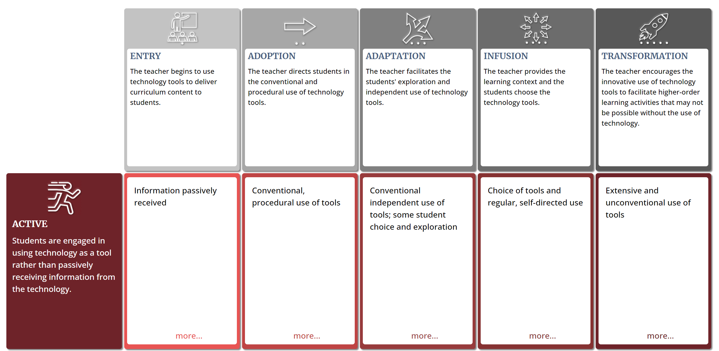
Technology Integration Matrix
Together, the five characteristics of meaningful learning environments and five levels of technology integration create a matrix of 25 cells. All TIM descriptors apply equally well to online and face-to-face instruction, Developed by the Florida Center for Instructional Technology (FCIT) in 2005, the TIM is now in its third edition (2019).
Source: https://fcit.usf.edu/matrix/matrix/
Funded by the European Union. Views and opinions expressed are however those of the author(s) only and do not necessarily reflect those of the European Union or the European Education and Culture Executive Agency (EACEA). Neither the European Union nor EACEA can be held responsible for them.

Slide 22
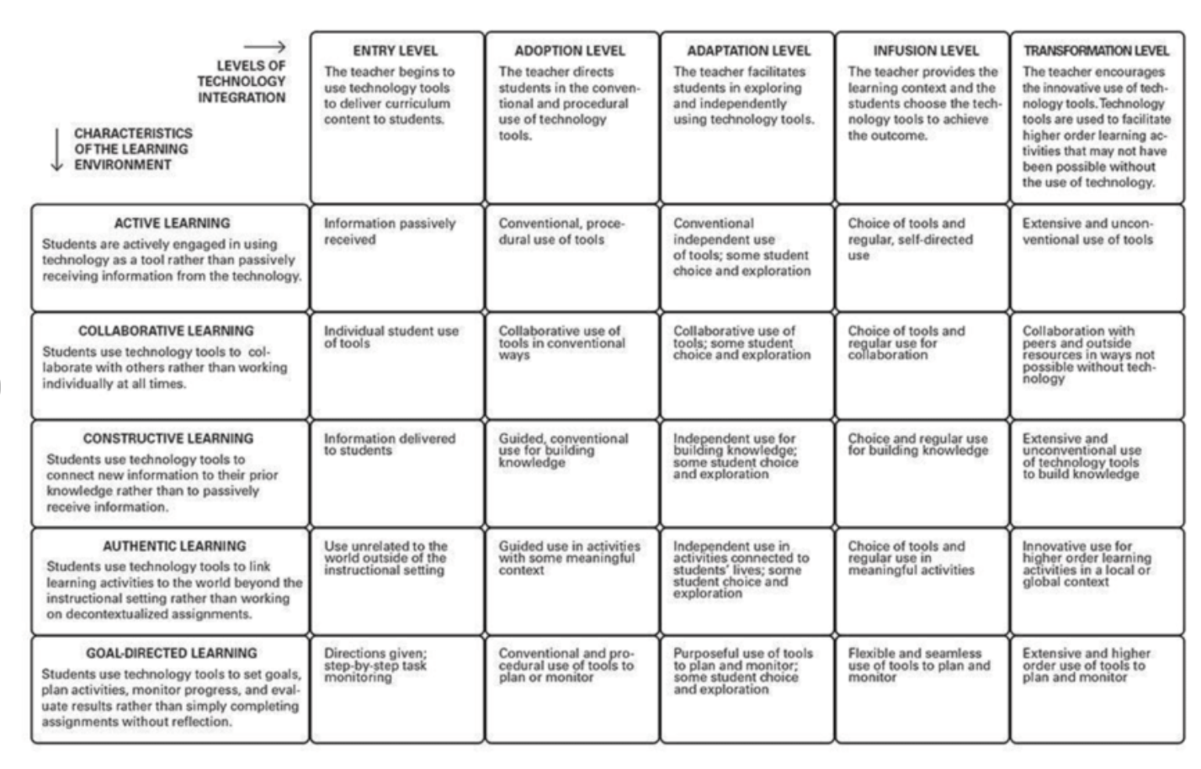
Technology Integration Matrix
Source: https://fcit.usf.edu/matrix/
Funded by the European Union. Views and opinions expressed are however those of the author(s) only and do not necessarily reflect those of the European Union or the European Education and Culture Executive Agency (EACEA). Neither the European Union nor EACEA can be held responsible for them.

Slide 23
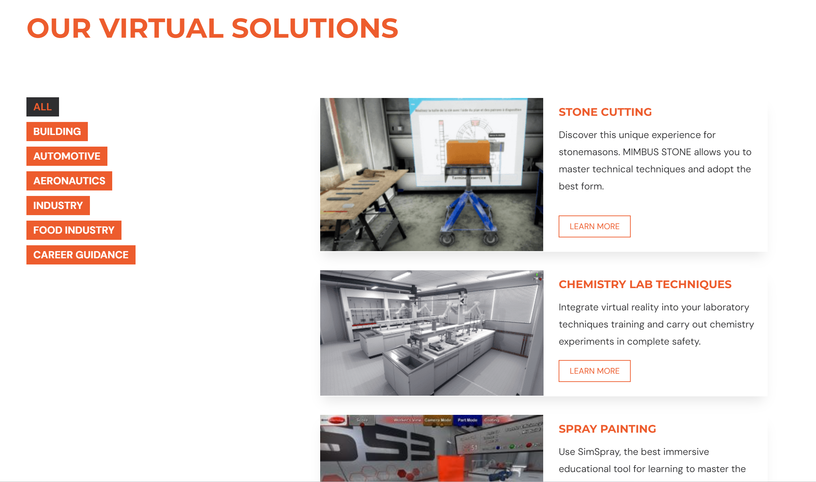
Case Studies in VET Technology Integration
More info here: https://mimbus.com/en/our-solutions/
Funded by the European Union. Views and opinions expressed are however those of the author(s) only and do not necessarily reflect those of the European Union or the European Education and Culture Executive Agency (EACEA). Neither the European Union nor EACEA can be held responsible for them.

Slide 24
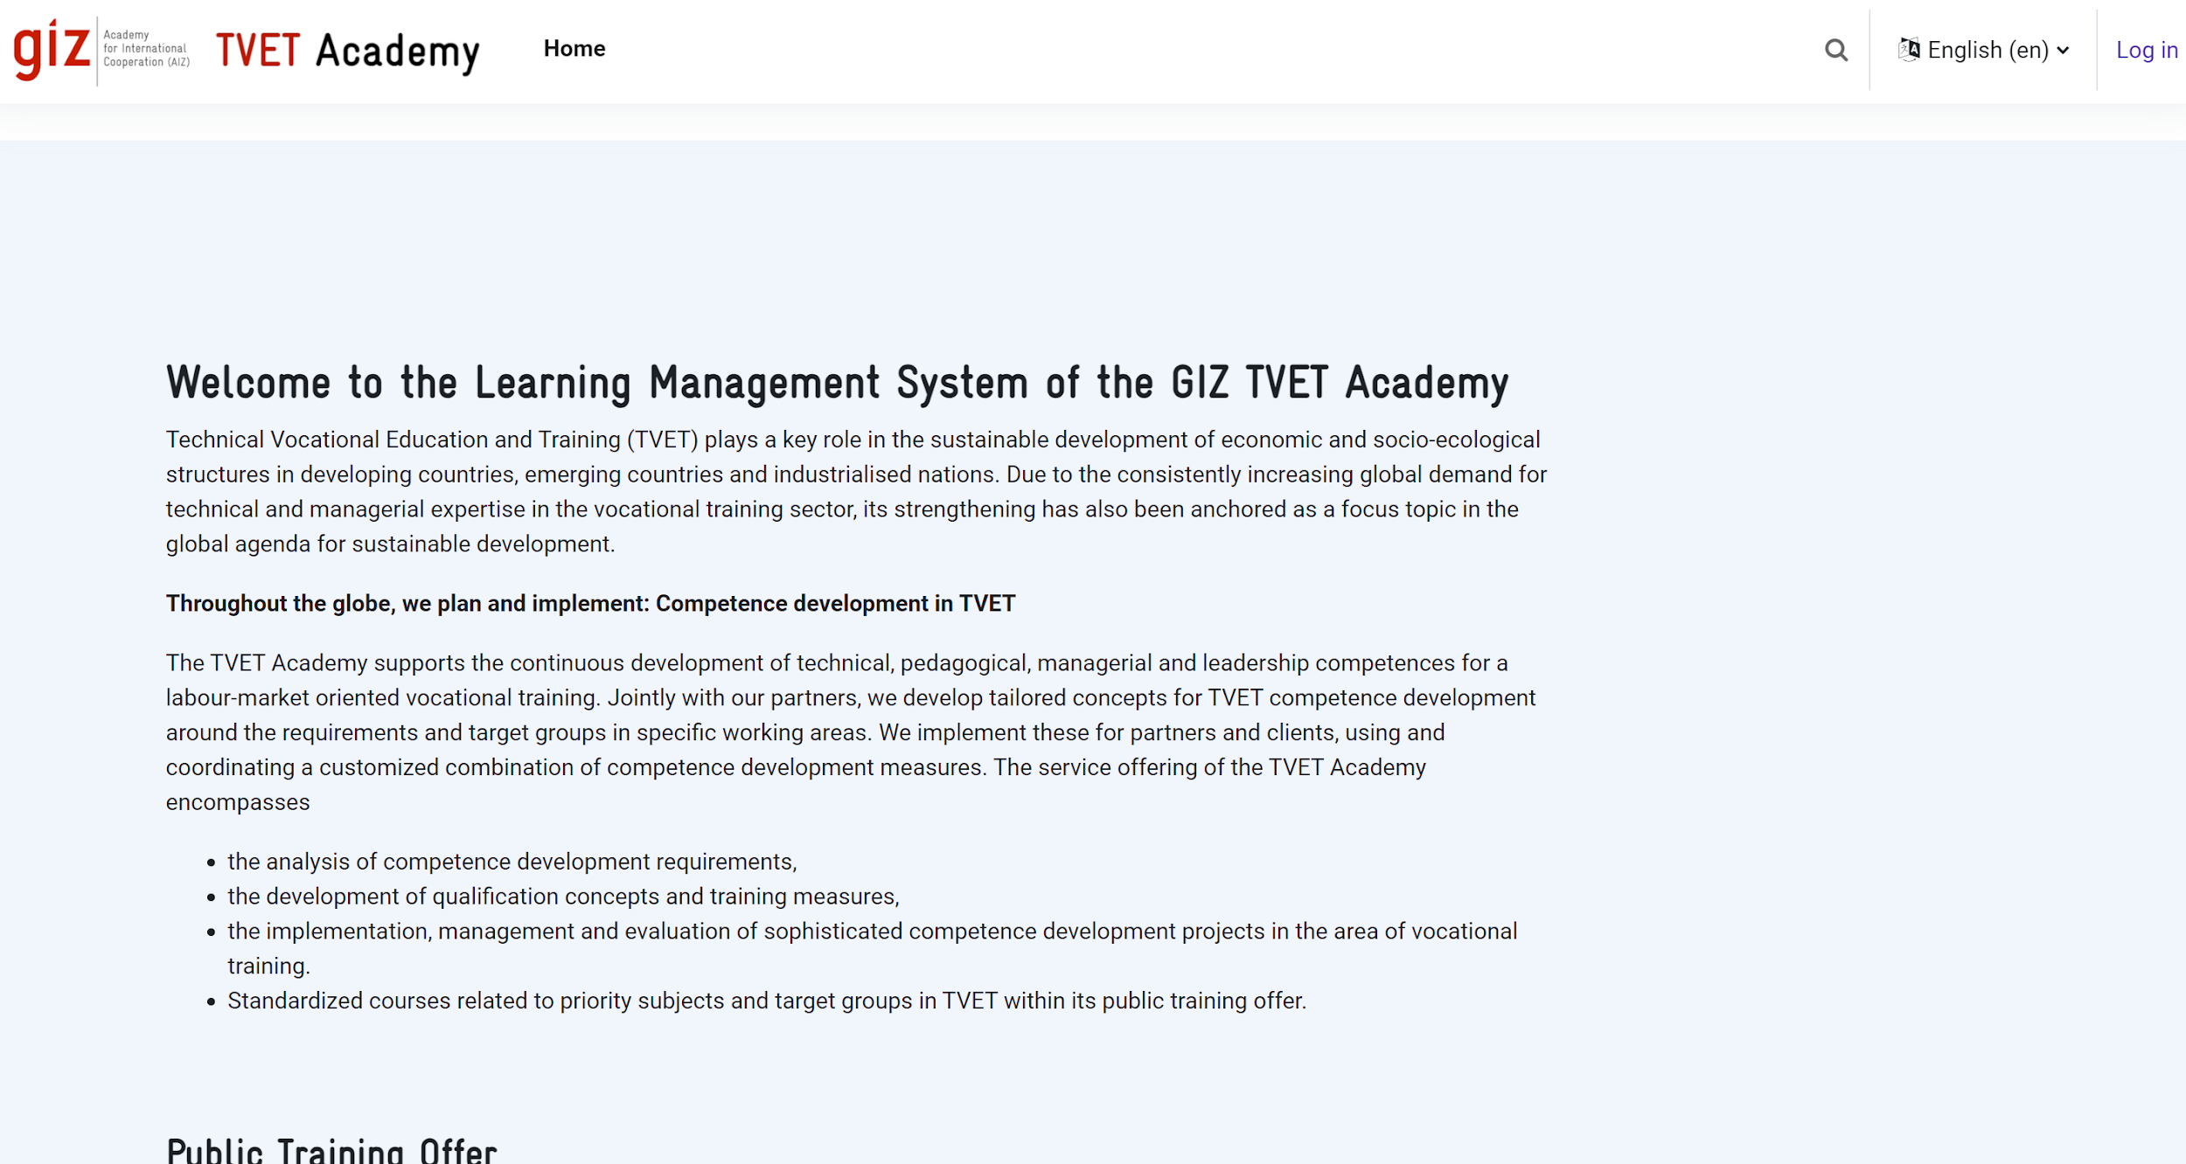
Case Studies in VET Technology Integration
More info here: https://tvet-academy.de/
Funded by the European Union. Views and opinions expressed are however those of the author(s) only and do not necessarily reflect those of the European Union or the European Education and Culture Executive Agency (EACEA). Neither the European Union nor EACEA can be held responsible for them.

Slide 25
Challenges
Resource Limitations: Limited budgets and resources for new technology.
Resistance to Change: Some educators and institutions are hesitant towards adopting new technologies.
Skill Gaps: Need for training to use advanced technologies effectively.
Equity and Access: Digital divide may prevent equal access to technological resources.
Infrastructure Constraints: Importance of reliable infrastructure for tech implementation.
Funded by the European Union. Views and opinions expressed are however those of the author(s) only and do not necessarily reflect those of the European Union or the European Education and Culture Executive Agency (EACEA). Neither the European Union nor EACEA can be held responsible for them.

Slide 26
Overcoming Obstacles in Tech Adoption
Strategic Partnerships: Relationships with tech companies and community organizations for resources and support.
Professional Development: Regular, comprehensive training/upskilling programs for educators and administrators.
Policy Advocacy: Work towards policy changes that provide funding and resources for tech upgrades.
Community Engagement: Involvement of the community to find innovative solutions for access and equity.
Phased Implementation: Adoption of a step-by-step approach to technology integration to mitigate infrastructure shocks.
Funded by the European Union. Views and opinions expressed are however those of the author(s) only and do not necessarily reflect those of the European Union or the European Education and Culture Executive Agency (EACEA). Neither the European Union nor EACEA can be held responsible for them.

Slide 27
Technology Tools for Collaboration
APPS & Platforms
Collaboration and Teamwork
Slack: A messaging app that facilitates team communication and collaboration through channels dedicated to specific topics or projects.
Trello: A project management tool that helps teams organize projects into boards, lists, and cards to track progress and collaborate on tasks.
Microsoft Teams: Combines workplace chat, meetings, notes, and attachments. It integrates with Office 365 and supports classroom collaboration.
Open Communication and Feedback
Google Forms: Easy-to-use tool for creating feedback forms, surveys, and quizzes to gather insights from learners and staff.
Mentimeter: An interactive presentation software that allows real-time feedback, polls, and Q&A sessions, enhancing engagement and communication.
Slido: A Q&A and polling platform that facilitates open communication during classes and meetings, allowing everyone to share their thoughts and questions.
Funded by the European Union. Views and opinions expressed are however those of the author(s) only and do not necessarily reflect those of the European Union or the European Education and Culture Executive Agency (EACEA). Neither the European Union nor EACEA can be held responsible for them.

Slide 28
Tools and Platforms
Artificial Intelligence (AI) Tools
Squirrel AI: An adaptive learning platform that personalizes the educational content for each learner
Century Tech: Uses AI to tailor learning paths for students in core subjects.
Virtual Reality (VR) and Augmented Reality (AR) Tools
Google Cardboard: An affordable VR solution that works with smartphones.
Microsoft HoloLens: An AR headset for mixed reality experiences.
zSpace: Provides AR/VR learning experiences on a desktop computer.
Funded by the European Union. Views and opinions expressed are however those of the author(s) only and do not necessarily reflect those of the European Union or the European Education and Culture Executive Agency (EACEA). Neither the European Union nor EACEA can be held responsible for them.

Slide 29
Tools and Platforms
Learning Management Systems (LMS)
Canvas: A web-based LMS that makes teaching and learning easier.
Moodle: An open-source learning platform designed to provide educators, administrators, and learners with a single robust, secure, and integrated system.
Schoology: Combines LMS with social networking to provide an engaging learning environment.
Content Creation and Courseware Tools
Articulate 360: A suite of tools for creating courseware, including interactive courses and custom learning content.
Adobe Captivate: A tool for creating eLearning content such as software demonstrations, software simulations, branched scenarios, and randomized quizzes.
Camtasia: A screen recorder and video editor useful for creating instructional videos.
Funded by the European Union. Views and opinions expressed are however those of the author(s) only and do not necessarily reflect those of the European Union or the European Education and Culture Executive Agency (EACEA). Neither the European Union nor EACEA can be held responsible for them.

Slide 30
Tools and Platforms
Assessment and Feedback Tools
Turnitin: Provides services for academic writing and feedback, including plagiarism detection.
Socrative: Allows educators to create assessments that students can access on any device.
Funded by the European Union. Views and opinions expressed are however those of the author(s) only and do not necessarily reflect those of the European Union or the European Education and Culture Executive Agency (EACEA). Neither the European Union nor EACEA can be held responsible for them.

Slide 31
What to consider when choosing Technology Tools for Collaboration?
Relevance: Select tools that are relevant to the industry sector the VET program is focused on.
Accessibility: Ensure that the chosen technology is accessible to all students, including those with disabilities.
User-Friendliness: Choose tools that are intuitive and easy to use to minimize the learning curve and technical barriers.
Privacy and Security: Prioritize tools that comply with data protection laws and keep student work secure.
Funded by the European Union. Views and opinions expressed are however those of the author(s) only and do not necessarily reflect those of the European Union or the European Education and Culture Executive Agency (EACEA). Neither the European Union nor EACEA can be held responsible for them.

Slide 32
Reflection Activity
Reflect on how the technologies you have integrated into your VET program align with current industry standards and practices. How has technology helped students develop skills that are directly applicable to their future careers?
Think about the collaborative projects and activities facilitated by technology in your classes. In what ways has technology supported effective collaboration among students, and where is there room for improvement?
Consider the challenges you have faced in integrating technology into your VET program. What strategies have you employed to overcome these challenges, and what have you learned from these experiences that could inform future technology integration efforts?
Funded by the European Union. Views and opinions expressed are however those of the author(s) only and do not necessarily reflect those of the European Union or the European Education and Culture Executive Agency (EACEA). Neither the European Union nor EACEA can be held responsible for them.

Slide 33
Additional Resources
Common challenges in integrating technology into VET
Vocational teachers and trainers in a changing world: the imperative of high-quality teacher training systems (ilo.org)
ICT Competency Framework for Teachers’ Harnessing OER
Digital Transformation of TVET and Skills Development Systems in Africa
TVET: Scaffolding digital skills to the future
Trends mapping study: Digital skills development in TVET teacher training
Policy brief: using digital credentials to keep the promises of TVET; Technical and Vocational Education and Training
Funded by the European Union. Views and opinions expressed are however those of the author(s) only and do not necessarily reflect those of the European Union or the European Education and Culture Executive Agency (EACEA). Neither the European Union nor EACEA can be held responsible for them.

