Slide 1




CollaboratiVET Curriculum for VET teachers/trainers/educators
Module 7: Cultivating a Learning Community: Context-Specific Implementation in VET Field
Unit 2 - Tailoring Collaborative Teaching Methods to VET Environments
Funded by the European Union. Views and opinions expressed are however those of the author(s) only and do not necessarily reflect those of the European Union or the European Education and Culture Executive Agency (EACEA). Neither the European Union nor EACEA can be held responsible for them.

Slide 2



Learning Objectives
  By the end of this unit, participants will be able to:
  Identify and Explain the Unique Characteristics of VET Learning Communities
  Understand and Apply the Principles of a Flexible Learning Environment
  Foster a Positive and Inclusive Learning Culture
  Align VET Content with Industry Standards and Labor Market Needs
  Navigate Challenges and Leverage Opportunities in VET Learning Communities

Slide 3
Introduction to Collaborative Teaching
Collaborative teaching involves two or more educators working together to plan, teach, and assess a course or a portion of a course. It extends to include collaborative learning, where students work in groups to solve problems, complete projects, or understand new concepts.
What are the key components?
Shared goals, collective responsibility, cooperative planning and preparation, joint teaching, and reflective assessment practices.
Funded by the European Union. Views and opinions expressed are however those of the author(s) only and do not necessarily reflect those of the European Union or the European Education and Culture Executive Agency (EACEA). Neither the European Union nor EACEA can be held responsible for them.

Slide 4
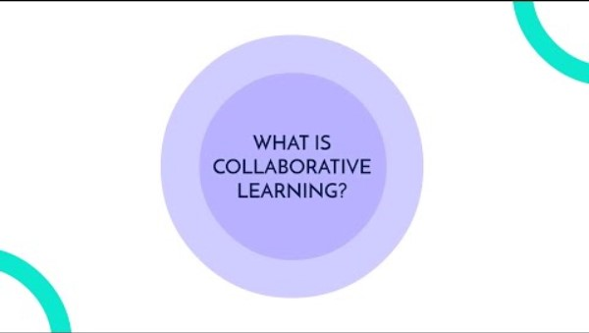
Collaborative Teaching Methods
Source: https://youtu.be/QVMoKmFiW64?feature=shared ?feature=shared
Funded by the European Union. Views and opinions expressed are however those of the author(s) only and do not necessarily reflect those of the European Union or the European Education and Culture Executive Agency (EACEA). Neither the European Union nor EACEA can be held responsible for them.

Slide 5
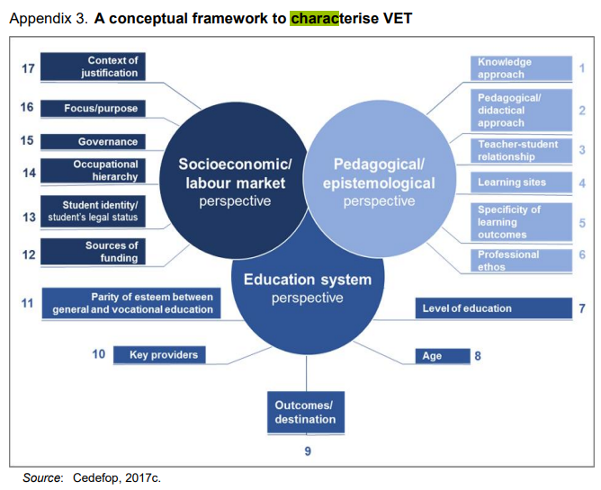
VET Environment Overview
The specific and dynamic environments in which VET schools operate influence them on different levels (Societal, national, regional, industrial
It is provided by various stakeholders and institutions at both national and international levels, both within and beyond formal education and training.
The decentralized structure of continuing vocational education and training (CVET) poses a difficulty in every nation.
It is inherently connected to labor markets at both the national and sectoral levels.
Source: https://www.cedefop.europa.eu/en/projects/changing-nature-and-role-vocational-education-and-training-vet-europe
Funded by the European Union. Views and opinions expressed are however those of the author(s) only and do not necessarily reflect those of the European Union or the European Education and Culture Executive Agency (EACEA). Neither the European Union nor EACEA can be held responsible for them.

Slide 6



Benefits of Collaborative Teaching in VET
For Educators:
Promotes professional development through shared knowledge and experiences, reduces workload by dividing responsibilities, and increases job satisfaction through a supportive teaching community.
For Learners:
Improves engagement and motivation, enhances understanding through diverse perspectives and teaching styles, and builds essential skills like communication, collaboration, and critical thinking.
For VET Programs:
Strengthens program quality and relevance, increases flexibility in curriculum delivery, and fosters a culture of continuous improvement and innovation.
Funded by the European Union. Views and opinions expressed are however those of the author(s) only and do not necessarily reflect those of the European Union or the European Education and Culture Executive Agency (EACEA). Neither the European Union nor EACEA can be held responsible for them.

Slide 7





Tailoring Collaborative Teaching in VET Environments
Recent studies suggest a cultural transition in education from individual learning to a more collaborative approach.
Teaching methods that actively involve students in collaboration have been proven to improve both learning outcomes and vocational skills.
These approaches aim to support interdependent support, personal responsibility, students’ ability to cooperate, and group dynamics.
Despite the evidence, numerous educators and institutions, including those in VET and academia, have not fully embraced these methods.
The need for larger support from peers (experts, administrators, coworkers, IT) is often named as an obstacle when introducing these progressive teaching approaches.
Source: Słowikowski, M., Pilat, Z., Smater, M., & Zieliński, J. (2018). Collaborative learning environment in vocational education. In AIP Conference Proceedings (Vol. 2029, No. 1). AIP Publishing. https://doi.org/10.1063/1.5066532
Funded by the European Union. Views and opinions expressed are however those of the author(s) only and do not necessarily reflect those of the European Union or the European Education and Culture Executive Agency (EACEA). Neither the European Union nor EACEA can be held responsible for them.

Slide 8
Tailoring Collaborative Teaching in VET Environments
Understanding VET Learner Needs:
Adapting Teaching Methods:
Contextual Learning: Skills and knowledge are taught in ways directly relevant to the workplace.
Interdisciplinary Approach: Use team teaching to bring together different subject experts for an integrated learning experience.
Practical Application: Collaborative teaching should involve practical projects that mirror real-world tasks and challenges faced in specific trades or professions.
Peer Learning: Encourage learners to teach and learn from one another, reflecting the collaborative nature of the workplace.
Funded by the European Union. Views and opinions expressed are however those of the author(s) only and do not necessarily reflect those of the European Union or the European Education and Culture Executive Agency (EACEA). Neither the European Union nor EACEA can be held responsible for them.

Slide 9
Tailoring Collaborative Teaching in VET Environments
Leveraging Technology:
  Digital Collaboration Tools: Introduce platforms like Microsoft Teams or Slack for group projects and communication, simulating modern work environments.
  Online Simulations and VR: Use technology to create simulations of workplace scenarios for collaborative problem-solving.
Fostering Soft Skills Development:
  Communication and Teamwork: Structure activities that require learners to practice communication, negotiation, and teamwork, which are critical in the VET sector.
  Leadership and Initiative: Create opportunities for learners to lead projects or parts of the training, developing their leadership and initiative-taking skills.
Funded by the European Union. Views and opinions expressed are however those of the author(s) only and do not necessarily reflect those of the European Union or the European Education and Culture Executive Agency (EACEA). Neither the European Union nor EACEA can be held responsible for them.

Slide 10

Tailoring Collaborative Teaching in VET Environments
HOW TO?
Source: https://youtu.be/PBIYIuaA4LI?feature=shared
Funded by the European Union. Views and opinions expressed are however those of the author(s) only and do not necessarily reflect those of the European Union or the European Education and Culture Executive Agency (EACEA). Neither the European Union nor EACEA can be held responsible for them.

Slide 11
Examples – Cases of Tailoring Collaborative Teaching in VET
Industry-Specific Projects : Automotive students work in teams to diagnose and repair a real car issue, guided by an industry mentor.
AUTOCOVE 2.0
Auto-Cove 2.0 is a Centres of Vocational Excellence (CoVE) project, where the consortium combats on its own behalf on climate change by developing the European Education and Training Area in Vehicle Sector of VET towards greener innovations. Automotive Engineering field employs 14.6 million people in Europe and the whole field is in the middle of a huge change of technologies. More information can be found here.
Automotive Technology program at Thomas More University of Applied Sciences in Belgium
An excellent example of a vocational education and training (VET) setting in Europe where automotive students work in teams to diagnose and repair real car issues, guided by industry mentors, is the Automotive Technology program at Thomas More University of Applied Sciences in Belgium. More information can be found here.
Funded by the European Union. Views and opinions expressed are however those of the author(s) only and do not necessarily reflect those of the European Union or the European Education and Culture Executive Agency (EACEA). Neither the European Union nor EACEA can be held responsible for them.

Slide 12
Examples – Cases of Tailoring Collaborative Teaching in VET
Cross-Disciplinary Collaboration: Culinary and business students collaborate to develop a restaurant concept, menu, and business plan.
Gamarra Culinary School's Veggie-Food Project in Spain
A notable case study exemplifying collaboration between culinary and business students to develop a restaurant concept, menu, and business plan is the Gamarra Culinary School's Veggie-Food Project in Spain. This initiative involves students from higher-level training in Culinary Management and Business Management working together to create a viable restaurant concept focused on healthy, plant-based cuisine. More information can be found here.
Funded by the European Union. Views and opinions expressed are however those of the author(s) only and do not necessarily reflect those of the European Union or the European Education and Culture Executive Agency (EACEA). Neither the European Union nor EACEA can be held responsible for them.

Slide 13
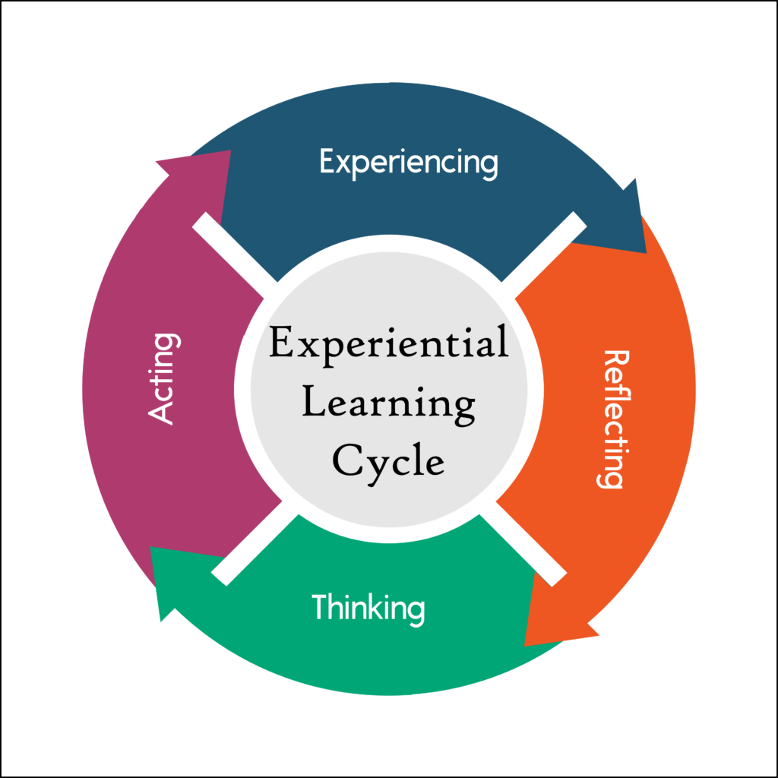
Customizing Methods for VET -Theoretical Frameworks
Experiential Learning
Key Proponent: David A. Kolb
Concept: Learning is a process where knowledge is created through the transformation of experience.
Application in VET: Collaborative projects in VET allow students to learn from experiences and reflect on them collectively, deepening understanding.
-More information about Experiential Learning can be found here: https://experientiallearninginstitute.org/what-is-experiential-learning/
Funded by the European Union. Views and opinions expressed are however those of the author(s) only and do not necessarily reflect those of the European Union or the European Education and Culture Executive Agency (EACEA). Neither the European Union nor EACEA can be held responsible for them.

Slide 14
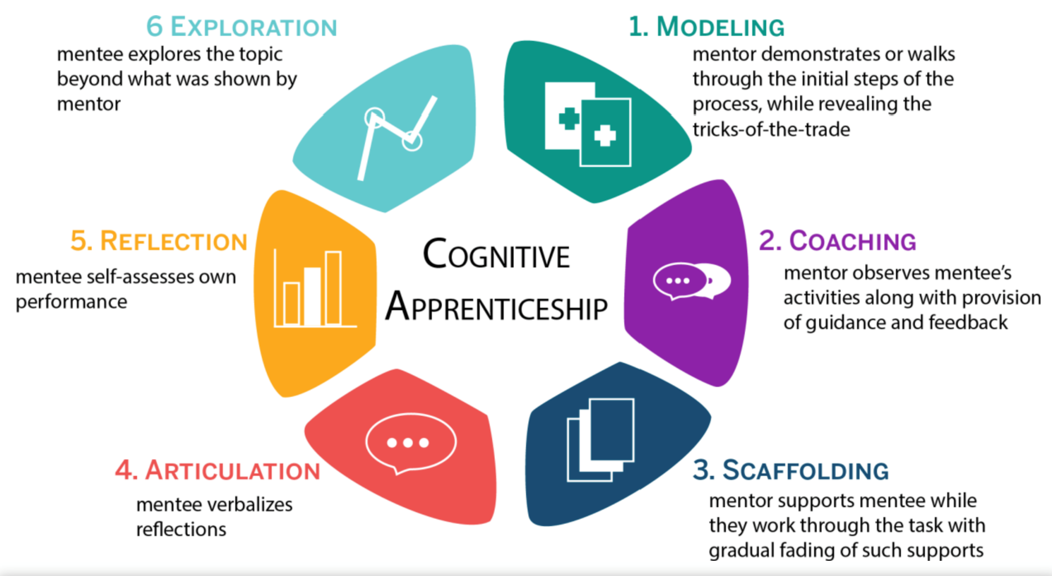
Customizing Methods for VET -Theoretical Frameworks
Cognitive Apprenticeship
Key Proponent: Allan Collins
Concept: Cognitive and metacognitive skills are taught in an apprenticeship model, where learners engage in authentic tasks with expert scaffolding.
Application in VET: Instructors and industry professionals guide learners through authentic tasks, providing scaffolding that fades as competence increases.
-More information about Cognitive Apprenticeship Framework can be found here: https://www.mcw.edu/-/media/MCW/Education/Academic-Affairs/OEI/Faculty-Quick-Guides/Cognitive-Apprenticeship-Theory.pdf
Funded by the European Union. Views and opinions expressed are however those of the author(s) only and do not necessarily reflect those of the European Union or the European Education and Culture Executive Agency (EACEA). Neither the European Union nor EACEA can be held responsible for them.

Slide 15
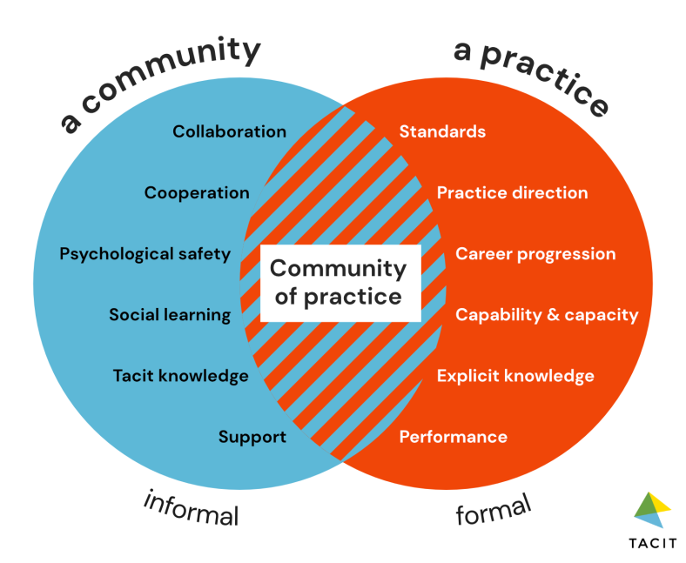
Customizing Methods for VET
Communities of Practice
Key Proponents: Etienne Wenger and William Snyder
Concept: Learning as participation in the communal practices of a community engaged in a shared domain of human endeavor.
Application in VET: Encourages the formation of learning communities where VET students and instructors continually share knowledge and skills.
More information can be found here.
Funded by the European Union. Views and opinions expressed are however those of the author(s) only and do not necessarily reflect those of the European Union or the European Education and Culture Executive Agency (EACEA). Neither the European Union nor EACEA can be held responsible for them.

Slide 16

Implementing Collaborative Teaching
TIPS
Ensure Relevance: Tailor collaborative projects to align with current industry practices and technologies.
Foster Agency: Encourage students to take ownership of their learning through choice in project topics and roles.
Reflect and Adapt: Use regular feedback sessions to refine collaborative methods, ensuring they meet learner and industry needs.
Use Technology: Leverage digital tools that are prevalent in the industry to facilitate collaboration and project management.
Funded by the European Union. Views and opinions expressed are however those of the author(s) only and do not necessarily reflect those of the European Union or the European Education and Culture Executive Agency (EACEA). Neither the European Union nor EACEA can be held responsible for them.

Slide 17






Technology Tools for Collaboration
APPS & Platforms
Collaboration and Teamwork
Slack: A messaging app that facilitates team communication and collaboration through channels dedicated to specific topics or projects.
Trello: A project management tool that helps teams organize projects into boards, lists, and cards to track progress and collaborate on tasks.
Microsoft Teams: Combines workplace chat, meetings, notes, and attachments. It integrates with Office 365 and supports classroom collaboration.
Open Communication and Feedback
Google Forms: Easy-to-use tool for creating feedback forms, surveys, and quizzes to gather insights from learners and staff.
Mentimeter: An interactive presentation software that allows real-time feedback, polls, and Q&A sessions, enhancing engagement and communication.
Slido: A Q&A and polling platform that facilitates open communication during classes and meetings, allowing everyone to share their thoughts and questions.
Funded by the European Union. Views and opinions expressed are however those of the author(s) only and do not necessarily reflect those of the European Union or the European Education and Culture Executive Agency (EACEA). Neither the European Union nor EACEA can be held responsible for them.

Slide 18






Technology Tools for Collaboration
APPS & Platforms
Virtual Learning Environments (VLEs)
Moodle
Blackboard
Articulate
Video Conferencing Platforms:
Zoom
Microsoft Teams
Interactive Whiteboards and Brainstorming Tools
Miro
Jamboard
Funded by the European Union. Views and opinions expressed are however those of the author(s) only and do not necessarily reflect those of the European Union or the European Education and Culture Executive Agency (EACEA). Neither the European Union nor EACEA can be held responsible for them.

Slide 19
What to consider when choosing Technology Tools for Collaboration?
Relevance: Select tools that are relevant to the industry sector the VET program is focused on.
Accessibility: Ensure that the chosen technology is accessible to all students, including those with disabilities.
User-Friendliness: Choose tools that are intuitive and easy to use to minimize the learning curve and technical barriers.
Privacy and Security: Prioritize tools that comply with data protection laws and keep student work secure.
Funded by the European Union. Views and opinions expressed are however those of the author(s) only and do not necessarily reflect those of the European Union or the European Education and Culture Executive Agency (EACEA). Neither the European Union nor EACEA can be held responsible for them.

Slide 20


Case Study - Examples
Source: https://www.cedefop.europa.eu/files/5590_en.pdf
Source: https://tvet-online.asia/21/designing-a-model-of-strategic-partnership-between-the-vocational-skills-development-system-and-industry-case-study-in-vietnam/
Funded by the European Union. Views and opinions expressed are however those of the author(s) only and do not necessarily reflect those of the European Union or the European Education and Culture Executive Agency (EACEA). Neither the European Union nor EACEA can be held responsible for them.

Slide 21
Case Study - Examples
Source: https://www.cedefop.europa.eu/files/5590_en.pdf
Source: https://tvet-online.asia/21/designing-a-model-of-strategic-partnership-between-the-vocational-skills-development-system-and-industry-case-study-in-vietnam/
Funded by the European Union. Views and opinions expressed are however those of the author(s) only and do not necessarily reflect those of the European Union or the European Education and Culture Executive Agency (EACEA). Neither the European Union nor EACEA can be held responsible for them.

Slide 22





Creating Your Collaborative Teaching Plan
Define Collaborative Goals: Outline clear, measurable objectives for what the collaborative activities aim to achieve in terms of learning outcomes and skill development.
Choose the Right Format: Decide on the collaborative teaching format—peer learning, team projects, joint problem-solving sessions, or cross-disciplinary work.
Select Appropriate Technology Tools: Choose technology platforms that support the collaborative goals, such as communication tools, project management software, or virtual simulations.
Plan for Assessment and Feedback: Develop criteria for assessing collaborative work, including peer assessment and reflective evaluations. Plan regular check-ins for group progress.
Communicate with Stakeholders: Engage with all stakeholders, including learners, other teachers, and industry partners, to explain the plan and gather input.
Review and Adapt: After implementation, review the collaborative teaching activities' effectiveness and adapt as necessary based on feedback and outcomes.
Funded by the European Union. Views and opinions expressed are however those of the author(s) only and do not necessarily reflect those of the European Union or the European Education and Culture Executive Agency (EACEA). Neither the European Union nor EACEA can be held responsible for them.

Slide 23



Reflection Activity
In what ways have you successfully incorporated collaborative teaching methods in your VET classroom? Consider the alignment of collaborative activities with industry practices, the efficacy of chosen teaching formats, and the active engagement strategies you have used.
Upon reflection, what aspects of your collaborative teaching approach could be improved? Are there challenges you have faced with role distribution among educators and students, integration of technology tools, or effectiveness of the collaborative assessment strategies?
Based on the potential areas for improvement in your collaborative teaching methods, what innovative solutions or strategies could you implement? This could involve exploring new technology platforms for collaboration, experimenting with different project management techniques, or developing more robust peer feedback systems.
Funded by the European Union. Views and opinions expressed are however those of the author(s) only and do not necessarily reflect those of the European Union or the European Education and Culture Executive Agency (EACEA). Neither the European Union nor EACEA can be held responsible for them.

Slide 24
Additional Resources
The Future of VET in EU
Collaborative learning environment in vocational education
Practices and strategies for enhancing learning through collaboration between vocational teacher training institutions and workplaces
Funded by the European Union. Views and opinions expressed are however those of the author(s) only and do not necessarily reflect those of the European Union or the European Education and Culture Executive Agency (EACEA). Neither the European Union nor EACEA can be held responsible for them.

