Slide 1
CollaboratiVET Curriculum for VET teachers/trainers/educators
Module 6: Assessing Learning in a Flipped Classroom: Evaluation and Refinement of the Implementation Process
Unit 4 - Evaluation and Continuous Improvement of Flipped Classroom Practices
Funded by the European Union. Views and opinions expressed are however those of the author(s) only and do not necessarily reflect those of the European Union or the European Education and Culture Executive Agency (EACEA). Neither the European Union nor EACEA can be held responsible for them.

Slide 2
Learning Objectives
By the end of this unit, participants will be able to:
Recognize the value of continuous development in a flexible flipped learning environment
Illustrate the interplay between formative and summative assessments in the improvement of pedagogical practices
Appraise communication, feedback and openness to new methods and technologies

Slide 3
Why evaluation in flipped classroom learning is important I ?
1. Review of learning progress:
Evaluation allows teachers to check students' progress and determine whether they have understood the learning content.
2. Identification of weak points:
The evaluation helps to identify weaknesses in the learning process.
3. Adapting lessons:
Evaluation enables teachers to adapt lessons to the needs of the learners.
4. Motivation of the learners:
Evaluation can increase learners' motivation as they can see how far they have come and what progress they have made.
5. Feedback for the learners:
Through evaluation, learners receive feedback on their performance.
Funded by the European Union. Views and opinions expressed are however those of the author(s) only and do not necessarily reflect those of the European Union or the European Education and Culture Executive Agency (EACEA). Neither the European Union nor EACEA can be held responsible for them.

Slide 4
Why evaluation in flipped classroom learning is important II ?
6. Review of teaching methods:
Evaluation enables teachers to review their teaching methods and adapt them if necessary.
7 Quality assurance:
The evaluation also serves to ensure the quality of the learning process. Teachers can check whether the learning objectives are being achieved and whether the lessons are effective.
8. Comparability:
Evaluation allows the performance of learners to be compared with each other. This enables teachers to assess the learning progress of individual students in comparison to the group as a whole.
9. Basis for decisions:
The results of the evaluation can serve as a basis for decisions, for example in the selection of further learning content or the organisation of lessons.
10 Continuous improvement process:
Evaluation is part of a continuous improvement process. Through regular evaluations, teachers can optimise the learning process and increase the quality of teaching.
Funded by the European Union. Views and opinions expressed are however those of the author(s) only and do not necessarily reflect those of the European Union or the European Education and Culture Executive Agency (EACEA). Neither the European Union nor EACEA can be held responsible for them.

Slide 5
The most important evaluation methods in flipped classroom learning
Self-assessment of learners:
Peer assessment:
Oral presentations:
Learners assess their own performance and learning progress.
The learners evaluate the performance of their classmates.
Learners present what they have learnt orally to the class.
Written tests and quizzes:
Project work:
Practical exercises:
Learners are tested in writing to check their knowledge and skills.
Learners work in groups on projects to apply and present the knowledge they have learnt.
Learners carry out practical exercises to put the knowledge they have learnt into practice.
Funded by the European Union. Views and opinions expressed are however those of the author(s) only and do not necessarily reflect those of the European Union or the European Education and Culture Executive Agency (EACEA). Neither the European Union nor EACEA can be held responsible for them.

Slide 6
What is peer assessment?
Peer assessment or peer review provides a structured learning process for students to critique and provide feedback to each other on their work.
It helps students develop lifelong skills in assessing and providing feedback to others, and also equips them with skills to self-assess and improve their own work.
More for peer assessment here: Module 3: Peer Assessment
Funded by the European Union. Views and opinions expressed are however those of the author(s) only and do not necessarily reflect those of the European Union or the European Education and Culture Executive Agency (EACEA). Neither the European Union nor EACEA can be held responsible for them.

Slide 7
Practical Tips for collecting and analysing data using questionnaires
Define clear goals and questions
Use clear language so that all participants can easily understand the questionnaire
Use scale to quantify the answers
Include open questions to give participants the opportunity to share their opinions and experiences in more detail
Guarantee anonymity and confidentiality
Carry out a pilot test to ensure that the questions are understandable and provide the desired information
Analyse data carefully
Communicate results
Funded by the European Union. Views and opinions expressed are however those of the author(s) only and do not necessarily reflect those of the European Union or the European Education and Culture Executive Agency (EACEA). Neither the European Union nor EACEA can be held responsible for them.

Slide 8
Interpretation of results
Identification of strengths and weaknesses: The interpretation of the results makes it possible to recognise the strengths and weaknesses of the flipped classroom concept.
Adaptation of teaching: by interpreting the results, adjustments can be made to teaching in order to better meet the needs of the learners.
Improvement of learning outcomes: The interpretation of the results makes it possible to understand the impact of the flipped classroom concept on learning outcomes.
Feedback to teachers and learners: The interpretation of the results provides the opportunity to give feedback to teachers and learners.
Continuous improvement: The interpretation of the results is an important step in the process of continuous improvement of the flipped classroom concept.
Funded by the European Union. Views and opinions expressed are however those of the author(s) only and do not necessarily reflect those of the European Union or the European Education and Culture Executive Agency (EACEA). Neither the European Union nor EACEA can be held responsible for them.

Slide 9
Feedback from learners is of great importance!
The feedback from the learners...
... enables teachers to improve teaching and respond to the needs of learners.
... helps to customise learning.
... can help to increase their motivation by showing them that their opinions and concerns are heard and taken into account.
... can help to identify problems or difficulties in the learning process that may have been overlooked and to recognise and improve them.
... can help to create a positive learning environment.
... promotes communication between teachers and learners.
... can help improve learning outcomes by providing teachers with valuable insights into learners' needs and challenges.
Funded by the European Union. Views and opinions expressed are however those of the author(s) only and do not necessarily reflect those of the European Union or the European Education and Culture Executive Agency (EACEA). Neither the European Union nor EACEA can be held responsible for them.

Slide 10
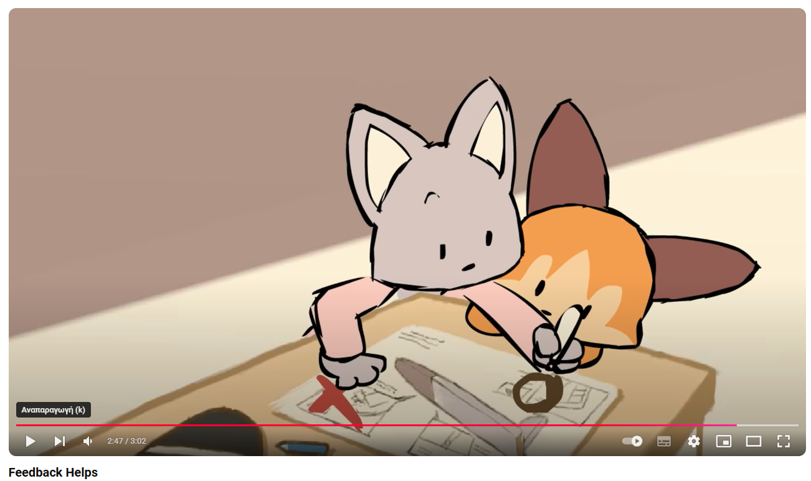
Why learners‘ feedback matters?
Funded by the European Union. Views and opinions expressed are however those of the author(s) only and do not necessarily reflect those of the European Union or the European Education and Culture Executive Agency (EACEA). Neither the European Union nor EACEA can be held responsible for them.

Slide 11
3 tips for continuous improvement
1. Identification of strengths and weaknesses:
2. incorporate feedback from learners:
3. continuous training and further education of teachers:
Analyse the evaluation results to identify the strengths and weaknesses of the flipped classroom approach.
Identify the areas where the approach works well and the areas where there is room for improvement.
Take learner feedback from the evaluation into account and use it as a valuable source of information.
Take learners' concerns and suggestions seriously and use them to improve the flipped classroom approach.
Provide regular training and development for teachers to improve their knowledge and skills in using the flipped classroom approach.
Funded by the European Union. Views and opinions expressed are however those of the author(s) only and do not necessarily reflect those of the European Union or the European Education and Culture Executive Agency (EACEA). Neither the European Union nor EACEA can be held responsible for them.

Slide 12
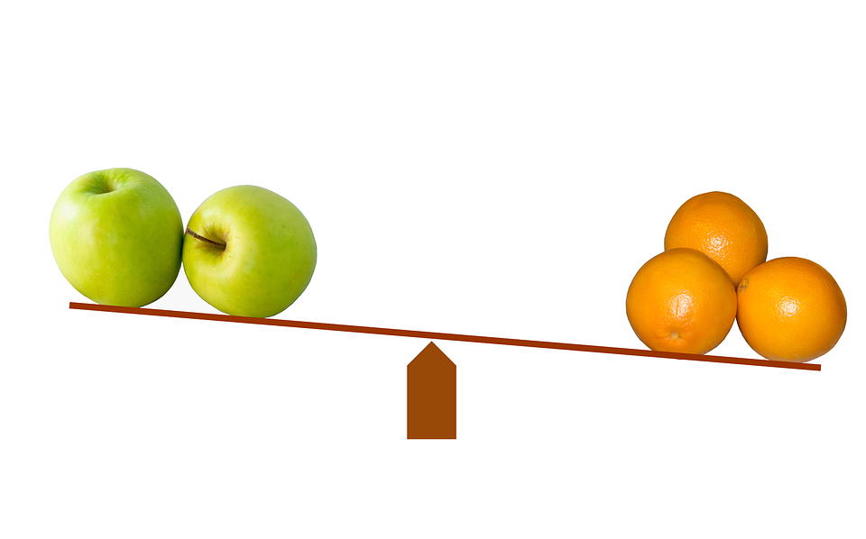
Challenges in the evaluation of flipped classroom learning
Measuring learner success:
One of the biggest challenges in evaluating flipped classroom models is measuring learner success. It can be difficult to find objective and reliable measures to assess learner progress and performance. Traditional assessment methods such as tests and grades may not be sufficient to capture the actual learning success in the flipped classroom.
Control and compare groups:
In order to evaluate the effectiveness of the flipped classroom model, it is important to set up control groups or comparison groups. This enables the comparison of learning outcomes and other relevant factors between the groups. However, creating such groups can be challenging, especially when it comes to access to resources and the organisation of lessons.
Funded by the European Union. Views and opinions expressed are however those of the author(s) only and do not necessarily reflect those of the European Union or the European Education and Culture Executive Agency (EACEA). Neither the European Union nor EACEA can be held responsible for them.

Slide 13
Your essential self-learning video pack:
Evaluation and Assessment in the Flipped Classroom
#Evaluation Flipped Classroom Evaluation 2 – YouTube
Flipped Classrooms Evaluations (Students&Teachers) – YouTube
Power-Up: Evaluation and Assessment in the Flipped Classroom - YouTube
Funded by the European Union. Views and opinions expressed are however those of the author(s) only and do not necessarily reflect those of the European Union or the European Education and Culture Executive Agency (EACEA). Neither the European Union nor EACEA can be held responsible for them.

Slide 14
Reflection Activity
In what ways would you prepare students for them to maximize the benefits provided by assessments?
How does formative assessment in the classroom compare to formative assessments during individual learning?
How would you organize the flipped classroom to better prepare your students for a final summative assessment and when?
What tools and methods would you use to draw and incorporate feedback from your students and why?
How would you assess a fellow VET trainer or teacher if you had to observe them implement Flipped Classroom?
Funded by the European Union. Views and opinions expressed are however those of the author(s) only and do not necessarily reflect those of the European Union or the European Education and Culture Executive Agency (EACEA). Neither the European Union nor EACEA can be held responsible for them.

Slide 15
Additional Resources
(PDF) ASSESSING THE EFFECTIVENESS OF FLIPPED CLASSROOM STRATEGY ON STUDENT PERFORMANCE
The Flipped Assessment: Aligning Evaluation of Student Success With the Flipped Classroom | Journal on Excellence in College Teaching
Evaluating Whether Flipped Classrooms Improve Student Learning in Science Education: A Systematic Review and Meta-Analysis: Scandinavian Journal of Educational Research: Vol 67 , No 1 - Get Access
Funded by the European Union. Views and opinions expressed are however those of the author(s) only and do not necessarily reflect those of the European Union or the European Education and Culture Executive Agency (EACEA). Neither the European Union nor EACEA can be held responsible for them.

