Slide 1
CollaboratiVET Curriculum for VET teachers/trainers/educators
Module 6: Assessing Learning in a Flipped Classroom: Evaluation and Refinement of the Implementation Process
Unit 2 - Developing Effective Formative Assessment Strategies
Funded by the European Union. Views and opinions expressed are however those of the author(s) only and do not necessarily reflect those of the European Union or the European Education and Culture Executive Agency (EACEA). Neither the European Union nor EACEA can be held responsible for them.

Slide 2
Learning Objectives
By the end of this unit, participants will be able to:
Describe the characteristics of formative assessments
Practice formative assessments as a vehicle for providing feedback
Compose formative assessment strategies on an ad hoc basis

Slide 3
Why is formative assessment in flipped classroom learning important?
Formative assessment enables learners to monitor and reflect on their own learning progress.
Regular feedback allows learners to check their knowledge and understanding and work specifically on their weaknesses.
Teachers can use formative assessment to adapt lessons to learners' needs and provide individualised support.
Formative assessment encourages active learning as learners have to continuously apply and review their knowledge.
Formative assessment allows learners to set their own learning goals and track their progress.
Formative assessment enables teachers to improve the learning process and make teaching more effective.
Funded by the European Union. Views and opinions expressed are however those of the author(s) only and do not necessarily reflect those of the European Union or the European Education and Culture Executive Agency (EACEA). Neither the European Union nor EACEA can be held responsible for them.

Slide 4
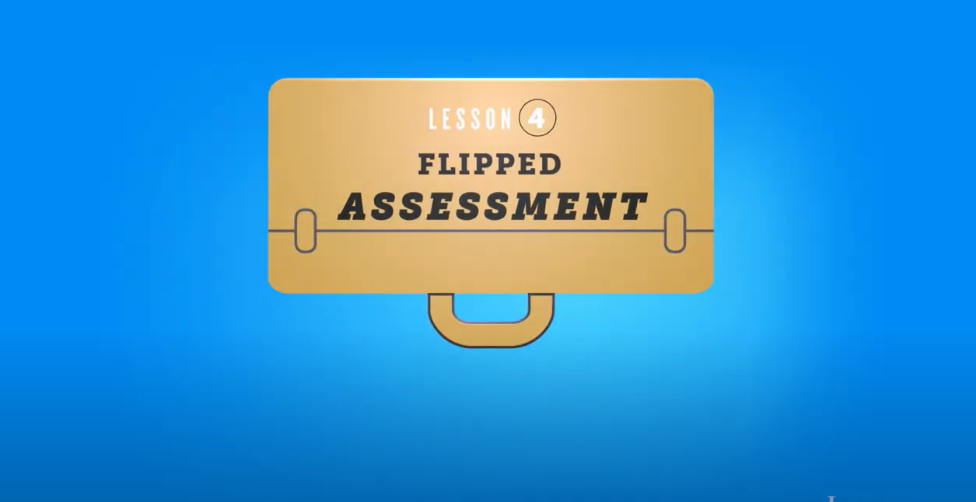
Play the video for an 1-minute learning pill
Funded by the European Union. Views and opinions expressed are however those of the author(s) only and do not necessarily reflect those of the European Union or the European Education and Culture Executive Agency (EACEA). Neither the European Union nor EACEA can be held responsible for them.

Slide 5
Goals of formative assessment
1
To enable learners to monitor and reflect on their own learning progress.
2
To allow learners to check their knowledge and understanding and work specifically on their weaknesses.
3
To encourage active learning as learners have to continuously apply and review their knowledge.
4
To allow learners to set their own learning goals and track their progress.
Funded by the European Union. Views and opinions expressed are however those of the author(s) only and do not necessarily reflect those of the European Union or the European Education and Culture Executive Agency (EACEA). Neither the European Union nor EACEA can be held responsible for them.

Slide 6
The 2 types of formative assessment
Oral feedback during the lesson:
Teachers give learners verbal feedback on their progress and performance during lessons.
Advantages:
Immediate feedback, direct interaction between teachers and students, opportunity to clarify questions and misunderstandings.
Written tasks and tests
Learners complete written tasks or tests to check their knowledge and understanding.
Advantages:
Opportunity for self-reflection, individualised pace, opportunity for targeted repetition and consolidation of the learning material.
In-Class Activities and Assessment for the Flipped Classroom | Centre for Teaching Excellence | University of Waterloo
Online Activities and Assessment for the Flipped Classroom | Centre for Teaching Excellence | University of Waterloo
Funded by the European Union. Views and opinions expressed are however those of the author(s) only and do not necessarily reflect those of the European Union or the European Education and Culture Executive Agency (EACEA). Neither the European Union nor EACEA can be held responsible for them.

Slide 7
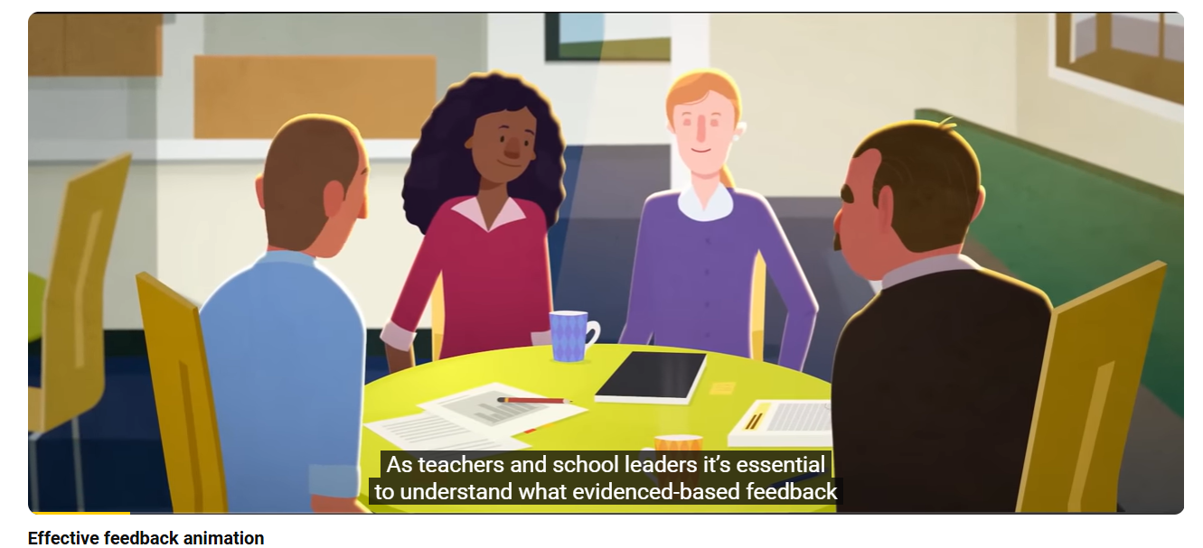
The importance of feedback for learners through 2 short videos
Funded by the European Union. Views and opinions expressed are however those of the author(s) only and do not necessarily reflect those of the European Union or the European Education and Culture Executive Agency (EACEA). Neither the European Union nor EACEA can be held responsible for them.

Slide 8
Why feedback is important for learners?
They aquire information about their current learning status and performance.
They can recognise their strengths and weaknesses and work specifically on their weaknesses.
They are able to check and improve their knowledge and understanding.
They are motivated to give their best and develop further.
They can set their own learning goals and track their progress.
The learning process is supported and learners can reflect on their thought processes and deepen their understanding.
Funded by the European Union. Views and opinions expressed are however those of the author(s) only and do not necessarily reflect those of the European Union or the European Education and Culture Executive Agency (EACEA). Neither the European Union nor EACEA can be held responsible for them.

Slide 9
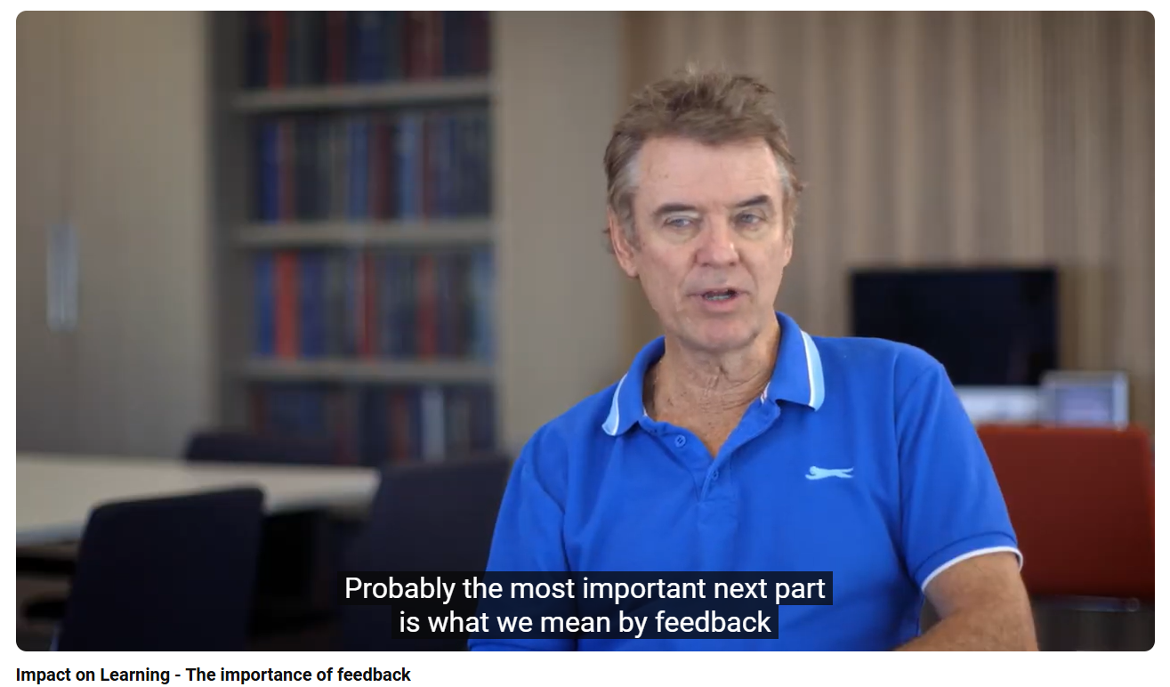
Impact on Learning - The importance of feedback
…the biggest benefit is assessment as feedback to teachers about their impact…
Funded by the European Union. Views and opinions expressed are however those of the author(s) only and do not necessarily reflect those of the European Union or the European Education and Culture Executive Agency (EACEA). Neither the European Union nor EACEA can be held responsible for them.

Slide 10
Self-reflection through formative assessments
Learners reflect on their own learning progress and recognise their strengths and weaknesses.
Learners set their own learning goals and track their progress.
Self-regulation is promoted as learners plan, through monitoring and evaluation of their learning independently.
Learners receive feedback on their mistakes and can correct them in a targeted manner.
Formative assessments motivate learners to give their best and continuously improve.
Funded by the European Union. Views and opinions expressed are however those of the author(s) only and do not necessarily reflect those of the European Union or the European Education and Culture Executive Agency (EACEA). Neither the European Union nor EACEA can be held responsible for them.

Slide 11
Regular review of learning progress leads to:
Promotion of independent learning
Increasing the motivation and commitment of learners
Improving the understanding and application of learning content
Strengthening the self-confidence of learners
Supporting the development of problem-solving skills
Encourage active participation in the learning process and interaction with other learners
Improving the learning outcomes and progress of learners
Funded by the European Union. Views and opinions expressed are however those of the author(s) only and do not necessarily reflect those of the European Union or the European Education and Culture Executive Agency (EACEA). Neither the European Union nor EACEA can be held responsible for them.

Slide 12
Use of technology for formative assessment in flipped classroom learning
Online platforms and learning management systems: These enable learners to access and submit learning materials and assignments online. Teachers can track learners' progress and provide individualised feedback.
Interactive learning videos: By using interactive elements such as quizzes or tasks in learning videos, learners can check their understanding and receive immediate feedback.
Online tests and quizzes: Teachers can create online tests and quizzes to check learners' understanding. The results can be analysed automatically.
Online discussion forums: Learners can discuss learning content online in discussion forums and ask questions. Teachers can follow the discussions and provide targeted feedback.
Online collaboration tools: Learners can work together online, e.g. by editing documents together or through virtual group work.
Funded by the European Union. Views and opinions expressed are however those of the author(s) only and do not necessarily reflect those of the European Union or the European Education and Culture Executive Agency (EACEA). Neither the European Union nor EACEA can be held responsible for them.

Slide 13
Importance of flexibility in the development and adaptation of formative assessment strategies
1 Adaptation to different learning needs: Flexibility allows teachers to use different strategies to meet the different needs of learners
2 Consideration of individual learning styles: Through flexible assessment strategies, teachers can accommodate different learning styles and enable learners to learn in their preferred way.
3. adaptation to learning progress: Flexible assessment strategies enable teachers to take into account the learning progress of students and adapt their teaching accordingly.
4 Adaptation to different learning objectives: Flexible assessment strategies allow teachers to consider different learning objectives and adapt the assessment accordingly
5. promote peer learning: flexible assessment strategies allow learners to interact and learn from each other by giving each other feedback
Funded by the European Union. Views and opinions expressed are however those of the author(s) only and do not necessarily reflect those of the European Union or the European Education and Culture Executive Agency (EACEA). Neither the European Union nor EACEA can be held responsible for them.

Slide 14
Documentation for formative assessment
Note observations: Teachers can make observations during lessons and record them in a notebook or electronic file.
Recording feedback: Teachers can record oral or written feedback for learners to give them detailed feedback.
Documentation of learning progress: Teachers can document learners' learning progress in order to track their development over time.
Digital tools for documentation: Teachers can use digital tools such as learning management systems or online portfolios to document observations, feedback and work samples.
Peer feedback documentation: Teachers can document peer feedback sessions to track and assess exchanges between learners.
Summary of learning progress: Teachers can create regular summaries of learners' progress to enable comprehensive assessment.
Funded by the European Union. Views and opinions expressed are however those of the author(s) only and do not necessarily reflect those of the European Union or the European Education and Culture Executive Agency (EACEA). Neither the European Union nor EACEA can be held responsible for them.

Slide 15
Time management in the context of formative assessments –
4 key aspects
Effective time management enables teachers to make the best use of teaching time and incorporate different assessment strategies into lessons without compromising learning progress.
Appropriate time management allows learners to plan time for reflection and self-assessment in order to reflect on their own learning and recognise their strengths and weaknesses.
Good time management allows learners to have time for dialogue and mutual assessment.
Good time management allows teachers to have time to communicate with learners to answer questions, give feedback and support learners in their individual learning goals.
Funded by the European Union. Views and opinions expressed are however those of the author(s) only and do not necessarily reflect those of the European Union or the European Education and Culture Executive Agency (EACEA). Neither the European Union nor EACEA can be held responsible for them.

Slide 16
Reflection Activity
Instructions: After reviewing the concepts and strategies for formative assessment in a flipped classroom, reflect on how you can implement these techniques in your own teaching environment. Use the following prompts to guide your reflection and be prepared to discuss your insights with your peers.
Self-Reflection on Current Practices:
Think about how you currently assess your students' progress. Do you primarily rely on summative assessments (e.g., final exams) or formative assessments (ongoing feedback)?
Adapting Formative Assessment to Your Classroom:
Based on the examples provided, which formative assessment methods could you incorporate into your flipped classroom approach? Consider the specific needs of your students.
Challenges and Solutions:
What challenges might you face in implementing formative assessments in a flipped classroom? For example, time constraints, diverse learning needs, or student engagement.
Action Plan:
Write down one specific formative assessment technique you will start using in your next lesson. Explain how you will implement it and how you will track its effectiveness.
Peer Discussion (Optional):
Share your action plan with a colleague. Provide each other with feedback on the feasibility of your ideas and suggestions for improvement.
Funded by the European Union. Views and opinions expressed are however those of the author(s) only and do not necessarily reflect those of the European Union or the European Education and Culture Executive Agency (EACEA). Neither the European Union nor EACEA can be held responsible for them.

Slide 17
Additional Resources
https://files.eric.ed.gov/fulltext/ED621617.pdf
https://files.eric.ed.gov/fulltext/EJ1311171.pdf
(PDF) ASSESSING THE EFFECTIVENESS OF FLIPPED CLASSROOM STRATEGY ON STUDENT PERFORMANCE
Assessing the Flipped Classroom | SpringerLink
Funded by the European Union. Views and opinions expressed are however those of the author(s) only and do not necessarily reflect those of the European Union or the European Education and Culture Executive Agency (EACEA). Neither the European Union nor EACEA can be held responsible for them.

