Slide 1
CollaboratiVET Curriculum for VET teachers/trainers/educators
Module 6: Assessing Learning in a Flipped Classroom: Evaluation and Refinement of the Implementation Process
Unit 1 - Assessment in a Flipped Classroom
Funded by the European Union. Views and opinions expressed are however those of the author(s) only and do not necessarily reflect those of the European Union or the European Education and Culture Executive Agency (EACEA). Neither the European Union nor EACEA can be held responsible for them.

Slide 2
Learning Objectives
By the end of this unit, participants will be able to:
Describe the types of assessments a VET teacher educator may implement
Interpret the relationship between the Flipped Classroom and assessment methods
Recognize the value of digital tools and creative thinking in the Flipped Classroom in relation to assessments

Slide 3
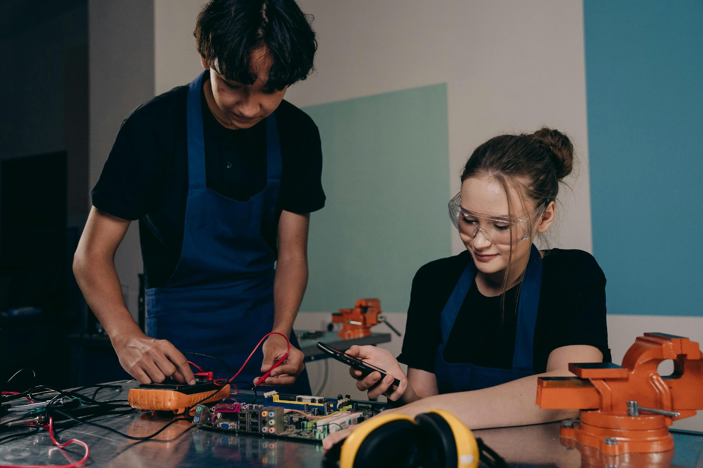
Assessment in VET
Vocational education and training (VET) programs aim to equip graduates with the specific competencies needed for their jobs and the certification that assures employers of these skills. Assessment, which is essential for certification, plays a critical role in confirming that graduates have acquired the necessary job competencies and supports employer confidence in the quality of the VET system.
Source: https://www.oecd-ilibrary.org/docserver/e26636eb-en.pdf?expires=1729711695&id=id&accname=guest&checksum=268B26D8F5D3B778E97EAD9ABF474C87
Funded by the European Union. Views and opinions expressed are however those of the author(s) only and do not necessarily reflect those of the European Union or the European Education and Culture Executive Agency (EACEA). Neither the European Union nor EACEA can be held responsible for them.

Slide 4
Aims of assessment in a flipped VET classroom concept
1
Checking understanding: The assessment of flipped classroom learning aims to check students' understanding of the learning content provided in advance.
2
Assessment of the application of knowledge: In addition to understanding, it is also important to assess how well students can apply the knowledge they have learnt in practical applications.
Assessment of collaboration: The flipped classroom approach encourages collaboration and exchange between students. It is therefore important to assess the collaboration and contribution of each individual.
3
Feedback on learning development: Assessment in flipped classroom learning should also be used to track students' learning progress and give them feedback to improve their learning.
4
Funded by the European Union. Views and opinions expressed are however those of the author(s) only and do not necessarily reflect those of the European Union or the European Education and Culture Executive Agency (EACEA). Neither the European Union nor EACEA can be held responsible for them.

Slide 5
Formative versus summative assessment
Formative assessment in the flipped classroom is used to monitor students' learning progress during the learning process and give them feedback to improve their learning.
The summative assessment in the flipped classroom takes place at the end of a learning section and serves to assess the knowledge and skills acquired by the students.
Funded by the European Union. Views and opinions expressed are however those of the author(s) only and do not necessarily reflect those of the European Union or the European Education and Culture Executive Agency (EACEA). Neither the European Union nor EACEA can be held responsible for them.

Slide 6
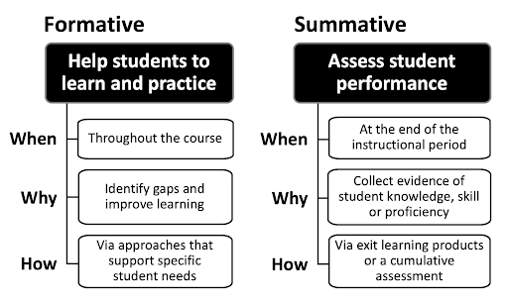
Formative versus summative assessment
Source: https://aheg.com.au/formative-vs-summative-assessment-a-comparison/
Funded by the European Union. Views and opinions expressed are however those of the author(s) only and do not necessarily reflect those of the European Union or the European Education and Culture Executive Agency (EACEA). Neither the European Union nor EACEA can be held responsible for them.

Slide 7
Overview of assessment systems during flipped classroom learning
1. Formative assessment during learning:
Quizzes or tests: Short quizzes or tests can be used during learning to check students' understanding and give them immediate feedback.
Discussions or group work: Through discussions or group work, students can apply their knowledge and assess their collaboration and communication skills.
2. Self-reflection:
Students can be asked to reflect on and evaluate their own learning development by answering questions about the effectiveness of the flipped classroom approach, their own motivation and learning progress.
3. Practical applications:
Projects or presentations: Students can be asked to demonstrate what they have learnt in practical applications by carrying out projects or giving presentations.
4. Summative assessment at the end of the learning section:
Tests or examinations: At the end of the learning section, tests or examinations can be used to assess the knowledge and skills learnt by the students.
Funded by the European Union. Views and opinions expressed are however those of the author(s) only and do not necessarily reflect those of the European Union or the European Education and Culture Executive Agency (EACEA). Neither the European Union nor EACEA can be held responsible for them.

Slide 8
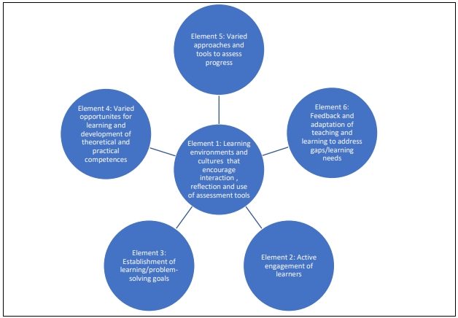
Formative Assessments in VET
The goal of formative assessment in VET is to help students refine both their theoretical knowledge and practical skills.
By providing regular feedback, it allows students to make incremental improvements, which are crucial for mastering hands-on tasks like operating machinery, completing technical tasks, or performing healthcare procedures.
Source: https://openspace.etf.europa.eu/sites/default/files/2021-02/Literature%20review%20Assessment.pdf Main source: Adapted from OECD (2005)
Funded by the European Union. Views and opinions expressed are however those of the author(s) only and do not necessarily reflect those of the European Union or the European Education and Culture Executive Agency (EACEA). Neither the European Union nor EACEA can be held responsible for them.

Slide 9
Examples of Formative Assessments in VET
Formative Assessments: They can be used during the learning process to monitor student progress and provide immediate feedback. Examples include:
Quizzes on vocational theory (e.g., safety procedures).
Group activities that involve practical problem-solving tasks, such as fixing machinery or designing a prototype.
Peer assessments where students review each other's work (e.g., assessing quality in a carpentry project).
Funded by the European Union. Views and opinions expressed are however those of the author(s) only and do not necessarily reflect those of the European Union or the European Education and Culture Executive Agency (EACEA). Neither the European Union nor EACEA can be held responsible for them.

Slide 10
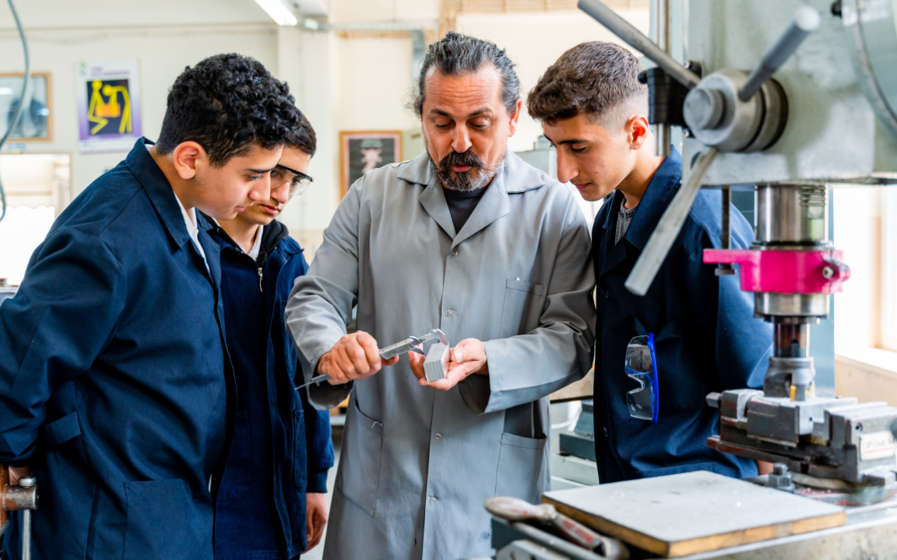
Summative Assessments in VET
In the case of summative assessment (assessment of learning), assessments are used to measure achieved learning outcomes and to make a summary judgement, such as promotion to the next class or certification.
In systems where high-stakes summative assessments (such as certification exams) are the primary determinant for progression or qualification, there is a tendency for both teaching and learning to become exam-focused.
This means that instead of covering the full breadth of the vocational curriculum, instruction may concentrate primarily on the content most likely to appear in the final exam.
Image Source: https://www.fortresslearning.edu.au/blog/assessing-knowledge-in-vet
Funded by the European Union. Views and opinions expressed are however those of the author(s) only and do not necessarily reflect those of the European Union or the European Education and Culture Executive Agency (EACEA). Neither the European Union nor EACEA can be held responsible for them.

Slide 11
Assessment of knowledge after implementation of flipped classroom learning - 4 options at a glance
With this type of question, learners are given several answer options from which they must choose the correct one. This enables a quick and efficient review of the acquired knowledge.
Open questions require a more detailed answer from the students. They have to explain their knowledge, give examples or express their opinion on a particular topic. Open questions allow for deeper reflection and show students' understanding.
1. multiple-choice questions:
2. open questions:
In application questions, students are presented with scenarios or problems in which they have to apply their knowledge. They have to show how they can use the knowledge they have learnt in real-life situations.
Case studies or tasks give students the opportunity to analyse complex problems and find solutions. They must apply their knowledge to understand the situation and propose appropriate actions.
3. application questions:
4. case studies or tasks:
Funded by the European Union. Views and opinions expressed are however those of the author(s) only and do not necessarily reflect those of the European Union or the European Education and Culture Executive Agency (EACEA). Neither the European Union nor EACEA can be held responsible for them.

Slide 12
Peer assessment as a tool for reviewing learning progress
Target:
Methods:
Advantages:
Peer assessment is used to evaluate students' learning progress in the flipped classroom and give them feedback from their classmates.
Peer assessment can take place through mutual review of tasks, projects or presentations. The students evaluate the performance of their classmates based on previously defined criteria.
Peer assessment promotes collaboration and exchange between pupils. It enables pupils to learn from each other and get to know different perspectives.
Funded by the European Union. Views and opinions expressed are however those of the author(s) only and do not necessarily reflect those of the European Union or the European Education and Culture Executive Agency (EACEA). Neither the European Union nor EACEA can be held responsible for them.

Slide 13
Self-assessment as a method of reflection
Self-assessment as a method for reflection in the flipped classroom:
Target:
Methods:
Advantages:
Self-assessment is used to reflect on students' learning progress in the flipped classroom and to give them the opportunity to evaluate their own learning.
Students can evaluate themselves by answering questions about their own motivation, understanding of the learning content and application of knowledge. They can also identify their strengths and weaknesses and set goals for future learning.
Self-assessment encourages self-reflection and independent learning among pupils. It enables students to recognise their progress and adapt their learning strategies.
Funded by the European Union. Views and opinions expressed are however those of the author(s) only and do not necessarily reflect those of the European Union or the European Education and Culture Executive Agency (EACEA). Neither the European Union nor EACEA can be held responsible for them.

Slide 14
Importance of feedback
Feedback plays a crucial role in flipped classroom learning. Here are some reasons why feedback is important in the flipped classroom:
1. Assess learning progress: Feedback enables students to assess their learning progress and understand how well they have understood the learning content. It helps them to recognise their strengths and weaknesses and adapt their learning strategies.
2. Error correction: Feedback helps students to recognise and correct their mistakes. It enables them to identify misunderstandings or gaps in understanding and to correct them.
3. Motivation and self-confidence: Positive feedback boosts students' motivation and self-confidence. It encourages them to keep going and do their best. Constructive feedback also helps them to improve their skills and develop further.
4. Improvement of learning strategies: Feedback gives students an indication of which learning strategies are effective and which may need to be adapted. It enables them to reflect on their learning processes and optimise their approach.
5. Adapting the lesson: Feedback is also important for the teacher to adapt the lesson in the flipped classroom. Feedback from students allows the teacher to recognise which topics or concepts need to be explained further or explored in more depth. This enables targeted and individualised support for learners.
Funded by the European Union. Views and opinions expressed are however those of the author(s) only and do not necessarily reflect those of the European Union or the European Education and Culture Executive Agency (EACEA). Neither the European Union nor EACEA can be held responsible for them.

Slide 15
Assessing Collaboration in VET
Evaluating teamwork in practical VET settings
In VET, many tasks are team-based, requiring students to collaborate on practical assignments, similar to real-world vocational jobs.
Assess how students work in teams during hands-on activities like building a project, managing a kitchen, or performing health-care tasks.
Collaboration assessments can focus on communication, task distribution, peer support, and team problem-solving abilities.
For example:
Students work in permanent teams to complete readiness assurance tests and application exercises that simulate real-world clinical scenarios. Peer evaluation is also a key component, where students provide feedback on each other's performance
A team of students is assigned to run a simulated restaurant service, where they must prepare a multi-course meal for a set number of guests
Funded by the European Union. Views and opinions expressed are however those of the author(s) only and do not necessarily reflect those of the European Union or the European Education and Culture Executive Agency (EACEA). Neither the European Union nor EACEA can be held responsible for them.

Slide 16
Peer and Self-Assessment
Peer Assessments: Encourage students to assess each other’s performance on practical tasks, such as teamwork during a building project or quality control in manufacturing. This process mimics industry feedback and helps students develop critical evaluation skills.
Self-Assessments: Have students reflect on their own performance, identifying areas of strength and improvement. This builds self-awareness and responsibility, essential for long-term professional development​
For example:
For example:
After completing a building project (e.g., constructing a small shed or wall), students assess each other’s teamwork, communication, and quality of work.
In a simulated manufacturing line, students assemble a product, and peers assess the quality of the final product.
After diagnosing and repairing a vehicle, students reflect on their own performance in terms of technical skill, troubleshooting, and efficiency.
After a simulated patient care scenario, students reflect on their ability to perform tasks such as taking vitals, administering medication, and communicating with the patient.
Funded by the European Union. Views and opinions expressed are however those of the author(s) only and do not necessarily reflect those of the European Union or the European Education and Culture Executive Agency (EACEA). Neither the European Union nor EACEA can be held responsible for them.

Slide 17
Digital Evaluation tools
Online quiz tools such as Kahoot, Quizizz or Socrative are useful technology supports in flipped classroom learning
Funded by the European Union. Views and opinions expressed are however those of the author(s) only and do not necessarily reflect those of the European Union or the European Education and Culture Executive Agency (EACEA). Neither the European Union nor EACEA can be held responsible for them.

Slide 18
Digital Evaluation tools
Collaborative document editing: Tools such as Google Docs or Microsoft Office 365 enable students to work together on documents and provide feedback
Funded by the European Union. Views and opinions expressed are however those of the author(s) only and do not necessarily reflect those of the European Union or the European Education and Culture Executive Agency (EACEA). Neither the European Union nor EACEA can be held responsible for them.

Slide 19
Digital Evaluation tools
Video analysis tools such as Edpuzzle or PlayPosit enable teachers to add interactive elements to videos. Students can answer questions or solve tasks during the video
Funded by the European Union. Views and opinions expressed are however those of the author(s) only and do not necessarily reflect those of the European Union or the European Education and Culture Executive Agency (EACEA). Neither the European Union nor EACEA can be held responsible for them.

Slide 20
Digital Evaluation tools
Learning platforms such as Moodle or Schoology offer functions for the assessment and feedback of assignments and tests. Teachers can upload assignments, students can work on them and teachers can provide feedback
Funded by the European Union. Views and opinions expressed are however those of the author(s) only and do not necessarily reflect those of the European Union or the European Education and Culture Executive Agency (EACEA). Neither the European Union nor EACEA can be held responsible for them.

Slide 21
The role of time management in the assessment of flipped classroom learning
The flipped classroom model requires good time planning, as students do a lot of their learning outside of class. An effective time management system helps students to make the most of their learning time and complete their assignments on time.
A time management system enables students to prioritise and organise their tasks. They can determine which tasks need to be completed first and which are less urgent. And it helps students to reduce stress as they can plan and organise their tasks better.
Funded by the European Union. Views and opinions expressed are however those of the author(s) only and do not necessarily reflect those of the European Union or the European Education and Culture Executive Agency (EACEA). Neither the European Union nor EACEA can be held responsible for them.

Slide 22
Efficient organisation supports assessment in flipped classroom learning
Good organisation enables students to structure their learning process. They can organise their learning materials, take notes and store important information.
Good organisation enables students to use their learning resources effectively. They can organise their materials, mark important information and access it easily.
Good organisation helps students to be more productive. They can plan their tasks better, use their time effectively and minimise distractions.
Good organisation encourages pupils to take responsibility for themselves. They learn to organise their own learning processes and take responsibility for their learning.
Funded by the European Union. Views and opinions expressed are however those of the author(s) only and do not necessarily reflect those of the European Union or the European Education and Culture Executive Agency (EACEA). Neither the European Union nor EACEA can be held responsible for them.

Slide 23
Importance of communication with learners in the context of assessment
Communication with students about assessment results in flipped classroom learning is of great importance. Here are some reasons:
1 Feedback and reflection: Communication about assessment results enables students to receive feedback and reflect on their performance.
2. Clarification of expectations: By communicating about assessment results, teachers can clarify their expectations of students. They can explain what criteria were used in the assessment and what goals should be achieved.
3. Motivation and recognition: Communication about assessment results enables teachers to recognise and acknowledge students' achievements. to continue their learning.
4. Goal setting support: communicating assessment results helps students to set their goals and track their progress.
5 Individual support: Teachers can offer individual support by communicating assessment results.
Funded by the European Union. Views and opinions expressed are however those of the author(s) only and do not necessarily reflect those of the European Union or the European Education and Culture Executive Agency (EACEA). Neither the European Union nor EACEA can be held responsible for them.

Slide 24
Importance of communication with parents, employers in the context of assessment
Transparency and information: Communication about assessment results enables parents or employers to be informed about the learning progress of students.
Collaboration and support: Communication about assessment results enables parents or employers to collaborate with teachers and support students.
Promoting learning: Communication about assessment results enables parents or employers to support students' learning.
Motivation and recognition: Communication about assessment results enables parents or employers to recognise and appreciate students' achievements.
Funded by the European Union. Views and opinions expressed are however those of the author(s) only and do not necessarily reflect those of the European Union or the European Education and Culture Executive Agency (EACEA). Neither the European Union nor EACEA can be held responsible for them.

Slide 25
Challenges of assessment in flipped classroom learning
1. Different learning speeds:
2. Lack of direct observation:
3. Time management of teachers:
In the flipped classroom, students learn individually and at their own pace. This can lead to challenges when it comes to assessment, as some students progress faster than others.
In the flipped classroom, students learn largely outside of the classroom. This means that teachers have fewer direct observation opportunities to assess students' performance.
In the flipped classroom, teachers have to prepare and review a large amount of learning materials. This can lead to a lack of time and make it difficult to assess student performance.
Funded by the European Union. Views and opinions expressed are however those of the author(s) only and do not necessarily reflect those of the European Union or the European Education and Culture Executive Agency (EACEA). Neither the European Union nor EACEA can be held responsible for them.

Slide 26
Reflection Activity
Reflect on the advantages of conducting assessments in a flipped classroom environment. What do you think are the most effective aspects of this approach when it comes to assessing students?
Consider how the flipped classroom allows for more in-depth practical assessments during class time, and whether it provides better opportunities for hands-on learning and application of skills. Think about how formative assessments, like quizzes or in-class discussions, help reinforce theoretical knowledge before students engage in practical work.
Reflect on the potential difficulties in monitoring student engagement and progress with pre-class activities. How do you ensure students are adequately prepared for in-class practical work?
Could you integrate more interactive tools, such as digital simulations or peer assessments, to enhance student engagement and provide more continuous feedback?
Funded by the European Union. Views and opinions expressed are however those of the author(s) only and do not necessarily reflect those of the European Union or the European Education and Culture Executive Agency (EACEA). Neither the European Union nor EACEA can be held responsible for them.

Slide 27
Additional Resources
Flipped Classroom, Peer Assessment and Computer Exercises: Flipped Classroom, Peer Assessment and Computer Exercises - YouTube
Four Assessment Strategies for the Flipped Learning Environment: https://www.facultyfocus.com/articles/blended-flipped-learning/four-assessment-strategies-for-the-flipped-learning-environment/
If you want to learn more about Peer Assessments: https://www.frontiersin.org/journals/psychology/articles/10.3389/fpsyg.2022.912568/full
Funded by the European Union. Views and opinions expressed are however those of the author(s) only and do not necessarily reflect those of the European Union or the European Education and Culture Executive Agency (EACEA). Neither the European Union nor EACEA can be held responsible for them.

