Slide 1
CollaboratiVET Curriculum for VET
teachers/trainers/educators
Module 5: Technology Tools for the Flipped Classroom
Unit 4 - Interactive Platforms for Collaboration and Engagement
Funded by the European Union. Views and opinions expressed are however those of the author(s) only and do not necessarily reflect those of the European Union or the European Education and Culture Executive Agency (EACEA). Neither the European Union nor EACEA can be held responsible for them.

Slide 2
Learning Objectives
By the end of this unit, participants will be able to:
Understand the role of interactive platforms in enhancing collaboration and engagement in VET settings.
Identify specific tools and techniques for fostering a student-centered, hands-on learning environment.
Explore ways to integrate technology to address diverse learning needs and increase engagement through real-world applications.
Develop skills to create dynamic, inclusive classrooms that leverage interactive platforms for a more personalized learning experience..

Slide 3
The need for innovation
In the digital renaissance of education, interactive platforms emerge as pivotal in transforming the educational landscape. The educational landscape can be highlighted by new innovations that support learning by creating student-focused and engaging classrooms compatible with the digital age.
Funded by the European Union. Views and opinions expressed are however those of the author(s) only and do not necessarily reflect those of the European Union or the European Education and Culture Executive Agency (EACEA). Neither the European Union nor EACEA can be held responsible for them.

Slide 4
Defining Interactive Learning
Interactive learning emphasizes active participation over passive information reception.
It uses technology to create dynamic, student-centered learning environments.
Students contribute to their educational experience, rather than just receiving information.
This method reflects a shift towards more engaging and immersive learning processes.
Funded by the European Union. Views and opinions expressed are however those of the author(s) only and do not necessarily reflect those of the European Union or the European Education and Culture Executive Agency (EACEA). Neither the European Union nor EACEA can be held responsible for them.

Slide 5
Interactive Platforms in VET
The Role of Interactive Platforms: Essential in transforming the VET classroom into a collaborative, hands-on environment where students actively participate in their learning.
Focus on Practical Skills: Platforms allow students to engage with practical skills and projects digitally before in-person application.
Revolutionizing the Flipped Classroom: These platforms enable VET students to study theoretical components online and use classroom time for practice, making learning more flexible and accessible.
Funded by the European Union. Views and opinions expressed are however those of the author(s) only and do not necessarily reflect those of the European Union or the European Education and Culture Executive Agency (EACEA). Neither the European Union nor EACEA can be held responsible for them.

Slide 6
Unveiling the Benefits
Content: Interactive learning environments offer numerous benefits, transcending traditional classroom boundaries:
Engagement: Captivating student interest, these platforms significantly enhance focus and information retention.
Skill Development: Collaborative exercises and problem-solving tasks develop essential soft skills, crucial for navigating real-world complexities.
Learning Style Accommodation: Tailoring to various learner preferences, interactive platforms ensure a more inclusive educational experience.
Immediate Feedback: Providing instant responses, these tools are key to adapting learning strategies and encouraging continuous improvement.
.
Funded by the European Union. Views and opinions expressed are however those of the author(s) only and do not necessarily reflect those of the European Union or the European Education and Culture Executive Agency (EACEA). Neither the European Union nor EACEA can be held responsible for them.

Slide 7
Specific benefits for VET contexts
Increased Engagement: Interactive platforms foster active participation, making learning more engaging, relevant, and enjoyable.
Example: A culinary class uses an interactive recipe platform where students can annotate steps with questions or tips.
Supports Different Learning Styles: Visual, auditory, and kinesthetic learners can benefit from multimedia content, simulations, and hands-on digital activities.
Example: Visual learners can benefit from diagrams, while kinesthetic learners engage with simulations.
Practical Skill Development: Interactive platforms often include realistic scenarios that mirror workplace challenges, helping students build practical skills and critical thinking.
Example: Health sciences students engage in a virtual patient-care simulation to practice decision-making.
Funded by the European Union. Views and opinions expressed are however those of the author(s) only and do not necessarily reflect those of the European Union or the European Education and Culture Executive Agency (EACEA). Neither the European Union nor EACEA can be held responsible for them.

Slide 8
Applying Real-World Challenges
Integrating Practical Scenarios: In VET, applying knowledge to real-world challenges enhances understanding and builds essential job skills.
Project-Based Learning: It is important to assign projects that solve genuine industry-related problems, encouraging students to think critically and creatively.
Collaboration: Teachers can allow students to work in groups using digital platforms to discuss, collaborate, and troubleshoot together.
Example: Culinary students design a menu using Google Classroom, receiving peer feedback on recipes and preparation steps.
Funded by the European Union. Views and opinions expressed are however those of the author(s) only and do not necessarily reflect those of the European Union or the European Education and Culture Executive Agency (EACEA). Neither the European Union nor EACEA can be held responsible for them.

Slide 9
Harnessing the Power of Technology
Video and Visual Presentations: Teachers can use videos and presentations to introduce skills and procedures before hands-on practice.
Example: A cosmetology class watches a video on skin care techniques before practicing on models.
Educational Games and Interactive Quizzes: Quizzes and games can be used to make learning fun while reinforcing critical skills.
Example: Automotive students participate in a gamified quiz on safety procedures using Kahoot!
Collaborative Document Editing: It is important to encourage group work and feedback through real-time document editing.
Example: Carpentry students co-design a blueprint in a shared document, adding notes and revisions in real-time.
Funded by the European Union. Views and opinions expressed are however those of the author(s) only and do not necessarily reflect those of the European Union or the European Education and Culture Executive Agency (EACEA). Neither the European Union nor EACEA can be held responsible for them.

Slide 10
Collaborative Platforms
Collaborative platforms like Google Classroom and Microsoft Teams revolutionize educational interaction
Google Classroom
Description: A widely-used learning management system (LMS) that enables educators to distribute assignments, give feedback, and manage classroom activities.
VET Use Case: Students in a construction course collaborate on design projects by submitting blueprints, providing peer feedback, and accessing shared resources like instructional videos and safety guidelines.
Microsoft Teams
Description: A collaboration and communication tool that supports file sharing, real-time messaging, and video meetings.
VET Use Case: Hospitality students use Teams to plan and manage an event project, organizing tasks, sharing documents, and holding virtual team meetings.
Funded by the European Union. Views and opinions expressed are however those of the author(s) only and do not necessarily reflect those of the European Union or the European Education and Culture Executive Agency (EACEA). Neither the European Union nor EACEA can be held responsible for them.

Slide 11
Collaborative Platforms
Slack
Description: A platform for organized communication with channels for different topics, real-time messaging, and file sharing.
VET Use Case: Automotive students use Slack to create channels for specific topics (e.g., diagnostics, repair techniques) and share updates, troubleshooting tips, and maintenance schedules.
Trello
Description: A visual project management tool that uses boards, lists, and cards to organize tasks and track progress.
VET Use Case: Welding students use Trello to manage a group project by dividing tasks into "To Do," "In Progress," and "Completed," assigning responsibilities, and tracking milestones.
Funded by the European Union. Views and opinions expressed are however those of the author(s) only and do not necessarily reflect those of the European Union or the European Education and Culture Executive Agency (EACEA). Neither the European Union nor EACEA can be held responsible for them.

Slide 12
Collaborative Platforms
Padlet
Description: A digital whiteboard where users can post and organize text, images, videos, and links collaboratively.
VET Use Case: Culinary students share recipe ideas, cooking techniques, and images of their dishes on a shared Padlet board for inspiration and group feedback.
Miro
Description: An interactive online whiteboard tool for brainstorming, planning, and collaboration.
VET Use Case: Engineering students use Miro to create a flowchart for a design project, collaboratively mapping out stages, sharing comments, and adding visuals to enhance understanding.
Funded by the European Union. Views and opinions expressed are however those of the author(s) only and do not necessarily reflect those of the European Union or the European Education and Culture Executive Agency (EACEA). Neither the European Union nor EACEA can be held responsible for them.

Slide 13
Collaborative Platforms
Edmodo
Description: A social learning platform that connects students and teachers in a secure environment for sharing resources, discussions, and assignments.
VET Use Case: Health science students in a flipped classroom use Edmodo to discuss case studies, share research articles, and ask questions about pre-class materials.
Asana
Description: A project management tool that helps teams organize, assign, and track project tasks with features like task lists, timelines, and calendars.
VET Use Case: Carpentry students use Asana to plan the stages of a woodworking project, set deadlines, and track progress as they work toward creating a finished product.
Funded by the European Union. Views and opinions expressed are however those of the author(s) only and do not necessarily reflect those of the European Union or the European Education and Culture Executive Agency (EACEA). Neither the European Union nor EACEA can be held responsible for them.

Slide 14
Other Tools to Use in the Classroom
Simbound (Digital Marketing and eCommerce)
Provides simulation tools for students to learn about online marketing and e-commerce
Offers a practical, hands-on environment
Allows learners to experiment with marketing strategies, SEO practices, and email marketing campaigns in a controlled setting
Labster (Science and Engineering)
Offers virtual lab simulations for conducting scientific experiments
Covers fields like biology, chemistry, and physics
Eliminates the need for a physical lab
Ideal for introducing complex laboratory techniques and concepts before hands-on practice in class
Funded by the European Union. Views and opinions expressed are however those of the author(s) only and do not necessarily reflect those of the European Union or the European Education and Culture Executive Agency (EACEA). Neither the European Union nor EACEA can be held responsible for them.

Slide 15
Other Tools to Use in the Classroom
Instructables (Various Trades)
A community for people who like to make things
Students can explore, document, and share their creations
Offers a rich resource for project ideas across various vocational areas
Includes areas such as woodworking, electronics, and crafting
Codecademy (IT and Computer Science)
An interactive platform that teaches coding in multiple programming languages
Ideal for IT and computer science students
Provides hands-on coding exercises
Includes projects to apply learning in a practical context
Funded by the European Union. Views and opinions expressed are however those of the author(s) only and do not necessarily reflect those of the European Union or the European Education and Culture Executive Agency (EACEA). Neither the European Union nor EACEA can be held responsible for them.

Slide 16
Other Tools to Use in the Classroom
AutoCAD (Architecture and Engineering)
A leading software tool for 3D design and drafting
Essential for students in architecture, engineering, and construction
Offers the ability to create precise 2D and 3D models
Students learn to use the software for projects and presentations
Funded by the European Union. Views and opinions expressed are however those of the author(s) only and do not necessarily reflect those of the European Union or the European Education and Culture Executive Agency (EACEA). Neither the European Union nor EACEA can be held responsible for them.

Slide 17
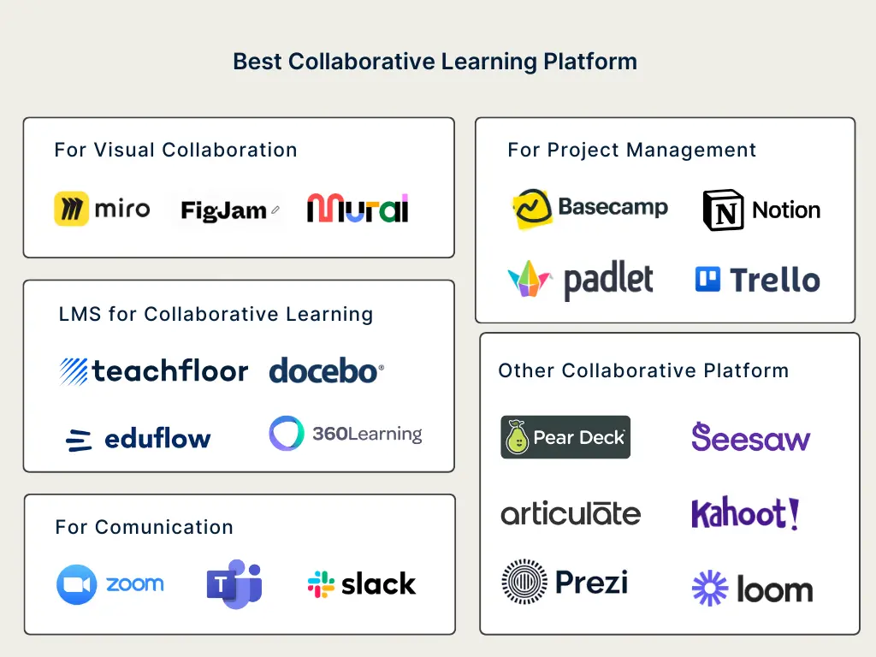
Other Tools to Use in the Classroom
Source: https://www.teachfloor.com/blog/best-collaborative-learning-tools-2022
Funded by the European Union. Views and opinions expressed are however those of the author(s) only and do not necessarily reflect those of the European Union or the European Education and Culture Executive Agency (EACEA). Neither the European Union nor EACEA can be held responsible for them.

Slide 18
Emphasizing Reflection and Feedback
Enable students to critically assess their progress and areas for improvement
Highlights the importance of structured self-reflection exercises
Emphasizes constructive feedback from educators
Fosters a culture of self-awareness and continuous development
Encourages students to develop a growth mindset
Helps students achieve their full potential
Funded by the European Union. Views and opinions expressed are however those of the author(s) only and do not necessarily reflect those of the European Union or the European Education and Culture Executive Agency (EACEA). Neither the European Union nor EACEA can be held responsible for them.

Slide 19
Reflection Activity
Pick a tool you would like to explore further (e.g., Google Classroom, Instructables, Labster). Outline a lesson that uses this tool to engage students with real-world applications.
How will this tool enhance students’ understanding of practical skills? What challenges might you face in implementing this tool in a VET setting? How could you encourage collaboration and engagement using this tool?
Funded by the European Union. Views and opinions expressed are however those of the author(s) only and do not necessarily reflect those of the European Union or the European Education and Culture Executive Agency (EACEA). Neither the European Union nor EACEA can be held responsible for them.

Slide 20
Resources
Google Classroom: Google Classroom is a learning management system (LMS) that facilitates communication between teachers and students. It enables the sharing of assignments, resources, and announcements in an organized way. It integrates with Google Drive and other Google tools, making it easy to manage digital coursework, provide feedback, and enhance collaboration in flipped classrooms. Website: https://classroom.google.com
Microsoft Teams: Microsoft Teams is a collaboration platform that supports messaging, file sharing, and real-time communication through channels. It’s ideal for flipped classrooms, offering features like video meetings, assignment management, and integration with other Microsoft 365 tools. Teams enables efficient collaboration and organization within learning environments. Website: https://www.microsoft.com/en/microsoft-teams
Simbound: Simbound is an educational platform that provides digital marketing and eCommerce simulations. It allows students to engage with real-world marketing scenarios, experimenting with SEO, email campaigns, and web analytics in a hands-on way. Simbound helps students develop digital marketing skills within a controlled, interactive environment. Website: https://www.simbound.com
Labster: Labster offers virtual lab simulations for students in fields like biology, chemistry, and physics. These interactive simulations allow students to conduct experiments and explore scientific concepts in a virtual environment, making it a great tool for science education, especially in flipped classrooms. Website: https://www.labster.com
Funded by the European Union. Views and opinions expressed are however those of the author(s) only and do not necessarily reflect those of the European Union or the European Education and Culture Executive Agency (EACEA). Neither the European Union nor EACEA can be held responsible for them.

Slide 21
Resources
Instructables: Instructables is a community-based platform where students can explore, create, and share DIY projects. It’s especially useful for vocational and technical education, offering step-by-step guides for projects across a range of areas such as electronics, woodworking, and crafting. Website: https://www.instructables.com
Codecademy: Codecademy is an interactive platform that teaches coding in various programming languages, including Python, JavaScript, and HTML/CSS. It offers hands-on exercises and projects, making it ideal for students learning computer science and IT skills. Website: https://www.codecademy.com
Coursera: Coursera is an online learning platform that provides access to a wide range of courses in various fields, including vocational skills like health care, construction, and business. It offers video lectures, readings, and quizzes, allowing students to learn at their own pace outside of class. Website: https://www.coursera.org
Udemy: Udemy is an online learning marketplace offering a wide variety of courses, including vocational and technical skills. Students can access video lectures and practical assignments across fields like culinary arts, IT, and personal development, making it a great supplement for classroom learning. Website: https://www.udemy.com
ThingLink: ThingLink is a platform for creating interactive media, such as images, videos, and 360-degree virtual tours. It’s especially useful for students in fields like media, real estate, and tourism education, enabling them to create immersive, interactive presentations. Website: https://www.thinglink.com
Funded by the European Union. Views and opinions expressed are however those of the author(s) only and do not necessarily reflect those of the European Union or the European Education and Culture Executive Agency (EACEA). Neither the European Union nor EACEA can be held responsible for them.

Slide 22
Resources
Slack: Slack is a communication platform ideal for flipped classrooms, enabling real-time messaging, file sharing, and collaboration through topic-specific channels. It integrates with numerous educational tools, enhancing focused discussions and teamwork among students and educators. This supports the unit’s aim of using technology for interactive learning and collaboration.
Trello: Trello is a project management tool that organizes tasks and projects into boards, lists, and cards. It's excellent for flipped classrooms, allowing students and teachers to visualize progress, assign tasks, and set deadlines collaboratively. Trello’s intuitive interface supports interactive learning projects, facilitating organization and communication within group work.
Funded by the European Union. Views and opinions expressed are however those of the author(s) only and do not necessarily reflect those of the European Union or the European Education and Culture Executive Agency (EACEA). Neither the European Union nor EACEA can be held responsible for them.

