Slide 1
CollaboratiVET Curriculum for VET teachers/trainers/educators
Module 5: Technology Tools for the Flipped Classroom
Unit 1 - Educational Technology for Flipped Learning
Funded by the European Union. Views and opinions expressed are however those of the author(s) only and do not necessarily reflect those of the European Union or the European Education and Culture Executive Agency (EACEA). Neither the European Union nor EACEA can be held responsible for them.

Slide 2
Learning Objectives
By the end of this unit, participants will be able to:
Identify key technology tools for flipped learning.
Understand how to use video tools for pre-class content.
Incorporate interactive quizzes for student engagement.
Recognize the role of collaborative tools in learning.
Use LMS platforms for organizing and distributing materials.
Ensure accessibility and inclusion in learning materials.
Facilitate student-centered learning by shifting the educator's role.

Slide 3
Educational technology for
Flipped Learning
In the flipped classroom model, traditional in-class instruction is moved outside of the classroom through the use of technology, allowing class time to be dedicated to interactive, practical learning. This method is especially powerful in vocational education and training (VET) settings, where hands-on skills are essential. The use of educational technology ensures that students come prepared with foundational knowledge, ready to apply what they’ve learned in real-world scenarios during class.
Funded by the European Union. Views and opinions expressed are however those of the author(s) only and do not necessarily reflect those of the European Union or the European Education and Culture Executive Agency (EACEA). Neither the European Union nor EACEA can be held responsible for them.

Slide 4
Why technology is important for
Flipped Learning?
Enhances learning experience: Technology enables the integration of subjects like mathematics and technology, making learning more dynamic and relevant to students' future careers
Promotes interactive learning: Technology allows students to engage in interactive activities such as quizzes, simulations, and problem-solving exercises, which promote critical thinking and collaboration
Facilitates content delivery: Pre-recorded videos and digital materials allow students to access and learn content at their own pace outside the classroom, preparing them for in-class hands-on activities
Shifts the teacher’s role: Technology transforms teachers from lecturers to facilitators or organizers of the learning process, encouraging students to take a more active role in their education​
Improves student engagement and motivation: The use of interactive tools and multimedia enhances student motivation, engagement, and interaction, leading to better learning outcomes
Supports diverse assessment and feedback: Technology enables various forms of assessment (e.g., quizzes, peer reviews) and provides timely feedback, which helps students improve their learning continuously​
Funded by the European Union. Views and opinions expressed are however those of the author(s) only and do not necessarily reflect those of the European Union or the European Education and Culture Executive Agency (EACEA). Neither the European Union nor EACEA can be held responsible for them.

Slide 5
Practical Tips for Engaging Pre-Class and Post-Class Materials
Funded by the European Union. Views and opinions expressed are however those of the author(s) only and do not necessarily reflect those of the European Union or the European Education and Culture Executive Agency (EACEA). Neither the European Union nor EACEA can be held responsible for them.

Slide 6
Preparing Pre-Class Materials
In the flipped classroom model, pre-class materials are critical to ensuring that students arrive prepared for more interactive, hands-on activities during class. These materials provide the foundational knowledge students need to engage in higher-order thinking tasks, such as problem-solving, collaboration, and practical application, when they enter the classroom.
HOW?
Create Engaging Video Content (video lectures, tutorials)
Use Interactive Videos
Provide Readings and Supplementary Materials (readings, handouts, infographics)
Incorporate accessibility features (transcripts for audio, readable format)
Organize Content in an LMS
Include Reflection or Preparatory Questions
Funded by the European Union. Views and opinions expressed are however those of the author(s) only and do not necessarily reflect those of the European Union or the European Education and Culture Executive Agency (EACEA). Neither the European Union nor EACEA can be held responsible for them.

Slide 7
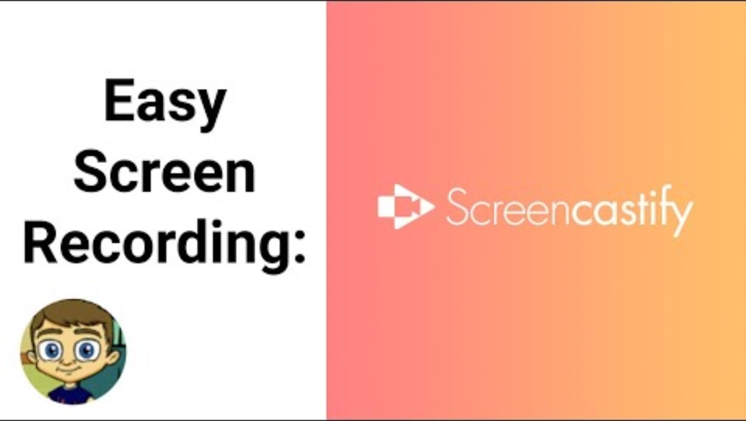
Video Creation Tools
Screencastify
Screencastify, is a useful tool in flipped learning that allows educators to create engaging lecture videos.
Supports self-paced learning: Allows students to learn at their own pace outside of class.
Goes beyond content delivery: Focuses on fostering a deeper learning environment.
Aligns with Flipped Learning principles: Emphasizes intentional content to maximize active engagement during class.
Maximizes classroom interaction: Frees up class time for more active, hands-on learning activities.
Funded by the European Union. Views and opinions expressed are however those of the author(s) only and do not necessarily reflect those of the European Union or the European Education and Culture Executive Agency (EACEA). Neither the European Union nor EACEA can be held responsible for them.

Slide 8
Use Video Editors with Engagement Features
Enhances student engagement: This approach increases participation and interaction from students.
Instant feedback: Provides immediate feedback to reinforce learning.
Supports Flipped Learning: Aligns with the Flipped Learning principle of promoting a rich learning culture.
Encourages active engagement: Motivates students to interact with the material before attending class.
Funded by the European Union. Views and opinions expressed are however those of the author(s) only and do not necessarily reflect those of the European Union or the European Education and Culture Executive Agency (EACEA). Neither the European Union nor EACEA can be held responsible for them.

Slide 9
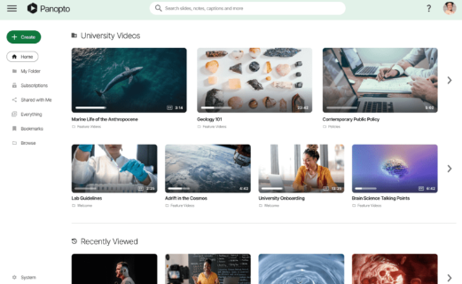
Use Screen and Video Recorders
Panopto
Panopto offers a seamless way to capture and share instructional content, mirroring the flexible environment pillar of Flipped Learning. This adaptability ensures students can access lessons anytime, anywhere, supporting diverse learning preferences and needs.
Tutorial
With quizzing and polling capabilities
Funded by the European Union. Views and opinions expressed are however those of the author(s) only and do not necessarily reflect those of the European Union or the European Education and Culture Executive Agency (EACEA). Neither the European Union nor EACEA can be held responsible for them.

Slide 10
Ensuring Accessibility
It's crucial to ensure that all learning materials are accessible to every student, including those with disabilities. Tools like closed captioning, screen readers, and text-to-speech software help ensure that flipped classroom materials can be accessed by all learners, fostering an inclusive learning environment.
Ensuring pre-class materials are accessible supports Flipped Learning's goal of providing personalized attention.
Accessibility tools improve content engagement for all students, regardless of their learning preferences or challenges.
Tools that enhance readability and accessibility help create equal opportunities for students to interact with the material.
Funded by the European Union. Views and opinions expressed are however those of the author(s) only and do not necessarily reflect those of the European Union or the European Education and Culture Executive Agency (EACEA). Neither the European Union nor EACEA can be held responsible for them.

Slide 11
Ensuring Accessibility
It's crucial to ensure that all learning materials are accessible to every student, including those with disabilities. Tools like closed captioning, screen readers, and text-to-speech software help ensure that flipped classroom materials can be accessed by all learners, fostering an inclusive learning environment.
Accessibility in Flipped Learning: Accessibility is a fundamental aspect of the Flipped Learning approach.
Video captioning tools: Utilize tools that provide video captioning to make materials accessible to all students.
Support for hearing-impaired students: Ensures students with hearing impairments can access learning content.
Promotes personalized attention: Aims to provide tailored learning experiences for every student.
Encourages continuous learning: Supports the goal of fostering ongoing learning opportunities for all learners.
Funded by the European Union. Views and opinions expressed are however those of the author(s) only and do not necessarily reflect those of the European Union or the European Education and Culture Executive Agency (EACEA). Neither the European Union nor EACEA can be held responsible for them.

Slide 12
Collaboration Tools for
Pre-Class Activities
Supports collaboration: Mirrors the collaborative pillar of Flipped Learning.
Transforms learning experience: These platforms change how students engage with content.
Promotes peer interaction: Encourages interaction and collaboration among students.
Fosters knowledge sharing: Facilitates sharing of ideas and resources among peers
Google Docs and Microsoft Teams: Enhance the Flipped Classroom by enabling real-time collaboration.
Funded by the European Union. Views and opinions expressed are however those of the author(s) only and do not necessarily reflect those of the European Union or the European Education and Culture Executive Agency (EACEA). Neither the European Union nor EACEA can be held responsible for them.

Slide 13
Peer-to-Peer Collaboration
Technology enhances peer-to-peer collaboration in the classroom, a key element of the Flipped Learning model.
Platforms like Padlet facilitate idea sharing and group work.
This approach promotes the collaborative and active learning benefits that are central to Flipped Learning..
https://padlet.com/
Funded by the European Union. Views and opinions expressed are however those of the author(s) only and do not necessarily reflect those of the European Union or the European Education and Culture Executive Agency (EACEA). Neither the European Union nor EACEA can be held responsible for them.

Slide 14
Enhancing your teaching practices with Interactive Quizzes
Embedding interactive quizzes in video content not only engages students but also offers immediate feedback, helping them gauge their understanding before class. This method fosters an active learning environment, encouraging participation and improving information retention.
Funded by the European Union. Views and opinions expressed are however those of the author(s) only and do not necessarily reflect those of the European Union or the European Education and Culture Executive Agency (EACEA). Neither the European Union nor EACEA can be held responsible for them.

Slide 15
Organising Content with LMS
- Leveraging LMS: Use Learning Management Systems to streamline the distribution of pre-class materials.
- Tracks student progress: These tools help monitor and assess student progress effectively.
- Flexibility in Flipped Learning: Supports the Flipped Learning benefit of flexibility in learning.
- Structured learning environment: Creates a structured and accessible environment for students.
- Helps manage classroom dynamics: Enables educators to manage the controlled chaos of a dynamic classroom effectively.
Funded by the European Union. Views and opinions expressed are however those of the author(s) only and do not necessarily reflect those of the European Union or the European Education and Culture Executive Agency (EACEA). Neither the European Union nor EACEA can be held responsible for them.

Slide 16
Active Learning with Technology
Integrating technology into active learning transforms vocational education and training (VET) by allowing students to engage in hands-on, practical experiences that prepare them for real-world tasks. From virtual simulations to collaborative design tools, technology enables students to practice skills, solve problems, and collaborate in environments that mirror their future workplaces. This approach not only enhances engagement but also builds confidence and competency in a range of vocational fields.
For example:
Automotive Repair: Diagnostic Simulations
Culinary Arts: Interactive Recipe Quizzes
Technology Used: Diagnostic simulation software
Description: Students use virtual diagnostic tools to simulate car repairs, identify faults, and troubleshoot issues before moving to real vehicles.
Outcome: Reinforces practical skills in a low-risk environment, allowing students to practice and build confidence.
Technology Used: Edpuzzle, H5P (interactive quizzes)
Description: Before hands-on cooking, students complete quizzes embedded in cooking videos, where they learn about ingredients, techniques, and safety.
Outcome: Ensures foundational knowledge, so class time focuses on applying these techniques in the kitchen.
Funded by the European Union. Views and opinions expressed are however those of the author(s) only and do not necessarily reflect those of the European Union or the European Education and Culture Executive Agency (EACEA). Neither the European Union nor EACEA can be held responsible for them.

Slide 17
Active Learning with Technology
For example:
Healthcare Training: Virtual Patient Simulations
Technology Used: VR simulations, 3D anatomy apps
Description: Students practice patient care skills with VR, such as taking vitals or administering medication, before working with real patients.
Outcome: Builds confidence and skill accuracy in a safe, controlled virtual environment.
Construction and Carpentry: 3D Modeling Software
Technology Used: CAD software (e.g., SketchUp, AutoCAD)
Description: Students design blueprints and virtual models of structures, experimenting with design choices and measurements.
Outcome: Helps students visualize projects and troubleshoot design flaws before construction, enhancing spatial and technical skills.
Funded by the European Union. Views and opinions expressed are however those of the author(s) only and do not necessarily reflect those of the European Union or the European Education and Culture Executive Agency (EACEA). Neither the European Union nor EACEA can be held responsible for them.

Slide 18
Post class activities Tools
Video Reflections: Encourage students to create short video summaries where they share their insights and key takeaways from the class. This could involve them recording themselves discussing what they have learned.
Digital Portfolios: Students can create e-portfolios that include samples of their work alongside reflective essays or commentary on what they learned from each piece. This not only showcases their achievements but also allows for deep reflection on their learning journey
Exit Tickets: At the end of each class, students can write down one key thing they learned or a question they still have on a sticky note or digital platform. This serves as a quick reflection tool and gives instructors insight into students' understanding
Funded by the European Union. Views and opinions expressed are however those of the author(s) only and do not necessarily reflect those of the European Union or the European Education and Culture Executive Agency (EACEA). Neither the European Union nor EACEA can be held responsible for them.

Slide 19
Feedback and Assessment Tools
Feedback and assessment play a vital role in flipped learning, offering quick insights into how students are doing, encouraging ongoing growth, and helping them build confidence as they learn at their own pace.
To gather Feedback you could use:
Digital Polls and Surveys (such as Mentimeter or Google Forms)
Discussion Platforms (such as Padlet oe Flipgrid)
Video Quizzes (such as Edpuzzle or PlayPosit)
For Assessment you could use:
Formative Assessments (such as Kahoot! or Quizizz)
Learning Management Systems (LMS) (such as Canvas or Moodle)
Self-Assessment Tools (such as Google Forms or Reflection Logs)
Funded by the European Union. Views and opinions expressed are however those of the author(s) only and do not necessarily reflect those of the European Union or the European Education and Culture Executive Agency (EACEA). Neither the European Union nor EACEA can be held responsible for them.

Slide 20
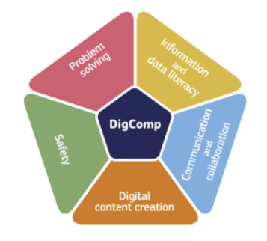
Continuing the Learning Journey
DigComp Framework - European Commission (europa.eu)
Digital Education Action Plan (2021-2027) - European Education Area (europa.eu)
Funded by the European Union. Views and opinions expressed are however those of the author(s) only and do not necessarily reflect those of the European Union or the European Education and Culture Executive Agency (EACEA). Neither the European Union nor EACEA can be held responsible for them.

Slide 21
Reflection Activity
Reflect on the technology tools you have used or plan to use in your flipped classroom. How effective are these tools in delivering pre-class content and engaging students in active learning during class? Consider how tools like video creation, interactive quizzes, and collaborative platforms enhance the learning process.
What challenges do you anticipate when integrating technology into your flipped classroom? Are there limitations related to access, student familiarity with tools, or technical issues that might hinder engagement? How can you address these challenges?
Based on the challenges you’ve identified, think of innovative strategies that could enhance the integration of technology into your flipped classroom. Could incorporating more accessible tools, providing student training, or offering diverse types of content (e.g., interactive quizzes or real-time collaboration) help improve the learning experience?
Funded by the European Union. Views and opinions expressed are however those of the author(s) only and do not necessarily reflect those of the European Union or the European Education and Culture Executive Agency (EACEA). Neither the European Union nor EACEA can be held responsible for them.

Slide 22
Additional Resources
Vocational education and training initiatives
A Conceptual Paper on the Roles of Vocational Education Instructors in Professional Learning Communities (PLC)
Funded by the European Union. Views and opinions expressed are however those of the author(s) only and do not necessarily reflect those of the European Union or the European Education and Culture Executive Agency (EACEA). Neither the European Union nor EACEA can be held responsible for them.

