Slide 1
CollaboratiVET Curriculum for VET teachers/trainers/educators
Module 4: Implementing the Flipped Classroom Approach and Collaborative Learning
Unit 4: Practical Strategies for Flipping Your Classroom
Funded by the European Union. Views and opinions expressed are however those of the author(s) only and do not necessarily reflect those of the European Union or the European Education and Culture Executive Agency (EACEA). Neither the European Union nor EACEA can be held responsible for them.

Slide 2
Learning Objectives
Understand the Role of Novelty in Learning
Maximize Effective Face-to-Face Interactions:
Facilitate Effective Student Planning:
Develop Key Student Skills for Flipped Learning:
Promote Continuous Improvement and Adaptability:
Apply Practical Techniques for Flipping the Classroom

Slide 3
The role for novelty in learning
In a flipped classroom, where traditional learning structures are inverted, incorporating novelty and variety plays a critical role. It significantly enhances student engagement by transforming the way instructional content is delivered and interacted with. Novelty reinvigorates students' curiosity and interest. It can be achieved by:
Utilizing various types of multimedia, like engaging videos, podcasts, and interactive simulations, to present information in diverse, stimulating ways.
Regularly changing the structure of in-class activities, alternating between group discussions, hands-on projects, and creative problem-solving sessions.
Introducing new topics or concepts interactively, perhaps through gamification or scenario-based learning, to enhance active participation and critical thinking.
Here is a guide by Dana Corey on 13 interactive presentation ideas to engage students in class:
https://www.avocor.com/blog/interactive-presentation-ideas-for-classroom/
Funded by the European Union. Views and opinions expressed are however those of the author(s) only and do not necessarily reflect those of the European Union or the European Education and Culture Executive Agency (EACEA). Neither the European Union nor EACEA can be held responsible for them.

Slide 4
The role for novelty in learning
Introducing new elements in teaching methodologies keeps the learning experience fresh and engaging. It prevents the process from becoming routine or monotonous, which is key to maintaining students' enthusiasm and preventing disengagement. Novelty in educational methods ensures that each learning session is an opportunity for discovery and excitement.
Additionally, it actively stimulates students' participation in their learning journey. This leads to deeper understanding and retention of material. When students encounter new and unexpected methods of learning, they engage more deeply, question more critically, and understand more comprehensively.
Funded by the European Union. Views and opinions expressed are however those of the author(s) only and do not necessarily reflect those of the European Union or the European Education and Culture Executive Agency (EACEA). Neither the European Union nor EACEA can be held responsible for them.

Slide 5
Maximizing face-to-face learning
The flipped classroom model underscores the importance of using classroom time effectively. It's crucial to engage students in activities that benefit most from direct interaction and discussion.
Classroom sessions are an opportunity to deepen understanding of concepts introduced online, through interactive and collaborative activities.
Funded by the European Union. Views and opinions expressed are however those of the author(s) only and do not necessarily reflect those of the European Union or the European Education and Culture Executive Agency (EACEA). Neither the European Union nor EACEA can be held responsible for them.

Slide 6
Maximizing face-to-face learning Effective Classroom Activities
Prioritize interactive activities during in-person sessions. This includes group discussions, collaborative problem-solving, and hands-on projects that encourage active engagement and deeper understanding of online materials. Activities should be designed to apply and expand upon what students have learned online, encouraging critical thinking and real-world application.
Take a look at this article by Avid to learn some more about maximizing face time:
https://avidopenaccess.org/resource/flip-the-learning-in-your-classroom/
Funded by the European Union. Views and opinions expressed are however those of the author(s) only and do not necessarily reflect those of the European Union or the European Education and Culture Executive Agency (EACEA). Neither the European Union nor EACEA can be held responsible for them.

Slide 7
Maximizing face-to-face learning Optimizing Classroom Engagement
Focus on active learning techniques to maximize student participation. Use methods such as debates, role-playing, or case studies to foster a dynamic learning environment. The teacher’s role is pivotal in facilitating discussions, guiding group activities, and ensuring that all students are actively participating and absorbing the material.
Debates
Dynamic Learning Environment
Role- playing
Case Studies
Funded by the European Union. Views and opinions expressed are however those of the author(s) only and do not necessarily reflect those of the European Union or the European Education and Culture Executive Agency (EACEA). Neither the European Union nor EACEA can be held responsible for them.

Slide 8
Maximizing face-to-face learning Integration with Online Learning
Seamlessly integrate in-person and online learning components. Ensure that online learning activities prepare students for the interactive and collaborative work they will do in the classroom. Consider using online discussions to set the groundwork for in-class activities, so students come prepared with ideas and questions, ready to dive deeper into the subject matter
IN-CLASS WORK
QUIZZES
ONLINE DISCUSSIONS
Read this article on Blended Learning: Combining online and in-person instruction: https://www.learnow.live/blog/blended-learning-combining-online-and-in-person-instruction
Funded by the European Union. Views and opinions expressed are however those of the author(s) only and do not necessarily reflect those of the European Union or the European Education and Culture Executive Agency (EACEA). Neither the European Union nor EACEA can be held responsible for them.

Slide 9
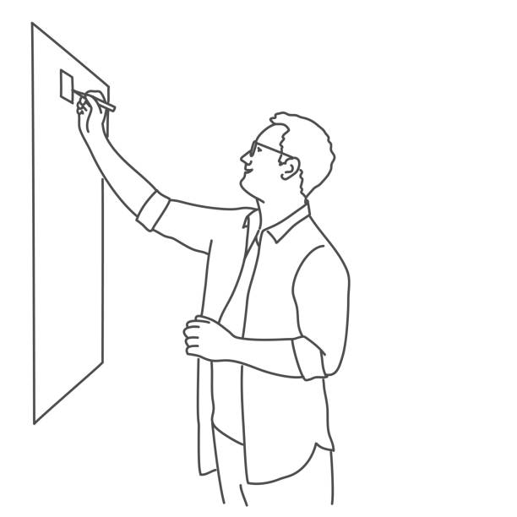
Encouraging effective student planning
In the flipped classroom model, students' ability to manage their study time is important for successful self-directed learning. Good planning helps them make the most of online study sessions, so they can come to in-person classes feeling more prepared and involved.
As a teacher, it's important to help students organize their self-study time by encouraging them to create a consistent study schedule. Emphasize the value of setting specific, realistic goals for each session. Additionally, suggest the use of planning tools like digital calendars, study apps, or to-do lists to help students manage their tasks, track assignments, and meet deadlines effectively.
Read this article by simplilearn on 10 time management skills and techniques for students: https://www.simplilearn.com/tutorials/time-management-tutorial/best-time-management-tips-for-students
Funded by the European Union. Views and opinions expressed are however those of the author(s) only and do not necessarily reflect those of the European Union or the European Education and Culture Executive Agency (EACEA). Neither the European Union nor EACEA can be held responsible for them.

Slide 10
Benefits of effective student planning
Student planning empowers learners to take control of their education by organizing their time and setting clear goals. This approach improves learning outcomes, reduces stress, and enhances classroom participation.
Improved Time Management: Planning helps students manage their time effectively, preventing last-minute cramming and ensuring enough time for challenging concepts.
Better Understanding: Regular planning allows for reviewing difficult topics, leading to a deeper, long-term understanding of the material.
Reduced Stress: Planning reduces anxiety by creating a clear path to meet deadlines, making students feel less overwhelmed.
Impacts on Learning Outcomes
Funded by the European Union. Views and opinions expressed are however those of the author(s) only and do not necessarily reflect those of the European Union or the European Education and Culture Executive Agency (EACEA). Neither the European Union nor EACEA can be held responsible for them.

Slide 11
Benefits of effective student planning
Meaningful Engagement: Students who plan ahead come to class better prepared, leading to more thoughtful contributions and discussions.
Preparedness: Planning helps students feel confident and ready for discussions and tasks, encouraging active participation in class..
Enhanced Classroom Participation
Made with AI
Funded by the European Union. Views and opinions expressed are however those of the author(s) only and do not necessarily reflect those of the European Union or the European Education and Culture Executive Agency (EACEA). Neither the European Union nor EACEA can be held responsible for them.

Slide 12
Encouraging effective student planning
The role of the educator
Educators can facilitate student planning by providing clear instructions, relevant resources, and frameworks for managing their independent learning.
Regular check-ins and feedback on students' planning and study progress can be highly beneficial. Consider incorporating planning and organization skills as part of the curriculum, teaching students effective strategies to organize and manage their learning process.
Funded by the European Union. Views and opinions expressed are however those of the author(s) only and do not necessarily reflect those of the European Union or the European Education and Culture Executive Agency (EACEA). Neither the European Union nor EACEA can be held responsible for them.

Slide 13
Developing key skills for flipped learning
In a flipped classroom, key student skills like time management, self-regulation, and effective communication are crucial. These skills are vital for academic success in this model and are equally important for real-world scenarios, preparing students for life beyond the classroom.
Teaching Self-Regulation and Time Management:
Help students set clear goals, monitor their progress, and reflect on their learning. Teach time management by guiding them to prioritize tasks and create study schedules for effective use of time.
Enhancing Communication Skills: Encourage group projects, presentations, and peer feedback to improve communication, helping students articulate ideas and respond constructively..
Facilitating Skill Development: Incorporate activities that build time management and communication skills, while modeling these behaviors and creating a supportive environment for practice and growth.
Funded by the European Union. Views and opinions expressed are however those of the author(s) only and do not necessarily reflect those of the European Union or the European Education and Culture Executive Agency (EACEA). Neither the European Union nor EACEA can be held responsible for them.

Slide 14
Continuous improvement in the flipped classroom
Embracing a culture of ongoing development means continuously refining the flipped classroom approach for effectiveness and engagement.
Remember to be receptive to feedback and adaptable, altering teaching methods in response to student needs and technological advancements.
Funded by the European Union. Views and opinions expressed are however those of the author(s) only and do not necessarily reflect those of the European Union or the European Education and Culture Executive Agency (EACEA). Neither the European Union nor EACEA can be held responsible for them.

Slide 15
Continuous improvement in the flipped classroom
Regular assessments, both formal (tests, projects) and informal (discussions, observations), are vital in evaluating the flipped classroom's efficacy.
Assessment and Feedback Loop
Utilize student feedback as a key resource to identify what works and areas needing improvement, optimizing the learning experience.
Pursue ongoing professional development through workshops, seminars, or online courses on flipped learning and innovative teaching.
Professional Development for Educators
Network with other educators to share experiences, challenges, and successful practices in flipped classroom settings.
Funded by the European Union. Views and opinions expressed are however those of the author(s) only and do not necessarily reflect those of the European Union or the European Education and Culture Executive Agency (EACEA). Neither the European Union nor EACEA can be held responsible for them.

Slide 16
Continuous improvement in the flipped classroom
Involve students in continuous improvement via student-led discussions, suggestion boxes, or regular reflection sessions. Student insights are crucial; their perspectives can greatly enhance the learning experience and help fine-tune the flipped classroom.
Student Involvement in the Improvement Process
Read this article by Maria Kampen on 6 types of assessment and how to use them: https://www.prodigygame.com/main-en/blog/types-of-assessment/
How do you use student feedback to change your practice? Read this article by Edutopia to learn the answer: https://www.edutopia.org/article/question-change-teaching-practice-student-feedback/
Funded by the European Union. Views and opinions expressed are however those of the author(s) only and do not necessarily reflect those of the European Union or the European Education and Culture Executive Agency (EACEA). Neither the European Union nor EACEA can be held responsible for them.

Slide 17
Enhancing student engagement in a flipped classroom
Incorporate active learning techniques like problem-based learning, class discussions, and interactive projects to boost engagement. Make activities more student-centered, allowing learners to actively shape their educational journey and apply their knowledge practically.
Utilizing Technology for Engagement:
Utilize technological tools such as interactive quizzes, virtual reality, and collaborative online platforms to enhance student engagement. Integrate these tools into both online pre-class work and face-to-face sessions to create a seamless and interactive learning experience.
Personalizing Learning Experiences:
Personalize learning to meet diverse student needs and interests. Tailor content, activities, and assessments to accommodate various learning styles. Examples include offering choice in assignments, using different teaching methods, and providing varied resources to cater to individual preferences.
Building a Collaborative Learning Environment:
Collaboration is key in a flipped classroom. Employ strategies like group projects and peer learning to build a strong classroom community. Foster a sense of belonging and teamwork among students, encouraging collaborative problem-solving and shared learning experiences.
Funded by the European Union. Views and opinions expressed are however those of the author(s) only and do not necessarily reflect those of the European Union or the European Education and Culture Executive Agency (EACEA). Neither the European Union nor EACEA can be held responsible for them.

Slide 18
Flipping beyond the classroom
Extend the flipped classroom model beyond traditional academics to include extracurricular activities, workshops, and real-world projects, broadening the educational scope. This expansion enhances learning's real-world applicability and fosters holistic education, connecting classroom theory with practical experiences.
Funded by the European Union. Views and opinions expressed are however those of the author(s) only and do not necessarily reflect those of the European Union or the European Education and Culture Executive Agency (EACEA). Neither the European Union nor EACEA can be held responsible for them.

Slide 19
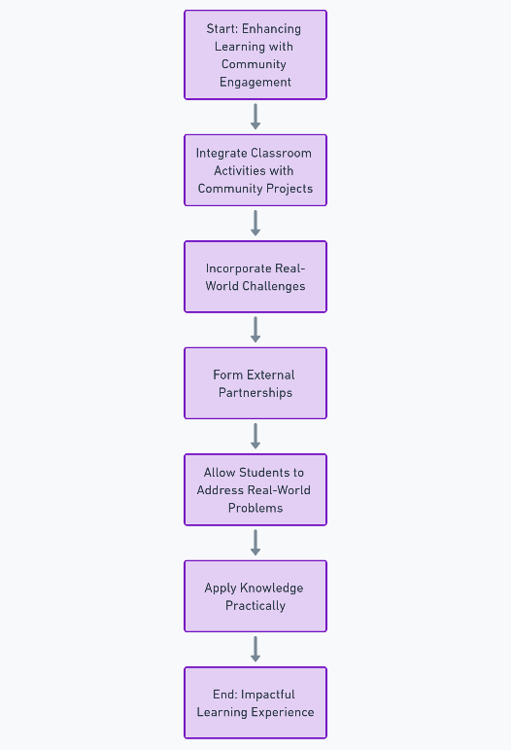
Flipping beyond the classroom Community and real-world engagement
Emphasize integrating classroom activities with community engagement and real-world challenges to make learning more impactful. Incorporate community projects and external partnerships into learning, allowing students to address real-world problems and apply their knowledge practically.
Made with AI
Funded by the European Union. Views and opinions expressed are however those of the author(s) only and do not necessarily reflect those of the European Union or the European Education and Culture Executive Agency (EACEA). Neither the European Union nor EACEA can be held responsible for them.

Slide 20
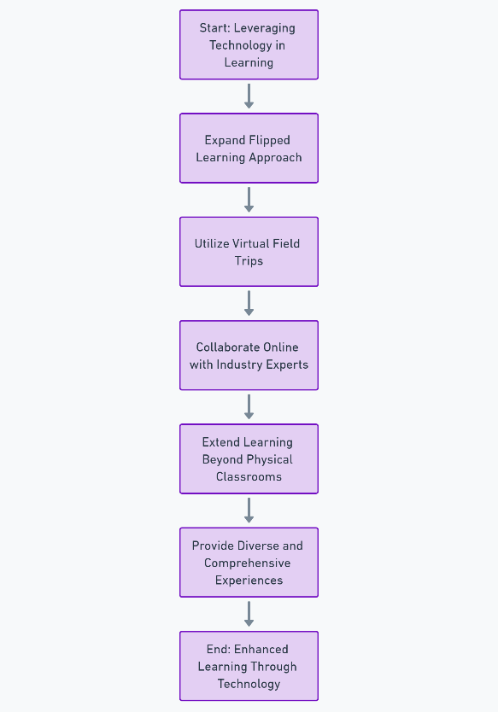
Flipping beyond the classroom Leveraging technology for wider application
Utilize technology to expand the flipped learning approach, using tools like virtual field trips and online collaborations with industry experts. Technological integration extends learning beyond physical classrooms, offering students diverse and comprehensive learning experiences.
Made with AI
Funded by the European Union. Views and opinions expressed are however those of the author(s) only and do not necessarily reflect those of the European Union or the European Education and Culture Executive Agency (EACEA). Neither the European Union nor EACEA can be held responsible for them.

Slide 21
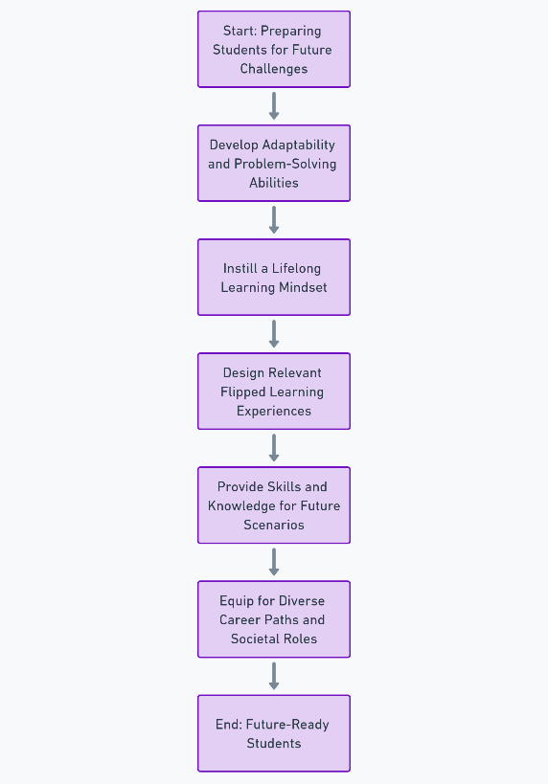
Flipping beyond the classroom Preparing students for future challenges
Focus the flipped classroom on preparing students for future challenges by developing adaptability, problem-solving abilities, and a lifelong learning mindset. Design flipped learning experiences that provide students with relevant skills and knowledge for various future scenarios, equipping them for diverse career paths and societal roles.
Made with AI
Funded by the European Union. Views and opinions expressed are however those of the author(s) only and do not necessarily reflect those of the European Union or the European Education and Culture Executive Agency (EACEA). Neither the European Union nor EACEA can be held responsible for them.

Slide 22
Fostering independent learning in flipped classrooms
Encourage students to take charge of their learning journey in the flipped classroom. Guide them to set personal learning goals and seek out resources independently.
This approach fosters a sense of ownership and responsibility, critical for lifelong learning.
Funded by the European Union. Views and opinions expressed are however those of the author(s) only and do not necessarily reflect those of the European Union or the European Education and Culture Executive Agency (EACEA). Neither the European Union nor EACEA can be held responsible for them.

Slide 23
Fostering independent learning in flipped classrooms Tools and strategies for independence
Helping students become more independent supports lifelong learning. By giving them useful tools and strategies, educators can encourage students to take control of their own learning journey.
Educational Apps: Fun, interactive apps let students practice and reinforce skills on their own.
Self-Directed Learning Tools
Online Research Platforms: Tools like Google Scholar help students dive deeper into topics that interest them.
Learning Journals: Journals help students reflect on their progress and identify areas for improvement.
Funded by the European Union. Views and opinions expressed are however those of the author(s) only and do not necessarily reflect those of the European Union or the European Education and Culture Executive Agency (EACEA). Neither the European Union nor EACEA can be held responsible for them.

Slide 24
Fostering independent learning in flipped classrooms Tools and strategies for independence
Exploring Subjects: Show students how to use apps and research tools to engage more deeply with what they’re learning.
Encouraging Autonomy: Equip students with tools and strategies so they can explore topics at their own pace, boosting their curiosity and confidence.
Teaching Effective Tool Use
Funded by the European Union. Views and opinions expressed are however those of the author(s) only and do not necessarily reflect those of the European Union or the European Education and Culture Executive Agency (EACEA). Neither the European Union nor EACEA can be held responsible for them.

Slide 25
Fostering independent learning in flipped classrooms Building critical thinking skills
Focus on developing students' critical thinking and problem-solving skills. Encourage them to question, analyze, and synthesize information from their independent studies. Use in-class time to challenge students with tasks that require application of their independently-gained knowledge.
While promoting independence, provide consistent guidance and support. Regular check-ins and feedback sessions help ensure students are on track and engaged. Create a classroom culture where seeking help is encouraged and viewed as a part of the learning process.
Funded by the European Union. Views and opinions expressed are however those of the author(s) only and do not necessarily reflect those of the European Union or the European Education and Culture Executive Agency (EACEA). Neither the European Union nor EACEA can be held responsible for them.

Slide 26
Integrating Formative Assessments in a Flipped Classroom
Create assessments that match the goals of the flipped classroom and keep them varied to suit different learning styles. Blend assessments into both online and in-class activities to give a full picture of student progress.
Feedback as a Tool for Growth: Focus on giving helpful, constructive feedback that guides students toward improvement. Encourage students to reflect on the feedback and use it to strengthen their understanding.
Student Participation in Assessment Design: Let students take part in designing some assessments, like peer reviews or quizzes. This involvement helps them engage more deeply with the material and gives them insight into the assessment process.
Check out this article by Eberly Center on the difference between formative and summative assessment: https://www.cmu.edu/teaching/assessment/basics/formative-summative.html
Funded by the European Union. Views and opinions expressed are however those of the author(s) only and do not necessarily reflect those of the European Union or the European Education and Culture Executive Agency (EACEA). Neither the European Union nor EACEA can be held responsible for them.

Slide 27
Enhancing collaboration in flipped learning
Promoting Collaborative Skills:
Emphasize the importance of teamwork and collaboration in the flipped classroom setting. Discuss how these skills are vital for both academic success and future career preparedness.
Introduce activities that require group work and collaborative problem-solving, fostering peer interaction and cooperative learning.
Funded by the European Union. Views and opinions expressed are however those of the author(s) only and do not necessarily reflect those of the European Union or the European Education and Culture Executive Agency (EACEA). Neither the European Union nor EACEA can be held responsible for them.

Slide 28
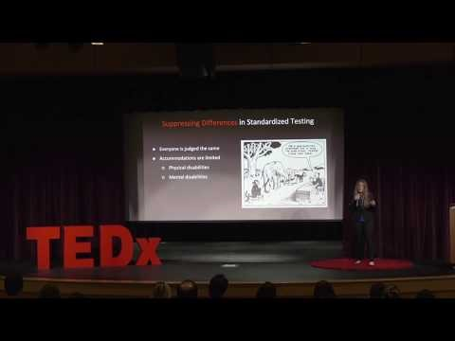
Enhancing collaboration in flipped learning
Watch this video by Maddie Edwards to understand how collaborative learning can transform group projects from unproductive to highly effective.
In the video, Maddie shares her personal experiences with traditional group work and how collaborative learning, when properly structured, can leverage individual strengths, enhance engagement, and create meaningful, supportive team dynamics. She also highlights five key strategies to foster effective collaboration, which can be directly applied in flipped learning environments
https://www.youtube.com/watch?v=-WG1CoPgJfY
Funded by the European Union. Views and opinions expressed are however those of the author(s) only and do not necessarily reflect those of the European Union or the European Education and Culture Executive Agency (EACEA). Neither the European Union nor EACEA can be held responsible for them.

Slide 29
Enhancing collaboration in flipped learning
Tools for Facilitating Collaboration:
Leverage digital tools to facilitate collaboration, both in and out of the classroom. This includes using platforms like online discussion forums, collaborative document editors, or project management tools.
Provide guidelines and training on how to use these tools effectively for group projects and collaborative activities.
Building a Community of Learners:
Focus on creating a supportive learning environment where students feel comfortable sharing ideas and working together.
Implement strategies like peer reviews, study groups, and discussion circles to encourage a sense of community and mutual support among students.
Assessing Group Work:
Develop fair and transparent methods to assess group projects and collaborative activities. Include criteria for individual contributions as well as group dynamics.
Consider self and peer assessments as part of the evaluation process to promote accountability and reflection on collaborative skills.
Funded by the European Union. Views and opinions expressed are however those of the author(s) only and do not necessarily reflect those of the European Union or the European Education and Culture Executive Agency (EACEA). Neither the European Union nor EACEA can be held responsible for them.

Slide 30
Reflection Activity
1.Reflect on Your Current Approach:
Reflect on your current teaching methodologies. How do they align with the flipped classroom model? Identify areas that could benefit from flipping.
2.Plan a Flipped Lesson:
Choose a topic or lesson you currently teach. Reimagine it using the flipped classroom model. Outline what students will do at home (e.g., watching videos, reading materials) and in-class activities (e.g., discussions, projects).
3.Integrate New Strategies:
Incorporate at least two new strategies discussed in Unit 4.4 into your lesson plan. This could include specific technology tools, formative assessment techniques, or methods for fostering independent learning.
Funded by the European Union. Views and opinions expressed are however those of the author(s) only and do not necessarily reflect those of the European Union or the European Education and Culture Executive Agency (EACEA). Neither the European Union nor EACEA can be held responsible for them.

Slide 31
Reflection Activity
4.Peer Review and Feedback:
If possible, share your flipped lesson plan with a colleague for feedback. Discuss what might work well and what challenges could arise.
5.Implementation and Reflection:
Implement the flipped lesson in your classroom (if feasible). Afterward, reflect on the experience. What worked well? What challenges did you face? How did students respond?
6.Evaluate and Adjust:
Based on your reflection and student feedback, identify adjustments to improve the experience. Consider aspects like student engagement, understanding of the material, and overall classroom dynamics.
7.Journaling:
Keep a reflective journal of your experiences with flipped classroom strategies. Note any insights, successes, or areas for growth.
Funded by the European Union. Views and opinions expressed are however those of the author(s) only and do not necessarily reflect those of the European Union or the European Education and Culture Executive Agency (EACEA). Neither the European Union nor EACEA can be held responsible for them.

Slide 32
Additional Resources
Books:
The Flipped Classroom: Practice and Practices in Higher Education" by Carl Reidsema, Lydia Kavanagh, Roger Hadgraft, and Neville Smith
Journal Articles:
Bosio, Giulio; Origo, Federica (2019) : Who Gains from Active Learning in Higher Education?, IZA Discussion Papers, No. 12445, Institute of Labor Economics (IZA), Bonn Ribeiro Silva, Elsa & Amorim, Catarina & Aparicio, José & Batista, Paula. (2022).
Trends of Active Learning in Higher Education and Students’ Well-Being: A Literature Review. Frontiers in Psychology.
Online Articles:
13 interactive presentation ideas to engage students in class (2023). Dana Corey for Avocor: https://www.avocor.com/blog/interactive-presentation-ideas-for-classroom/
Flip the learning in your classroom. Avid: https://avidopenaccess.org/resource/flip-the-learning-in-your-classroom/
Blended Learning: Combining Online and In-Person Instruction (2023). Learn Now: https://www.learnow.live/blog/blended-learning-combining-online-and-in-person-instruction
Funded by the European Union. Views and opinions expressed are however those of the author(s) only and do not necessarily reflect those of the European Union or the European Education and Culture Executive Agency (EACEA). Neither the European Union nor EACEA can be held responsible for them.

Slide 33
Additional Resources
10 Time Management Skills and Techniques for Students (2023). Simpli Learn: https://www.simplilearn.com/tutorials/time-management-tutorial/best-time-management-tips-for-students
6 types of assessment and how to use them (2024). Maria Kampen: https://www.prodigygame.com/main-en/blog/types-of-assessment/
Question: How Do You Use Student Feedback to Change Your Practice (2023). Edutopia: https://www.edutopia.org/article/question-change-teaching-practice-student-feedback/
Video
Creating a Better Future Through Collaborative Learning | Maddie Edwards | TEDxYouth@Brambleton (2019). https://www.youtube.com/watch?v=-WG1CoPgJfY
Funded by the European Union. Views and opinions expressed are however those of the author(s) only and do not necessarily reflect those of the European Union or the European Education and Culture Executive Agency (EACEA). Neither the European Union nor EACEA can be held responsible for them.

Slide 34
Icons Library

