Slide 1




CollaboratiVET Curriculum for VET teachers/trainers/educators
Module 4: Implementing the Flipped Classroom Approach and Collaborative Learning
Unit 3 - Blended Learning in Action: Integrating Online and In-Person Components
Funded by the European Union. Views and opinions expressed are however those of the author(s) only and do not necessarily reflect those of the European Union or the European Education and Culture Executive Agency (EACEA). Neither the European Union nor EACEA can be held responsible for them.

Slide 2



Learning Objectives
  Understand the Role of Energizers
  Identify Effective Modalities for Various Content
  Apply Multimedia Tools in Teaching
  Facilitate Self-Paced Online Learning
  Design Application-Oriented Activities

Slide 3
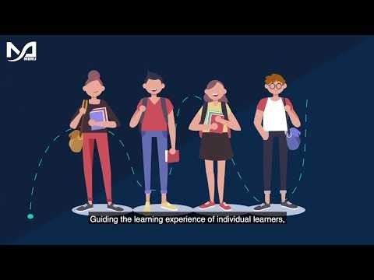
Understanding blended learning
Blended learning is an educational approach that combines online educational materials and opportunities for interaction online with traditional place-based classroom methods.
Watch this short video on Blended Learning by MBRU:
It requires the physical presence of both teacher and student, with some element of student control over time, place, path, or pace.
This approach integrates the benefits of face-to-face instruction with the flexibility of online learning, aiming to provide a more personalized and engaging learning experience.
https://www.youtube.com/watch?v=-bwhR1ZKGRE
Funded by the European Union. Views and opinions expressed are however those of the author(s) only and do not necessarily reflect those of the European Union or the European Education and Culture Executive Agency (EACEA). Neither the European Union nor EACEA can be held responsible for them.

Slide 4

Understanding Blended Learning
For students, online learning brings flexibility, letting them learn at their own pace and access resources whenever they need. It also makes learning more engaging with interactive materials that suit different learning styles. Plus, there's a wealth of online resources like videos and tools available for easy access. Online learning encourages students to take charge of their learning, promoting critical thinking and independence.
Funded by the European Union. Views and opinions expressed are however those of the author(s) only and do not necessarily reflect those of the European Union or the European Education and Culture Executive Agency (EACEA). Neither the European Union nor EACEA can be held responsible for them.

Slide 5
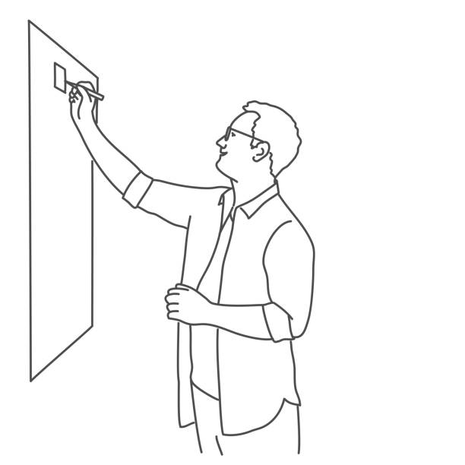
Blended learning represents a shift towards amore integrated, flexible, and student-centered approach to education, leveraging the strengths of both traditional and digital learning environments.
Understanding Blended Learning
learning environments.
For teachers, online teaching offers diverse methods to keep lessons dynamic and adaptable. It makes tracking student progress easier with real-time insights from digital tools. Teachers can interact more with students through various platforms, fostering communication and collaboration. Lastly, there are plenty of online resources to enrich lesson plans and make teaching more effective.
Funded by the European Union. Views and opinions expressed are however those of the author(s) only and do not necessarily reflect those of the European Union or the European Education and Culture Executive Agency (EACEA). Neither the European Union nor EACEA can be held responsible for them.

Slide 6



The need for balance
Blended learning isn't just about combining online and offline modalities; it's also about balancing energy levels and engagement to optimize learning.
Energizers in Learning:
Definition: Short, lively activities designed to increase energy, engagement, and enthusiasm in the learning environment.
Role in Blended Learning: They break the monotony of traditional or online learning, especially when students might feel overwhelmed or disengaged.
Funded by the European Union. Views and opinions expressed are however those of the author(s) only and do not necessarily reflect those of the European Union or the European Education and Culture Executive Agency (EACEA). Neither the European Union nor EACEA can be held responsible for them.

Slide 7

The need for balance
Strategies for integrating energizers:
Scheduled Breaks: Include interactive breaks between intensive sessions.
Interactive Online Tools: Quizzes and games in online platforms to re-energize.
Physical Activities: Brief activities in person to reinvigorate students.
Benefits of using energizers:
Improved Focus: Reset attention and enhance focus.
Enhanced Engagement: Make learning more enjoyable and dynamic.
Supports Various Learning Styles: Activities cater to different preferences.
Made with AI
Funded by the European Union. Views and opinions expressed are however those of the author(s) only and do not necessarily reflect those of the European Union or the European Education and Culture Executive Agency (EACEA). Neither the European Union nor EACEA can be held responsible for them.

Slide 8

The need for balance
Tips for Effective Use!
Match the type of energizer with the learning activity that follows
Keep energizers brief and purposeful – they should energize, not distract
Solicit student feedback on energizer activities to gauge effectiveness and preference
Made with AI
Funded by the European Union. Views and opinions expressed are however those of the author(s) only and do not necessarily reflect those of the European Union or the European Education and Culture Executive Agency (EACEA). Neither the European Union nor EACEA can be held responsible for them.

Slide 9

Choosing the right modality
Blended learning combines various modalities – from traditional classroom settings to diverse online platforms. Key to successful blended learning is knowing which modality suits different types of content and learning objectives.
A simple way to help you select the right modality is to think of the following criteria:
Learning Objectives: Interactive activities for in-person learning and reflective exercises for online.
Nature of Content: Use multimedia online for complex concepts and classrooms for discussions and projects.
Student Needs and Preferences: Consider diverse learning styles and accessibility.
Examples of modality selection
Multimedia for complex topics
In-person for collaborative learning
VS
Funded by the European Union. Views and opinions expressed are however those of the author(s) only and do not necessarily reflect those of the European Union or the European Education and Culture Executive Agency (EACEA). Neither the European Union nor EACEA can be held responsible for them.

Slide 10
Examples of Modality Selection
Multimedia for Complex Topics:
Engaging with Intricate Concepts: Multimedia tools like videos, animations, and simulations help simplify complex topics by making abstract ideas more accessible.
Self-Paced Exploration: Multimedia allows students to learn at their own pace, revisiting challenging content as needed.
Use of Visual Tools: Videos, animations, and simulations engage multiple senses, making them ideal for subjects requiring visualization, like science or engineering.
In-Person for Collaborative Learning:
Direct Interaction: In-person learning promotes face-to-face communication, fostering real-time collaboration and idea exchange.
Hands-on Activities: It is ideal for hands-on tasks, like lab work or vocational training, where physical interaction with materials is required.
Immediate Feedback and Discussion: In-person instruction allows for instant feedback and dynamic discussions, enhancing student engagement and interaction.
Funded by the European Union. Views and opinions expressed are however those of the author(s) only and do not necessarily reflect those of the European Union or the European Education and Culture Executive Agency (EACEA). Neither the European Union nor EACEA can be held responsible for them.

Slide 11
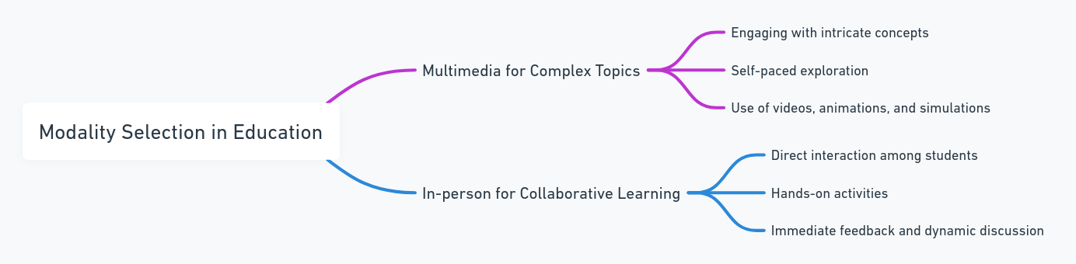
Examples of Modality Selection
Made with AI
Funded by the European Union. Views and opinions expressed are however those of the author(s) only and do not necessarily reflect those of the European Union or the European Education and Culture Executive Agency (EACEA). Neither the European Union nor EACEA can be held responsible for them.

Slide 12

Choosing the right modality
Integrating modalities effectively:
Ensure smooth transitions between online and offline components.
Use online platforms for pre-class or post-class activities to complement in-person sessions.
Encourage feedback from students to continuously refine the blend of modalities.
Benefits of Thoughtful Modality Integration
Enhanced understanding through the use of the most appropriate tools for each topic.
Greater student engagement by catering to different learning styles and preferences.
Flexibility in teaching methods, leading to more dynamic and adaptable lesson plans.
.
Let’s practice!
Plan a short lesson that integrates both online and offline components. Specify the following:
What part of the lesson is best suited for online?
What part should remain in person?
How will you transition between the two?
Funded by the European Union. Views and opinions expressed are however those of the author(s) only and do not necessarily reflect those of the European Union or the European Education and Culture Executive Agency (EACEA). Neither the European Union nor EACEA can be held responsible for them.

Slide 13

Multimedia in Teaching Complex Concepts
Multimedia tools like videos, interactive simulations and infographics transform the teaching of complex concepts. Firstly, multimedia helps students understand complex ideas better by using visuals and interactive elements. It also keeps students engaged with captivating content. Plus, it suits different learning styles, catering to auditory, visual, and kinesthetic learners.
Implementing multimedia effectively means choosing tools that match learning goals, adding interactive elements for engagement, and balancing multimedia with other teaching methods.
.
Take a look at PhET Interactive Simulations here:
https://phet.colorado.edu/
PhET is a free online platform that offers over 165 interactive math and science simulations in 121 languages. Founded in 2002 by Nobel Laureate Carl Wieman.
Funded by the European Union. Views and opinions expressed are however those of the author(s) only and do not necessarily reflect those of the European Union or the European Education and Culture Executive Agency (EACEA). Neither the European Union nor EACEA can be held responsible for them.

Slide 14


Multimedia in Teaching Complex Concepts
Watch this video by The Modern Classroom Projects to for teacher tips on creating engaging videos:
Read this article by Midori Nediger on what infographics are and how to design them:
https://venngage.com/blog/what-is-an-infographic/
https://www.youtube.com/watch?v=mjA6uVB1-TA
Funded by the European Union. Views and opinions expressed are however those of the author(s) only and do not necessarily reflect those of the European Union or the European Education and Culture Executive Agency (EACEA). Neither the European Union nor EACEA can be held responsible for them.

Slide 15
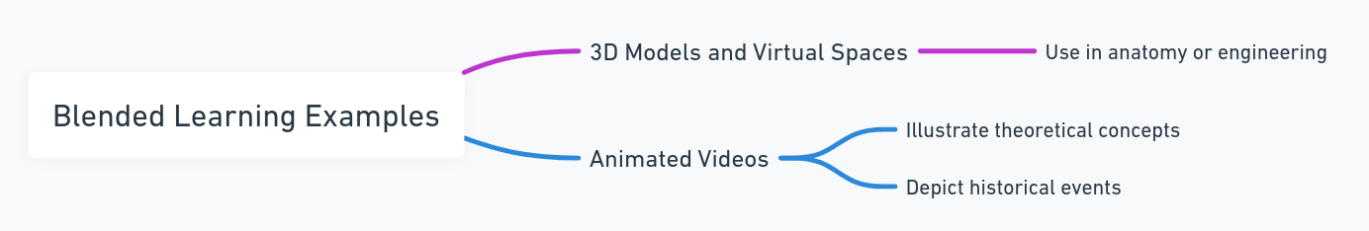
Multimedia in Teaching Complex Concepts
3D Models and Virtual Spaces:
3D models allow students to explore complex structures like the human body or mechanical systems interactively and safely, providing a deeper understanding. These immersive, hands-on tools make abstract concepts easier to understand, offering experiences beyond what traditional classrooms can provide.
.
Animated Videos:
Animated videos simplify complex concepts in subjects like science or math by visually breaking them down into step-by-step sequences.
In history, animated videos recreate key events, helping students better understand and visualize important moments.
They engage visual learners, making abstract or static information more dynamic, relatable, and memorable.
Funded by the European Union. Views and opinions expressed are however those of the author(s) only and do not necessarily reflect those of the European Union or the European Education and Culture Executive Agency (EACEA). Neither the European Union nor EACEA can be held responsible for them.

Slide 16

Multimedia in Teaching Complex Concepts
When evaluating effectiveness, it's important to keep an eye on how engaged and well students understand when using multimedia tools. Getting feedback from students helps identify areas for improvement and adjust teaching methods accordingly. In conclusion, using multimedia in blended learning is a great way to make learning engaging and effective for all students.
.
Funded by the European Union. Views and opinions expressed are however those of the author(s) only and do not necessarily reflect those of the European Union or the European Education and Culture Executive Agency (EACEA). Neither the European Union nor EACEA can be held responsible for them.

Slide 17

Engaging Students in Self-Paced Learning
Self-paced learning allows students to absorb material at their own speed, accommodating individual learning styles and needs.
It’s crucial for online components of blended learning, where students often control their pace of learning.
Read this article by Digital Learning Institute to learn about Self-Paced Learning: Definition, Benefits and Tips:
https://www.digitallearninginstitute.com/blog/what-is-self-paced-learning-definition-benefits-and-tips
Funded by the European Union. Views and opinions expressed are however those of the author(s) only and do not necessarily reflect those of the European Union or the European Education and Culture Executive Agency (EACEA). Neither the European Union nor EACEA can be held responsible for them.

Slide 18
Engaging Students in Self-Paced Learning
Challenges in self-paced learning
Ensuring consistent engagement and preventing procrastination can be challenging.
Balancing flexibility with the need to meet deadlines and complete course objectives.
Supporting Student Autonomy
Encourage goal-setting and time management skills.
Offer resources on effective study habits and self-assessment tools.
Assessment in Self-Paced Learning
Incorporate formative assessments that students can take at their own pace to gauge their understanding.
Use these assessments to provide personalized feedback and support.
Strategies for effective self-paced learning
Clear structure and guidelines
Interactive and varied content
Regular check-ins and feedback
Encouraging Peer Interaction
Facilitate online discussion forums or study groups to keep students connected and engaged with their peers.
Peer support can be instrumental in motivating students and promoting a deeper understanding of the material.
Funded by the European Union. Views and opinions expressed are however those of the author(s) only and do not necessarily reflect those of the European Union or the European Education and Culture Executive Agency (EACEA). Neither the European Union nor EACEA can be held responsible for them.

Slide 19
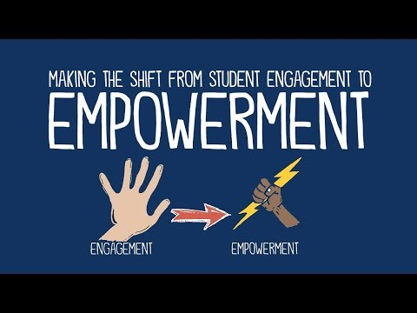
Engaging Students in Self-Paced Learning
Watch this video by John Spenser on the shift from engaging students to empowering learners
What challenges have you encountered with self-paced learning? How could you address procrastination or disengagement?
Think of one strategy you could implement to enhance student responsibility in a self-paced environment.
https://www.youtube.com/watch?v=BYBJQ5rIFjA
Funded by the European Union. Views and opinions expressed are however those of the author(s) only and do not necessarily reflect those of the European Union or the European Education and Culture Executive Agency (EACEA). Neither the European Union nor EACEA can be held responsible for them.

Slide 20

Designing Application-Oriented Activities
Focus on Practical Application
Emphasize the importance of activities that enable students to apply what they've learned in practical scenarios, bridging the gap between theory and practice.
Key Aspects of Application-Oriented Activities
Relevance: Design activities that are closely related to real-world scenarios to make the learning more applicable and meaningful.
Creativity: Encourage students to think creatively and innovatively in applying concepts, fostering problem-solving skills.
Collaboration: Incorporate group projects or tasks that require teamwork, simulating real-life collaborative environments.
Funded by the European Union. Views and opinions expressed are however those of the author(s) only and do not necessarily reflect those of the European Union or the European Education and Culture Executive Agency (EACEA). Neither the European Union nor EACEA can be held responsible for them.

Slide 21
Designing Application-Oriented Activities
Read this article by Harvard University on how to make real world connections to course material: https://ablconnect.harvard.edu/make-real-world-connections-course-material
Implementing application-oriented activities effectively involves providing clear instructions, using diverse methods like case studies, and offering ongoing feedback.
These activities should engage students and cater to different learning styles. When assessing them, it's important to evaluate both the process and the product. Overall, application-oriented activities in blended learning deepen understanding and engagement among students.
Read this article by Drexel to learn how to inspire creativity in the classroom: https://drexel.edu/soe/resources/teacher-resources/inspire-creativity-in-the-classroom/
Read this digest to get ideas on how collaborative learning and teamwork work in simulations: https://fastercapital.com/topics/collaborative-learning-and-teamwork-in-simulation-centers.html
Funded by the European Union. Views and opinions expressed are however those of the author(s) only and do not necessarily reflect those of the European Union or the European Education and Culture Executive Agency (EACEA). Neither the European Union nor EACEA can be held responsible for them.

Slide 22
Assessment strategies in blended learning
Blended learning environments require a multifaceted approach to assessment, combining traditional and digital methodologies to evaluate student performance effectively
Key assessment strategies:
Formative Assessments: Regular, informal assessments like quizzes and discussions to monitor ongoing progress.
Summative Assessments: Formal evaluations, such as exams or projects, to assess overall comprehension.
Digital Tools: Online platforms for efficient tracking and feedback.
Peer and Self-Assessment: Encouraging reflective and critical thinking skills.
Funded by the European Union. Views and opinions expressed are however those of the author(s) only and do not necessarily reflect those of the European Union or the European Education and Culture Executive Agency (EACEA). Neither the European Union nor EACEA can be held responsible for them.

Slide 23
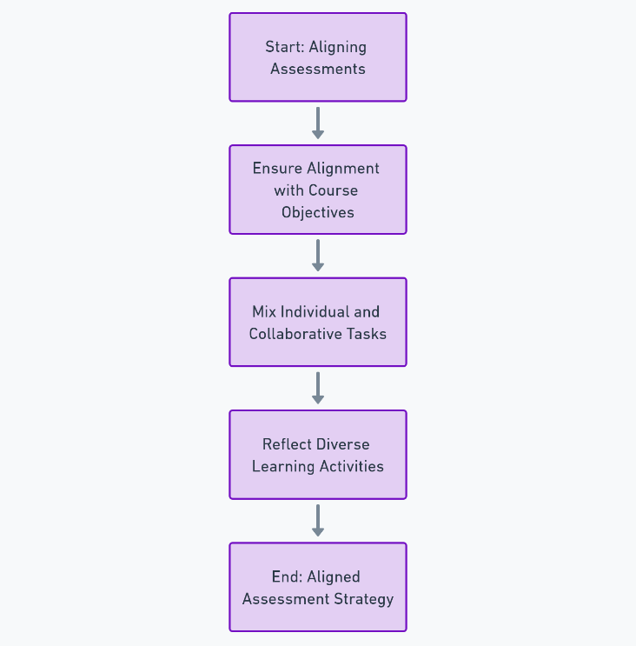

Assessment strategies in blended learning
Aligning assessments with learning goals is essential in blended courses, ensuring they match course objectives. Tasks should vary between individual and collaborative efforts to mirror the diverse learning activities.
Made with AI
Made with AI
Funded by the European Union. Views and opinions expressed are however those of the author(s) only and do not necessarily reflect those of the European Union or the European Education and Culture Executive Agency (EACEA). Neither the European Union nor EACEA can be held responsible for them.

Slide 24
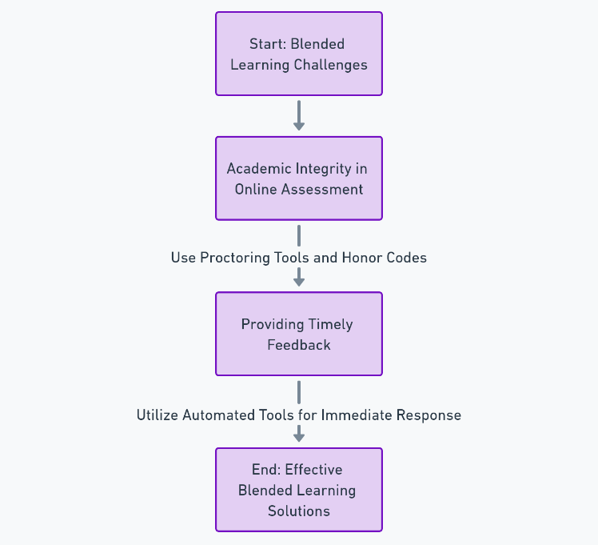

Assessment strategies in blended learning
Challenges such as maintaining academic integrity, can be addressed through various strategies. Providing timely feedback is crucial, particularly in online settings, to support student learning effectively.
Made with AI
Made with AI
Funded by the European Union. Views and opinions expressed are however those of the author(s) only and do not necessarily reflect those of the European Union or the European Education and Culture Executive Agency (EACEA). Neither the European Union nor EACEA can be held responsible for them.

Slide 25


Overcoming challenges in blended learning
Technological barriers
Low tech solutions, Resource support
Maintaining student engagement
Interactive teaching, Tailored content
Managing workload
Balance assignments, Clear guidelines
Funded by the European Union. Views and opinions expressed are however those of the author(s) only and do not necessarily reflect those of the European Union or the European Education and Culture Executive Agency (EACEA). Neither the European Union nor EACEA can be held responsible for them.

Slide 26
Overcoming challenges in blended learning
Assessment integrity
Varied assessment methods, Monitoring tools
Teacher training and preparedness
Professional development, Digital tool training
Funded by the European Union. Views and opinions expressed are however those of the author(s) only and do not necessarily reflect those of the European Union or the European Education and Culture Executive Agency (EACEA). Neither the European Union nor EACEA can be held responsible for them.

Slide 27

Case Studies/ Examples of blended learning success
Implementing the Flipped classroom approach in Cambridge science teaching: the results indicated positive student experiences and perceptions of learning gains, as reflected in the quantitative data collected. Despite initial concerns about the extra preparation time required, students appreciated the opportunity for deeper engagement and understanding. Lessons learned from the implementation included the importance of articulating preparation expectations and providing guidance on video playback options. Additionally, organizing videos into shorter segments and offering transcripts for accessibility proved beneficial.
https://www.cctl.cam.ac.uk/newsletter/case-study-flipped-classroom
Funded by the European Union. Views and opinions expressed are however those of the author(s) only and do not necessarily reflect those of the European Union or the European Education and Culture Executive Agency (EACEA). Neither the European Union nor EACEA can be held responsible for them.

Slide 28
Case Studies/ Examples of blended learning success
A Case Study of Teachers’ Experiences of Blended Teaching and Learning by Diane Cunningham: The study specifically examines the beliefs and practices of four high school teachers, scrutinizing their experiences through interviews, observation data, and artifact analysis. These educators, each with varying lengths of career experience, were observed to effectively integrate their beliefs into their teaching methods within the blended learning context. Their approaches centered on promoting active, authentic learning for students, with the teachers viewing themselves as facilitators, coaches, guides, and co-learners.
https://files.eric.ed.gov/fulltext/EJ1301080.pdf
Funded by the European Union. Views and opinions expressed are however those of the author(s) only and do not necessarily reflect those of the European Union or the European Education and Culture Executive Agency (EACEA). Neither the European Union nor EACEA can be held responsible for them.

Slide 29
Case Studies/ Examples of blended learning success
Anytime Anywhere, Blended learning using live streaming at Deakin University: This study highlights the dynamic interplay between technology, teaching methods, and student engagement. In these studies, live streaming was integrated into the blended learning framework to bridge the gap between off-campus and on-campus students, enhancing real-time interaction and collaboration. This approach sought to make learning experiences more personal, relevant, and engaging, addressing the challenge of adapting to students’ desires for flexibility and accessibility in their education.
https://er.educause.edu/articles/2015/7/anytime-and-anywhere-a-case-study-for-blended-learning
Funded by the European Union. Views and opinions expressed are however those of the author(s) only and do not necessarily reflect those of the European Union or the European Education and Culture Executive Agency (EACEA). Neither the European Union nor EACEA can be held responsible for them.

Slide 30

Reflection Activity
1. Reflect on Your Current Teaching Methods:
  Think about your current teaching approach. How much do you currently integrate online and in-person components?
  Identify one aspect of your teaching that could benefit most from a more blended approach.
2. Analyze a Blended Learning Scenario:
  Reflect on one of the case studies discussed in this unit or conceive a similar scenario relevant to your context.
  Identify what makes the blended learning approach effective in this scenario and how similar strategies might be applied in your teaching.
3. Plan a Blended Learning Activity:
  Design a rough plan for a blended learning activity you could implement. Consider the balance of online and offline elements and how they complement each other.
  Think about the learning objectives, resources needed, and how you will assess student learning.
How has your understanding of blended learning changed after this unit?
Funded by the European Union. Views and opinions expressed are however those of the author(s) only and do not necessarily reflect those of the European Union or the European Education and Culture Executive Agency (EACEA). Neither the European Union nor EACEA can be held responsible for them.

Slide 31
Reflection Activity
6. Address Potential Challenges:
  Consider potential challenges you might face implementing this activity (technological barriers, student engagement, etc.).
  Brainstorm possible solutions or strategies to overcome these challenges.
7. Personal Development Goals:
  Reflect on what skills or knowledge you need to develop to effectively implement blended learning strategies.
  Set one or two personal development goals related to blended learning.
8. Feedback and Sharing:
  If possible, share your plan and reflections with a colleague or in a teacher’s forum for feedback.
  Discuss how blended learning strategies can be adapted and applied in different educational contexts.
What is one action you will commit to in order to enhance your teaching practice using blended learning approaches?
Funded by the European Union. Views and opinions expressed are however those of the author(s) only and do not necessarily reflect those of the European Union or the European Education and Culture Executive Agency (EACEA). Neither the European Union nor EACEA can be held responsible for them.

Slide 32
Additional Resources
Books:
Blended: Using Disruptive Innovation to Improve Schools, by Michael B. Horn and Heather Staker
The Handbook of Blended Learning: Global Perspectives, Local Designs, by Curtis J. Bonk and Charles R. Graham
Online Articles:
https://members.aect.org/pdf/Proceedings/proceedings13/2013i/13_21.pdf
Harvard University. How to make real world connections to course material:
https://ablconnect.harvard.edu/make-real-world-connections-course-material
Drexel. How to inspire creativity in the classroom:
https://drexel.edu/soe/resources/teacher-resources/inspire-creativity-in-the-classroom
How collaborative learning and teamwork in simulations:
https://fastercapital.com/topics/collaborative-learning-and-teamwork-in-simulation-centers.html
Read this article by Midori Nediger on what infographics are and how to design them:
https://venngage.com/blog/what-is-an-infographic/
Read this article by Digital Learning Institute to learn about Self-Paced Learning: Definition, Benefits and Tips: https://www.digitallearninginstitute.com/blog/what-is-self-paced-learning-definition-benefits-and-tips
.
Funded by the European Union. Views and opinions expressed are however those of the author(s) only and do not necessarily reflect those of the European Union or the European Education and Culture Executive Agency (EACEA). Neither the European Union nor EACEA can be held responsible for them.

Slide 33
Additional Resources
Online Courses:
Coursera: https://tinyurl.com/yyhjjus5
edX: /edx-blendedx-blended-learning-with-edx
Professional Associations:
https://iste.org/blog/get-started-with-blended-learning
Videos:
MBRU (2020). What is Blended Learning:
https://www.youtube.com/watch?v=-bwhR1ZKGRE
The Modern Classrooms Project (2021). Teacher Tips| Engaging Instructional Videos: https://www.youtube.com/watch?v=mjA6uVB1-TA
John Spencer (2019). The shift from engaging students to empowering learners: https://www.youtube.com/watch?v=BYBJQ5rIFjA
.
Funded by the European Union. Views and opinions expressed are however those of the author(s) only and do not necessarily reflect those of the European Union or the European Education and Culture Executive Agency (EACEA). Neither the European Union nor EACEA can be held responsible for them.

Slide 34






Icons Library

