Slide 1
CollaboratiVET Curriculum for VET teachers/trainers/educators
Module 4: Implementing the Flipped Classroom Approach and Collaborative learning
Unit 2 - Facilitating in-class collaborative activities: Techniques and best practices
Funded by the European Union. Views and opinions expressed are however those of the author(s) only and do not necessarily reflect those of the European Union or the European Education and Culture Executive Agency (EACEA). Neither the European Union nor EACEA can be held responsible for them.

Slide 2
Learning Objectives
Understand the role of the teacher as a knowledge manager
Navigate and integrate various forms of knowledge in the classroom
Implement role-playing as an educational strategy
Personalise collaborative learning activities
Facilitate constructive interactions among students
Promote student autonomy and responsibility in learning
Assess and enhance collaborative learning

Slide 3
Understand the role of the teacher as a knowledge manager
In the flipped classroom model, the teacher transitions from the traditional role of the primary knowledge provider to a facilitator of knowledge discovery and application. This shift involves guiding students through their own learning journeys, encouraging active seeking and organization of information. As knowledge managers, teachers play a critical role in helping students structure new information in a way that is meaningful, thus facilitating easier recall and application.
Evolves from being the sole source of knowledge to a facilitator of knowledge discovery and application.
Guides students through the process of knowledge acquisition.
The teacher:
Helps students structure newly acquired information in a meaningful way, facilitating easier recall and application.
Helps students structure newly acquired information in a meaningful way, facilitating easier recall and application
Supports students as they integrate new information with existing knowledge.
Fosters an environment of knowledge innovation, prompting students to think critically and creatively to produce original ideas and solutions.
Funded by the European Union. Views and opinions expressed are however those of the author(s) only and do not necessarily reflect those of the European Union or the European Education and Culture Executive Agency (EACEA). Neither the European Union nor EACEA can be held responsible for them.

Slide 4
Understand the role of the teacher as a knowledge manager
The teacher has to:
Carefully select and organize resources and activities that are both relevant and challenging, tailored to meet the diverse needs of students.
Encourage an environment where collaboration and dialogue are central, enhancing the depth and breadth of learning experiences.
Balance various perspectives and information sources to guide students towards a coherent and comprehensive understanding.
Inspire students to extend beyond mere understanding to creating and contributing new knowledge, fostering a culture of innovation and critical thinking.
O
U
T
C
O
M
E
S
A learning environment where students actively participate in the creation and management of their knowledge, leading to a deeper learning and greater retention
Students are equipped with skills not just for the classroom, but for lifelong learning and problem-solving in varied contexts
Funded by the European Union. Views and opinions expressed are however those of the author(s) only and do not necessarily reflect those of the European Union or the European Education and Culture Executive Agency (EACEA). Neither the European Union nor EACEA can be held responsible for them.

Slide 5
Mystery Box Challenge: Unbox the Knowledge
How to play
Imagine that each role of the teacher as a knowledge manager is a mystery box that needs to be "unboxed" and solved!
You will receive clues about what’s inside each box (which corresponds to one of the teacher's roles) and then complete the challenge associated with that box.
Each task is reflective, allowing you to design, reflect, and think critically about how to apply these roles on your own.
Funded by the European Union. Views and opinions expressed are however those of the author(s) only and do not necessarily reflect those of the European Union or the European Education and Culture Executive Agency (EACEA). Neither the European Union nor EACEA can be held responsible for them.

Slide 6
Mystery Box Challenge: Unbox the Knowledge The boxes
In a world of information overload, your role is to curate the right resources. What will you choose?
Select and curate resources for a specific lesson topic.
Choose:
1 high-quality source and explain why it’s useful
1 misleading source and explain why it’s problematic
1 non-traditional source (e.g., a meme or social media post) and explain how it can engage the students
You’ve curated the resources, but now you need to guide your students through them. How will you facilitate their learning journey?
Create a learning pathway using the curated resources.
Provide 2 key questions to help students link theory to practice.
Describe how you would assist struggling students without giving direct answers.
In the professional world, multiple perspectives and approaches are inevitable. How will you help your students navigate these differing viewpoints?
Imagine a scenario with competing perspectives in your field.
Create an exercise where students compare two views and explain how they’d combine them in their approach.
Reflect on how you'd help students critically evaluate both without showing bias
Your final challenge is to inspire your students to apply what they’ve learned in innovative ways. How will you encourage creativity?
Design a project where students solve a real-world problem using lesson knowledge.
Select a format for presenting their solution.
Reflect on how you'll encourage creativity and innovation beyond what they’ve learned.
Funded by the European Union. Views and opinions expressed are however those of the author(s) only and do not necessarily reflect those of the European Union or the European Education and Culture Executive Agency (EACEA). Neither the European Union nor EACEA can be held responsible for them.

Slide 7
Navigate and integrate various forms of knowledge in the classroom
Facilitating Knowledge Navigation
The vast sea of available information in today’s digital age makes it essential for teachers to guide students in navigating and integrating various forms of knowledge. The role involves teaching students to discern credible sources, make connections between different pieces of knowledge, and fit them into a broader context. This approach encourages cross-disciplinary thinking and a more holistic understanding of subjects.
Funded by the European Union. Views and opinions expressed are however those of the author(s) only and do not necessarily reflect those of the European Union or the European Education and Culture Executive Agency (EACEA). Neither the European Union nor EACEA can be held responsible for them.

Slide 8
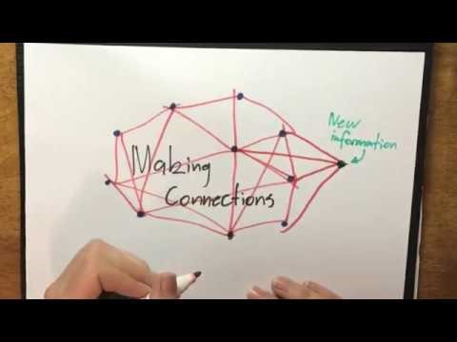
Navigate and integrate various forms of knowledge in the classroom
Teachers act as navigators, steering students through an extensive array of information and helping them identify what is most relevant and credible. They demonstrate how to connect different knowledge areas, fostering a mindset that appreciates the interconnectedness of various disciplines.
Integrating Knowledge Forms:
Competing Knowledge: Address different viewpoints and theories, turning debate into a learning opportunity.
Complementary Knowledge: Show how different information pieces can work together for a more comprehensive understanding.
Unique Contributions: Each student brings their insights, enriching the collective learning experience.
Common Ground: Establish a base of shared knowledge for all students to expand upon, ensuring a unified starting point for deeper exploration.
Watch this video by Mr H's Learning Resources to understand the the metacognitive strategy of making connections for reading comprehension:
https://www.youtube.com/watch?v=lLPb1JAkdtc&t=128s
Funded by the European Union. Views and opinions expressed are however those of the author(s) only and do not necessarily reflect those of the European Union or the European Education and Culture Executive Agency (EACEA). Neither the European Union nor EACEA can be held responsible for them.

Slide 9
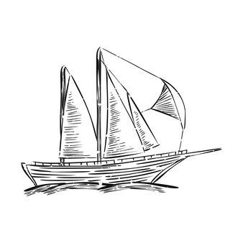
Navigate and integrate various forms of knowledge in the classroom
In class strategies:
Collaborative Learning: Implement group activities where knowledge is shared and synthesized collectively.
Problem-Based Learning: Pose real-world problems requiring an amalgamation of various knowledge forms for solutions.
Peer Teaching: Facilitate opportunities for students to teach and learn from each other, sharing diverse perspectives.
As a result
Students develop a multifaceted understanding of subjects, prepared to think critically and creatively.
They learn to value diversity in thought and approach, seeing it as a resource rather than a barrier to learning.
Funded by the European Union. Views and opinions expressed are however those of the author(s) only and do not necessarily reflect those of the European Union or the European Education and Culture Executive Agency (EACEA). Neither the European Union nor EACEA can be held responsible for them.

Slide 10
Implement role-playing as an educational strategy
Role-playing in an educational setting serves as a dynamic and interactive learning activity where students simulate real-life scenarios by acting out specific roles. This method increases engagement, enhances empathy, and provides a unique way to analyze and solve problems.
Role-playing transcends traditional teaching methodologies by involving students in active, scenario-based learning. It shifts the classroom dynamics from passive listening to active participation, fostering a deeper understanding of the subject matter.
Funded by the European Union. Views and opinions expressed are however those of the author(s) only and do not necessarily reflect those of the European Union or the European Education and Culture Executive Agency (EACEA). Neither the European Union nor EACEA can be held responsible for them.

Slide 11
Implement role-playing as an educational strategy The benefits of role playing
Enhanced Engagement: Students are often more invested and involved when they can actively participate in a scenario.
Development of Soft Skills: Role-playing exercises improve essential skills like communication, negotiation, and conflict resolution.
Deeper Understanding: By embodying different perspectives, students gain a more profound and empathetic understanding of various viewpoints.
Risk-Free Practice Environment: Provides a safe space for students to practice and hone their skills before applying them in real-world situations.
Funded by the European Union. Views and opinions expressed are however those of the author(s) only and do not necessarily reflect those of the European Union or the European Education and Culture Executive Agency (EACEA). Neither the European Union nor EACEA can be held responsible for them.

Slide 12
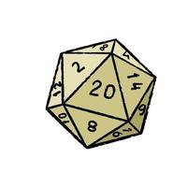
Implement role-playing as an educational strategy Role-playing strategies
Clear Objectives: Set specific goals for what the role-play intends to achieve within the learning process.
Structured Scenarios: Offer well-developed contexts and clear instructions to guide students in their roles.
Diverse Role Allocation: Ensure a variety of roles to suit different student personalities and learning styles, enhancing the inclusivity of the exercise.
Reflective Debriefing: Post-activity discussions are essential for consolidating learning and reflecting on the experience.
In a role-play, how do clear objectives and structured scenarios help you engage with the task? How can diverse role allocation benefit students with different learning styles, and why is reflective debriefing important for reinforcing what you’ve learned?
Funded by the European Union. Views and opinions expressed are however those of the author(s) only and do not necessarily reflect those of the European Union or the European Education and Culture Executive Agency (EACEA). Neither the European Union nor EACEA can be held responsible for them.

Slide 13
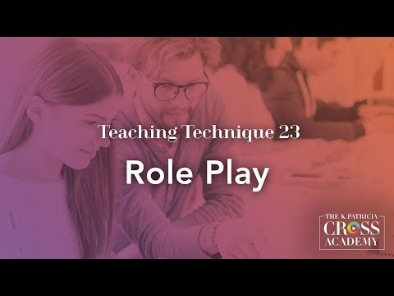
Implement role-playing as an educational strategy
Customizing role-play activities for the classroom involves considering a few important factors. Firstly, educators should create scenarios that relate to the course material and connect with students' experiences and interests. Secondly, roles should be assigned to students in a way that challenges them but also fits their strengths and comfort levels. Lastly, allowing flexibility in how roles are interpreted encourages creativity and lets students express themselves. By focusing on these aspects, educators can create engaging role-play activities that enhance student learning.
Watch this video by the K. Patricia Kross Academy to lean more about role play.
https://www.youtube.com/watch?v=ztCYENO1ydA
Funded by the European Union. Views and opinions expressed are however those of the author(s) only and do not necessarily reflect those of the European Union or the European Education and Culture Executive Agency (EACEA). Neither the European Union nor EACEA can be held responsible for them.

Slide 14
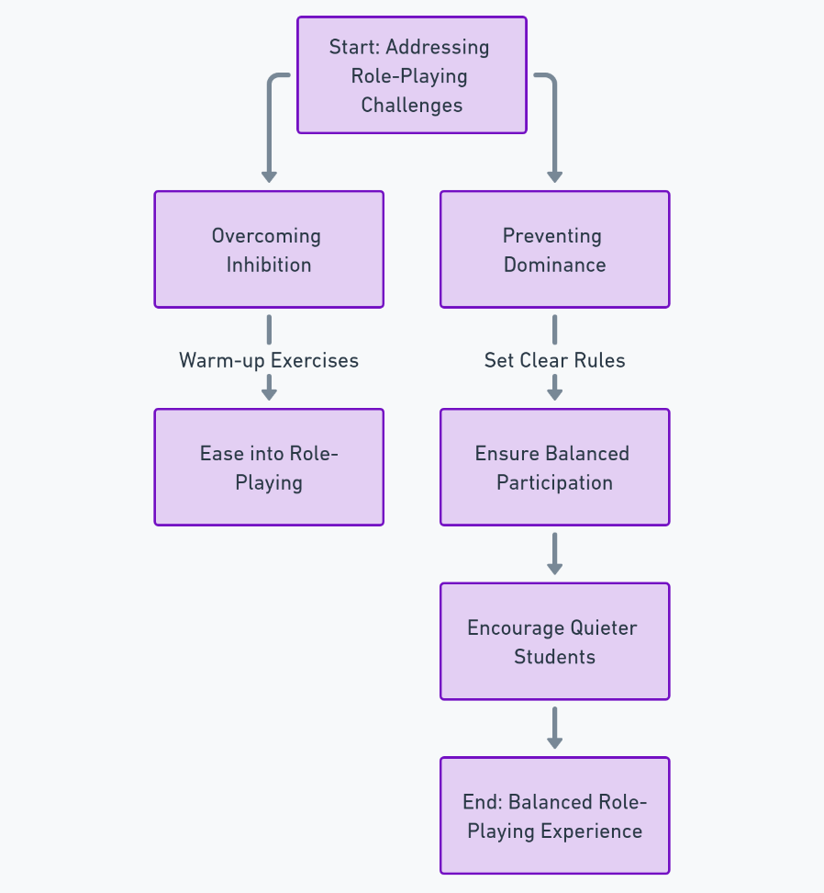
Implement role-playing as an educational strategy
Challenges and Solutions
Challenges and Solutions
Overcoming Inhibition: Some students might initially feel shy or uncomfortable. Warm-up exercises can help ease students into role-playing.
Preventing Dominance: Set clear participation rules and encourage quieter students to ensure balanced involvement.
Made with AI
Funded by the European Union. Views and opinions expressed are however those of the author(s) only and do not necessarily reflect those of the European Union or the European Education and Culture Executive Agency (EACEA). Neither the European Union nor EACEA can be held responsible for them.

Slide 15
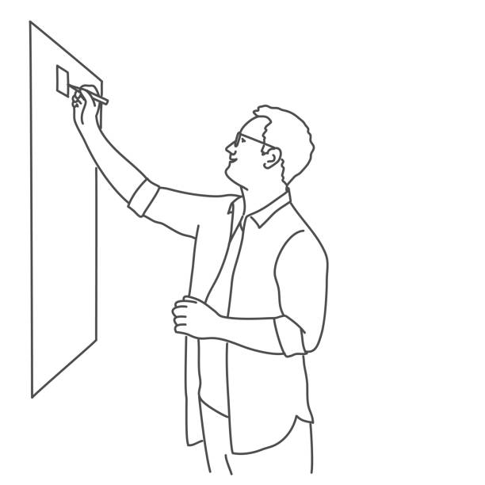
Implement role-playing as an educational strategy
One very nice approach to implement is to gradually learn the personalities of each student and what this could mean for the role they will be dealing with. On the one hand, this could be used to provide compatible roles to make the learning process more enjoyable for the student. On the other hand incompatible roles can be given to students in order to get them out of their comfort zones. If they are struggling, you may guide them to request help when necessary. Rather than struggling individually, the learner should understand that weaknesses are both challenges they can overcome and grow and opportunities to implement a bigger pool of solutions offered by the whole team.
One very nice approach to implement is to gradually learn the personalities of each student and what this could mean for the role they will be dealing with. On the one hand, this could be used to provide compatible roles to make the learning process more enjoyable for the student. On the other hand incompatible roles can be given to students in order to get them out of their comfort zones. If they are struggling, you may guide them to request help when necessary. Rather than struggling individually, the learner should understand that weaknesses are both challenges they can overcome and grow and opportunities to implement a bigger pool of solutions offered by the whole team.
Funded by the European Union. Views and opinions expressed are however those of the author(s) only and do not necessarily reflect those of the European Union or the European Education and Culture Executive Agency (EACEA). Neither the European Union nor EACEA can be held responsible for them.

Slide 16
Personalise collaborative learning activities
Tailoring for Effective Collaboration Personalizing collaborative learning activities means aligning them with the diverse needs, strengths, and interests of each student. It’s about creating an inclusive learning environment where every student can contribute meaningfully and benefit from the collective learning experience.
Funded by the European Union. Views and opinions expressed are however those of the author(s) only and do not necessarily reflect those of the European Union or the European Education and Culture Executive Agency (EACEA). Neither the European Union nor EACEA can be held responsible for them.

Slide 17
Personalised collaborative learning activities
How to do it
Understand Learner Profiles: Assess each student's individual needs, learning styles, and preferences. This understanding allows for the design of activities that resonate with each student, making learning more relevant and impactful.
Flexible Grouping: Mix and match students in different groups for various activities. This strategy encourages dynamic interaction, peer learning, and exposes students to diverse perspectives.
Choice of Roles: In group tasks, offer students roles that align with their interests and strengths. This empowerment allows them to take ownership of their learning and perform with confidence.
Inclusive Activities: Design tasks that are accessible to all students, considering different abilities and providing support where needed.
Reflective Practices: Implement reflective exercises where students contemplate their group interactions and the learning process. This practice fosters self-awareness and adaptive learning strategies.
Personalizing collaborative learning is not about individualization but about creating a rich tapestry of learning experiences that tap into the potential of each student, making the collaborative process more robust, inclusive, and effective.
Funded by the European Union. Views and opinions expressed are however those of the author(s) only and do not necessarily reflect those of the European Union or the European Education and Culture Executive Agency (EACEA). Neither the European Union nor EACEA can be held responsible for them.

Slide 18
Personalised collaborative learning activities
Benefits
Personalized collaboration brings many benefits to student learning. Firstly, it boosts engagement by making learning more relevant and interesting to each student. Secondly, it promotes fairness by recognizing and valuing the unique contributions of every student. Additionally, it encourages autonomy and motivation by giving students choices and acknowledging their achievements. Lastly, it creates a positive learning environment where students support and learn from each other. Overall, personalized collaboration helps students succeed academically while developing important social and emotional skills.
Watch this video by Edutopia on how collaborative learning builds better understanding.
https://www.youtube.com/watch?v=rWEwv_qobpU
Funded by the European Union. Views and opinions expressed are however those of the author(s) only and do not necessarily reflect those of the European Union or the European Education and Culture Executive Agency (EACEA). Neither the European Union nor EACEA can be held responsible for them.

Slide 19
Facilitate constructive interactions among students
Constructive interactions are the foundation of a collaborative and engaging learning environment. In the flipped classroom, facilitating these interactions among students is essential for nurturing critical thinking, communication skills, and the ability to work effectively in teams. Here are five ways to help you do it:
Establish Ground Rules: Set clear guidelines for respect, active listening, and equitable participation to create a supportive and productive discussion environment.
Diverse Grouping: Rotate group members regularly to expose students to a variety of perspectives and working styles.
Guided Discussions: Use thought-provoking questions to keep discussions focused and productive, ensuring they remain on track and contribute to the learning objectives.
Conflict Resolution: Equip students with strategies to address and resolve disagreements constructively, turning potential conflicts into learning opportunities
Role Assignment: Designate specific roles within group activities to ensure each student has a defined purpose and can contribute effectively.
Funded by the European Union. Views and opinions expressed are however those of the author(s) only and do not necessarily reflect those of the European Union or the European Education and Culture Executive Agency (EACEA). Neither the European Union nor EACEA can be held responsible for them.

Slide 20
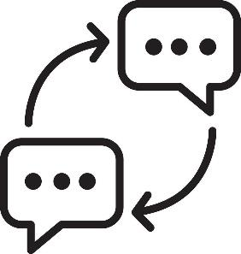
Facilitate constructive interactions among students
Measuring Interaction Quality:
Observation: Actively monitor group interactions, providing real-time guidance and feedback.
Reflection: Encourage students to reflect on their experiences in group activities, focusing on what they contributed and learned from others.
Assessment Criteria: Incorporate collaboration and interaction quality into assessment rubrics to recognize and encourage constructive participation.
Practical Ways to Promote Constructive Dialogue:
Think-Pair-Share: Encourage independent thinking, followed by sharing and discussing ideas with a partner, and eventually with the larger group.
Debate Formats: Organize structured debates where students research, present, and defend their viewpoints, fostering a deeper understanding of the topic.
Peer Review: Include sessions where students can offer constructive feedback, enhancing the learning experience through peer insights.
Funded by the European Union. Views and opinions expressed are however those of the author(s) only and do not necessarily reflect those of the European Union or the European Education and Culture Executive Agency (EACEA). Neither the European Union nor EACEA can be held responsible for them.

Slide 21
Promote student autonomy and responsibility in learning
Promoting autonomy and responsibility in students prepares them for lifelong learning and success beyond the classroom. It encourages students to take charge of their educational journey, leading to greater motivation, self-confidence, and academic performance.
Funded by the European Union. Views and opinions expressed are however those of the author(s) only and do not necessarily reflect those of the European Union or the European Education and Culture Executive Agency (EACEA). Neither the European Union nor EACEA can be held responsible for them.

Slide 22
Ways to promote student autonomy and responsibility in learning
There are different ways to foster student autonomy and responsibility in learning. We are going to introduce you to seven of them.
1. Choice and Voice: Provide opportunities for students to make choices about their learning, such as selecting topics, methods, or project approaches. This inclusion enhances their engagement and investment in the learning process.
2. Goal Setting: Support students in setting their own learning goals. Assist them in developing actionable plans to achieve these goals, fostering a sense of purpose and direction in their learning journey.
3. Self-Assessment: Equip students with the skills to evaluate their own work. Encourage them to identify areas for improvement, reinforcing their ability to critically reflect on their learning.
7. Encouraging Responsibility in Learning: Fostering responsibility in learning involves encouraging students to actively participate in and take ownership of their educational journey. This means helping them understand that their success is linked to their effort, engagement, and the steps they take to manage their own learning.
4. Individual Learning Responsibility: Motivate students to take ownership of their learning by actively seeking resources, asking questions, and engaging in self-driven exploration.
.
5. Collaborative Responsibility: In group settings, foster a sense of shared responsibility where each member contributes to and supports the learning of others.
6. Accountability Measures: Implement systems like learning contracts or peer assessments to hold students accountable for their learning progress.
Funded by the European Union. Views and opinions expressed are however those of the author(s) only and do not necessarily reflect those of the European Union or the European Education and Culture Executive Agency (EACEA). Neither the European Union nor EACEA can be held responsible for them.

Slide 23
Benefits of promoting student autonomy and responsibility in learning
1. It Empowers Students Giving students autonomy makes them active learners, taking control of their education and how they engage with the material. This boosts confidence and engagement, encouraging students to explore topics deeply and solve problems independently. For example, in a vocational setting, students might choose their own projects or methods, leading to more meaningful learning.
Funded by the European Union. Views and opinions expressed are however those of the author(s) only and do not necessarily reflect those of the European Union or the European Education and Culture Executive Agency (EACEA). Neither the European Union nor EACEA can be held responsible for them.

Slide 24
Benefits of promoting student autonomy and responsibility in learning
2. It Builds Critical Life Skills
Decision-Making and Problem-Solving: Autonomy helps students develop these skills by requiring them to make choices about their learning. These skills are crucial for success in both personal and professional life, preparing students to handle real-world challenges. For example, a student managing a group project learns to delegate, manage time, and solve conflicts, building problem-solving abilities.
Self-Regulation: Autonomy fosters self-regulation, requiring students to set goals, manage time, and stay focused. Self-regulation is key for lifelong learning and career success, helping students become independent, effective learners. For example, in a flipped classroom, students manage their study habits to prepare for class, honing their self-regulation skills.
Funded by the European Union. Views and opinions expressed are however those of the author(s) only and do not necessarily reflect those of the European Union or the European Education and Culture Executive Agency (EACEA). Neither the European Union nor EACEA can be held responsible for them.

Slide 25
Benefits of promoting student autonomy and responsibility in learning
3. It Encourages Deeper Investment
Higher Achievement Levels: When students take ownership of their learning, they become more engaged, leading to higher achievement. They set higher standards for themselves and strive to meet or exceed them. Greater investment in learning results in more effort, better outcomes, and a more meaningful educational experience.
For example, a student choosing a project they're passionate about will likely produce a more ambitious and successful outcome.
.
Increased Satisfaction: Autonomy and responsibility foster a sense of control over the learning process, boosting motivation and satisfaction. Greater satisfaction makes learning enjoyable, reduces burnout, and encourages continued engagement.
For example, a self-directed project can lead to a strong sense of accomplishment, making the learning experience more rewarding.
Funded by the European Union. Views and opinions expressed are however those of the author(s) only and do not necessarily reflect those of the European Union or the European Education and Culture Executive Agency (EACEA). Neither the European Union nor EACEA can be held responsible for them.

Slide 26
Assess and enhance collaborative learning
Why assessment matters:
Regular assessment of collaborative learning ensures that the objectives of group work are being met and identifies areas for improvement.
It provides feedback to students on their group process skills, such as communication, conflict resolution, and distribution of tasks.
Funded by the European Union. Views and opinions expressed are however those of the author(s) only and do not necessarily reflect those of the European Union or the European Education and Culture Executive Agency (EACEA). Neither the European Union nor EACEA can be held responsible for them.

Slide 27
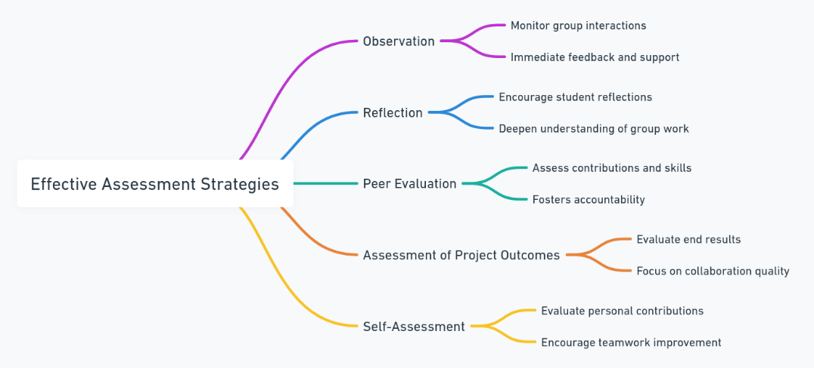
Assess and enhance collaborative learning Effective Assessment Strategies
There are several assessment strategies that have proved to be effective. Here, we are going to introduce you to five of them.
Observation: Monitor group interactions to provide immediate feedback and guide positive dynamics.
Reflection: Encourage students to reflect on their group work, enhancing understanding and future collaboration.
Peer Evaluation: Use peer assessments to promote accountability and recognize diverse strengths.
Assessment of Project Outcomes: Evaluate both the content and collaboration in group projects.
Self-Assessment: Have students assess their own contributions to foster self-awareness and improve teamwork skills.
Funded by the European Union. Views and opinions expressed are however those of the author(s) only and do not necessarily reflect those of the European Union or the European Education and Culture Executive Agency (EACEA). Neither the European Union nor EACEA can be held responsible for them.

Slide 28
Assess and enhance collaborative learning Practically enhancing collaborative learning
The classroom becomes a space where collaborative learning is continually refined, leading to improved group dynamics and more effective learning outcomes.
Students develop robust teamwork and communication skills, preparing them for collaborative challenges in academic and professional settings.
Ways to practically enhance collaborative learning!
Use assessment data to identify successful collaboration strategies and areas needing improvement.
Provide targeted feedback to groups on how to work more cohesively and efficiently.
Facilitate discussions or workshops focused on improving group dynamics and collaborative skills.
Introduce new tools or methods to keep group activities engaging and productive.
OUTCOME
Assessing and enhancing collaborative learning is an ongoing process that plays a vital role in the success of flipped classroom methodologies. It not only strengthens the learning outcomes but also enriches the students' overall educational experience, equipping them with essential skills for their future endeavors.
Funded by the European Union. Views and opinions expressed are however those of the author(s) only and do not necessarily reflect those of the European Union or the European Education and Culture Executive Agency (EACEA). Neither the European Union nor EACEA can be held responsible for them.

Slide 29
Reflection Activity
Enhancing collaborative learning practices
1. Reflect on Your Current Collaborative Practices:
List the collaborative learning techniques you currently use in your classroom.
What works well? What doesn't?
2. Identify Areas for Improvement:
Based on your reflections, identify areas where your facilitation of collaborative learning could improve.
Consider how you might better assess and support collaborative activities.
3. Plan an Implementation Strategy:
Choose one new collaborative learning technique or assessment strategy you learned about in this module.
Develop a plan for how you will implement this strategy in your classroom.
4. Set Goals:
Set specific goals for what you hope to achieve with the new strategy. How will it enhance student learning?
How will you measure the success of this new approach?
How does enhancing collaborative learning align with my teaching philosophy and goals?
Funded by the European Union. Views and opinions expressed are however those of the author(s) only and do not necessarily reflect those of the European Union or the European Education and Culture Executive Agency (EACEA). Neither the European Union nor EACEA can be held responsible for them.

Slide 30
Reflection Activity
Enhancing collaborative learning practices
5. Consider Student Autonomy:
How will the new strategy promote student autonomy and responsibility?
Think of ways to encourage students to take more active roles in managing their learning process.
6. Peer Sharing:
Share your plan with a colleague and get their feedback. What insights can they provide based on their own experiences?
Discuss how you might collaborate or support each other in implementing these strategies.
7. Reflective Journaling:
After implementing the new strategy, keep a reflective journal of observations, student feedback, and your own thoughts on the process.
Use this journal to make ongoing adjustments and document the progress towards your collaborative learning goals.
How does collaborative learning contribute to the kind of learning community I want to build in my classroom?
Funded by the European Union. Views and opinions expressed are however those of the author(s) only and do not necessarily reflect those of the European Union or the European Education and Culture Executive Agency (EACEA). Neither the European Union nor EACEA can be held responsible for them.

Slide 31
Additional resources
Books and texts:
Collaborative learning techniques: A handbook for college faculty, by Elizabeth F. Barkley, K. Particia Cross and Claire Howell Major
Making cooperative learning work, by David Johnson and Roger T. Johnson
Online resources and websites:
Team based learning collaborative https://www.teambasedlearning.org/
The Guardian teacher network https://www.theguardian.com/teacher-network/teacher-blog
Digital tools for collaboration:
Padlet https://padlet.com/
Microsoft Teams https://www.microsoft.com/en-us/microsoft-teams/group-chat-software
Google Workspace https://tinyurl.com/5dxd6rks
Videos:
Reading Comprehension: Making Connections. Mr H’s Learning Resource: https://www.youtube.com/watch?v=lLPb1JAkdtc&t=128s
Teaching Technique 23: Role Play. The K. Particia Cross Academy: https://www.youtube.com/watch?v=ztCYENO1ydA
Funded by the European Union. Views and opinions expressed are however those of the author(s) only and do not necessarily reflect those of the European Union or the European Education and Culture Executive Agency (EACEA). Neither the European Union nor EACEA can be held responsible for them.

Slide 32
Icons Library

