Slide 1
CollaboratiVET Curriculum for VET teachers/trainers/educators
Module 4: Implementing the Flipped Classroom Approach and Collaborative Learning
Unit 1 - Launching the Flipped Classroom: Implementation Strategies and Considerations
Funded by the European Union. Views and opinions expressed are however those of the author(s) only and do not necessarily reflect those of the European Union or the European Education and Culture Executive Agency (EACEA). Neither the European Union nor EACEA can be held responsible for them.

Slide 2
Learning Objectives
Understanding the Flipped Classroom Model
Evaluating the Current Teaching Practice
Implementing Ice-Breaker and Energizer activities
Addressing Student Self-Regulation and Engagement
Identifying When to Flip and When Not to
Facilitating Learning Using Online Media

Slide 3
Understanding the complexity of the Flipped Classroom Theory
The flipped classroom is an educational strategy that inverts traditional teaching methods, delivering instructional content outside of the classroom and moving activities, including those that may have traditionally been considered homework, into the classroom.
Preparation: The success of a flipped classroom depends on well-prepared pre-class materials. Teachers must create or select engaging and accessible content, such as videos and interactive lessons, which requires time, creativity, and tech skills.
Student Adjustment: Students must take more responsibility for learning outside of class and come prepared for active participation during class.
Equity: Ensuring all students have equal access to necessary technology and resources is essential, as lacking access can worsen educational inequalities in the flipped classroom model.
Assessment: Traditional assessments may not align with the flipped classroom model. Teachers need to create new methods to measure and track student progress effectively.
Why is it complex?
Pedagogical Shift: Transitioning to a flipped classroom changes the teacher's role from delivering content to guiding students in applying concepts. It shifts the focus from instruction to facilitation.
Watch this video by Blade on the challenges to flipped learning and the suggested solutions: https://www.youtube.com/watch?v=H4TQZSabHuA
Funded by the European Union. Views and opinions expressed are however those of the author(s) only and do not necessarily reflect those of the European Union or the European Education and Culture Executive Agency (EACEA). Neither the European Union nor EACEA can be held responsible for them.

Slide 4
Potential Benefits of the Flipped Classroom Theory
Despite its challenges, the flipped classroom model brings a wealth of benefits.
Enhanced Engagement:
In the flipped classroom, students engage with materials at their own pace before class, allowing them to absorb content more thoroughly. This leads to better understanding, reduces frustration, and boosts participation and confidence during in-class activities, fostering deeper engagement with the subject matter.
Deeper Classroom Interaction:
In the flipped model, class time is focused on interactive learning through discussions, collaboration, and problem-solving. This shift allows teachers to facilitate deeper understanding and peer learning, fostering critical thinking and creating a more engaging and immersive classroom experience.
Personalized Learning:
The flipped classroom allows for differentiated instruction by freeing up class time for teachers to address individual student needs. This enables personalized support for struggling students and advanced opportunities for those excelling, accommodating different learning styles and improving overall outcomes.
Funded by the European Union. Views and opinions expressed are however those of the author(s) only and do not necessarily reflect those of the European Union or the European Education and Culture Executive Agency (EACEA). Neither the European Union nor EACEA can be held responsible for them.

Slide 5
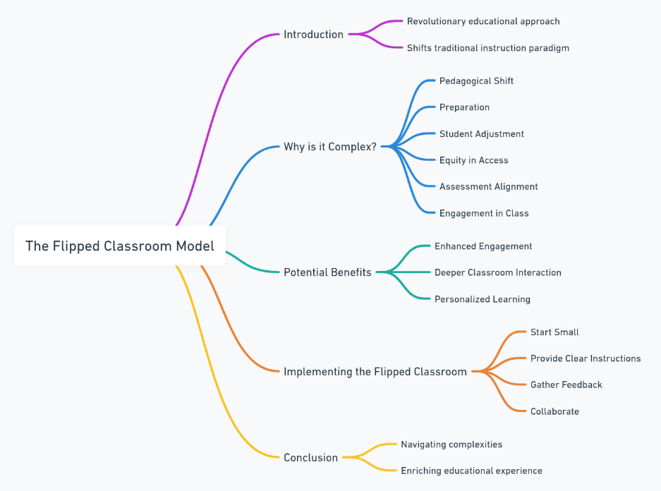
What could educators do to get the maximum benefits?
Implementing the flipped classroom effectively requires strategic planning and adaptability. Here are some practical steps for educators:
Start Small: Begin with flipping a single lesson or subject to understand the dynamics and adjust strategies accordingly.
Gather Feedback: Continuously solicit student input to refine and improve the teaching-learning process.
Provide Clear Instructions: Make sure students understand the expectations and have the resources they need for pre-class learning.
Collaborate: Share experiences and strategies with colleagues for mutual learning and support in implementing flipped classroom practices.
Funded by the European Union. Views and opinions expressed are however those of the author(s) only and do not necessarily reflect those of the European Union or the European Education and Culture Executive Agency (EACEA). Neither the European Union nor EACEA can be held responsible for them.

Slide 6
Evaluating the Current teaching Practice
Evaluating current teaching practices is essential before transitioning to a flipped classroom model. This evaluation helps in understanding the effectiveness of current methods and identifying potential areas for integration of the flipped model.
Key Considerations for Evaluation:
Student Engagement: Evaluate the level of student involvement during traditional lectures. Are students actively participating and displaying signs of engagement, or are they passive recipients of information?
Content Delivery: Assess the current method of delivering content. Does it facilitate effective learning, or is it primarily one-way communication?
Accessibility: Consider whether all students have equal access to the necessary resources for learning outside the classroom, such as technology and internet connectivity
Funded by the European Union. Views and opinions expressed are however those of the author(s) only and do not necessarily reflect those of the European Union or the European Education and Culture Executive Agency (EACEA). Neither the European Union nor EACEA can be held responsible for them.

Slide 7
Evaluating the Current teaching Practice
Homework and Assignments: Analyze if the current homework assignments are effectively reinforcing classroom learning. Could these assignments be adapted into in-class activities for enhanced collaboration and support?
Assessment Effectiveness: Reflect on how well current assessments capture student learning. Explore the potential for more formative, interactive assessment methods during class time.
Teacher-Student Interaction: Examine the nature of interactions between teachers and students. Is there sufficient support for individual learning needs or small group interactions?
Technology Integration: Review the use of technology in current teaching practices. Is there scope to enhance the use of digital tools to support a flipped learning approach?
Think about your current class setup. Are all students equally able to access digital resources outside of class? How do you ensure that no one is left behind due to lack of technology or resources?”
Funded by the European Union. Views and opinions expressed are however those of the author(s) only and do not necessarily reflect those of the European Union or the European Education and Culture Executive Agency (EACEA). Neither the European Union nor EACEA can be held responsible for them.

Slide 8
Evaluating the Current teaching Practice
Steps to Evaluate:
Conduct surveys or interviews with students to gather their perspectives on current teaching methods.
Review past assessment results to identify trends in student performance.
Reflect on classroom dynamics, particularly the balance between lecturing and interactive activities.
Analyze the existing use of technology in teaching and learning processes.
Read this article by Diane Sherron on how student surveys can be used to improve the quality of education:
https://blocksurvey.io/research/student-surveys-to-improve-quality-of-education
Funded by the European Union. Views and opinions expressed are however those of the author(s) only and do not necessarily reflect those of the European Union or the European Education and Culture Executive Agency (EACEA). Neither the European Union nor EACEA can be held responsible for them.

Slide 9
Evaluating the Current teaching Practice
Time to practice!
Now it is time to list key aspects of current teaching practices that work well and areas where you face challenges. Place them under “Successes” and “Challenges”.
Implementing Change Based on Evaluation:
Develop a plan addressing identified areas needing improvement.
Consider pilot initiatives, integrating elements of the flipped classroom in specific lessons.
Regularly seek feedback from students and colleagues to continuously refine the approach.
Successes Vs Challenges
Funded by the European Union. Views and opinions expressed are however those of the author(s) only and do not necessarily reflect those of the European Union or the European Education and Culture Executive Agency (EACEA). Neither the European Union nor EACEA can be held responsible for them.

Slide 10
Pre-Class Preparation
Pre-class preparation is essential in the flipped classroom model. It sets the stage for active, in-depth learning during class time. This preparation phase involves students engaging with the lesson's fundamental concepts at their own pace outside of the classroom, creating a foundation for more interactive and advanced learning during subsequent in-class sessions.
Funded by the European Union. Views and opinions expressed are however those of the author(s) only and do not necessarily reflect those of the European Union or the European Education and Culture Executive Agency (EACEA). Neither the European Union nor EACEA can be held responsible for them.

Slide 11
Pre-Class Preparation
Pre-class preparation requires several key elements:
Content Curation: Provide high-quality, accessible learning materials like videos, articles, and podcasts that thoroughly cover essential concepts.
Engagement Strategies: Create interactive pre-class activities like quizzes or reflective questions to actively engage students with the material.
Feedback Mechanisms: Set up ways for students to ask questions, such as virtual office hours, Q&A boards, or discussion forums.
Guidance for Preparation: Give clear instructions on what to focus on, including key questions and objectives, so students concentrate on the most important parts of the material.
Ensuring Accessibility: Ensure all materials are accessible to all students, considering different needs and technology access levels.
Funded by the European Union. Views and opinions expressed are however those of the author(s) only and do not necessarily reflect those of the European Union or the European Education and Culture Executive Agency (EACEA). Neither the European Union nor EACEA can be held responsible for them.

Slide 12
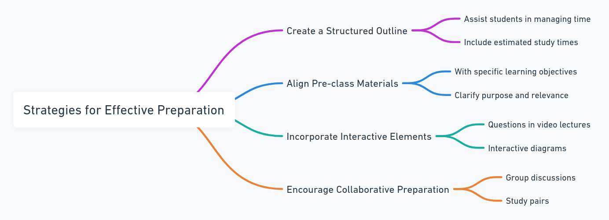
Strategies for effective preparation
Structured Outline: A clear outline guides students through pre-class materials by organizing main topics, subtopics, and key points for better focus and understanding
Interactive Elements: Including interactive tasks encourages active learning, helping students engage with and retain the material.
Consistency: A consistent format for pre-class materials builds reliable learning habits and aligns with the flipped classroom approach, reducing confusion.
Learning Objectives: Defining learning goals helps students concentrate on the most important aspects of the material, clarifying what they should know by the end.
Peer Collaboration: Promoting collaboration during pre-class preparation deepens understanding and mirrors in-class teamwork.
Funded by the European Union. Views and opinions expressed are however those of the author(s) only and do not necessarily reflect those of the European Union or the European Education and Culture Executive Agency (EACEA). Neither the European Union nor EACEA can be held responsible for them.

Slide 13
Tips for Success
Begin with Compelling Content: Start pre-class preparation with engaging materials to capture students' attention and encourage deeper involvement. Use provocative questions, intriguing videos, real-world examples, or current events to make lessons more relatable and spark curiosity.
Cater to Different Learning Styles: Adapt materials to suit different learning preferences. Use diverse media to improve understanding and retention:
Visual Learners: Infographics, diagrams, or videos.
Auditory Learners: Podcasts or audio summaries.
Kinesthetic Learners: Interactive tools like simulations or games.
Reading/Writing Learners: Reading materials or writing prompts for reflection.
Funded by the European Union. Views and opinions expressed are however those of the author(s) only and do not necessarily reflect those of the European Union or the European Education and Culture Executive Agency (EACEA). Neither the European Union nor EACEA can be held responsible for them.

Slide 14
Tips for success
Offer Additional Resources: Providing extra resources helps curious students explore topics in greater depth, allowing for advanced learning. For example you could use reading lists, video suggestions (like a documentary on the French Revolution for history), or interactive tools (e.g., math calculators for algebraic equations).
Provide Consistent Support: Regular support during pre-class preparation keeps students engaged and prevents confusion. Offer clear instructions, spaces for questions (like a class FAQ or discussion board), and regular Q&A sessions, ensuring students feel supported and confident in their learning.
Funded by the European Union. Views and opinions expressed are however those of the author(s) only and do not necessarily reflect those of the European Union or the European Education and Culture Executive Agency (EACEA). Neither the European Union nor EACEA can be held responsible for them.

Slide 15
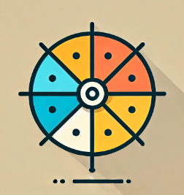
Spin the wheel of Success- Pre-class preparation edition
Imagine you are spinning a wheel that lands on one of the four Tips for Success:
Begin with Compelling Content
Cater to Different Learning Styles
Offer Additional Resources
Provide Consistent Support
After “spinning the wheel” and landing on one of the tips, complete a mini-challenge or reflection based on the tip. You should go through all four tips by the end of the activity.
Begin with Compelling Content Challenge: Create a 2-3 sentence hook that will instantly grab your students’ attention. Use one of these techniques: A surprising fact or statistic A provocative question A fun or unexpected image or meme
2. Cater to Different Learning Styles Challenge: Choose one multimedia element for each learning style: Visual, Auditory, Kinesthetic, and Reading/Writing. Which learning style do you think is the most challenging to cater to in your classroom? What multimedia element could make this style more engaging?
3. Offer Additional Resources Challenge: Find or create two additional resources for students who want to go deeper into the subject matter. These can be optional but should encourage further exploration. What type of student do you think will use these resources? How can you present them in a way that doesn’t overwhelm the class but invites deeper learning?
4. Provide Consistent Support Challenge: Design a support system for your students as they engage with pre-class materials. How will this support system make students feel more confident about the pre-class material? What would you do if a student still struggles despite these supports?
Funded by the European Union. Views and opinions expressed are however those of the author(s) only and do not necessarily reflect those of the European Union or the European Education and Culture Executive Agency (EACEA). Neither the European Union nor EACEA can be held responsible for them.

Slide 16
Pre-Class Preparation
Ice Breakers and Energizers
In a flipped classroom, where in-class time is devoted to interactive and collaborative learning, starting the session with ice breakers and incorporating energizers can significantly enhance student engagement and participation. These activities are essential tools for creating a comfortable and conducive learning atmosphere, especially when students are expected to actively contribute and collaborate.
Ice breakers serve the purpose of fostering connections and comfort among participants in group settings, such as classrooms. They facilitate introductions and help individuals feel at ease with one another, thereby promoting a sense of camaraderie and collaboration.
Examples of ice breakers include activities like "Two Truths and a Lie," where participants share personal information for others to guess, and "Quickfire Questions," which prompt rapid responses to encourage quick thinking.
Funded by the European Union. Views and opinions expressed are however those of the author(s) only and do not necessarily reflect those of the European Union or the European Education and Culture Executive Agency (EACEA). Neither the European Union nor EACEA can be held responsible for them.

Slide 17
Pre-Class Preparation
Ice Breakers and Energizers
On the other hand, energizers aim to boost energy levels and shift mood and mindset, particularly useful during long sessions or when tackling complex topics. These activities help rejuvenate students and make the learning process more enjoyable by breaking monotony.
Examples of energizers include “Stretch Breaks” which involve quick guided stretches to refresh students physically and mentally, and "Quick Games," short and fun activities that may incorporate light physical movement or mental challenges.
Funded by the European Union. Views and opinions expressed are however those of the author(s) only and do not necessarily reflect those of the European Union or the European Education and Culture Executive Agency (EACEA). Neither the European Union nor EACEA can be held responsible for them.

Slide 18
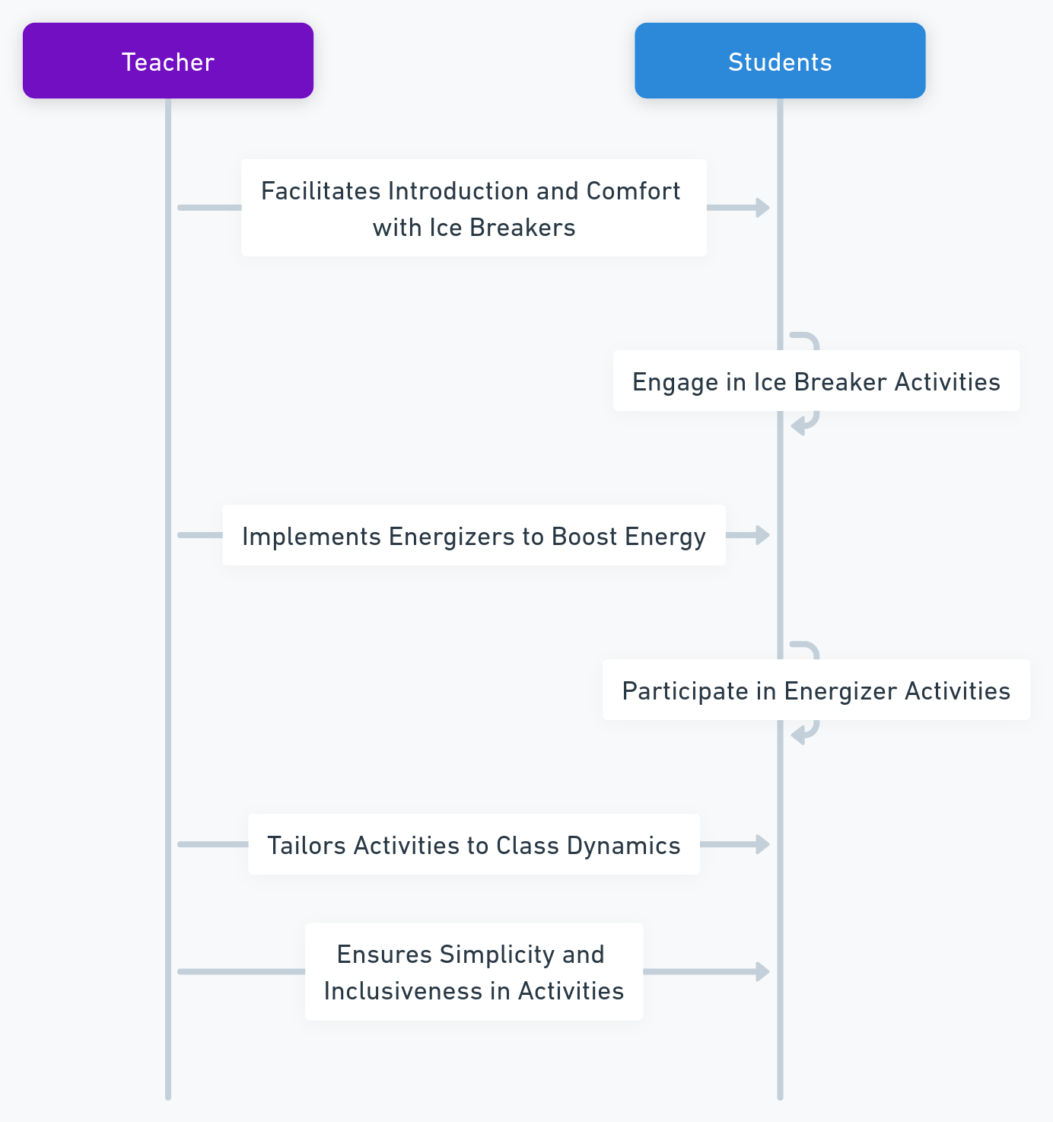
Pre-Class Preparation
Ice Breakers and Energizers
When implementing ice breakers and energizers it's essential to tailor activities to the audience's age, background, and dynamics. Keeping activities simple ensures they are easy to understand and participate in, while being inclusive involves considering the physical and emotional comfort of all students when selecting activities.
Ice breakers and energizers are not mere fillers; they play a crucial role in a flipped classroom by setting a positive tone and fostering an environment conducive to active learning. When executed thoughtfully, they can significantly enhance the effectiveness of the learning experience, making it more engaging and enjoyable for students.
Created with AI
Funded by the European Union. Views and opinions expressed are however those of the author(s) only and do not necessarily reflect those of the European Union or the European Education and Culture Executive Agency (EACEA). Neither the European Union nor EACEA can be held responsible for them.

Slide 19
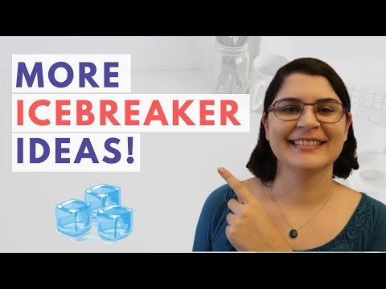
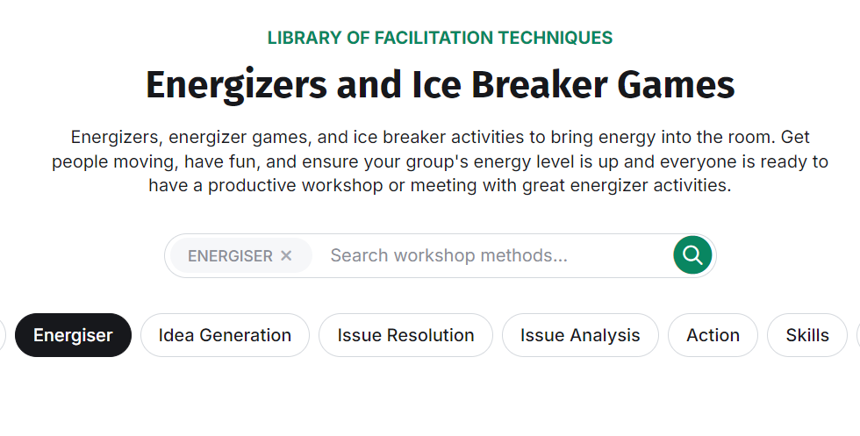
Pre-Class Preparation
Ice Breakers and Energizers
Watch this video by Ever Educating to get some ice breakers ideas:
Check out this library by Session Lab to get some energizers ideas for your next class:
https://www.youtube.com/watch?v=RsUAY2Wq_7Q
https://www.sessionlab.com/library/energiser
Funded by the European Union. Views and opinions expressed are however those of the author(s) only and do not necessarily reflect those of the European Union or the European Education and Culture Executive Agency (EACEA). Neither the European Union nor EACEA can be held responsible for them.

Slide 20
Addressing Student Self- Regulation and Engagement
In the flipped classroom model, where students are expected to actively participate in their own learning, the ability to self-regulate and stay engaged is crucial. This environment demands that students effectively manage their learning processes.
Self-regulation refers to a student's ability to manage their emotions, behavior, and attention to achieve long-term educational goals. Engagement is the visible outcome of motivation, the student's investment in learning and involvement in classroom activities. Both are crucial for success in a flipped classroom environment.
Funded by the European Union. Views and opinions expressed are however those of the author(s) only and do not necessarily reflect those of the European Union or the European Education and Culture Executive Agency (EACEA). Neither the European Union nor EACEA can be held responsible for them.

Slide 21
Addressing Student Self- Regulation and Engagement
Challenges to Self-Regulation:
How to Address It:
Distractions and time-management issues outside of class:
In self-regulated learning environments, such as flipped or blended classrooms, students often face challenges managing distractions and their time effectively without the structure of a traditional classroom. Competing priorities like social media, entertainment, or family obligations can make it difficult to stay focused on pre-class preparation.
Without structure, students may struggle to prioritize learning, leading to procrastination, incomplete work, and last-minute cramming. Poor time management can hinder material retention and reduce overall engagement.
Set Clear Expectations: Provide guidelines on how long pre-class work should take and break tasks into smaller, manageable parts.
Time-Management Tools: Introduce tools like digital calendars, time-blocking methods, or apps like Pomodoro timers to help students stay focused.
Create a Study Routine: Encourage students to establish a regular routine for pre-class work, helping them build a habit that minimizes distractions.
Funded by the European Union. Views and opinions expressed are however those of the author(s) only and do not necessarily reflect those of the European Union or the European Education and Culture Executive Agency (EACEA). Neither the European Union nor EACEA can be held responsible for them.

Slide 22
Addressing Student Self- Regulation and Engagement
Challenges to Self-Regulation:
How to Address It:
Lack of Intrinsic Motivation:
Intrinsic motivation is the internal drive to engage in an activity for its own sake. Many students struggle with independent learning because they lack this inner motivation, seeing pre-class preparation as a tedious task rather than an opportunity for growth. Without a personal connection to the material, maintaining engagement is challenging.
Without intrinsic motivation, students are more likely to disengage, skip assignments, or complete tasks superficially. This leads to lower-quality learning and reduced engagement during in-class activities.
Make the Material Relevant: Connect the content to students' personal interests, career aspirations, or real-world issues to make learning more meaningful.
Offer Autonomy: Provide choices in how students engage with materials or present their understanding, fostering a sense of ownership.
Gamification: Incorporate game-like elements such as points, rewards, or challenges to make the learning process more enjoyable and engaging.
Funded by the European Union. Views and opinions expressed are however those of the author(s) only and do not necessarily reflect those of the European Union or the European Education and Culture Executive Agency (EACEA). Neither the European Union nor EACEA can be held responsible for them.

Slide 23
Addressing Student Self- Regulation and Engagement
Challenges to Self-Regulation:
How to Address It:
Difficulty in Setting Personal Learning Objectives
Students often struggle to set personal learning objectives, especially in self-directed environments. They may be unsure of how to identify learning needs, break larger goals into smaller steps, or stay focused on long-term improvement. Without clear goals, students may feel aimless and lack direction in their pre-class preparation.
Clear learning objectives are essential for effective self-regulation. Without them, students may engage with content passively, leading to surface-level learning and a lack of true understanding. Setting goals helps students stay motivated, track progress, and internalize the material more effectively.
Provide Goal-Setting Frameworks: Introduce students to frameworks like SMART goals (Specific, Measurable, Achievable, Relevant, Time-bound) to guide them in creating focused objectives.
Reflective Prompts: Use prompts that encourage students to think about what they want to achieve from the pre-class material, helping them set personalized learning goals.
Break Down Larger Goals: Help students divide larger learning goals into smaller, manageable objectives that are easier to achieve and track.
Think back to a recent time when you had trouble focusing or completing a task outside of class. Which challenge resonated with you? Why?
Funded by the European Union. Views and opinions expressed are however those of the author(s) only and do not necessarily reflect those of the European Union or the European Education and Culture Executive Agency (EACEA). Neither the European Union nor EACEA can be held responsible for them.

Slide 24
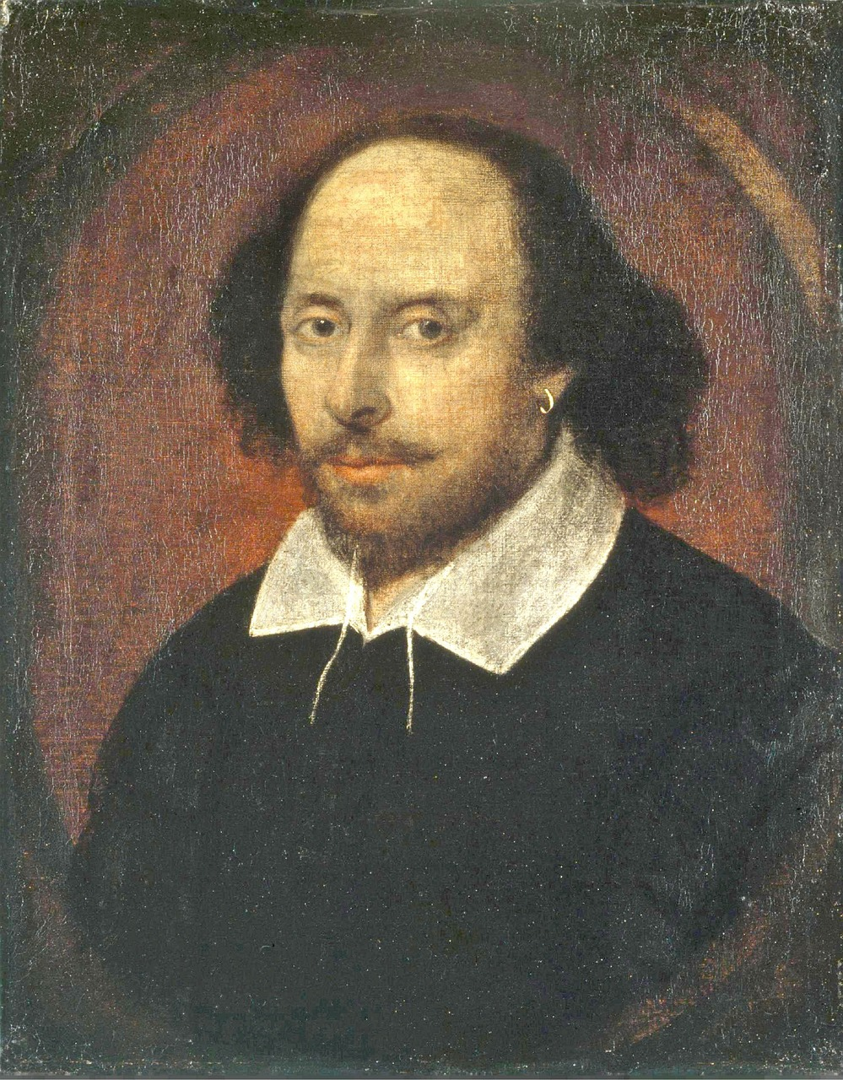
Identifying when to flip and when not to flip
To flip or not to flip
The decision to implement a flipped classroom model should be a strategic choice, made after careful consideration of several factors. Understanding when to employ this approach and when to adhere to more traditional methods is crucial for its success.
Funded by the European Union. Views and opinions expressed are however those of the author(s) only and do not necessarily reflect those of the European Union or the European Education and Culture Executive Agency (EACEA). Neither the European Union nor EACEA can be held responsible for them.

Slide 25
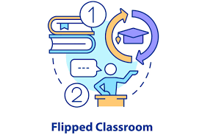
Identifying when to flip and when not to flip
When not to Flip:
If the material is foundational and straightforward, traditional teaching might be more effective
When students lack the resources or motivation to prepare outside of class
Topics that require immediate feedback or clarification from the instructor
Ideal Conditions for Flipping:
Complex concepts that require extended thought and can be introduced through multimedia
Topics where students would benefit from peer interaction and hands-on practice in class
Subjects where students’ pre-class preparation can lead to more meaningful discussions and engagements during the class
VS
Funded by the European Union. Views and opinions expressed are however those of the author(s) only and do not necessarily reflect those of the European Union or the European Education and Culture Executive Agency (EACEA). Neither the European Union nor EACEA can be held responsible for them.

Slide 26
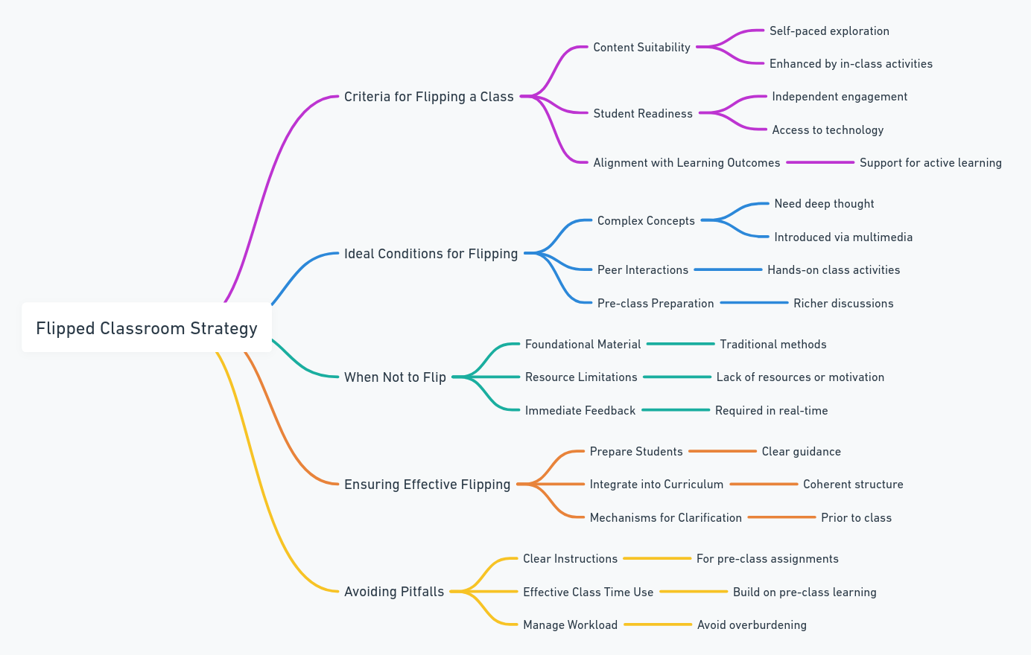
Identifying when to flip and when not to flip
To ensure effective flipping, provide clear guidance and support for pre-class work and integrate flipped sessions into the curriculum. It's also crucial to create avenues for students to clarify doubts before class.
Additionally, avoid common pitfalls like unclear instructions, ineffective use of class time, and overwhelming students with too much pre-class work
Deciding when to flip a class should involve a thoughtful evaluation of the benefits, the readiness of the students, and the nature of the content. A successful flipped classroom experience involves careful preparation, adequate student support, and integration into the broader educational goals.
Funded by the European Union. Views and opinions expressed are however those of the author(s) only and do not necessarily reflect those of the European Union or the European Education and Culture Executive Agency (EACEA). Neither the European Union nor EACEA can be held responsible for them.

Slide 27
Facilitating Learning Using Online Media
In the modern educational landscape, online media has become an indispensable tool, offering a myriad of platforms and resources that enhance both teaching and learning. Its role in education is transformative, providing flexibility, accessibility, and opportunities for interactive and personalized learning experiences.
Funded by the European Union. Views and opinions expressed are however those of the author(s) only and do not necessarily reflect those of the European Union or the European Education and Culture Executive Agency (EACEA). Neither the European Union nor EACEA can be held responsible for them.

Slide 28
Facilitating Learning Using Online Media
Advantages of Online Media
Accessibility: With online media, students can access learning materials anytime and anywhere, accommodating different learning paces and styles.
Interactivity: Tools like forums, quizzes, and interactive videos actively engage students in the learning process.
Multimedia resources: The use of various media formats, including videos, podcasts, and infographics, caters to different learning preferences and helps in the retention of concepts.
Collaboration: Online platforms facilitate peer learning and discussions, extending learning beyond the physical classroom.
Funded by the European Union. Views and opinions expressed are however those of the author(s) only and do not necessarily reflect those of the European Union or the European Education and Culture Executive Agency (EACEA). Neither the European Union nor EACEA can be held responsible for them.

Slide 29
Facilitating Learning Using Online Media Effective Strategies
Curating High-Quality Content: Select relevant, high-quality materials to engage students and support understanding.
Interactive Activities: Use discussions, multimedia projects, and other interactive methods to engage students.
Online Assessments: Use assessments and surveys to track student progress and gather feedback for refining teaching strategies.
Guide Conversations: Participate and lead online discussions to encourage meaningful student interactions.
Funded by the European Union. Views and opinions expressed are however those of the author(s) only and do not necessarily reflect those of the European Union or the European Education and Culture Executive Agency (EACEA). Neither the European Union nor EACEA can be held responsible for them.

Slide 30
Facilitating Learning Using Online Media Challenges and Considerations
Digital Literacy: Both educators and students need training and support to effectively navigate online tools.
Access to Technology: Ensuring equitable access may involve providing devices or reliable internet connections for all students.
Cognitive Overload: Avoid overwhelming students with too much information to maintain engagement.
Funded by the European Union. Views and opinions expressed are however those of the author(s) only and do not necessarily reflect those of the European Union or the European Education and Culture Executive Agency (EACEA). Neither the European Union nor EACEA can be held responsible for them.

Slide 31
Reflection Activity: Implementing the flipped classroom model
Reflect on your current practice:
Write down 3 aspects of your current teaching practice that align with the flipped classroom model
Identify 1 aspect of your teaching practice that you feel could be immediately enhanced by implementing a flipped classroom approach
2. Challenges and solutions:
List two challenges you anticipate might arise when flipping your classroom
For each challenge, propose a potential solution based on what you have learned in this unit
3. Plan a flipped lesson
Choose a topic or lesson you currently teach you believe would benefit from the flipped model
Sketch a brief outline of what pre-class and in-class activities might look like
Describe how you would measure the success of this flipped lesson
Funded by the European Union. Views and opinions expressed are however those of the author(s) only and do not necessarily reflect those of the European Union or the European Education and Culture Executive Agency (EACEA). Neither the European Union nor EACEA can be held responsible for them.

Slide 32
Reflection Activity: Implementing the flipped classroom model
4. Student engagement:
How will you ensure students are engaged with pre-class material? List two strategies
How will you adapt your in-class activities to take advantage of students’ pre-class preparation?
5. Feedback loop:
Devise a method for receiving student feedback on the flipped lesson to assess their engagement and understanding
6. Personal growth:
Reflect on how the process of planning a flipped lesson contributes to your professional development as an educator.
Consider sharing your reflections with a colleague or in a professional learning community. How has your perspective on the flipped classroom model changed after this unit?
What is one action you will commit to in order to move towards implementing or improving a flipped classroom approach in your teaching?
Funded by the European Union. Views and opinions expressed are however those of the author(s) only and do not necessarily reflect those of the European Union or the European Education and Culture Executive Agency (EACEA). Neither the European Union nor EACEA can be held responsible for them.

Slide 33
Additional Resources
Books:
“Flip your classroom, reach every student in every class every day”, by Jonathan Bergmann and Aaron Sams
“Flipped learning: a guide for higher education faculty”, by Robert Talbert
Websites:
The flipped learning network https://flippedlearning.org/
Khan academy https://tinyurl.com/2bv36uvn
Video creation tools:
Loom https://www.loom.com/
Funded by the European Union. Views and opinions expressed are however those of the author(s) only and do not necessarily reflect those of the European Union or the European Education and Culture Executive Agency (EACEA). Neither the European Union nor EACEA can be held responsible for them.

