Slide 1
CollaboratiVET Curriculum for VET teachers/trainers/educators
Module 3: Designing Flipped Classroom Lessons through collaborative methods
Unit 4 - Good practices and how-to guide
Funded by the European Union. Views and opinions expressed are however those of the author(s) only and do not necessarily reflect those of the European Union or the European Education and Culture Executive Agency (EACEA). Neither the European Union nor EACEA can be held responsible for them.

Slide 2
Learning Objectives
By the end of this unit, participants will be able to:
Identify effective practices for designing collaborative flipped lessons in VET settings.
Learn strategies to enhance student engagement through well-designed collaborative activities.
Understand how to utilize collaborative tools effectively for maximizing student learning.
Develop confidence in creating an inclusive and supportive collaborative learning environment.

Slide 3
Advanced Engagement Techniques in Flipped Classrooms
In the realm of flipped classrooms, pioneering engagement strategies are paramount for enhancing student participation and motivation. A focal point of these strategies is the incorporation of gamification elements, which transform learning into a more game-like experience. This includes the use of points, badges, leaderboards, and challenges to foster a competitive yet collaborative atmosphere. Interactive learning scenarios further complement gamification by simulating real-world problems and scenarios in a controlled, virtual environment. These scenarios encourage students to apply theoretical knowledge in practical situations, enhancing understanding and retention. By integrating these strategies, educators can create a more dynamic and immersive learning experience that motivates students to engage deeply with the course material, both within and outside the classroom.
Funded by the European Union. Views and opinions expressed are however those of the author(s) only and do not necessarily reflect those of the European Union or the European Education and Culture Executive Agency (EACEA). Neither the European Union nor EACEA can be held responsible for them.

Slide 4
What to consider?
Know Your Learners
Understand Student Needs: Tailor content to suit the specific needs of VET students, considering their background, interests, and current skills.
Learning Preferences: Recognize that students have different learning styles. Incorporate multimedia, hands-on activities, and peer collaboration to cater to diverse preferences.
Clear Learning Outcomes
Define Objectives: Clearly articulate what students should achieve by the end of the flipped lesson. Use measurable outcomes like “Students will be able to troubleshoot basic mechanical issues.”
Align Activities with Outcomes: Design collaborative activities that align with the objectives, ensuring that students apply their pre-class learning during the collaborative, in-class sessions.
Effective Pre-Class Preparation
Engaging Pre-Class Content: Provide varied resources such as instructional videos, articles, quizzes, and hands-on guides that students need to complete before the in-class session.
Accountability Mechanisms: Incorporate short quizzes or reflection questions to ensure students engage with the pre-class content, preparing them for collaborative activities.
Funded by the European Union. Views and opinions expressed are however those of the author(s) only and do not necessarily reflect those of the European Union or the European Education and Culture Executive Agency (EACEA). Neither the European Union nor EACEA can be held responsible for them.

Slide 5
What to consider?
Structured In-Class Collaboration
Role Assignment: Assign roles like “discussion leader,” “note-taker,” or “practical task coordinator” to make sure every student participates meaningfully.
Hands-On Focus: Ensure that in-class activities focus on hands-on, real-world problem-solving that reflects industry practices. For example, students might work together to assemble and test a mechanical component.
Utilize Collaborative Learning Tools
Digital Collaboration Tools: Tools such as Google Workspace (Docs, Slides) and Trello can facilitate real-time collaboration, content creation, and task tracking.
Visual and Interactive Tools: Use tools like Padlet or Miro for brainstorming, visual mapping, and creating diagrams collaboratively.
Online Learning Platforms: Platforms like Moodle or Microsoft Teams can be used to host resources, manage tasks, and facilitate discussions.
Scaffold Collaborative Activities
Provide Supportive Resources: Offer templates, guides, and checklists to help students navigate collaborative activities.
Set Milestones: Establish clear milestones for group projects to maintain progress and identify challenges early.
Feedback Opportunities: Incorporate multiple opportunities for formative feedback from both peers and instructors.
Funded by the European Union. Views and opinions expressed are however those of the author(s) only and do not necessarily reflect those of the European Union or the European Education and Culture Executive Agency (EACEA). Neither the European Union nor EACEA can be held responsible for them.

Slide 6
Leveraging Analytics for Personalized Learning
By analysing data on learner interactions, assessments, and feedback, educators can identify learning patterns, preferences, and challenges unique to each student.
This intelligence allows for the customization of educational content and feedback, ensuring that each learner receives instruction that is most suitable to their learning style and progress.
Analytics can inform the creation of personalized learning paths, enabling students to navigate through course material at a pace and in a sequence that optimizes their learning outcomes.
The goal is to foster a more engaging, effective, and individualized learning experience that adapts in real-time to the needs of each student.
Funded by the European Union. Views and opinions expressed are however those of the author(s) only and do not necessarily reflect those of the European Union or the European Education and Culture Executive Agency (EACEA). Neither the European Union nor EACEA can be held responsible for them.

Slide 7
Interdisciplinary Projects and Collaborative Learning
Embracing interdisciplinary projects within flipped classrooms opens avenues for holistic education, transcending traditional subject boundaries to foster real-world skills and collaboration.
By integrating concepts from diverse fields, students engage in comprehensive projects that mimic the interconnected nature of knowledge in the professional world.
This approach encourages teamwork, as students from varied academic backgrounds bring unique perspectives and expertise to the table.
Projects may include designing a sustainable community garden (combining biology, environmental science, and urban planning) or developing a business plan for a startup (merging economics, technology, and creative arts).
Funded by the European Union. Views and opinions expressed are however those of the author(s) only and do not necessarily reflect those of the European Union or the European Education and Culture Executive Agency (EACEA). Neither the European Union nor EACEA can be held responsible for them.

Slide 8
Expert Guest Contributions in Flipped Learning
Incorporating expert guest contributions into flipped classroom content significantly enriches the curriculum with practical insights and industry relevance.
HOW?
Through recorded interviews, live Q&A sessions, and guest-curated content that offer students exposure to real-world applications of theoretical knowledge.
Experts provide diverse perspectives, update learners on current trends, and share experiences that bridge the gap between academia and industry.

Slide 9
Sustainable Practices in Flipped Classroom Design
In flipped classroom design, adopting sustainable practices involves the mindful selection of digital tools and resources to minimize environmental impact.
This entails utilizing energy-efficient technologies, promoting paperless materials, and encouraging the reuse and sharing of digital content.
Educators can foster environmental awareness among students by integrating eco-friendly topics into the curriculum and highlighting the importance of sustainability in digital literacy.
By modelling and advocating for responsible consumption of digital resources, flipped classrooms can contribute to broader environmental sustainability goals, preparing students to be conscientious digital citizens.
Funded by the European Union. Views and opinions expressed are however those of the author(s) only and do not necessarily reflect those of the European Union or the European Education and Culture Executive Agency (EACEA). Neither the European Union nor EACEA can be held responsible for them.

Slide 10
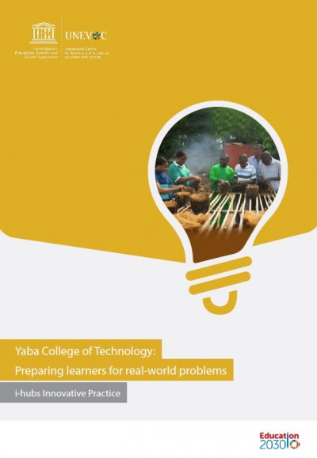
Community Engagement and Flipped Classrooms
Integrating community engagement with flipped classroom activities fosters a learning environment that extends beyond academic knowledge, directly impacting societal well-being.
Strategies include partnering with local organizations for service-learning projects, where students apply course concepts to address community issues.
Encouraging students to lead initiatives based on course topics promotes active learning and civic responsibility.
Additionally, leveraging community experts as part of the flipped content provides real-world perspectives, enriching the learning experience.
Source: https://unevoc.unesco.org/alit/Advancing+Learning+and+Innovation+in+TVET+-+Resources/lang=enaktakt/akt=detail/qs=6422
Funded by the European Union. Views and opinions expressed are however those of the author(s) only and do not necessarily reflect those of the European Union or the European Education and Culture Executive Agency (EACEA). Neither the European Union nor EACEA can be held responsible for them.

Slide 11
Evaluating and Evolving Flipped Classroom Practices
To continuously improve flipped classroom practices, educators should adopt a systematic evaluation process using both quantitative and qualitative metrics.
This involves analysing student performance data, engagement analytics, and feedback through surveys, focus groups, and one-on-one interviews.
Stakeholder feedback, including from students, parents, and faculty, is crucial for identifying strengths and areas for improvement.
Implementing a cycle of reflective practice—plan, act, observe, reflect—enables educators to make informed adjustments to teaching strategies, content delivery, and technology use, ensuring that flipped classroom methodologies remain effective, responsive, and aligned with educational goals.
Plan
Act
Observe
Reflect
Funded by the European Union. Views and opinions expressed are however those of the author(s) only and do not necessarily reflect those of the European Union or the European Education and Culture Executive Agency (EACEA). Neither the European Union nor EACEA can be held responsible for them.

Slide 12
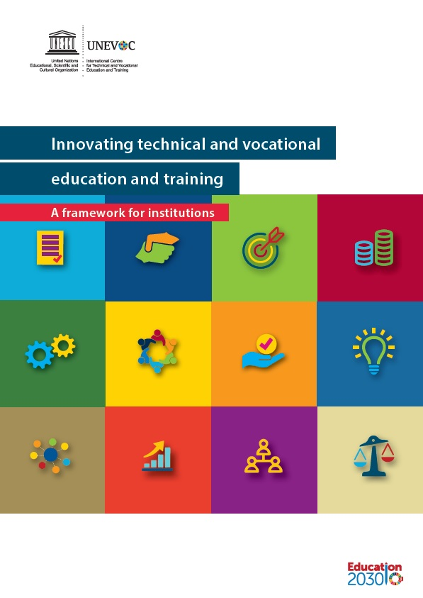
Future Directions in Flipped Learning
As flipped learning evolves, educators can anticipate innovations in adaptive learning technologies, augmented and virtual reality (AR/VR) for immersive learning experiences, and AI-driven personalized learning paths.
The integration of global collaboration platforms will further enhance cross-cultural learning opportunities.
Moreover, the development of blockchain for secure, transparent educational records and credentialing offers new possibilities in recognizing and transferring learning achievements.
Source: https://unevoc.unesco.org/alit/Advancing+Learning+and+Innovation+in+TVET+-+Resources/lang=enaktakt/akt=tg/st=adv/qs=i-hubs
Funded by the European Union. Views and opinions expressed are however those of the author(s) only and do not necessarily reflect those of the European Union or the European Education and Culture Executive Agency (EACEA). Neither the European Union nor EACEA can be held responsible for them.

Slide 13
Practical How-To Guide for Facilitating
Collaborative Learning
Designing the Collaborative Flipped Lesson
Plan Pre-Class Content: Choose engaging and varied resources that provide foundational knowledge students need. Ensure that content is accessible and linked to practical in-class applications.
Create Real-World Activities: Develop in-class tasks that encourage students to use their pre-class knowledge practically, such as repairing a piece of equipment or troubleshooting a problem.
Managing Group Dynamics
Forming Groups: Form groups of mixed abilities to encourage peer learning. Ensure that group members rotate roles across different activities, giving each student a chance to develop a broad range of skills.
Encourage Communication: Promote open communication among group members. Use icebreaker activities or structured discussions to build rapport and trust.
Funded by the European Union. Views and opinions expressed are however those of the author(s) only and do not necessarily reflect those of the European Union or the European Education and Culture Executive Agency (EACEA). Neither the European Union nor EACEA can be held responsible for them.

Slide 14
Practical How-To Guide for Facilitating
Collaborative Learning
Facilitating During In-Class Sessions
Monitor and Support: Move around the classroom, observe group interactions, and provide support where needed. Ask guiding questions to help groups that are stuck and encourage problem-solving.
Active Engagement: Encourage students to actively engage with their peers’ ideas by asking questions, providing constructive feedback, and building upon each other’s contributions.
Assessment and Evaluation
Formative Assessment: Use peer assessments, in-class observations, and reflective exercises to assess student participation and learning throughout the process.
Self-Assessment: Ask students to evaluate their own performance within their group and reflect on how they can contribute more effectively next time.
Reflection and Continuous Improvement
Post-Activity Reflection: Encourage students to reflect on their learning process after each collaborative activity. Ask them to consider questions like, “How did our group collaborate effectively?” or “What could we do differently next time?”
Continuous Iteration: Use student feedback to refine collaborative activities. Regularly iterate and improve flipped lessons to better meet the needs of your students.
Funded by the European Union. Views and opinions expressed are however those of the author(s) only and do not necessarily reflect those of the European Union or the European Education and Culture Executive Agency (EACEA). Neither the European Union nor EACEA can be held responsible for them.

Slide 15
Examples: Good Practices
Scenario-Based Problem Solving
Activity: Present students with a scenario that replicates a real-world problem in their vocational field, such as troubleshooting a common issue with a plumbing system. Groups work collaboratively to devise a solution.
Objective: Develop critical thinking and practical problem-solving skills in an industry-relevant context.
Collaborative Design Challenge
Activity: Assign students to create a product design, such as a chair for carpentry students or a recipe for culinary students. Groups sketch the design, prepare a material list, and outline a plan for implementation.
Objective: Foster creativity, planning, and communication skills through a task that directly relates to their vocational training.
Group Presentations on Industry Practices
Activity: Assign each group a different topic, such as “Safety Procedures in Construction” or “Customer Handling in Hospitality.” Groups create a presentation and deliver it to the class.
Objective: Develop communication, research, and presentation skills, while also building a deeper understanding of core vocational practices.
Funded by the European Union. Views and opinions expressed are however those of the author(s) only and do not necessarily reflect those of the European Union or the European Education and Culture Executive Agency (EACEA). Neither the European Union nor EACEA can be held responsible for them.

Slide 16
Case Studies
English for the Workplace (Cyprus)
Context: A teacher applied a flipped model to transform an English language course, addressing student struggles with complex concepts.
Implementation: Pre-recorded video lectures (20 mins each) were provided as pre-class content, along with quizzes and discussion forums for independent engagement.
In-Class Activities: Focused on active learning, including collaborative projects and role-playing, such as mock interviews, peer reviews, and presentations.
Outcomes: Improved student comprehension, motivation, and participation. In-class sessions fostered critical thinking and hands-on application of theoretical knowledge.
Source: https://www.digicompass.eu/en/implementing-flipped-learning-in-higher-education-a-real-life-example/
Funded by the European Union. Views and opinions expressed are however those of the author(s) only and do not necessarily reflect those of the European Union or the European Education and Culture Executive Agency (EACEA). Neither the European Union nor EACEA can be held responsible for them.

Slide 17
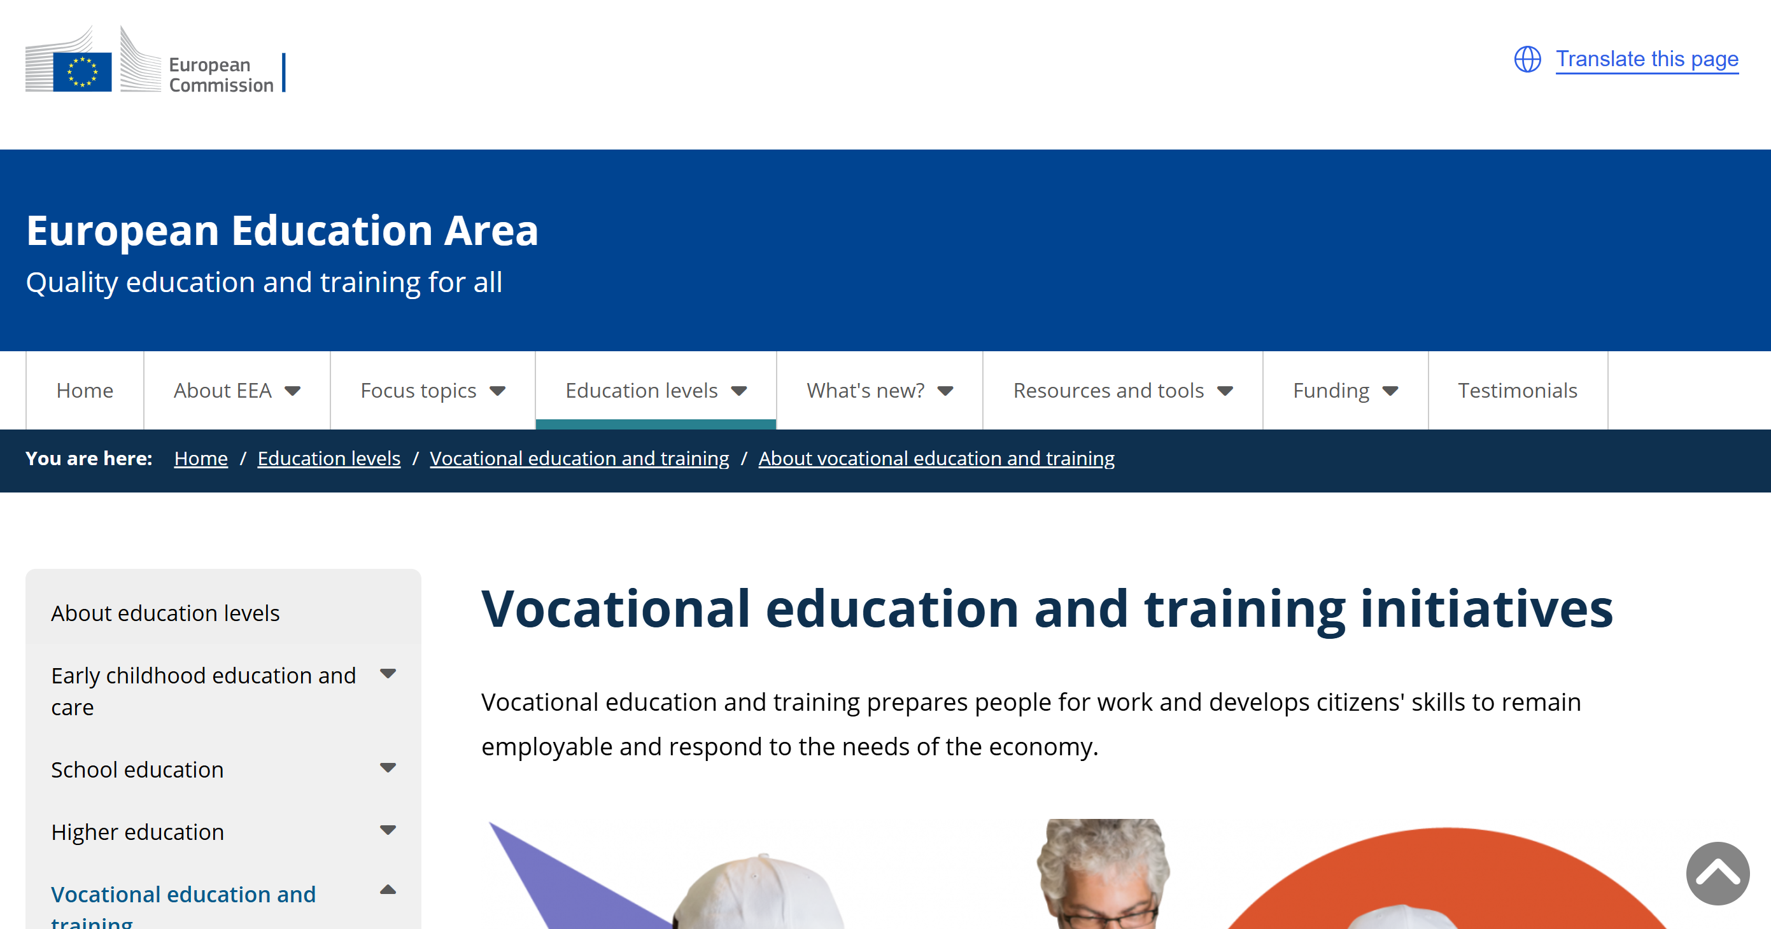
Good practices and continuous professional development
European Commission – European Education Area
Source: https://education.ec.europa.eu/education-levels/vocational-education-and-training/about-vocational-education-and-training
Funded by the European Union. Views and opinions expressed are however those of the author(s) only and do not necessarily reflect those of the European Union or the European Education and Culture Executive Agency (EACEA). Neither the European Union nor EACEA can be held responsible for them.

Slide 18
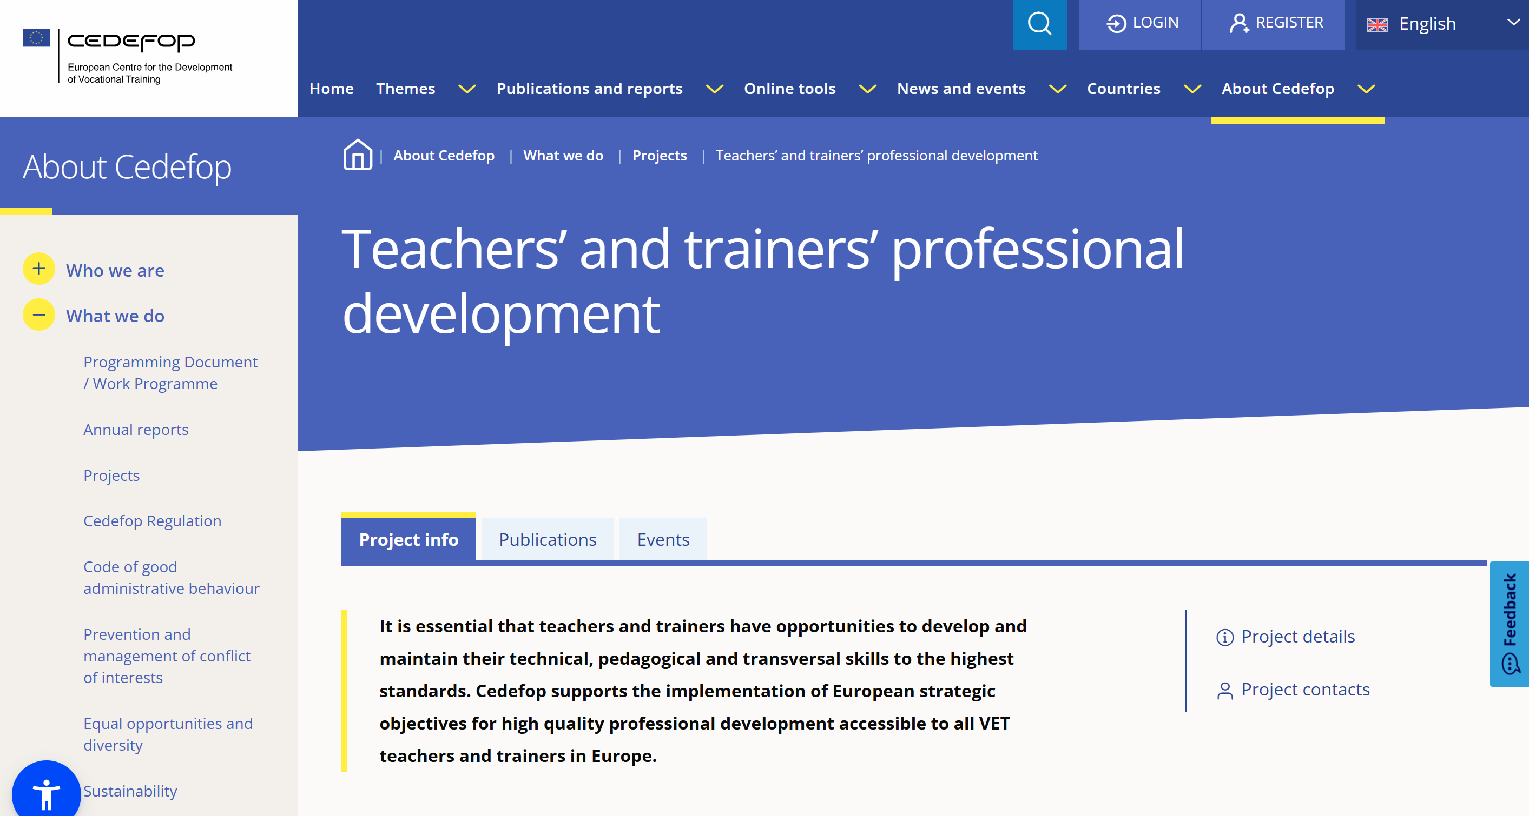
Good practices and continuous professional development
CEDEFOP Resources: Offering learning providers practical support, Cedefop launched the VET toolkit for tackling early leaving in 2017 and the VET toolkit for empowering NEETs in 2021 and has been constantly updating and enriching their resources since then.
Source: https://www.cedefop.europa.eu/en/projects/teachers-and-trainers-professional-development
Funded by the European Union. Views and opinions expressed are however those of the author(s) only and do not necessarily reflect those of the European Union or the European Education and Culture Executive Agency (EACEA). Neither the European Union nor EACEA can be held responsible for them.

Slide 19
Reflection Activity
Consider the gamification and interactive learning scenarios you've implemented. How have these strategies affected student motivation and participation? Note specific instances where you observed a change.
Review the data you've collected on student performance and engagement. How have you used this information to personalize learning experiences? Reflect on the effectiveness of these adjustments.
Think about the collaborative projects you've facilitated. How well did students apply knowledge across different subjects? Reflect on the collaboration dynamics and the learning outcomes achieved.
Reflect on the incorporation of industry experts in your content. How did their insights contribute to the curriculum? Consider student feedback and the relevance of these contributions to learning objectives.
Evaluate your use of eco-friendly technologies and materials. How have these choices impacted the learning environment and student awareness of sustainability?
Reflect on the community service projects linked to your classroom activities. Assess the impact on both students and the community. What lessons did students learn about civic responsibility?
Reflect on the feedback and data you've used to evolve your flipped classroom approach. What changes have you made, and how have they affected student learning?
Consider emerging trends in education technology and methodologies. How prepared do you feel to integrate these innovations into your teaching? Reflect on areas where you might need further development or resources.
Funded by the European Union. Views and opinions expressed are however those of the author(s) only and do not necessarily reflect those of the European Union or the European Education and Culture Executive Agency (EACEA). Neither the European Union nor EACEA can be held responsible for them.

