Slide 1
CollaboratiVET Curriculum for VET teachers/trainers/educators
Module 3: Designing Flipped Classroom Lessons through Collaborative Methods
Unit 3 - Facilitating Collaborative Activities in Flipped Classroom Settings
Funded by the European Union. Views and opinions expressed are however those of the author(s) only and do not necessarily reflect those of the European Union or the European Education and Culture Executive Agency (EACEA). Neither the European Union nor EACEA can be held responsible for them.

Slide 2
Learning
Objectives
By the end of this unit, participants will be able to:
Understand the role of the instructor in facilitating collaborative activities in flipped classrooms.
Learn strategies for designing and managing collaborative tasks effectively.
Identify tools and techniques that support student collaboration.
Develop skills to handle challenges in facilitating group activities in VET settings.

Slide 3
The Role of the Instructor in Flipped Collaborative Learning
Guide, Not Lecturer: Instructors act as facilitators rather than traditional lecturers. Their role is to guide, prompt, and support students in collaborative learning rather than delivering direct instruction during class.
Monitor Group Progress: Regular monitoring of each group’s progress ensures that all students are engaged and contributing meaningfully. Instructors provide support as needed, whether it be answering questions, giving feedback, or mediating group conflicts.
Foster a Collaborative Environment: Encourage an open, supportive classroom culture where students feel comfortable sharing ideas and engaging in constructive discussions.
Funded by the European Union. Views and opinions expressed are however those of the author(s) only and do not necessarily reflect those of the European Union or the European Education and Culture Executive Agency (EACEA). Neither the European Union nor EACEA can be held responsible for them.
Empowering Collaborative Learning:

Slide 4
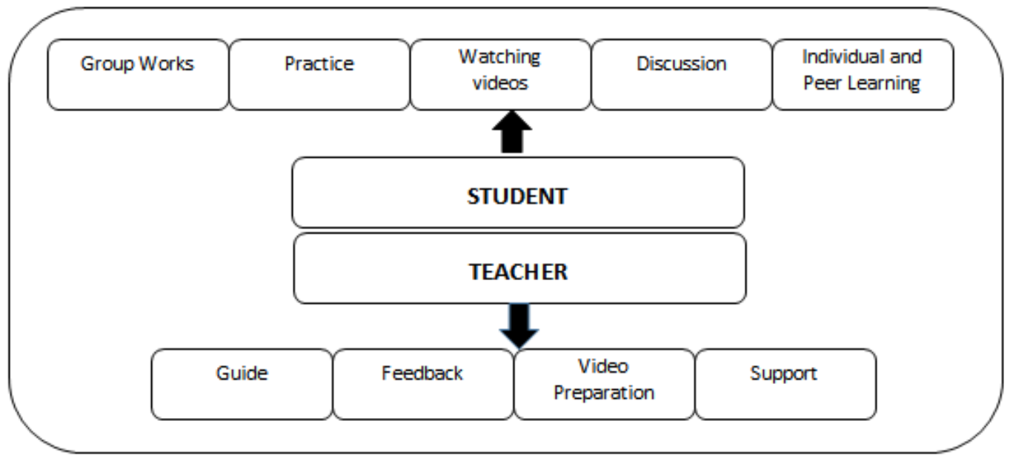
The Role of the Instructor in Flipped Collaborative Learning
Source: https://www.researchgate.net/figure/Teacher-and-student-roles-in-the-flipped-classroom-model_fig2_312056149
Funded by the European Union. Views and opinions expressed are however those of the author(s) only and do not necessarily reflect those of the European Union or the European Education and Culture Executive Agency (EACEA). Neither the European Union nor EACEA can be held responsible for them.
Empowering Collaborative Learning:

Slide 5
Elevating the Role of the Educator in Collaborative Learning
Transition from Teacher to Guide: Embrace the shift from traditional teaching to facilitation, where the educator guides the learning process and supports student collaboration.
1
Creating a Supportive Environment: Learn how to create a safe and supportive environment that encourages risk-taking and values the contributions of all students.
2
Frameworks for Participation: Introduce frameworks and structures that ensure every student has the opportunity to participate meaningfully in collaborative activities.
3
Designing for Diversity: Leverage the diversity within the classroom to enhance the richness of collaborative interactions and outcomes.
4
Dynamic Problem-Solving: Equip yourself with strategies to guide students through dynamic problem-solving activities that are hallmarks of effective flipped classroom experiences.
5
Utilising Digital Platforms: Develop the skill to leverage digital platforms in a way that maximizes student engagement and facilitates seamless collaboration across physical and virtual spaces.
6
Funded by the European Union. Views and opinions expressed are however those of the author(s) only and do not necessarily reflect those of the European Union or the European Education and Culture Executive Agency (EACEA). Neither the European Union nor EACEA can be held responsible for them.
Empowering Collaborative Learning:

Slide 6
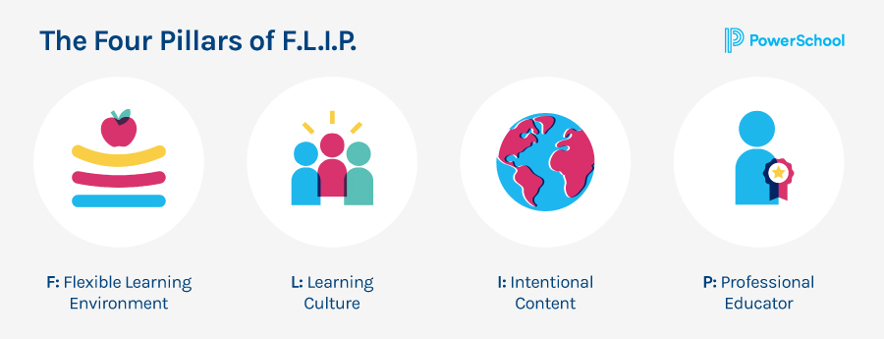
Cultivating an Inclusive Collaborative Environment: Strategies for Fostering Equity and Contribution in Learning.
Creating a Foundation for Inclusivity
Incorporate Varied Perspectives: Begin with content that reflects diverse perspectives, setting the stage for an inclusive environment where all voices are expected and encouraged.
Design Lessons for All: Use lesson designs that provide multiple entry points for learning, ensuring that materials are accessible to students with various backgrounds and abilities.
Group Dynamics Management: Introduce techniques for managing group dynamics, ensuring balanced participation by providing clear roles and responsibilities.
Structured Interaction: Design structured activities that require input from all group members, such as think-pair-share or jigsaw discussions.
Strategies for Encouraging Equitable Participation
Source: https://www.powerschool.com/blog/a-beginners-guide-to-the-flipped-classroom/
Funded by the European Union. Views and opinions expressed are however those of the author(s) only and do not necessarily reflect those of the European Union or the European Education and Culture Executive Agency (EACEA). Neither the European Union nor EACEA can be held responsible for them.

Slide 7
Cultivating an Inclusive Collaborative Environment: Strategies for Fostering Equity and Contribution in Learning.
Leveraging Digital Tools for Inclusivity
Use Technology Thoughtfully: Select and utilize digital tools that enhance inclusivity, such as platforms that allow anonymous participation or those that provide options for different modes of expression.
Facilitate Reflective Dialogue: Employ discussion platforms that encourage reflective dialogue, giving time and space for each student to articulate their thoughts and contribute to the conversation.
Celebrate Contributions: Make it a practice to acknowledge and celebrate all forms of student contributions, fostering an environment of appreciation and mutual respect.
Continuous Feedback Loop: Implement a continuous feedback loop that allows students to express how included they feel in the learning process and adjust strategies accordingly.
Cultivating a Culture of Respect and Appreciation
Funded by the European Union. Views and opinions expressed are however those of the author(s) only and do not necessarily reflect those of the European Union or the European Education and Culture Executive Agency (EACEA). Neither the European Union nor EACEA can be held responsible for them.

Slide 8
Facilitation Beyond Content: Enhancing Interaction and Inclusivity Through Skilful Facilitation
The Evolving Role of the Educator
From Delivering to Empowering: Transition the educator's focus from delivering content to empowering students to actively engage with the material and each other.
Guidance Over Directing: Shift from directing activities to guiding students as they navigate through collaborative processes, encouraging exploration and discovery.
Utilising Digital Tools for Enhanced Facilitation
Interactive Platforms: Introduce interactive digital platforms that allow for real-time collaboration and communication among students, breaking down barriers to participation.
Analytics for Insight: Employ analytics tools to gain insights into student engagement and collaboration patterns, enabling targeted support where needed.
Strategies for Facilitating Inclusive Interactions
Equal Access to Technology: Ensure all students have equal access to the digital tools required for collaboration, considering the varying levels of technological literacy and access.
Cultural Sensitivity in Technology Use: Recognize cultural nuances in communication and collaboration, selecting and using digital tools that respect these differences.
Developing Facilitation Techniques
Active Listening and Mediation: Cultivate active listening skills and mediation techniques to guide discussions and ensure all student voices are heard.
Feedback and Improvement: Create mechanisms for students to provide feedback on the facilitation process, using this input to refine techniques and approaches.
Facilitation as a Path to Deeper Learning
Emphasize that through effective facilitation, educators can unlock deeper levels of understanding and interaction among students, making the collaborative process as important as the content itself in the learning journey.
Funded by the European Union. Views and opinions expressed are however those of the author(s) only and do not necessarily reflect those of the European Union or the European Education and Culture Executive Agency (EACEA). Neither the European Union nor EACEA can be held responsible for them.

Slide 9
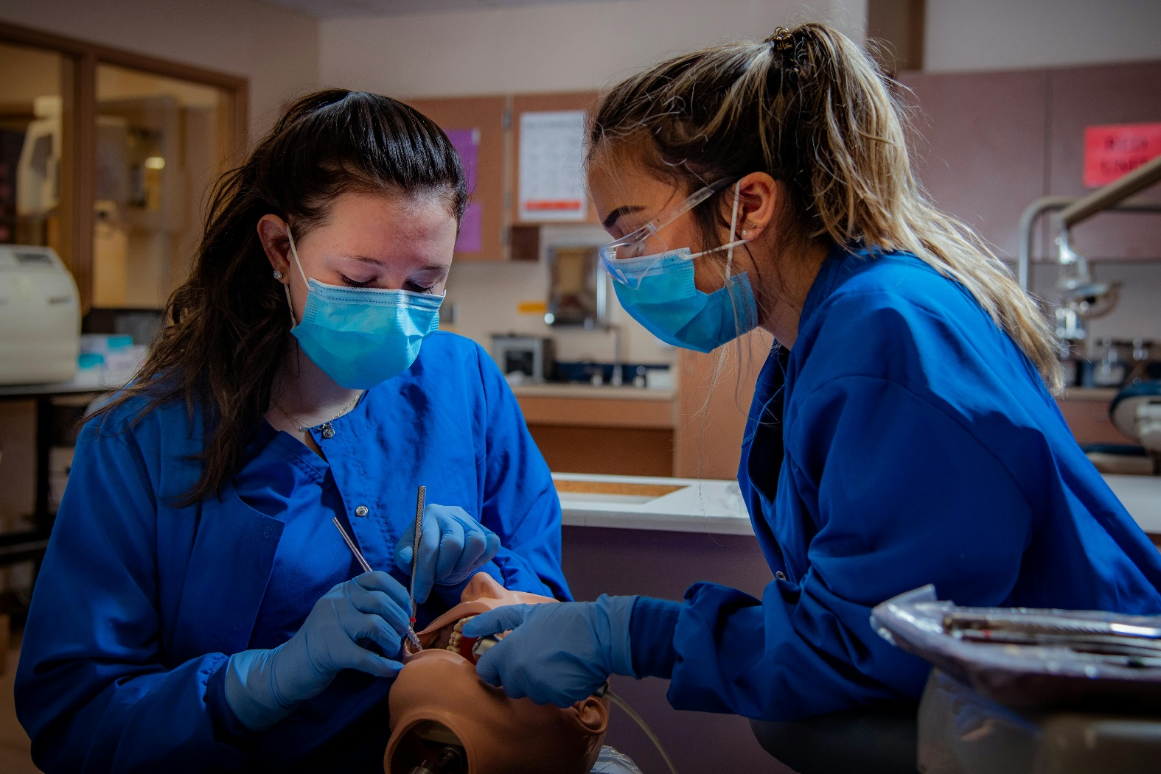
Active Learning through Collaboration: Turning Collaboration into a Catalyst for Active Learning
Integrating real-world problems
Real-Life Relevance: Use problems and scenarios drawn from real life to anchor collaborative activities, which helps students understand the practical applications of what they are learning.
Problem-Solving Skills: Encourage students to employ critical thinking and problem-solving skills as they work together to find solutions to complex, real-world issues.
Leveraging case-based scenarios:
Scenario Exploration: Introduce case-based scenarios that require students to analyse, discuss, and apply concepts in context, promoting deeper learning through practical application.
Diverse Perspectives: Utilize the diverse perspectives within the group to approach scenarios from multiple angles, enriching the learning experience.
Funded by the European Union. Views and opinions expressed are however those of the author(s) only and do not necessarily reflect those of the European Union or the European Education and Culture Executive Agency (EACEA). Neither the European Union nor EACEA can be held responsible for them.

Slide 10
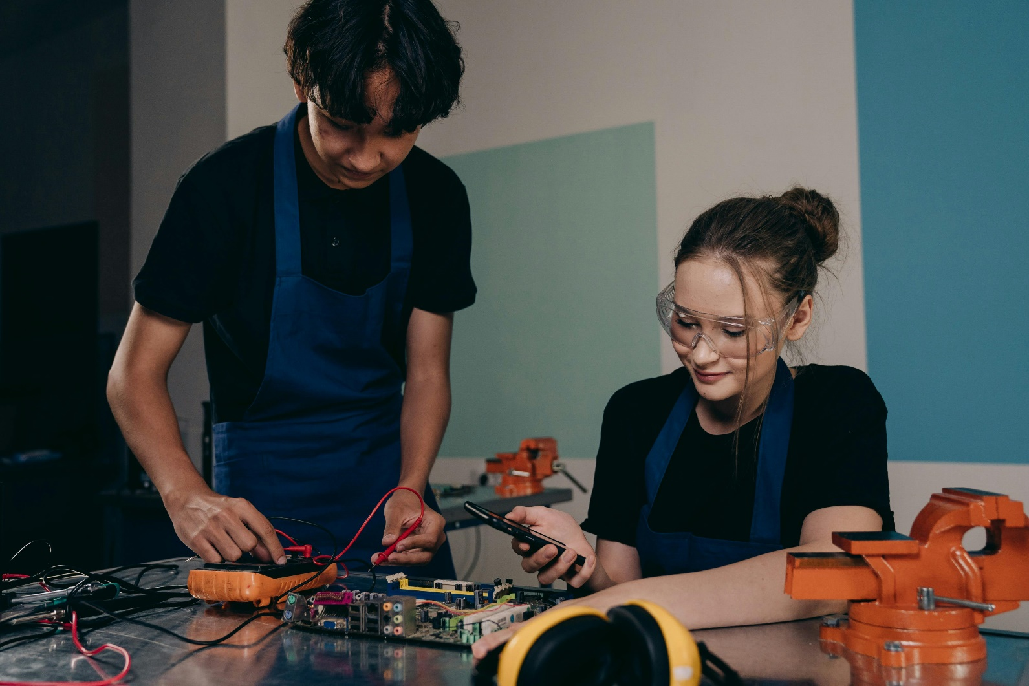
Active Learning through Collaboration: Turning Collaboration into a Catalyst for Active Learning
Facilitation strategies for active learning:
Guided Discovery: Equip educators with strategies to guide students through the discovery process without providing direct answers, encouraging exploration and inquiry.
Feedback Loops: Establish quick feedback loops that enable students to test their ideas and receive immediate input, fostering a dynamic learning process.
Constructing active learning spaces:
Physical and Digital Spaces: Create spaces, both physical and digital, that are conducive to active learning. Use classroom layouts that facilitate easy group formation and digital platforms that support virtual collaboration.
Engagement Tools: Incorporate engagement tools like audience response systems and collaborative software that promote participation and allow students to contribute in real-time.
Funded by the European Union. Views and opinions expressed are however those of the author(s) only and do not necessarily reflect those of the European Union or the European Education and Culture Executive Agency (EACEA). Neither the European Union nor EACEA can be held responsible for them.

Slide 11
Dynamics of Teamwork in Education
Essential Elements of Student Teamwork:
Communication: Stress the importance of clear and open communication as the foundation of successful teamwork, encouraging students to express their ideas and listen actively to their peers.
Role Clarification: Discuss the significance of defining roles within the team to ensure a balanced workload and clear responsibilities, preventing misunderstandings and ensuring effective collaboration.
Conflict Resolution in Teamwork:
Identifying Conflict Early: Equip students with the ability to recognize the early signs of conflict and understand that conflict, when managed properly, can lead to growth and better solutions.
Strategies for Resolution: Offer conflict resolution strategies, including mediation techniques and structured problem-solving methods, to help students navigate disagreements constructively.
Consensus Building:
The Art of Compromise: Highlight techniques for achieving consensus, emphasizing the value of compromise and the ability to integrate diverse perspectives into a cohesive plan of action.
Decision-Making Process: Provide a framework for collaborative decision-making that encourages participation from all team members and leads to decisions that are supported by the entire group.
Collaborative Decision-Making:
Leveraging Group Strengths: Encourage students to leverage their collective strengths and knowledge when making decisions, leading to more informed and robust outcomes.
Facilitator's Role: Clarify the educator's role as a facilitator in this process, providing guidance without dictating the direction, allowing students to take ownership of their decisions.
Funded by the European Union. Views and opinions expressed are however those of the author(s) only and do not necessarily reflect those of the European Union or the European Education and Culture Executive Agency (EACEA). Neither the European Union nor EACEA can be held responsible for them.

Slide 12
Examples of Collaborative Activities in Flipped VET Classrooms
Case Study Analysis
Activity: Assign a real-world case study related to the vocational field (e.g., an automotive troubleshooting case). Groups analyze the scenario, identify key problems, and propose solutions.
Objective: Develop critical thinking, practical problem-solving skills, and teamwork.
Project-Based Learning
Activity: Assign groups to create a project, such as designing a marketing plan for a local business, constructing a piece of furniture, or setting up a basic electrical circuit.
Objective: Apply theoretical knowledge to a practical task and develop project management, planning, and hands-on skills.
Role-Playing Scenarios
Activity: Students role-play a client interaction, such as a customer service situation in hospitality or a consultation with a healthcare patient.
Objective: Enhance communication skills, understand industry-specific scenarios, and practice professional behavior.
Funded by the European Union. Views and opinions expressed are however those of the author(s) only and do not necessarily reflect those of the European Union or the European Education and Culture Executive Agency (EACEA). Neither the European Union nor EACEA can be held responsible for them.

Slide 13
Scaling Collaboration Across Curriculum: Broadening the Scope of Collaborative Learning
Integrating Collaboration Holistically:
Curriculum Mapping: Begin with mapping the curriculum to identify opportunities where collaborative activities can naturally enhance learning outcomes across subjects.
Interdisciplinary Projects: Design interdisciplinary projects that require students to apply skills and knowledge from multiple subjects, promoting a deeper understanding and application of concepts.
Building Skills Progressively:
Skill Ladders: Develop skill ladders that outline the progression of collaborative skills from basic to advanced, ensuring students build on their abilities systematically.
Reflective Practices: Incorporate reflective practices that encourage students to consider how they work within teams, what they have learned from collaborative activities, and areas for improvement.
Fostering a Collaborative Classroom Culture:
Consistent Collaboration Norms: Establish consistent norms for collaboration that are applied across all classes and activities, creating a familiar and safe environment for students to engage in teamwork.
Teacher Collaboration: Encourage teachers across different subjects to collaborate, sharing strategies and insights on facilitating group work, to create a unified approach to collaborative learning.
Leveraging Technology for Cross-Curricular Collaboration:
Digital Platforms: Utilize digital platforms that support collaboration across different subjects, allowing students to work on projects that span multiple areas of study.
Virtual Exchange: Facilitate virtual exchanges with students from other classes, schools, or even countries, broadening the scope of collaboration and exposing students to diverse perspectives.
Evaluating Collaborative Competencies:
Integrated Assessments: Design assessments that evaluate collaborative competencies alongside academic knowledge, highlighting the importance of teamwork skills in academic success.
Feedback Loops: Create feedback loops where students can receive input on their collaborative skills from peers, teachers, and through self-assessment, encouraging ongoing development.
Funded by the European Union. Views and opinions expressed are however those of the author(s) only and do not necessarily reflect those of the European Union or the European Education and Culture Executive Agency (EACEA). Neither the European Union nor EACEA can be held responsible for them.

Slide 14
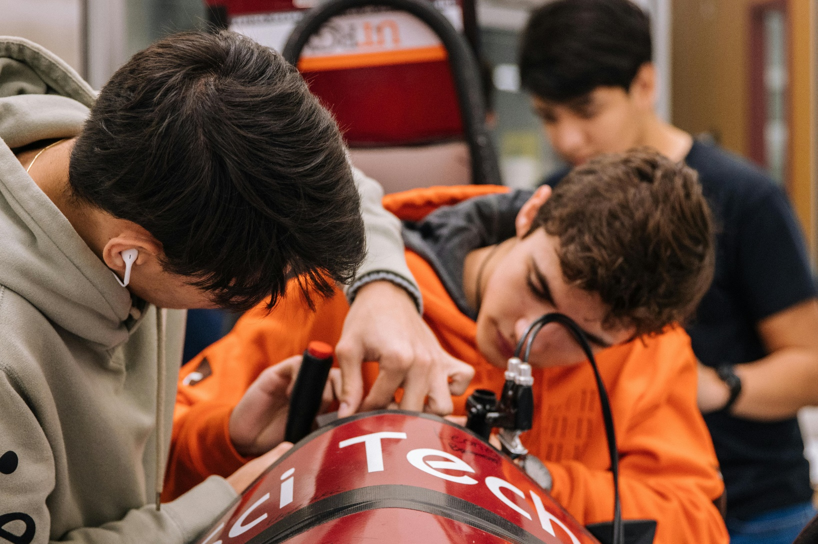
Scaling Collaboration Across Curriculum: Broadening the Scope of Collaborative Learning
As educators, our goal extends beyond facilitating collaboration within isolated units. We aim to weave collaborative activities throughout the curriculum, fostering a culture of teamwork and communication that builds cumulatively over time.
Scaling collaborative activities across the curriculum is not just about increasing the quantity of group work but about deepening the quality of collaborative experiences. By embedding collaboration into the fabric of the curriculum, educators can cultivate essential skills that prepare students for the complexities of the modern world, where teamwork and communication are key to success. This approach transforms the classroom into a dynamic space where learning is active, social, and interconnected across disciplines.
Funded by the European Union. Views and opinions expressed are however those of the author(s) only and do not necessarily reflect those of the European Union or the European Education and Culture Executive Agency (EACEA). Neither the European Union nor EACEA can be held responsible for them.

Slide 15
Case Scenario: Boosting Teamwork in Automotive Technology Training
Background: In a vocational training centre, Ms. Garcia teaches an Automotive Technology course designed to prepare students for careers in automotive repair and diagnostics. She noticed a gap in her students' ability to apply collaborative skills in hands-on, workshop-based activities.
The Challenge: To embed effective and inclusive collaborative practices in a flipped classroom setting, enhancing the application of technical skills through teamwork, and leveraging digital tools for active learning.
Strategies Employed:
Workshop Collaborative Stations: Ms. Garcia set up collaborative stations in the workshop where students had to diagnose and repair vehicle issues in small teams, simulating real-world scenarios.
Digital Documentation Platforms: Teams used digital platforms like Trello to document their diagnostic process, assign tasks, and track progress, fostering organizational and communication skills.
Facilitated Peer Feedback: After completing repair tasks, teams presented their solutions and received structured feedback from peers through a digital feedback system, encouraging critical thinking and reflection.
Industry Expert Webinars: Leveraging the flipped classroom model, Ms. Garcia arranged for industry experts to host webinars on complex automotive technologies, followed by team-based projects where students applied what they learned..
Outcome:
Enhanced Practical Skills: Students demonstrated improved technical skills and a deeper understanding of automotive technology through hands-on, collaborative problem-solving.
Strengthened Team Dynamics: The course saw a notable improvement in teamwork, with students actively engaging in their roles and effectively communicating within their teams.
Industry-Relevant Learning: Feedback from students highlighted the value of integrating industry expertise into their learning, making their education more relevant and engaging.
Career Readiness: Graduates from Ms. Garcia’s class reported feeling more confident and prepared for the workforce, attributing this to the collaborative skills and real-world experience gained during the course.
Conclusion:
This case study showcases the impact of integrating collaborative activities in a VET context, particularly within a flipped classroom model. By fostering teamwork in practical, workshop-based learning and utilizing digital tools for planning and feedback, educators can significantly enhance both the learning experience and the career readiness of their students in vocational and technical education programs.
Funded by the European Union. Views and opinions expressed are however those of the author(s) only and do not necessarily reflect those of the European Union or the European Education and Culture Executive Agency (EACEA). Neither the European Union nor EACEA can be held responsible for them.

Slide 16
Handling Challenges in Facilitating Collaborative Activities
Unequal Participation
Solution: Assign specific roles and responsibilities to each member, ensuring everyone has a defined part to play. Use peer evaluations to assess contributions and promote accountability.
Conflict within Groups
Solution: Encourage open communication and set up conflict resolution guidelines. The instructor should mediate if necessary to help students work through disagreements.
Time Management
Solution: Provide structured timelines for each task and emphasize the importance of setting group goals. Milestones and check-ins can help keep groups on track.
Access to Tools and Resources
Solution: Ensure that all students have access to necessary tools and provide alternatives for those who may face accessibility issues. For example, offer offline content or provide additional lab time for hands-on activities.
Funded by the European Union. Views and opinions expressed are however those of the author(s) only and do not necessarily reflect those of the European Union or the European Education and Culture Executive Agency (EACEA). Neither the European Union nor EACEA can be held responsible for them.

Slide 17
Reflection Activity
Reflect on a recent collaborative activity you facilitated. How did you incorporate the strategies for effective collaboration discussed in this module? In what ways did you ensure that the activity was inclusive and allowed all students to contribute meaningfully?
Which digital tools did you employ to enhance collaboration and active learning? How effective were these tools in achieving your educational objectives? Were there any challenges in integrating these tools into your collaborative activities? How did you address them?
Consider a project or activity where students worked on real-world problems. How did this approach impact student engagement and learning outcomes? How did you facilitate peer feedback and reflection within this context? What changes would you make to improve this process?
What new facilitation techniques or strategies have you tried as a result of this module? What was the outcome? Reflect on your growth as an educator in facilitating collaborative learning. What areas do you feel you have improved in, and what areas do you still want to develop?
Based on what you've learned in this unit, what strategies will you implement to enhance collaboration in your next content creation project? Are there specific tools or techniques you plan to explore further to support these strategies?
Funded by the European Union. Views and opinions expressed are however those of the author(s) only and do not necessarily reflect those of the European Union or the European Education and Culture Executive Agency (EACEA). Neither the European Union nor EACEA can be held responsible for them.

Slide 18
Resources
Professional Development Goals:
Coursera: Offers a variety of courses to help you learn relevant skills, expand your professional network, and find more satisfaction at work. Consider setting goals like developing a new skill set or enhancing workplace skills.
BetterUp: Provides insights into staying on top of industry trends and networking with professionals in your field.
Asana: Explore seminars, webinars, workshops, and social media platforms (like LinkedIn) to elevate your skill set and connect with peers.
Foundations of Facilitating Collaboration:
Liberating Structures: These facilitation techniques empower participants and foster collaboration. Examples include “1-2-4-All” (which ensures all voices are heard) and “TRIZ” (Theory of Inventive Problem Solving).
Active Learning Techniques: Techniques like “Inside/Outside Circle” promote participatory learning in flipped classrooms.
Creating an Inclusive Learning Environment: Acknowledge diversity, use varied content formats, emphasize cultural competence, and ensure accessibility.
Flipped Classrooms:
Medium: Explore the concept of flipped classrooms, how it works, and its benefits. It shifts from a teacher-centred approach to a more learner-centred one, enhancing active learning and engagement.
Academia.edu: Read about building collaboration in flipped classrooms and how technology can support this model.
Funded by the European Union. Views and opinions expressed are however those of the author(s) only and do not necessarily reflect those of the European Union or the European Education and Culture Executive Agency (EACEA). Neither the European Union nor EACEA can be held responsible for them.

