Slide 1
CollaboratiVET Curriculum for VET teachers/trainers/educators
Module 3: Designing Flipped Classroom Lessons through Collaborative Methods
Unit 1: Collaborative Lesson Design in a Flipped Classroom
Funded by the European Union. Views and opinions expressed are however those of the author(s) only and do not necessarily reflect those of the European Union or the European Education and Culture Executive Agency (EACEA). Neither the European Union nor EACEA can be held responsible for them.

Slide 2
Learning Objectives
By the end of this unit, participants will be able to:
Understand the principles of collaborative learning within a flipped classroom framework.
Design collaborative lesson plans that align with VET requirements.
Implement technology and tools to support pre-class and in-class activities.
Assess collaborative learning outcomes to improve lesson effectiveness.

Slide 3
The Flipped Classroom: A new era for learning
Definition & Core Concept
Empowering Collaborative Learning
Why It Matters
The flipped classroom inverts traditional teaching methods, delivering instruction online outside of class and moving "homework" into the classroom.
Students first engage with new material at home, then apply concepts through collaborative activities in class.
Active Participation: Encourages students to actively engage with material, fostering a community of learners who support each other's educational journey.
Tailored to Every Student: Supports varied learning paces, allowing students to prepare at their own speed and spend classroom time on interactive, hands-on learning.
Maximising In-Class Time: Frees up classroom sessions for discussions, group projects and practical exercises, making learning more dynamic and engaging.
The flipped classroom is not just a teaching method; it's a pathway to deeper understanding and greater student engagement. By integrating this approach, we cultivate a learning environment that values active participation, collaborative problem-solving and the diverse talents of every student.
Funded by the European Union. Views and opinions expressed are however those of the author(s) only and do not necessarily reflect those of the European Union or the European Education and Culture Executive Agency (EACEA). Neither the European Union nor EACEA can be held responsible for them.

Slide 4
Relevancy of the Flipped Classroom Model to VET
Engagement and Participation: Flipped classrooms enable students to prepare independently, enhancing readiness for interactive sessions.
Personalized Learning: Students control pre-class study pace, allowing more time for practical tasks in class.
Improved Outcomes: Students experience active learning and real-world application, improving skill retention.
Soft Skills Development: Collaboration in flipped classrooms builds teamwork, problem-solving, and self-direction.
Funded by the European Union. Views and opinions expressed are however those of the author(s) only and do not necessarily reflect those of the European Union or the European Education and Culture Executive Agency (EACEA). Neither the European Union nor EACEA can be held responsible for them.

Slide 5
Principles of Collaborative Lesson Design
Student-Centered Learning: Lessons should encourage students to actively participate, ask questions, and collaborate on practical tasks.
Iterative Design: It is important to regularly refine lesson plans based on student feedback and learning outcomes.
Reflective Practice: Instructors should assess their teaching approaches, incorporating changes as needed.
Stakeholder Engagement: It is important to consider input from students, instructors, and industry experts to align lessons with real-world demands.
Funded by the European Union. Views and opinions expressed are however those of the author(s) only and do not necessarily reflect those of the European Union or the European Education and Culture Executive Agency (EACEA). Neither the European Union nor EACEA can be held responsible for them.

Slide 6
Analysing Successful Collaborative Lesson Designs involves examining various criteria to ensure they positively influence student engagement and learning outcomes.
The analysis of lesson designs can be organised into four key criteria:
Objectives and Learning Outcomes: The lesson design must have clear, measurable objectives and learning outcomes that align with educational standards. This ensures that the lessons are purposeful and focused on specific skills or knowledge that students need to acquire.
Collaboration and Interactivity: Effective lesson designs encourage collaboration among students. This can involve group projects, peer reviews, or other activities that require students to work together, share ideas, and learn from each other. Interactivity also plays a crucial role, as engaging students in interactive tasks helps maintain their interest and facilitates deeper learning.
Integration of Technology: Integrating technology into lesson designs can enhance learning by providing diverse resources, tools for collaboration, and opportunities for interactive learning. Technology can also support differentiated instruction, allowing teachers to meet the varied needs of their students.
Assessment and Feedback: Assessments should be aligned with the lesson's objectives and provide a means for evaluating student learning. Effective lesson designs include both formative and summative assessments, offering feedback to students that is timely, constructive, and specific. This feedback is essential for guiding students' learning and helping them improve.
Funded by the European Union. Views and opinions expressed are however those of the author(s) only and do not necessarily reflect those of the European Union or the European Education and Culture Executive Agency (EACEA). Neither the European Union nor EACEA can be held responsible for them.

Slide 7
Strategies in designing Flipped Classrooms in VET
Segmenting Content: It is important to break down lectures or tutorials into short, accessible units (e.g., 10-15 minute videos) for easier retention.
Incorporating Interactive Elements: Digital quizzes or discussion prompts can be used to check understanding of pre-class materials.
Multimedia Resources: Videos, podcasts, and tutorials can be included to appeal to varied learning styles.
Active Learning: Group work and interactive tasks can be organised for class time that allow students to practice skills collaboratively.
Funded by the European Union. Views and opinions expressed are however those of the author(s) only and do not necessarily reflect those of the European Union or the European Education and Culture Executive Agency (EACEA). Neither the European Union nor EACEA can be held responsible for them.

Slide 8
Analysing Successful Collaborative Lesson Designs involves examining various criteria to ensure they positively influence student engagement and learning outcomes.
These criteria are crucial for analysing lesson designs because they directly impact how well students engage with the material and the outcomes of their learning. A well-designed lesson that incorporates these elements can foster an environment where students are actively involved in their learning process, leading to better understanding, retention, and application of knowledge.
Collaboration and interactivity make learning more enjoyable and meaningful, while the thoughtful integration of technology can cater to diverse learning styles and needs. Finally, assessments and feedback are fundamental in monitoring progress and ensuring that learning objectives are met, thereby enhancing the overall effectiveness of the educational experience.
Funded by the European Union. Views and opinions expressed are however those of the author(s) only and do not necessarily reflect those of the European Union or the European Education and Culture Executive Agency (EACEA). Neither the European Union nor EACEA can be held responsible for them.

Slide 9
Identifying Key Elements for Student Engagement
Pre-Class Preparation: Students must come prepared, having reviewed the assigned materials beforehand. This foundation allows them to engage deeply during class activities.
Interactive Activities: It is important to incorporate activities that promote interaction among students and between students and the teacher. This can include discussions, group projects, and hands-on experiments, which encourage active participation and critical thinking.
Feedback Mechanisms: Implementing immediate feedback through quizzes, peer assessments, or interactive platforms helps students understand their progress and areas for improvement in real-time.
Technology Integration: Technology can be used to facilitate collaboration, access resources, and submit assignments. This can enhance learning experiences and accommodate different learning styles.
Flexible Learning Paths: Teachers can offer various ways to achieve learning objectives, catering to individual student needs and preferences. This can include optional resources, different project options, or varied discussion topics.
Student Autonomy: Teachers can encourage students to take charge of their learning by setting goals, self-assessing, and engaging in self-directed learning activities. This fosters a sense of ownership and motivation.
Community Building: A supportive learning environment where students feel safe to express ideas and take risks should be developed. This can be fostered through ice-breaker activities, setting class norms, and regular team-building exercises.
Instructor Role: Teachers act as facilitators rather than traditional lecturers, guiding students through their learning journey, providing support, and encouraging collaboration.
Assessment Strategies: Teachers can use formative assessments that focus on the process of learning and summative assessments that reflect collaborative efforts and individual achievement.
Reflection and Adaptation: Teachers can encourage students to reflect on their learning experiences and outcomes. Similarly, educators should adapt teaching strategies based on student feedback and performance to improve the learning process continually.
Funded by the European Union. Views and opinions expressed are however those of the author(s) only and do not necessarily reflect those of the European Union or the European Education and Culture Executive Agency (EACEA). Neither the European Union nor EACEA can be held responsible for them.

Slide 10
Implementing Pre-Class Content in VET
Different strategies can ensure that students come prepared, maximizing hands-on practice time and allowing class time to focus on skill application and collaboration.
For example:
Culinary Course: Students can watch a video on food safety, then complete a quiz on sanitation protocols.
Automotive Course: Learners can review diagrams of engine components and complete a short assessment on part identification.
Healthcare Course: Students can watch a video on patient safety and complete a reflection on best practices
Funded by the European Union. Views and opinions expressed are however those of the author(s) only and do not necessarily reflect those of the European Union or the European Education and Culture Executive Agency (EACEA). Neither the European Union nor EACEA can be held responsible for them.

Slide 11
Designing In-Class Activities for Collaboration
HOW?
Group Projects: Teachers can assign teams to real-world tasks like assembling equipment, planning a service procedure, or conducting a safety audit.
Rotational Stations: Stations should be created where students perform various parts of a complex task, such as inspecting, repairing, and testing a device. Rotate students through each station to ensure comprehensive skill development.
Peer Teaching: Learners can take turns teaching a specific part of the task to their peers, reinforcing their understanding and building confidence.
Funded by the European Union. Views and opinions expressed are however those of the author(s) only and do not necessarily reflect those of the European Union or the European Education and Culture Executive Agency (EACEA). Neither the European Union nor EACEA can be held responsible for them.

Slide 12
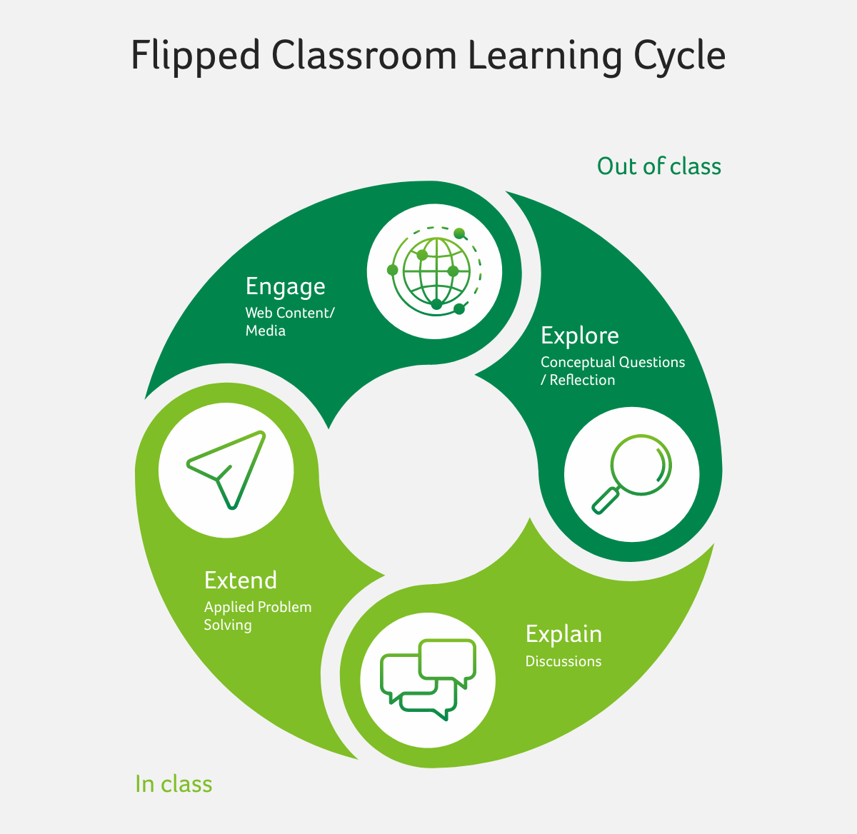
Strategies for Effective Collaboration
Effective collaboration in a flipped classroom environment is essential for maximising learning outcomes. Here we introduce a variety of tools and techniques designed to enhance collaboration among students and between students and educators.
Source: https://blog.acer.com/en/discussion/801/how-to-develop-and-manage-a-successful-flipped-classroom-model
Funded by the European Union. Views and opinions expressed are however those of the author(s) only and do not necessarily reflect those of the European Union or the European Education and Culture Executive Agency (EACEA). Neither the European Union nor EACEA can be held responsible for them.

Slide 13
Assessing Collaborative Learning Outcomes in VET
Engagement: Participation can be tracked through digital platforms (e.g., online discussion boards) or in-class activities (e.g., group tasks).
Skill Mastery: Final products of group work can be evaluated, individual reflections, and practical demonstrations.
Soft Skills Assessment: Peer feedback forms, group discussions, and instructor observations can be used to gauge teamwork, communication, leadership, and problem-solving abilities.
Continuous Feedback: Ongoing, formative feedback should be provided during activities to help students improve collaboratively.
Funded by the European Union. Views and opinions expressed are however those of the author(s) only and do not necessarily reflect those of the European Union or the European Education and Culture Executive Agency (EACEA). Neither the European Union nor EACEA can be held responsible for them.

Slide 14
Strategies for Effective Collaboration
Collaborative Platforms: Utilise online platforms like Google Workspace, Microsoft Teams, or Slack to facilitate communication, file sharing, and project management. These platforms allow students to work together synchronously or asynchronously, enabling continuous collaboration outside of the classroom.
Interactive Whiteboards: Tools like Miro or Jamboard offer a shared space for brainstorming, diagramming, and organizing ideas. They're particularly effective for visualising concepts, planning projects, and gathering feedback in real-time.
Peer Review Systems: Implement systems for peer feedback, such as Turnitin PeerMark or other peer evaluation tools. These systems encourage students to critique each other's work constructively, fostering a culture of continuous improvement and mutual support.
Project Management Tools: Encourage the use of project management software like Trello or Asana to help student groups plan, execute, and monitor their collaborative projects. These tools can help keep projects on track and ensure that all members contribute equally.
Funded by the European Union. Views and opinions expressed are however those of the author(s) only and do not necessarily reflect those of the European Union or the European Education and Culture Executive Agency (EACEA). Neither the European Union nor EACEA can be held responsible for them.

Slide 15
Strategies for Effective Collaboration
Discussion Forums and Blogs: Online discussion forums (e.g., Piazza, Moodle forums) and blog platforms can encourage reflective thinking and provide opportunities for students to articulate and share their insights. They also offer a way for quieter students to contribute their ideas.
Video Conferencing Tools: Leverage video conferencing tools like Zoom or Google Meet for live discussions, group meetings, and virtual office hours. These tools help maintain a personal connection and facilitate real-time collaboration and discussion.
Role Assignments: Assigning specific roles within group projects (e.g., researcher, presenter, coordinator) can help distribute tasks evenly, ensure accountability, and give students a clear sense of their contributions to the group effort.
Funded by the European Union. Views and opinions expressed are however those of the author(s) only and do not necessarily reflect those of the European Union or the European Education and Culture Executive Agency (EACEA). Neither the European Union nor EACEA can be held responsible for them.

Slide 16
Strategies for Effective Collaboration
Collaboration Contracts: Create collaboration contracts at the start of group projects. These agreements can outline expectations, roles, deadlines, and conflict resolution strategies, providing a clear framework for effective group work.
Feedback Loops: Establish regular feedback loops using surveys, reflections, or check-ins to monitor the health of the collaborative process. This can help identify issues early and adjust strategies as needed.
Training Sessions: Offer workshops or tutorials on effective communication, conflict resolution, and collaborative tools. Educating students on these essential skills can enhance the quality of group interactions and outcomes.
Funded by the European Union. Views and opinions expressed are however those of the author(s) only and do not necessarily reflect those of the European Union or the European Education and Culture Executive Agency (EACEA). Neither the European Union nor EACEA can be held responsible for them.

Slide 17
Step-by-Step Guide to Designing Collaborative Flipped Lessons: HOW TO?
1. Identify Learning Objectives: Define what students should learn and apply, focusing on practical skills.
2. Select and Segment Content: Determine what will be covered in pre-class materials (videos, readings).
3. Create Interactive Pre-Class Materials: Add quizzes, exercises, or discussion boards to pre-class content.
4. Plan In-Class Collaborative Activities: Design group projects or hands-on tasks to apply learned concepts.
5. Integrate Technology and Tools: Choose suitable platforms for sharing materials and facilitating collaboration (e.g., Google Classroom, Padlet).
Funded by the European Union. Views and opinions expressed are however those of the author(s) only and do not necessarily reflect those of the European Union or the European Education and Culture Executive Agency (EACEA). Neither the European Union nor EACEA can be held responsible for them.

Slide 18
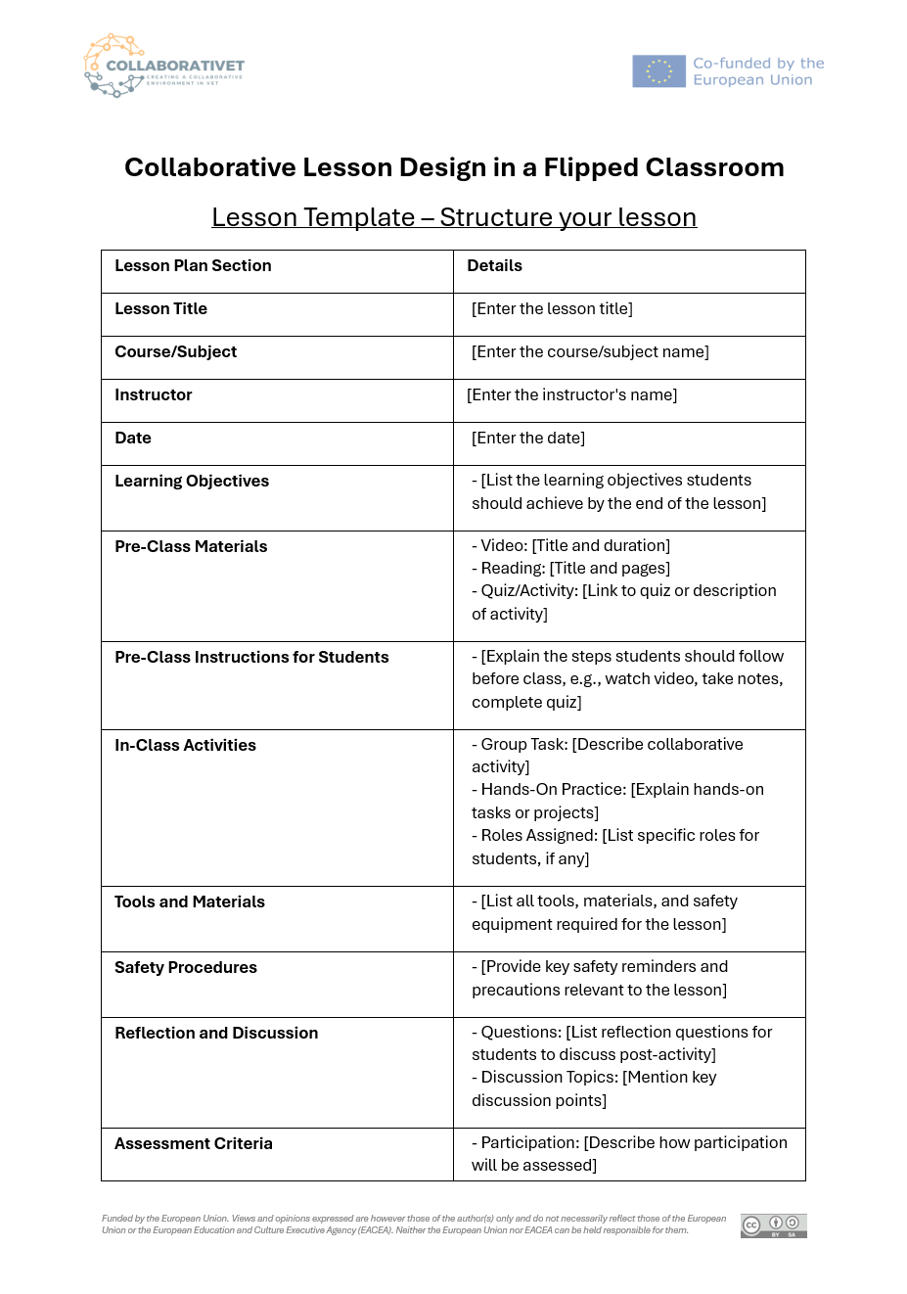
How to create your lesson plan?
Provide Lesson Details: Begin by entering the lesson title, course, instructor's name, and date of the lesson.
Define Learning Objectives: Clearly specify the skills or knowledge students should gain by the end of the lesson.
Outline Pre-Class and In-Class Activities: List pre-class materials and instructions, then describe collaborative and hands-on activities for in-class learning.
Detail Tools, Safety, and Reflection: Document all required tools, safety procedures, and reflection questions to ensure a comprehensive learning experience.
Describe Assessment and Follow-Up: Specify assessment criteria, including participation and skill mastery, and include post-class assignments or additional resources for continued learning.
Check our CollaboratiVET Template
Funded by the European Union. Views and opinions expressed are however those of the author(s) only and do not necessarily reflect those of the European Union or the European Education and Culture Executive Agency (EACEA). Neither the European Union nor EACEA can be held responsible for them.

Slide 19
Case Study: Implementing Collaborative Learning in IT Networking
Enhancing Skills and Engagement in IT Networking through Collaborative Learning
Background: The IT Networking program at TechVoc College faced challenges in engaging students with complex networking concepts and practical applications using traditional lecture methods.
Challenge: Engaging students with complex networking concepts and practical applications using traditional lecture methods.
Implementation:
Flipped Classroom Model: Instructors introduced new networking concepts through video lectures and online readings as homework, reserving class time for hands-on, collaborative problem-solving activities.
Collaborative Lesson Design: Students were organized into teams to design and implement network solutions based on scenarios provided in pre-class materials. Teams were tasked with different aspects of network setup and troubleshooting, promoting specialization and comprehensive understanding.
Pre-Class Engagement: Interactive materials and quizzes ensured students arrived prepared, fostering a readiness to dive into hands-on activities and discussions.
Collaborative Activities: Students collaborated on real-world networking problems, relying on each team member's insights and skills to develop and implement solutions.
Technology Integration: Utilization of network simulation software and collaborative tools like GitHub for code sharing and version control enabled effective planning and execution of network designs.
Peer Teaching: Teams presented their network solutions to the class, explaining the rationale behind their design choices and troubleshooting methods, enhancing peer learning.
Feedback and Reflection: Regular feedback sessions and reflective exercises helped students identify their strengths and areas for growth, both technically and in teamwork.
Outcomes:
Enhanced Student Engagement: The shift to a flipped classroom and emphasis on collaborative projects significantly boosted interest and participation in networking topics.
Improved Learning Outcomes: Students showed marked improvement in both theoretical knowledge and practical networking skills, with better performance in assessments and projects.
Increased Collaboration Skills: The program fostered essential soft skills, including communication, teamwork, and problem-solving, preparing students for the collaborative nature of IT work.
Positive Feedback: Students reported a more enjoyable and engaging learning experience, appreciating the practical application of concepts and the opportunity to work closely with peers.
Funded by the European Union. Views and opinions expressed are however those of the author(s) only and do not necessarily reflect those of the European Union or the European Education and Culture Executive Agency (EACEA). Neither the European Union nor EACEA can be held responsible for them.

Slide 20
Sample Lesson Plan: Electrical Wiring
Pre-Class
Content: Students review safety protocols and basic wiring techniques via video.
Activity: Complete a short quiz to assess understanding of safety measures.
In-Class
Hands-On Task: Small groups set up circuits, troubleshoot issues, and present their setup for peer feedback.
Collaboration: Groups work together to identify and solve common wiring problems, with each member contributing specific skills.
Post-Class
Reflection Assignment: Complete a reflection on challenges faced, solutions applied, and how safety protocols were implemented during the activity.
Funded by the European Union. Views and opinions expressed are however those of the author(s) only and do not necessarily reflect those of the European Union or the European Education and Culture Executive Agency (EACEA). Neither the European Union nor EACEA can be held responsible for them.

Slide 21
Reflection Activity
How do my current lesson designs facilitate active learning and collaboration among students?
Engagement and Preparation: How do I ensure students are adequately prepared and engaged with the material before class? What strategies could I implement to enhance pre-class engagement?
Collaborative Activities: Reflect on the collaborative activities currently used in your lessons. Are they effective in promoting deep understanding and peer interaction? How can they be improved?
Technology Integration: Consider the role of technology in your lesson designs. Is it being used to its full potential to facilitate collaboration and active learning? What tools could further enhance your lessons?
Feedback Mechanisms: How are feedback mechanisms integrated into your lessons? Are they timely, constructive, and conducive to student growth? How can you make feedback more meaningful?
Assessment Alignment: Evaluate whether your assessments are aligned with your learning objectives. Do they accurately measure the desired learning outcomes? How can you adjust them for better alignment?
Funded by the European Union. Views and opinions expressed are however those of the author(s) only and do not necessarily reflect those of the European Union or the European Education and Culture Executive Agency (EACEA). Neither the European Union nor EACEA can be held responsible for them.

