Slide 1
CollaboratiVET Curriculum for VET teachers/trainers/educators
Module 2: The Flipped Classroom Approach
2.4: Scaling and Sustaining the Flipped Classroom Model
Funded by the European Union. Views and opinions expressed are however those of the author(s) only and do not necessarily reflect those of the European Union or the European Education and Culture Executive Agency (EACEA). Neither the European Union nor EACEA can be held responsible for them.

Slide 2
Learning Objectives
By the end of this unit, participants will be able to:
Establish standardized processes and guidelines for flipped classroom implementation to maintain quality and coherence in educational experiences
Identify strategies and considerations essential for scaling and sustaining flipped classroom initiatives
Prepare their institutions for future education trends by embracing innovative teaching models and to integrate digital technologies

Slide 3
Why is scaling flipped classroom initiatives considered crucial for educational institutions?
Enhancing Accessibility and Equity
Quality Assurance and Collaboration
Student Engagement and Future Preparedness
Flipped Classroom democratizes access to student-centered learning.
Promotes educational equity across various courses and disciplines.
Ensures all students have opportunities for engaging in flipped learning.
Standardized processes maintain quality and coherence.
Facilitates cross-departmental collaboration among faculty.
Knowledge sharing, best practices exchange, and collective innovation.
Increased student engagement and academic performance.
Higher levels of student satisfaction and success.
Prepares institutions for future education trends and challenges.
Funded by the European Union. Views and opinions expressed are however those of the author(s) only and do not necessarily reflect those of the European Union or the European Education and Culture Executive Agency (EACEA). Neither the European Union nor EACEA can be held responsible for them.

Slide 4
Why is scaling flipped classroom initiatives considered crucial for educational institutions?
Source: https://www.youtube.com/watch?v=C0aWBcnB4vs
Funded by the European Union. Views and opinions expressed are however those of the author(s) only and do not necessarily reflect those of the European Union or the European Education and Culture Executive Agency (EACEA). Neither the European Union nor EACEA can be held responsible for them.

Slide 5
Key Considerations for Scaling Flipped Learning
Cross-departmental collaboration: Foster collaboration among educators to share best practices and resources.
Technology investment: Ensure robust infrastructure for content delivery and collaboration (LMS, video platforms).
Standardization: Establish clear guidelines and processes to ensure consistency across different courses.
Funded by the European Union. Views and opinions expressed are however those of the author(s) only and do not necessarily reflect those of the European Union or the European Education and Culture Executive Agency (EACEA). Neither the European Union nor EACEA can be held responsible for them.

Slide 6
Encouraging Cross-Departmental Collaboration
Foster an environment of collaboration among faculty members from various departments.
Encourage sharing of resources, experiences, and best practices related to flipped learning.
Establish standardized processes and guidelines for implementation.
Define clear roles and responsibilities for educators.
Create evaluation criteria for assessing effectiveness.
Promote innovative ideas and strategies exchange.
Funded by the European Union. Views and opinions expressed are however those of the author(s) only and do not necessarily reflect those of the European Union or the European Education and Culture Executive Agency (EACEA). Neither the European Union nor EACEA can be held responsible for them.

Slide 7
The Importance of Technology Infrastructure
Learning management systems (LMS) support content delivery and assignment management.
Multimedia creation tools allow educators to create engaging pre-class materials.
Video hosting platforms provide students with easy access to instructional content.
Funded by the European Union. Views and opinions expressed are however those of the author(s) only and do not necessarily reflect those of the European Union or the European Education and Culture Executive Agency (EACEA). Neither the European Union nor EACEA can be held responsible for them.

Slide 8
Investing in Robust Technology Infrastructure
Provide access to learning management systems, multimedia creation tools, and video hosting platforms.
Support delivery and management of flipped classroom content.
Enhance student engagement and participation through digital resources.
Facilitate collaboration and communication among educators, students, and administrators.
Equip educators with tools and resources to effectively implement flipped classroom practices.
Support student success through strategic investment in technology.
Funded by the European Union. Views and opinions expressed are however those of the author(s) only and do not necessarily reflect those of the European Union or the European Education and Culture Executive Agency (EACEA). Neither the European Union nor EACEA can be held responsible for them.

Slide 9
Standardizing the Flipped Classroom Approach
Standardizing the Flipped Classroom Approach means creating a consistent framework across courses and departments to ensure a unified and effective learning experience. This involves developing clear guidelines for course design, defining the roles and responsibilities of educators, and setting evaluation criteria to measure the success of the flipped model. By standardizing these elements, institutions can ensure quality, consistency, and scalability in delivering flipped learning.
Create standardized guidelines for course design, ensuring consistency in pre-class content, in-class activities, and assessments.
Define clear roles and responsibilities for educators in implementing the flipped model.
Develop evaluation criteria for measuring the effectiveness of the flipped classroom in different departments.
HOW?
Funded by the European Union. Views and opinions expressed are however those of the author(s) only and do not necessarily reflect those of the European Union or the European Education and Culture Executive Agency (EACEA). Neither the European Union nor EACEA can be held responsible for them.

Slide 10
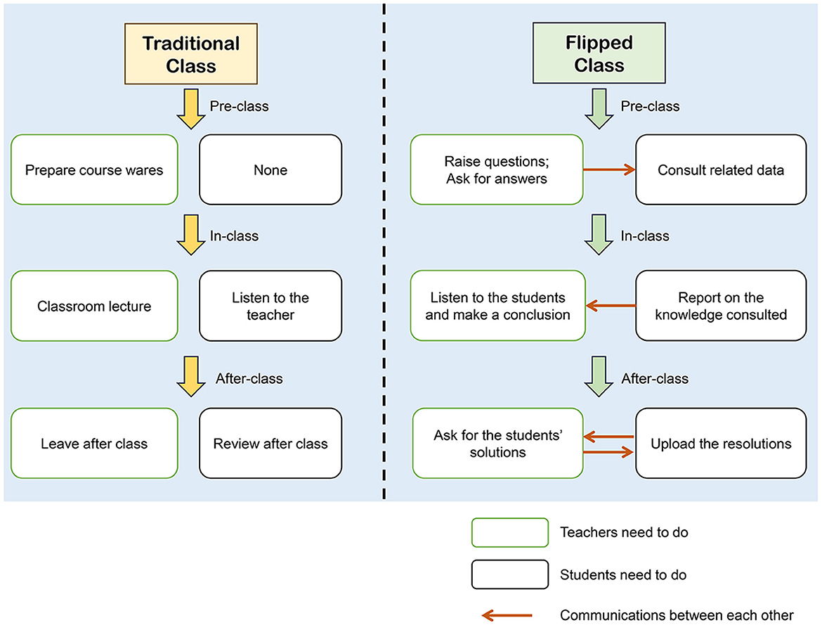
Standardizing the Flipped Classroom Approach
Check list
Course Design Guidelines:
Standardize pre-class content (e.g., videos, readings) across courses.
Create a consistent format for in-class activities, focusing on engagement and collaboration.
Ensure assessments align with course objectives and flipped classroom goals.
Educator Roles and Responsibilities:
Clearly define the role of educators as facilitators rather than lecturers.
Assign responsibilities for content creation, student feedback, and in-class guidance.
Evaluation Criteria:
Develop benchmarks for assessing student engagement, comprehension, and collaboration.
Create rubrics for evaluating the effectiveness of the flipped model in different courses or departments.
Source: https://www.frontiersin.org/journals/education/articles/10.3389/feduc.2024.1382948/full
Funded by the European Union. Views and opinions expressed are however those of the author(s) only and do not necessarily reflect those of the European Union or the European Education and Culture Executive Agency (EACEA). Neither the European Union nor EACEA can be held responsible for them.

Slide 11
Recipe for Success…
Engaging and Interactive Content:
Utilize multimedia elements like videos, simulations, and quizzes.
Cater to diverse learning styles and boost student engagement.
Clear Learning Objectives:
Communicate learning objectives aligning with course outcomes.
Maintain coherence and relevance for flipped lessons.
Active Learning In-Class:
Design activities promoting critical thinking and collaboration.
Facilitate knowledge application through problem-solving and discussions.
Timely Feedback:
Provide constructive feedback on pre-class assignments and in-class activities.
Use formative assessments to gauge comprehension and adjust instructional strategies.
Educational Technology Integration:
Utilize interactive platforms, virtual labs, and collaboration tools.
Enhance student interaction and participation in flipped learning experiences.
Funded by the European Union. Views and opinions expressed are however those of the author(s) only and do not necessarily reflect those of the European Union or the European Education and Culture Executive Agency (EACEA). Neither the European Union nor EACEA can be held responsible for them.

Slide 12
Additional Ingredients…
1. Personalized Learning Pathways:
Offer supplementary resources and personalized learning materials.
Accommodate varying learning paces and preferences.
2. Collaborative Learning Environment:
Foster peer teaching, group projects, and peer feedback mechanisms.
Promote active student participation and mutual support.
3. Reflection and Metacognition:
Incorporate opportunities for reflection and self-assessment.
Foster self-regulation skills and monitoring of learning progress.
4. Continuous Professional Development:
Provide training workshops and peer mentoring for instructors.
Enhance pedagogical skills and technical proficiency in flipped learning.
5. Evaluation and Continuous Improvement:
Collect feedback from students and faculty members.
Utilize data analytics to evaluate learning outcomes and refine practices.
Funded by the European Union. Views and opinions expressed are however those of the author(s) only and do not necessarily reflect those of the European Union or the European Education and Culture Executive Agency (EACEA). Neither the European Union nor EACEA can be held responsible for them.

Slide 13
Ensuring Long-Term Success of Flipped Classroom Model
Strategies for Sustainable Effectiveness...
... align online and face-to-face components with learning objectives, outcomes, and standards.
... employ formative and summative assessment tools across both components.
... clear and consistent communication of expectations, instructions, and feedback for both online and in-person activities.
... foster deeper understanding and sustain interest.
... guidance, scaffolding, and differentiated instruction to support learners' needs.
... collect data, feedback, and reflections from both components.
... evaluate effectiveness and make informed adjustments for optimized learning experiences.
Funded by the European Union. Views and opinions expressed are however those of the author(s) only and do not necessarily reflect those of the European Union or the European Education and Culture Executive Agency (EACEA). Neither the European Union nor EACEA can be held responsible for them.

Slide 14
A Flipped Classroom is Not a Time-Saving Teaching Method!
Developing an online learning path and a corresponding lecture that is at the same time also a valuable learning experience requires careful preparation.
Funded by the European Union. Views and opinions expressed are however those of the author(s) only and do not necessarily reflect those of the European Union or the European Education and Culture Executive Agency (EACEA). Neither the European Union nor EACEA can be held responsible for them.

Slide 15
Ensuring the ongoing effectiveness of the Flipped Classroom model
1. Continuous Assessment and Feedback
2. Ongoing Professional Development
3. Inclusivity and Supportive Technology Integration
Consistently assess impact on student learning outcomes, engagement, and satisfaction
Provide ongoing professional development in flipped classroom pedagogy, instructional design, and technology integration
Provide ongoing professional development in flipped classroom pedagogy, instructional design, and technology integration
Funded by the European Union. Views and opinions expressed are however those of the author(s) only and do not necessarily reflect those of the European Union or the European Education and Culture Executive Agency (EACEA). Neither the European Union nor EACEA can be held responsible for them.

Slide 16
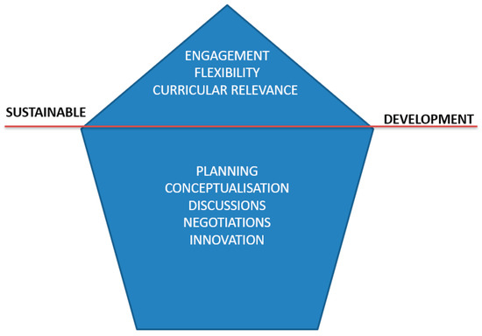
Ensuring the ongoing effectiveness of the Flipped Classroom model
Funded by the European Union. Views and opinions expressed are however those of the author(s) only and do not necessarily reflect those of the European Union or the European Education and Culture Executive Agency (EACEA). Neither the European Union nor EACEA can be held responsible for them.

Slide 17
Professional Development for Educators
Professional development is essential for educators to successfully implement the flipped classroom model. This involves providing ongoing training on pedagogical techniques and technology integration, ensuring that educators can effectively create and deliver content for flipped learning environments.
Additionally, peer mentoring and faculty workshops create opportunities for educators to share best practices, collaborate on new strategies, and overcome common challenges. Continuous learning helps educators stay updated on innovative approaches that enhance student engagement and learning outcomes.
Source: https://www.flglobal.org/training2021/
Funded by the European Union. Views and opinions expressed are however those of the author(s) only and do not necessarily reflect those of the European Union or the European Education and Culture Executive Agency (EACEA). Neither the European Union nor EACEA can be held responsible for them.

Slide 18
Continuous Assessment of the Flipped Classroom Model
To ensure the effectiveness of the flipped classroom model, continuous assessment is key. To effectively assess the flipped classroom model, follow these step-by-step strategies to ensure alignment and continuous improvement:
Establish Clear Learning Objectives:
Start by clearly defining what you want students to achieve both from the pre-class materials and in-class activities.
Use Formative Assessments:
Implement quizzes, discussion prompts, or reflections during and after pre-class activities to monitor student understanding before in-class sessions.
Summative Assessments:
Design end-of-unit tests, projects, or presentations to evaluate cumulative learning outcomes and ensure content mastery.
Review the Alignment:
Regularly check if the online materials align with in-class tasks, ensuring that pre-class preparation effectively supports classroom discussions and hands-on work.
Collect Feedback:
Ask for student feedback on their experiences with both the pre-class content and in-class activities. Use surveys or one-on-one check-ins to gather insights.
Analyze Performance Data:
Look at student performance on formative and summative assessments to identify trends in learning progress.
Adjust Teaching Strategies:
Based on the data and feedback, adjust your content, in-class activities, or assessment methods to better align with learning goals and improve student outcomes.
Funded by the European Union. Views and opinions expressed are however those of the author(s) only and do not necessarily reflect those of the European Union or the European Education and Culture Executive Agency (EACEA). Neither the European Union nor EACEA can be held responsible for them.

Slide 19
Importance of Data-Driven Improvement
Data-driven improvement is essential for refining the flipped classroom model. To ensure continuous enhancement of the flipped classroom model, follow these step-by-step strategies for using data to drive improvement:
Collect Quantitative Data: Use metrics such as quiz scores, exam results, and attendance records to measure student performance. Gather data on engagement levels by tracking participation in discussions and group activities.
Collect Qualitative Data: Conduct student surveys, feedback forms, and reflective essays to understand their learning experience, motivation, and satisfaction with the flipped classroom approach.
Analyze Student Performance: Review the data to identify trends in student progress, noting areas where students are excelling and areas where they may be struggling.
Evaluate Engagement and Participation: Assess how actively students are participating in both pre-class and in-class activities. Look for patterns of high engagement or low involvement and determine the causes.
Compare Learning Outcomes: Compare current learning outcomes with previous terms or classes that used traditional teaching methods. Evaluate whether the flipped classroom model has led to measurable improvements in student performance.
Identify Areas for Improvement: Based on your analysis, identify specific areas where the flipped classroom can be improved—whether it’s modifying content delivery, enhancing collaboration, or providing more resources for struggling students.
Implement Changes: Use the insights gained from the data to adjust teaching methods, update content, or modify assessments. Regularly review the effectiveness of these changes to ensure continuous improvement.
Funded by the European Union. Views and opinions expressed are however those of the author(s) only and do not necessarily reflect those of the European Union or the European Education and Culture Executive Agency (EACEA). Neither the European Union nor EACEA can be held responsible for them.

Slide 20
Key factors for sustaining the flipped classroom
Engage
Engage stakeholders at all levels (educators, students, administrators) to create a supportive learning environment.
Ensure
Ensure ongoing technology updates and support for both educators and students.
Promote
Promote collaborative learning communities to encourage the sharing of resources and ideas.
Funded by the European Union. Views and opinions expressed are however those of the author(s) only and do not necessarily reflect those of the European Union or the European Education and Culture Executive Agency (EACEA). Neither the European Union nor EACEA can be held responsible for them.

Slide 21
Reflection Activity
Reflect on the challenges and opportunities for scaling the flipped classroom model in your institution.
What resources and strategies would you need to implement flipped learning on a larger scale? How can you ensure sustainability while maintaining educational quality?
Funded by the European Union. Views and opinions expressed are however those of the author(s) only and do not necessarily reflect those of the European Union or the European Education and Culture Executive Agency (EACEA). Neither the European Union nor EACEA can be held responsible for them.

Slide 22
Additional Resources
The (Flipped) Classroom of the 21st Century https://www.panopto.com/blog/the-classroom-of-the-21st-century/
Scaling Flipped Learning Part 4: Learning Spaces, FLIP Learnings https://flippedlearning.org/syndicated/scaling-flipped-learning-part-4-learning-spaces/
Flipped Classroom: Future of Education?, LearnDash https://www.learndash.com/flipped-classroom-future-of-education-infographic/
Research, Perspectives, and Recommendations on Implementing the Flipped Classroom, Cristina Rotellar, PharmD and Jeff Cain, EdD, MS https://www.ncbi.nlm.nih.gov/pmc/articles/PMC4827585/
Scaling Flipped Learning Part 2: Shifting Pedagogy, Education Technology Solutions https://educationtechnologysolutions.com/2017/03/scaling-flipped-learning-part-2-shifting-pedagogy/
Evaluation of a Flipped Classroom Model: A Case Study from Oman , Sage Journals https://journals.sagepub.com/doi/full/10.1177/2319714520909006
Effects of flipping the classroom on learning outcomes and satisfaction: A meta-analysis, David C.D. van Alten, Chris Phielix, Jeroen Janssen, Liesbeth Kester, ScienceDirect https://www.sciencedirect.com/science/article/pii/S1747938X18305694
How the flipped classroom affects knowledge, skills, and engagement in higher education: Effects on students' satisfaction, Luis R. Murillo-Zamorano , José Ángel López Sánchez , Ana Luisa Godoy-Caballero, SienceDirect https://www.sciencedirect.com/science/article/abs/pii/S0360131519301617
Driving, sustaining and scaling up blended learning practices in higher education institutions: a proposed framework, Cher Ping Lim, Tianchong Wang & Charles Graham, BMC https://innovationeducation.biomedcentral.com/articles/10.1186/s42862-019-0002-0
How to Develop and Manage a Successful Flipped Classroom Model, Acer Corner https://blog.acer.com/en/discussion/801/how-to-develop-and-manage-a-successful-flipped-classroom-model
Funded by the European Union. Views and opinions expressed are however those of the author(s) only and do not necessarily reflect those of the European Union or the European Education and Culture Executive Agency (EACEA). Neither the European Union nor EACEA can be held responsible for them.

