Slide 1
CollaboratiVET Curriculum for VET teachers/trainers/educators
Module 2: The Flipped Classroom Approach
Unit 3 - Key Components of the Flipped Classroom
Funded by the European Union. Views and opinions expressed are however those of the author(s) only and do not necessarily reflect those of the European Union or the European Education and Culture Executive Agency (EACEA). Neither the European Union nor EACEA can be held responsible for them.

Slide 2
Learning Objectives
By the end of this unit, participants will be able to:
Understand the core components of the flipped classroom approach.
Explore how flipped learning fosters engagement, collaboration, and independent learning.
Learn how to design and implement flipped classroom environments in VET.

Slide 3
The F-L-I-P Model
F
Flexible Environment
L
Learning Culture
I
Professional Educator
P
Intentional Content
Funded by the European Union. Views and opinions expressed are however those of the author(s) only and do not necessarily reflect those of the European Union or the European Education and Culture Executive Agency (EACEA). Neither the European Union nor EACEA can be held responsible for them.

Slide 4
F…for Flexible Environment
The first pillar, emphasizes the importance of adaptability and versatility in the learning space. Educators must create environments that can accommodate diverse learning activities, preferences, and modalities. This may involve rearranging classroom layouts, integrating technology, and providing opportunities for both independent and collaborative work. By fostering flexibility, educators empower students to take ownership of their learning and tailor their experiences to suit their individual needs.
Funded by the European Union. Views and opinions expressed are however those of the author(s) only and do not necessarily reflect those of the European Union or the European Education and Culture Executive Agency (EACEA). Neither the European Union nor EACEA can be held responsible for them.

Slide 5
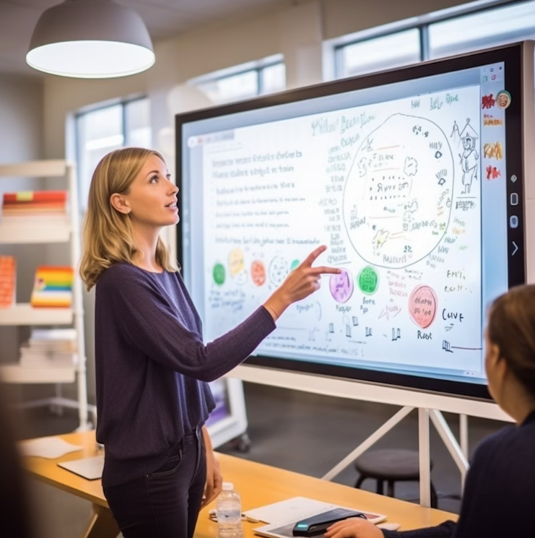
L…for Learning Culture
The second pillar, embodies a fundamental shift from a teacher-centered to a student-centered approach. In a flipping classroom, the focus is on fostering a culture of active engagement, inquiry, and collaboration. Students are encouraged to explore topics in greater depth, participate in meaningful discussions, and take ownership of their learning journey. By cultivating a dynamic and participatory learning culture, educators create opportunities for deeper understanding, critical thinking, and knowledge creation.
Funded by the European Union. Views and opinions expressed are however those of the author(s) only and do not necessarily reflect those of the European Union or the European Education and Culture Executive Agency (EACEA). Neither the European Union nor EACEA can be held responsible for them.

Slide 6
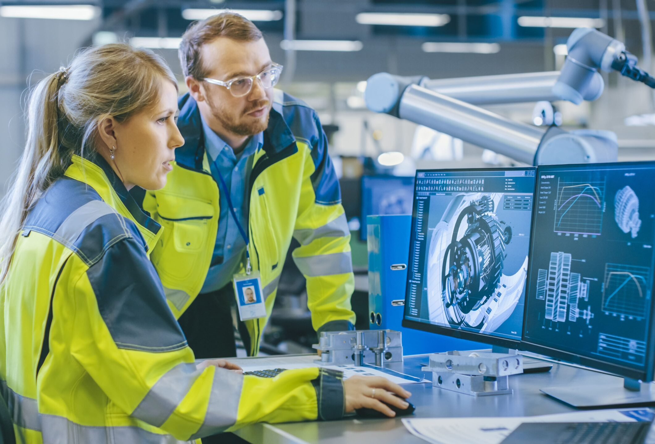
I…for Intentional Content
The third pillar, underscores the importance of thoughtful and purposeful content design. Educators must carefully select and curate materials that align with learning objectives, promote conceptual understanding, and facilitate meaningful learning experiences. This may involve creating engaging multimedia resources, providing scaffolding and support materials, and integrating real-world applications. By designing intentional content, educators optimize student engagement, comprehension, and retention of key concepts.
Funded by the European Union. Views and opinions expressed are however those of the author(s) only and do not necessarily reflect those of the European Union or the European Education and Culture Executive Agency (EACEA). Neither the European Union nor EACEA can be held responsible for them.

Slide 7
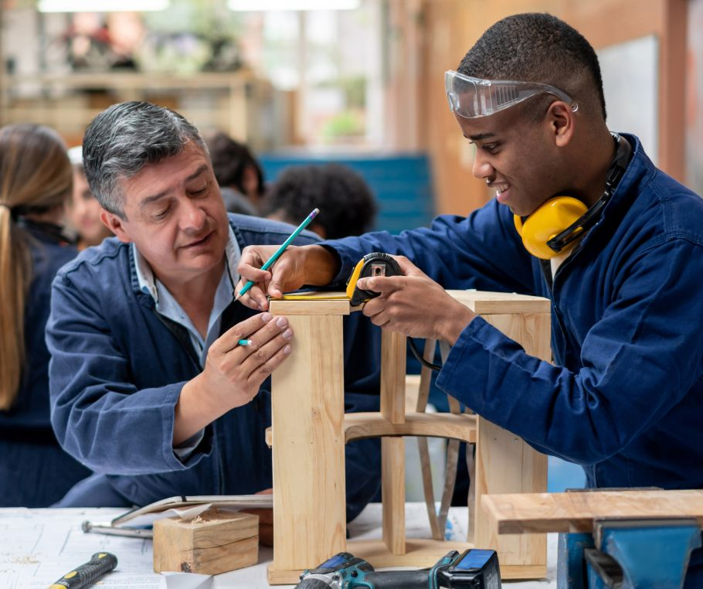
P…for Professional Educators
The fourth pillar, highlights the critical role of educators as facilitators, mentors, and guides in the learning process. In a flipped classroom, educators serve as instructional leaders, providing guidance, feedback, and support to students as they navigate their learning journey. This may involve facilitating discussions, providing personalized instruction, and fostering a collaborative and supportive learning environment. By embracing a growth mindset, engaging in reflective practice, and continuously seeking professional development opportunities, educators enhance their effectiveness and impact in the flipping classroom.
Funded by the European Union. Views and opinions expressed are however those of the author(s) only and do not necessarily reflect those of the European Union or the European Education and Culture Executive Agency (EACEA). Neither the European Union nor EACEA can be held responsible for them.

Slide 8
The 4 Pillars of the Flipped Model
F
Flexible Environment
Allow students to interact and reflect on their learning needs
L
Learning Culture
Give students the opportunity to participate in activities without the teacher being the focus of learning
I
Intentional Content
Continuously observe and monitor students to make appropriate adjustments
Establish activities and make them accessible to students through differentiation and feedback
Simplify and facilitate students’ access to the concepts used during learning
P
Create and/or select relevant content, usually in video format, for students
Professional Educator
Be available to students, both individually and collectively and give feedback in real time
Conduct ongoing formative assessments during class time through observation and recording
Funded by the European Union. Views and opinions expressed are however those of the author(s) only and do not necessarily reflect those of the European Union or the European Education and Culture Executive Agency (EACEA). Neither the European Union nor EACEA can be held responsible for them.

Slide 9
Main characteristics of a Flipped Classroom
Pre-class learning: Students engage with course materials independently (e.g., videos, readings).
In-class activities: Students focus on applying knowledge through group work, discussions, and practical exercises.
Flexible classroom environments: Students attend configurable spaces for collaborative or individual activities, revisit difficult concept and discuss with their teacher in case it is needed.
Funded by the European Union. Views and opinions expressed are however those of the author(s) only and do not necessarily reflect those of the European Union or the European Education and Culture Executive Agency (EACEA). Neither the European Union nor EACEA can be held responsible for them.

Slide 10
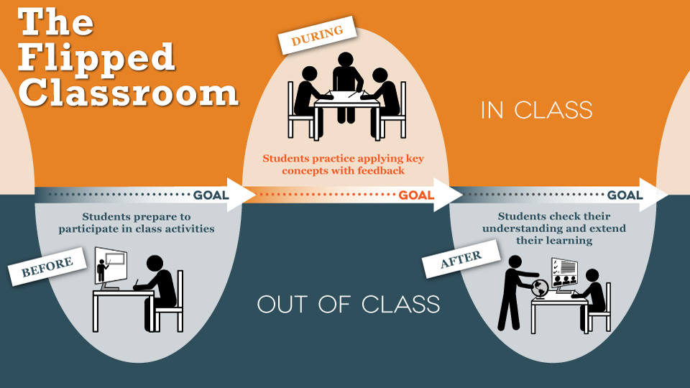
Main characteristics of a Flipped Classroom
Source: https://www.researchgate.net/figure/A-description-of-the-Flipped-classroom-model_fig7_281800116
Funded by the European Union. Views and opinions expressed are however those of the author(s) only and do not necessarily reflect those of the European Union or the European Education and Culture Executive Agency (EACEA). Neither the European Union nor EACEA can be held responsible for them.

Slide 11
Role of Technology in VET Flipped Classrooms
Transforms the Teacher’s Role: Technology shifts teachers from being traditional lecturers to becoming facilitators of learning, organizing activities and supporting students as they take ownership of their learning journey.
Improves Student Motivation and Outcomes: The use of technology in flipped classrooms boosts student motivation, engagement, and interaction, leading to better academic performance and improved learning outcomes.
Supports Feedback and Assessment: In output-oriented classrooms, technology allows for diverse assessment methods and timely feedback, enhancing the overall learning process.
Funded by the European Union. Views and opinions expressed are however those of the author(s) only and do not necessarily reflect those of the European Union or the European Education and Culture Executive Agency (EACEA). Neither the European Union nor EACEA can be held responsible for them.

Slide 12
Role of Technology in VET Flipped Classrooms
Enhances Learning Experience:Technology plays a crucial role in the flipped classroom by integrating digital tools into traditional subjects, improving student engagement and understanding.
Promotes Critical Thinking and Collaboration: Interactive activities and problem-solving exercises facilitated through technology promote critical thinking, teamwork, and active participation.
Facilitates Pre-Class Learning: Technology enables the creation of effective learning materials, such as pre-recorded videos, simulations, and online quizzes, which students can access independently before class.
Funded by the European Union. Views and opinions expressed are however those of the author(s) only and do not necessarily reflect those of the European Union or the European Education and Culture Executive Agency (EACEA). Neither the European Union nor EACEA can be held responsible for them.

Slide 13
Designing a Flipped Classroom
Define learning objectives by establishing clear learning objectives akin to laying the foundation for a scholarly journey. Define the educational goals and outcomes that students should achieve.
Choose Tools Delve by selecting and curating educational resources meticulously, ensuring alignment with learning objectives and relevance to students' academic needs.
Craft pre-class assignments that serve as preparatory groundwork, engaging students in meaningful exploration and priming their minds for in-depth discussion.
Function as a conductor orchestrating a symphony of engagement. Design in-class activities that stimulate critical thinking, collaboration, and application of acquired knowledge, fostering a dynamic and participatory learning environment.
Customize learning spaces by transforming into an adaptive designer. Tailor the physical classroom environment to accommodate diverse learning modalities, fostering inclusivity and flexibility in instructional delivery.
Engage in continuous reflection and iteration, leveraging insights gained from past experiences to refine instructional practices and optimize learning outcomes.
Funded by the European Union. Views and opinions expressed are however those of the author(s) only and do not necessarily reflect those of the European Union or the European Education and Culture Executive Agency (EACEA). Neither the European Union nor EACEA can be held responsible for them.

Slide 14
Designing a Flipped Classroom
The Flipped Class: Rethinking Space & Time
Source: https://youtu.be/BfsLbGgUMDU?feature=shared
Funded by the European Union. Views and opinions expressed are however those of the author(s) only and do not necessarily reflect those of the European Union or the European Education and Culture Executive Agency (EACEA). Neither the European Union nor EACEA can be held responsible for them.

Slide 15
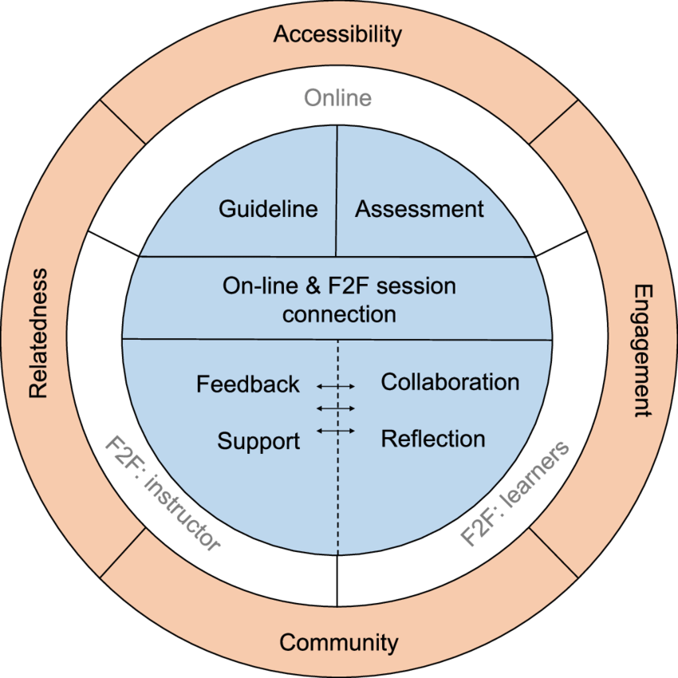
Engaging students in the Flipped Classroom
Flipped learning wheel (FLW)
Online & F2F Connection: Seamless transition between online and in-class activities.
Guidelines & Assessment: Clear instructions and aligned assessments to support learning.
Feedback & Support: Continuous feedback and instructor guidance.
Collaboration & Reflection: Promotes teamwork and student reflection on learning.
Accessibility & Engagement: Easy access to materials with engaging, interactive tasks.
Community & Relatedness: Builds a supportive learning environment and strong student-instructor relationships.
Source: Flipped learning wheel (FLW): a framework and process design for flipped L2 writing classes. April 2020. Available here: https://www.researchgate.net/publication/340416063_Flipped_learning_wheel_FLW_a_framework_and_process_design_for_flipped_L2_writing_classes
Funded by the European Union. Views and opinions expressed are however those of the author(s) only and do not necessarily reflect those of the European Union or the European Education and Culture Executive Agency (EACEA). Neither the European Union nor EACEA can be held responsible for them.

Slide 16
Tips for successful implementation
Start with small changes, flipping one lesson or module at a time.
Provide clear instructions and support for students using digital tools.
Collaborate with colleagues to share resources and best practices.
Funded by the European Union. Views and opinions expressed are however those of the author(s) only and do not necessarily reflect those of the European Union or the European Education and Culture Executive Agency (EACEA). Neither the European Union nor EACEA can be held responsible for them.

Slide 17
Reflection Activity
Review the elements of the Flipped Learning Wheel (e.g., feedback, collaboration, engagement, accessibility).Choose two components that you believe are the most critical for effective flipped learning in your context.Write them down and briefly explain why you selected them.
How can you apply the components you've chosen in your own teaching or learning environment?Consider specific examples where you could integrate technology, enhance student engagement, or foster collaboration in your flipped classroom.
Funded by the European Union. Views and opinions expressed are however those of the author(s) only and do not necessarily reflect those of the European Union or the European Education and Culture Executive Agency (EACEA). Neither the European Union nor EACEA can be held responsible for them.

Slide 18
Additional Resources
The Flipped Classroom, Center for Teaching Excellence , UTRGV https://www.utrgv.edu/cte/resources-new/course-design/flipped-classrooms/index.htm
https://elearningindustry.com/flipped-classroom-new-generation-classroom
7 Things You Should Know About Flipped Classrooms, Boise State University https://www.boisestate.edu/ctl-flipping/publications/7-know/
Flipped Classroom: The New Generation Of Classroom, eLearning Industry https://elearningindustry.com/flipped-classroom-new-generation-classroom
7 Steps To A Flipped Classroom, By TeachThought Staff / March 20, 2013 / Learning / Blended Learning, Essential, Experienced Teacher https://www.teachthought.com/learning/a-flipped-classroom/
Flipped learning https://elearning.tki.org.nz/Teaching/Future-focused-learning/Flipped-learning
The advantages of a flipped classroom, WINJIGO https://www.winjigo.com/the-advantages-of-a-flipped-classroom/
Funded by the European Union. Views and opinions expressed are however those of the author(s) only and do not necessarily reflect those of the European Union or the European Education and Culture Executive Agency (EACEA). Neither the European Union nor EACEA can be held responsible for them.

