Slide 1




CollaboratiVET Curriculum for VET teachers/trainers/educators
Module 2: The Flipped Classroom Approach
Unit 2 - The role in VET, Benefits and Challenges of the Flipped Classroom
Funded by the European Union. Views and opinions expressed are however those of the author(s) only and do not necessarily reflect those of the European Union or the European Education and Culture Executive Agency (EACEA). Neither the European Union nor EACEA can be held responsible for them.

Slide 2



Learning Objectives
  By the end of this unit, participants will be able to:
  Understand the role of the flipped classroom in vocational education and training (VET).
  Explore the benefits of flipped learning in promoting practical skills and collaboration.
  Analyse the challenges faced in implementing flipped classrooms in VET.
  Discuss potential solutions to these challenges.

Slide 3
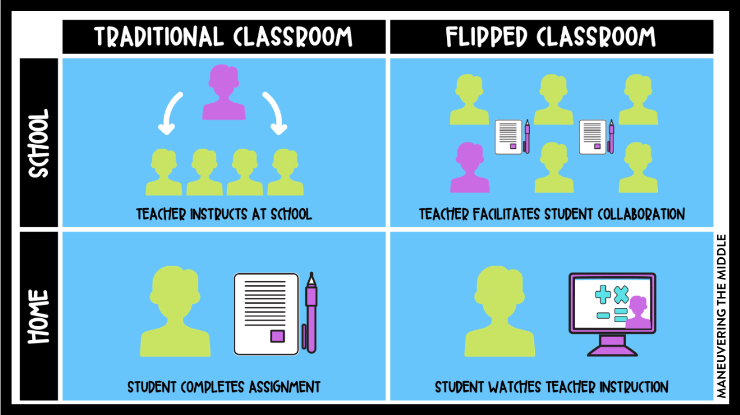
Introduction to the Flipped Classroom in VET
The flipped classroom redefines how teaching is organized by shifting content delivery to outside class time.
Students engage in pre-class learning (videos, readings) and use in-class time for hands-on activities and collaborative learning.
The model is especially valuable in VET where practical skills and real-world application are essential.
Source: https://www.maneuveringthemiddle.com/the-flipped-classroom-and-hybrid-learning/
Funded by the European Union. Views and opinions expressed are however those of the author(s) only and do not necessarily reflect those of the European Union or the European Education and Culture Executive Agency (EACEA). Neither the European Union nor EACEA can be held responsible for them.

Slide 4
The Role of Flipped Learning in Vocational Education
Reversing Traditional Instruction
Empowering Independent Study
Amplifying Practical Skill Development
Fostering Collaborative Learning
Aligning with VET Objectives
Maximizing Instructor Facilitation
Pre-Class Learning, In-Class Application
Access to Foundational Knowledge Anytime
Preparatory Phase for Hands-On Activities
In-Class Sessions for Peer Interaction
Meeting Industry Demands for Practical Proficiency
Guiding and Supporting In-Class Engagement
Funded by the European Union. Views and opinions expressed are however those of the author(s) only and do not necessarily reflect those of the European Union or the European Education and Culture Executive Agency (EACEA). Neither the European Union nor EACEA can be held responsible for them.

Slide 5
The Role of Flipped Learning in Vocational Education
Create
Evaluate
Analyse
Apply
Understand
Remember
The flipped learning approach is highly relevant in vocational education due to its ability to engage students in higher-order thinking and practical applications.
By moving traditional lectures outside the classroom, VET learners can spend class time on hands-on activities, problem-solving, and skill-building.
Various Studies (Bhagat et al., 2016; Singh et al., 2017) show improved cognitive skills and higher achievement in flipped classroom settings compared to traditional methods.
Bhagat, V., Haque, M., Bin Abu Bakar, Y. I., Husain, R., & Khairi, C. M. (2016). Emotional maturity of medical students impacting their adult learning skills in a newly established public medical school at the east coast of Malaysian Peninsula. Advances in medical education and practice, 575-584. Available here.
Singh, H., Jaswant, S., Singh, C. K. S., Mohtar, T. M. T., and Mostafa, N. A. (2017). A review of research on flipped classroom approach for teaching communication skills in English. Available here.
Funded by the European Union. Views and opinions expressed are however those of the author(s) only and do not necessarily reflect those of the European Union or the European Education and Culture Executive Agency (EACEA). Neither the European Union nor EACEA can be held responsible for them.

Slide 6
Advancement of VET Programs by…
1
Optimizing In-Person Sessions
2
Fostering Practical Application
3
Cultivating Essential Competencies
4
Flexibility and Inclusivity
Funded by the European Union. Views and opinions expressed are however those of the author(s) only and do not necessarily reflect those of the European Union or the European Education and Culture Executive Agency (EACEA). Neither the European Union nor EACEA can be held responsible for them.

Slide 7
Impact of Flipped Learning in VET
Cognitive Impact
Self-regulation and Self-efficacy
Emotional Impact
Real-World Skills Development
Funded by the European Union. Views and opinions expressed are however those of the author(s) only and do not necessarily reflect those of the European Union or the European Education and Culture Executive Agency (EACEA). Neither the European Union nor EACEA can be held responsible for them.

Slide 8
Cognitive Impact
Emotional Impact
Higher Cognitive Skills: Flipped classrooms engage students in higher-order thinking, improving critical thinking, problem-solving, and creativity.
Achievement in Specialised Fields: Studies show improvement in specific fields like mathematics and radiology with learners gaining better understanding and skill development.
Flipped learning positively influences learners' motivation, self-efficacy, and engagement.
Studies show increased learner enthusiasm and collaboration, fostering a better learning environment.
Real-world skills
Self-regulation and self-efficacy
Flipped classrooms improve responsibility, problem-solving ability, creative thinking, and communication skills among VET learners.
By simulating real-world work scenarios, flipped learning fosters the development of skills needed for the workplace.
Flipped learning helps students take control of their learning by managing time and tasks effectively
Vocational learners in flipped classrooms are more likely to persevere and achieve high scores
Source: A conceptual review of the effectiveness of flipped learning in vocational learners’ cognitive skills and emotional states. Available here.
Funded by the European Union. Views and opinions expressed are however those of the author(s) only and do not necessarily reflect those of the European Union or the European Education and Culture Executive Agency (EACEA). Neither the European Union nor EACEA can be held responsible for them.

Slide 9
Practical Skill Acquisition > Direct Path to Workforce Readiness
Addressing Skills Gap > Meeting Industry Demand for Specialized Expertise
Promoting Lifelong Learning > Cultivating Continuous Professional Development
Driving Economic Growth > Empowering Individuals for Career Advancement
Fostering Job Satisfaction > Aligning Skills with Personal and Professional Goals
Advancing Societal Well-Being > Contributing to Stable Employment and Prosperity
Bridging Skills to Careers
Funded by the European Union. Views and opinions expressed are however those of the author(s) only and do not necessarily reflect those of the European Union or the European Education and Culture Executive Agency (EACEA). Neither the European Union nor EACEA can be held responsible for them.

Slide 10
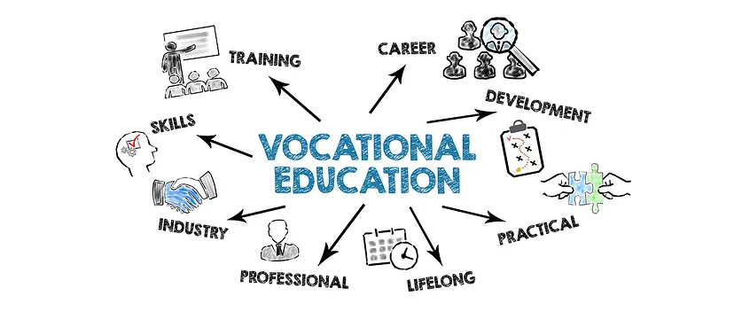
Bridging Skills to Careers
Real-World Skill Application: The flipped classroom approach provides opportunities for students to apply theoretical knowledge to real-world tasks. By dedicating in-class time to hands-on activities, simulations, and case studies, learners develop practical skills directly related to their career paths.
Enhancing Critical Workforce Skills: Through collaborative projects and problem-solving exercises, the flipped model helps students develop critical workforce skills such as:
                Problem-solving and critical thinking.
                Communication and teamwork.
                Adaptability and self-management.
Funded by the European Union. Views and opinions expressed are however those of the author(s) only and do not necessarily reflect those of the European Union or the European Education and Culture Executive Agency (EACEA). Neither the European Union nor EACEA can be held responsible for them.

Slide 11
Bridging Skills to Careers
Personalized Learning for Career Readiness: The flipped approach allows students to progress at their own pace with pre-class materials, ensuring they master foundational skills before applying them in class. This prepares them to meet the specific demands of their chosen careers, making them job-ready upon graduation.
Industry Alignment: Instructors can align flipped classroom activities with industry standards and emerging trends, ensuring that learners are prepared for the latest workplace technologies and practices.
Lifelong Learning: By promoting self-directed learning, the flipped model nurtures a mindset of continuous learning, which is essential for staying competitive in an evolving job market.
Funded by the European Union. Views and opinions expressed are however those of the author(s) only and do not necessarily reflect those of the European Union or the European Education and Culture Executive Agency (EACEA). Neither the European Union nor EACEA can be held responsible for them.

Slide 12
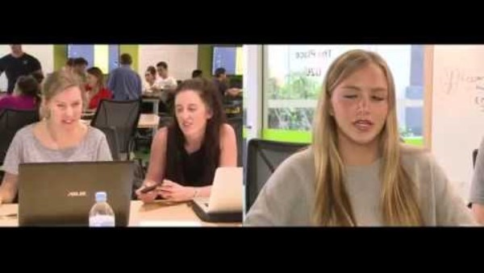
Bridging Skills to Careers
End of lectures as we know them? Business school flipped classrooms
Funded by the European Union. Views and opinions expressed are however those of the author(s) only and do not necessarily reflect those of the European Union or the European Education and Culture Executive Agency (EACEA). Neither the European Union nor EACEA can be held responsible for them.

Slide 13

Bridging Skills to Careers
Engaging Vocational Students with the Flipped Classroom
Source: https://youtu.be/mDz8sdlBP8o?feature=shared
Funded by the European Union. Views and opinions expressed are however those of the author(s) only and do not necessarily reflect those of the European Union or the European Education and Culture Executive Agency (EACEA). Neither the European Union nor EACEA can be held responsible for them.

Slide 14
Importance of Flipped Approach in Specific Fields
Case studies
In Maastricht University, Netherlands, a study, identified the benefits of the flipped approach. Although primarily focused on public health education, the application of flipped classroom formats in vocational contexts was explored. More information can be found here.
Other examples:
Flipped learning has proven particularly effective in technical and healthcare fields, improving both theoretical and practical knowledge
Learners in engineering and agriculture benefit from the method's flexibility and emphasis on critical thinking and problem-solving
Source: A conceptual review of the effectiveness of flipped learning in vocational learners’ cognitive skills and emotional states. Available here.
Funded by the European Union. Views and opinions expressed are however those of the author(s) only and do not necessarily reflect those of the European Union or the European Education and Culture Executive Agency (EACEA). Neither the European Union nor EACEA can be held responsible for them.

Slide 15
Challenges of Flipped Classroom in VET
Tight Budgets Limiting Investment in Infrastructure
Cost-Prohibitive Technology Procurement
Ensuring Equitable Access for All Students
Educators Lacking Proficiency in Digital Tools
Integration of Multimedia Content Requires Training
Impeding Effective Implementation of Flipped Learning
Funded by the European Union. Views and opinions expressed are however those of the author(s) only and do not necessarily reflect those of the European Union or the European Education and Culture Executive Agency (EACEA). Neither the European Union nor EACEA can be held responsible for them.

Slide 16
What strategies should be followed to deal with ?
1. Clear Alignment with Learning Objectives and Standards
2. Careful Planning for Technology-Enhanced Activities
3. Investment in Robust Learning Management Systems (LMS)
4. Provision of Multimedia Tools and Technical Support Services
5. Ongoing Training and Support for Educators and Students
Funded by the European Union. Views and opinions expressed are however those of the author(s) only and do not necessarily reflect those of the European Union or the European Education and Culture Executive Agency (EACEA). Neither the European Union nor EACEA can be held responsible for them.

Slide 17
The Future of Flipped learning in Vocational Education and Training
As flipped learning continues to evolve, it will play a key role in digital transformation, helping VET learners adapt to emerging technologies and industry trends.
The method's flexibility and adaptability make it ideal for addressing future workforce needs.
Funded by the European Union. Views and opinions expressed are however those of the author(s) only and do not necessarily reflect those of the European Union or the European Education and Culture Executive Agency (EACEA). Neither the European Union nor EACEA can be held responsible for them.

Slide 18

The Future of Flipped learning in Vocational Education and Training
As the educational landscape evolves rapidly, it is essential to make VET more appealing by embracing innovation and modernization. This can be achieved by introducing new learning environments, cutting-edge tools, and progressive teaching methods.
One of the most effective approaches to drive this transformation is Flipped Learning, which empowers learners through active participation and the integration of technology, making vocational education more dynamic and relevant to today’s needs.
Source: https://op.europa.eu/webpub/empl/VET-skills-for-today-and-future/pdf/KE0621179ENN.pdf
Funded by the European Union. Views and opinions expressed are however those of the author(s) only and do not necessarily reflect those of the European Union or the European Education and Culture Executive Agency (EACEA). Neither the European Union nor EACEA can be held responsible for them.

Slide 19
Additional Resources
The flipped classroom: A review of its advantages and challenges, Science Direct https://www.sciencedirect.com/science/article/abs/pii/S0360131518302045
Pros and Cons of a Flipped Classroom, School of Education American University – Washington DC https://soeonline.american.edu/blog/flipped-classroom-pros-ands-cons/
What are the main challenges and solutions for flipped classroom implementation? https://www.linkedin.com/advice/3/what-main-challenges-solutions-flipped-classroom
Proceedings of the 2014 International Conference on Economic Management and Trade Cooperation , Atlantis Press https://www.atlantis-press.com/proceedings/emtc-14/11721
Flip- IT! Flipped Classroom in European Vocational Education, Itstudy https://www.itstudy.hu/en/projects/flipped-classroom
A conceptual review of the effectiveness of flipped learning in vocational learners’ cognitive skills and emotional states, Frontiers (Published online 2023 Jan 13) https://www.frontiersin.org/journals/psychology/articles/10.3389/fpsyg.2022.1039025/full
New Blended Learning Strategy Based on Flipped-Learning for Vocational Work-Linked Training, Mohamed El Hajji, Rachid Drissi El Bouzaidi, Hassan Douzi, El Hassane Khouya, Journal of Education and Practice, Vol.7, No.36, 2016
The Flipped-Classroom Instructional Procedure Development and Its Implementation Effectiveness in Improving Procedural Knowledge Learning Outcomes at Vocational High Schools, Admaja Dwi Herlambang, Olivia Dyah Fransisca, Tri Afirianto, ELINVO (Electronics, Informatics, and Vocational Education), November 2023;vol8(2):201-213
Funded by the European Union. Views and opinions expressed are however those of the author(s) only and do not necessarily reflect those of the European Union or the European Education and Culture Executive Agency (EACEA). Neither the European Union nor EACEA can be held responsible for them.

Slide 20



Reflection Activity
Reflect on Current Practices: Think about the current state of VET in your institution or community.What are some challenges or limitations you see in terms of engagement, technology integration, or teaching methods? Write down one area where VET could benefit from innovation.
Explore the Potential of Flipped Learning: How could flipped learning address the challenges you identified? In what ways can this approach make VET more appealing, interactive, and relevant to learners? Consider specific tools or strategies (e.g., interactive videos, collaborative projects, online discussions).
Develop an Action Plan: Based on your reflections, create a brief action plan outlining how you could introduce or improve flipped learning in your VET environment. Identify one specific course or module where you can implement flipped learning, and describe the tools, methods, and resources you would need to get started.
Funded by the European Union. Views and opinions expressed are however those of the author(s) only and do not necessarily reflect those of the European Union or the European Education and Culture Executive Agency (EACEA). Neither the European Union nor EACEA can be held responsible for them.

