Slide 1
CollaboratiVET Curriculum for VET teachers/trainers/educators
Module 2: The Flipped Classroom Approach
Unit 1 - Introduction to the Flipped Classroom Model
Funded by the European Union. Views and opinions expressed are however those of the author(s) only and do not necessarily reflect those of the European Union or the European Education and Culture Executive Agency (EACEA). Neither the European Union nor EACEA can be held responsible for them.

Slide 2
Learning Objectives
By the end of this unit, participants will be able to:
Understand the concept and principles of Flipped Classroom.
Recognise the educational value where flipped learning is most effective and the factors influencing its effectiveness.
Recognise the value of digital tools and creative thinking in the Flipped Classroom but the challenges that have to be faced as well.
Identify the variations of flipped classroom models.
Learn how to design an effective flipped classroom course.

Slide 3
What is Flipped Classroom?
Flipped classroom is a form of blended learning where learners read or watch online lecture materials at home, before participating in interaction in a classroom environment.
UNESCO-UNEVOC Glossary. Available here.
Funded by the European Union. Views and opinions expressed are however those of the author(s) only and do not necessarily reflect those of the European Union or the European Education and Culture Executive Agency (EACEA). Neither the European Union nor EACEA can be held responsible for them.

Slide 4
What is Flipped Classroom?
Flipped classroom is an inverted method of teaching where traditional classroom activities are completed outside of class time.
Class time is dedicated to discussion, problem-solving, and student interaction.
This approach is learner-centered and technology-driven, allowing students to engage with content at their own pace.
Flipped learning in vocational education enhances professional development by improving cognitive skills (critical thinking, problem-solving) and emotional states (motivation, self-efficacy).
Funded by the European Union. Views and opinions expressed are however those of the author(s) only and do not necessarily reflect those of the European Union or the European Education and Culture Executive Agency (EACEA). Neither the European Union nor EACEA can be held responsible for them.

Slide 5
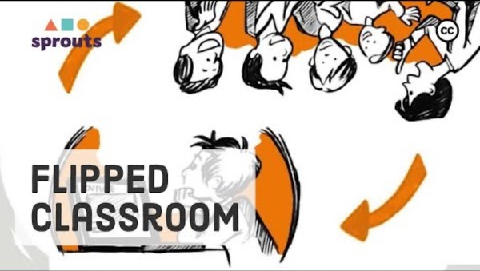
What is Flipped Classroom?
Source: https://youtu.be/qdKzSq_t8k8?feature=shared
Funded by the European Union. Views and opinions expressed are however those of the author(s) only and do not necessarily reflect those of the European Union or the European Education and Culture Executive Agency (EACEA). Neither the European Union nor EACEA can be held responsible for them.

Slide 6
Understanding the Flipped Classroom Approach
1
The Flipped Classroom Approach reverses the traditional classroom structure by shifting content delivery outside of class time
2
Detailed breakdown of the reversed classroom structure, highlighting pre-class preparation and in-class engagement
Analysis of the impact of shifting passive learning activities outside the classroom to promote interactive and engaging in-class experiences
3
Explanation of the role of technology in facilitating flipped learning and its importance in fostering flexibility and adaptability
4
Funded by the European Union. Views and opinions expressed are however those of the author(s) only and do not necessarily reflect those of the European Union or the European Education and Culture Executive Agency (EACEA). Neither the European Union nor EACEA can be held responsible for them.

Slide 7
How does it work?
1. Pre-Class Preparation:
Students are provided with instructional materials before class. These materials can include pre-recorded lectures, readings, videos, or online modules.
Students engage with these materials independently, typically outside of class time.
The aim is for students to gain exposure to foundational concepts and content at their own pace, preparing them for in-class activities.
2. In-Class Activities:
Class time is dedicated to active learning experiences, such as problem-solving tasks, group discussions, and project work.
Instead of passively receiving lectures, students apply their learning through hands-on activities and collaborative exercises.
The teacher serves as a facilitator, guiding students through these activities and providing feedback as they work through concepts and solve problems together.
Funded by the European Union. Views and opinions expressed are however those of the author(s) only and do not necessarily reflect those of the European Union or the European Education and Culture Executive Agency (EACEA). Neither the European Union nor EACEA can be held responsible for them.

Slide 8
How does it work?
3. Technology Integration:
Technology plays a crucial role in the Flipped Classroom model, facilitating access to instructional materials and enabling interactive learning experiences.
Students often access pre-class materials through digital platforms or learning management systems.
Technology also allows for flexibility in delivering content, as teachers can utilize a variety of multimedia resources to cater to different learning styles.
4. Feedback and Assessment:
In-class activities provide opportunities for immediate feedback from the teacher and peers.
Assessment in a flipped classroom may involve formative assessments during class sessions and summative assessments to evaluate student understanding over time.
Continuous feedback loops help teachers gauge student progress and adjust instruction as needed to address learning gaps.
Funded by the European Union. Views and opinions expressed are however those of the author(s) only and do not necessarily reflect those of the European Union or the European Education and Culture Executive Agency (EACEA). Neither the European Union nor EACEA can be held responsible for them.

Slide 9
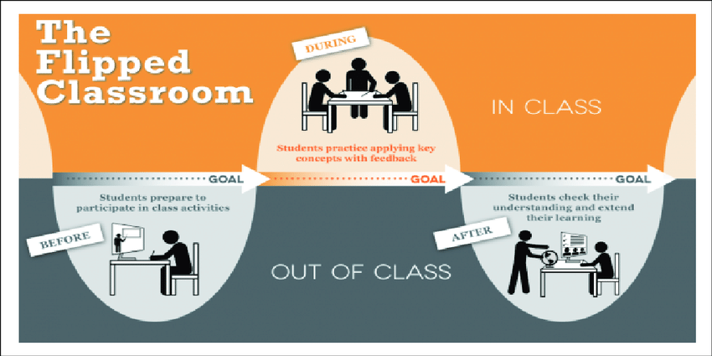
How does it work?
Source: Flipped Learning Model and the development of talent at school. Available here.
Funded by the European Union. Views and opinions expressed are however those of the author(s) only and do not necessarily reflect those of the European Union or the European Education and Culture Executive Agency (EACEA). Neither the European Union nor EACEA can be held responsible for them.

Slide 10
Bloom’s taxonomy: A revised version
Evaluation
Create
Synthesis
Evaluate
Analysis
Analyse
Application
Apply
Comprehension
Understand
Knowledge
Remember
Funded by the European Union. Views and opinions expressed are however those of the author(s) only and do not necessarily reflect those of the European Union or the European Education and Culture Executive Agency (EACEA). Neither the European Union nor EACEA can be held responsible for them.

Slide 11
Bloom’s taxonomy: A revised version
Create
After class
Evaluate
Analyse
During class
Apply
Understand
Before class
Remember
Funded by the European Union. Views and opinions expressed are however those of the author(s) only and do not necessarily reflect those of the European Union or the European Education and Culture Executive Agency (EACEA). Neither the European Union nor EACEA can be held responsible for them.

Slide 12
The 4 Pillars of the Flipped Model
Flexible Environment
F
Learning Culture
L
Intentional Content
I
Professional Educator
P
Funded by the European Union. Views and opinions expressed are however those of the author(s) only and do not necessarily reflect those of the European Union or the European Education and Culture Executive Agency (EACEA). Neither the European Union nor EACEA can be held responsible for them.

Slide 13
The 4 Pillars of the Flipped Model
F
Flexible Environment
Allow students to interact and reflect on their learning needs
Continuously observe and monitor students to make appropriate adjustments
L
Learning Culture
Give students the opportunity to participate in activities without the teacher being the focus of learning
Establish activities and make them accessible to students through differentiation and feedback
I
Intentional Content
Simplify and facilitate students’ access to the concepts used during learning
Create and/or select relevant content, usually in video format, for students
P
Professional Educator
Be available to students, both individually and collectively and give feedback in real time
Conduct ongoing formative assessments during class time through observation and recording
Funded by the European Union. Views and opinions expressed are however those of the author(s) only and do not necessarily reflect those of the European Union or the European Education and Culture Executive Agency (EACEA). Neither the European Union nor EACEA can be held responsible for them.

Slide 14
Through time …
The Flipped Classroom concept emerged in the early 2000s as educators sought innovative ways to enhance student engagement and learning outcomes.
Initially, the model relied heavily on videos and online resources to deliver pre-class content to students.
Teachers began recording lectures or curating online materials for students to review independently before attending class sessions.
This early adoption laid the groundwork for the flipped classroom approach, demonstrating its potential to transform traditional teaching methods.
Educational technology platforms have become more sophisticated, offering a wider range of tools and resources to support flipped learning.
Teachers now have access to interactive multimedia content, adaptive learning platforms, and virtual reality experiences to enhance pre-class materials.
Additionally, educational research has provided valuable insights into the effectiveness of flipped learning across various disciplines and student populations.
Studies have highlighted the benefits of active learning and student-centered instruction, further validating the flipped classroom approach.
The COVID-19 pandemic further accelerated the adoption of flipped learning as schools and universities shifted to remote and hybrid learning models.
Historical Overview
Advancement
Funded by the European Union. Views and opinions expressed are however those of the author(s) only and do not necessarily reflect those of the European Union or the European Education and Culture Executive Agency (EACEA). Neither the European Union nor EACEA can be held responsible for them.

Slide 15
Through time …
Source: https://www.globsyn.edu.in/blog/how-is-flipped-classroom-flipping-the-role-of-traditional-classroom-pedagogy
Funded by the European Union. Views and opinions expressed are however those of the author(s) only and do not necessarily reflect those of the European Union or the European Education and Culture Executive Agency (EACEA). Neither the European Union nor EACEA can be held responsible for them.

Slide 16
Variations of Flipped Classroom Models
Comparative Analysis:
Suitability:
Advantages and Challenges:
Different variations, unique characteristics, applications.
Diverse educational settings, learner needs.
Associated with each variation.
Funded by the European Union. Views and opinions expressed are however those of the author(s) only and do not necessarily reflect those of the European Union or the European Education and Culture Executive Agency (EACEA). Neither the European Union nor EACEA can be held responsible for them.

Slide 17
Examples of Flipped Classroom Models
Debate and Discussion-Based Flipped Classroom: Pre-class materials followed by class debates or discussions.
Micro-Flipped Classroom: A mix of traditional lectures and flipped content.
In-Class/Faux Flipped Classroom: Pre-class activities are completed in school due to the digital divide.
Virtual Flipped Classroom: Fully online, combining pre-class materials and virtual group sessions.
Funded by the European Union. Views and opinions expressed are however those of the author(s) only and do not necessarily reflect those of the European Union or the European Education and Culture Executive Agency (EACEA). Neither the European Union nor EACEA can be held responsible for them.

Slide 18
Analytical Framework
Developing Compelling Pre-Class Materials: Create engaging and informative materials such as videos, readings, or interactive modules and use multimedia elements to cater to diverse learning styles and maintain student interest.
Ensuring Accessibility: Provide multiple formats for accessing materials to accommodate different learning needs and ensure compatibility with various devices and internet connections to promote accessibility for all students.
Articulating Learning Objectives: Clearly communicate learning objectives for each session to guide student engagement with pre-class materials and align objectives with course outcomes and assessments to ensure coherence and relevance.
Funded by the European Union. Views and opinions expressed are however those of the author(s) only and do not necessarily reflect those of the European Union or the European Education and Culture Executive Agency (EACEA). Neither the European Union nor EACEA can be held responsible for them.

Slide 19
Strategies
Incorporate
Incorporate formative assessments such as quizzes, reflections, or online discussions to ensure students engage with pre-class materials.
Set
Set deadlines and provide incentives for completing pre-class assignments to promote accountability and motivation.
Plan
Plan interactive and collaborative activities that build upon pre-class materials and encourage active participation.
Use
Use a variety of instructional strategies such as group discussions, case studies, problem-solving tasks, and hands-on exercises to promote deeper learning.
Offer
Offer individualized support during in-class sessions through targeted interventions and differentiated instruction.
Provide
Provide timely feedback on student progress and performance to address misconceptions and guide further learning.
Foster
Foster a supportive learning environment where students feel comfortable seeking help and participating actively in discussions.
Funded by the European Union. Views and opinions expressed are however those of the author(s) only and do not necessarily reflect those of the European Union or the European Education and Culture Executive Agency (EACEA). Neither the European Union nor EACEA can be held responsible for them.

Slide 20
Advantages (over traditional methods)
Flipped courses promote active engagement by requiring students to interact with pre-class materials before attending class WHEN traditional courses often rely on passive listening during lectures, whereas flipped courses encourage students to take an active role in their learning process.
Flipped courses allow students to progress through materials at their own pace, accessing pre-class materials asynchronously WHEN traditional courses typically follow a fixed schedule, with all students receiving the same content at the same time, regardless of individual learning needs.
By engaging with pre-class materials independently and participating in active learning activities during class, students develop a deeper understanding of the content and are better able to retain information over time.
Flipped courses foster deeper comprehension of course material by allowing students to engage with concepts multiple times, both before and during class. This iterative approach to learning promotes deeper understanding and mastery of the material compared to traditional lecture-based instruction.
Funded by the European Union. Views and opinions expressed are however those of the author(s) only and do not necessarily reflect those of the European Union or the European Education and Culture Executive Agency (EACEA). Neither the European Union nor EACEA can be held responsible for them.

Slide 21
Advantages (over traditional methods)
The active engagement and interactive nature of flipped courses promote better retention of information.
Students are more likely to remember and apply what they have learned when they have actively participated in the learning process.
Flipped courses accommodate diverse learning styles by providing flexibility in how students access and engage with course materials.
Students can choose the format and pace of their learning, allowing them to tailor their learning experience to suit their individual preferences and needs.
Funded by the European Union. Views and opinions expressed are however those of the author(s) only and do not necessarily reflect those of the European Union or the European Education and Culture Executive Agency (EACEA). Neither the European Union nor EACEA can be held responsible for them.

Slide 22
Benefits
Reframing Classroom Dynamics
Optimized Teacher-Student Interactions
Enhanced Student Engagement
Flexibility and Accessibility
Deeper Conceptual Understanding
Funded by the European Union. Views and opinions expressed are however those of the author(s) only and do not necessarily reflect those of the European Union or the European Education and Culture Executive Agency (EACEA). Neither the European Union nor EACEA can be held responsible for them.

Slide 23
Importance of communication with learners in the context of assessment
Communication with students about assessment results in flipped classroom learning is of great importance. Here are some reasons:
1 Feedback and reflection: Communication about assessment results enables students to receive feedback and reflect on their performance.
2. Clarification of expectations: By communicating about assessment results, teachers can clarify their expectations of students. They can explain what criteria were used in the assessment and what goals should be achieved.
3. Motivation and recognition: Communication about assessment results enables teachers to recognise and acknowledge students' achievements. to continue their learning.
4. Goal setting support: communicating assessment results helps students to set their goals and track their progress.
5 Individual support: Teachers can offer individual support by communicating assessment results.
Funded by the European Union. Views and opinions expressed are however those of the author(s) only and do not necessarily reflect those of the European Union or the European Education and Culture Executive Agency (EACEA). Neither the European Union nor EACEA can be held responsible for them.

Slide 24
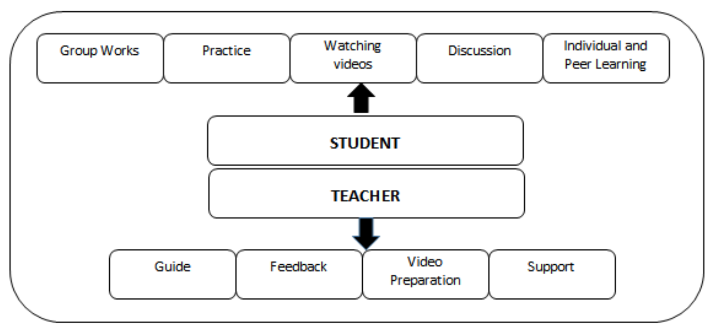
Student-learner interaction in a Flipped Classroom
The flipped model enhances the student-teacher relationship through increased interaction during class.
Teachers act as facilitators, guiding students through problem-solving and collaboration.
Source: Flipped Classroom with Problem Based Activities. Available here.
Funded by the European Union. Views and opinions expressed are however those of the author(s) only and do not necessarily reflect those of the European Union or the European Education and Culture Executive Agency (EACEA). Neither the European Union nor EACEA can be held responsible for them.

Slide 25
Student – Teacher Interaction
Personalized Support: Teachers provide tailored guidance, clarifications, and encouragement, fostering deeper understanding
Empowerment: Students take ownership of their learning journey, exploring interests and engaging in self-directed learning
Mutual Respect: The student-teacher relationship evolves into a partnership of shared responsibility and mutual respect
Enhanced Learning: Experience the transformative power of flipped learning in enriching student-teacher connections and enhancing academic success
Funded by the European Union. Views and opinions expressed are however those of the author(s) only and do not necessarily reflect those of the European Union or the European Education and Culture Executive Agency (EACEA). Neither the European Union nor EACEA can be held responsible for them.

Slide 26
Challenges in Implementing a Flipped Classroom Model
1. Digital Divide:
2. Resistance to Change:
3. Resistance to Change:
Unequal access to technology and internet connectivity among students.
Disparities hinder engagement with pre-class materials, impacting participation in flipped learning.
Mitigation requires schools to ensure equitable access to necessary resources for all students.
Students and educators accustomed to traditional teaching methods may resist the shift to flipped learning.
Some students prefer passive instruction methods, while educators may struggle with new technologies.
Overcoming resistance involves fostering a culture of innovation and providing robust professional development opportunities.
Students and educators accustomed to traditional teaching methods may resist the shift to flipped learning.
Some students prefer passive instruction methods, while educators may struggle with new technologies.
Overcoming resistance involves fostering a culture of innovation and providing robust professional development opportunities.
Funded by the European Union. Views and opinions expressed are however those of the author(s) only and do not necessarily reflect those of the European Union or the European Education and Culture Executive Agency (EACEA). Neither the European Union nor EACEA can be held responsible for them.

Slide 27
Reflection Activity
Think about the flipped classroom model in general. What are its most significant strengths?Consider aspects like student engagement, collaborative learning, accessibility to learning materials, the use of technology, and how it shifts the learning process. How does this model promote active learning and student-centered instruction compared to traditional teaching methods?
Reflecting on the flipped classroom, identify areas that could be enhanced. Are there challenges in your school or during your daily teaching practice related to technology access, student accountability for pre-class work, the effectiveness of in-class activities, or the balance between independent learning and guided instruction?
Funded by the European Union. Views and opinions expressed are however those of the author(s) only and do not necessarily reflect those of the European Union or the European Education and Culture Executive Agency (EACEA). Neither the European Union nor EACEA can be held responsible for them.

