Slide 1
CollaboratiVET Curriculum for VET teachers/trainers/educators
MODULE 1 - Introduction to Blended Learning and Collaborative Teaching Methods
Unit 4 - Good Practices
Funded by the European Union. Views and opinions expressed are however those of the author(s) only and do not necessarily reflect those of the European Union or the European Education and Culture Executive Agency (EACEA). Neither the European Union nor EACEA can be held responsible for them.

Slide 2
Learning Objectives
By the end of this unit, you will be able to:
Define and understand the different blended learning models
Select the most appropriate blended learning model for a specific case, considering the needs of the learners, the resources available and the learning objectives
Use digital tools and platforms to facilitate communication, collaboration and individualized learning
Identify best practices for blended learning
Understand the importance of planning and organization in blended learning

Slide 3
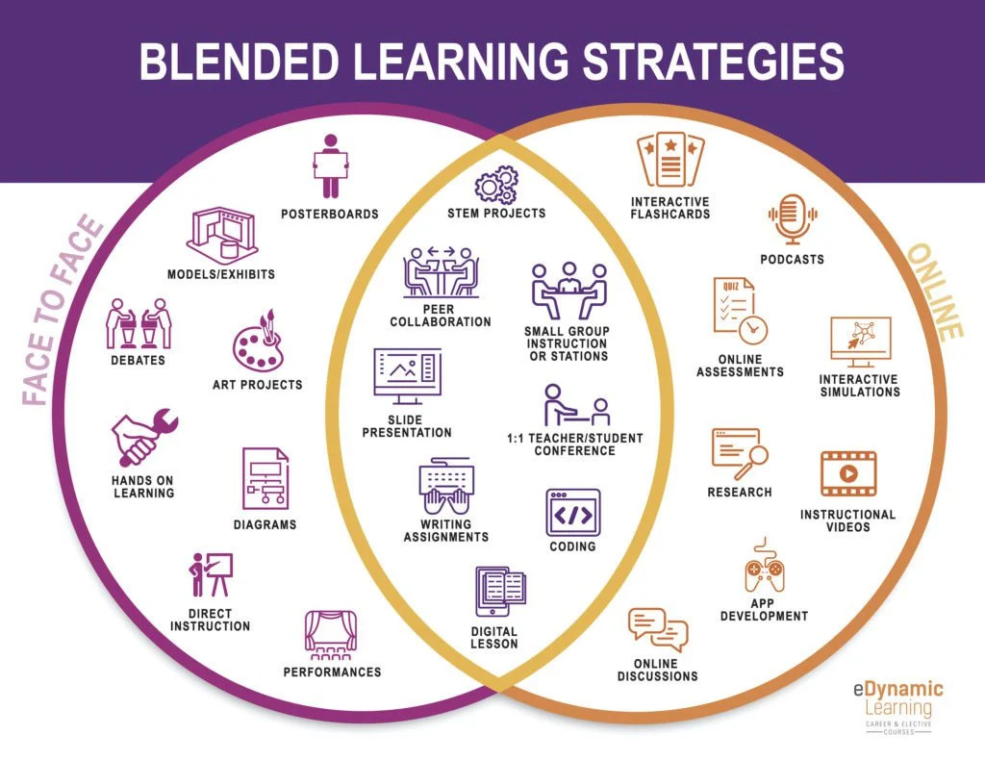
Blended Learning Practices
Seamless Integration of Technology
Data-Driven Personalisation
Consistent Communication
Interactive and Collaborative Activities
Ongoing Professional Development
Source: https://edynamiclearning.com/5-effective-blended-learning-strategies/
Funded by the European Union. Views and opinions expressed are however those of the author(s) only and do not necessarily reflect those of the European Union or the European Education and Culture Executive Agency (EACEA). Neither the European Union nor EACEA can be held responsible for them.

Slide 4
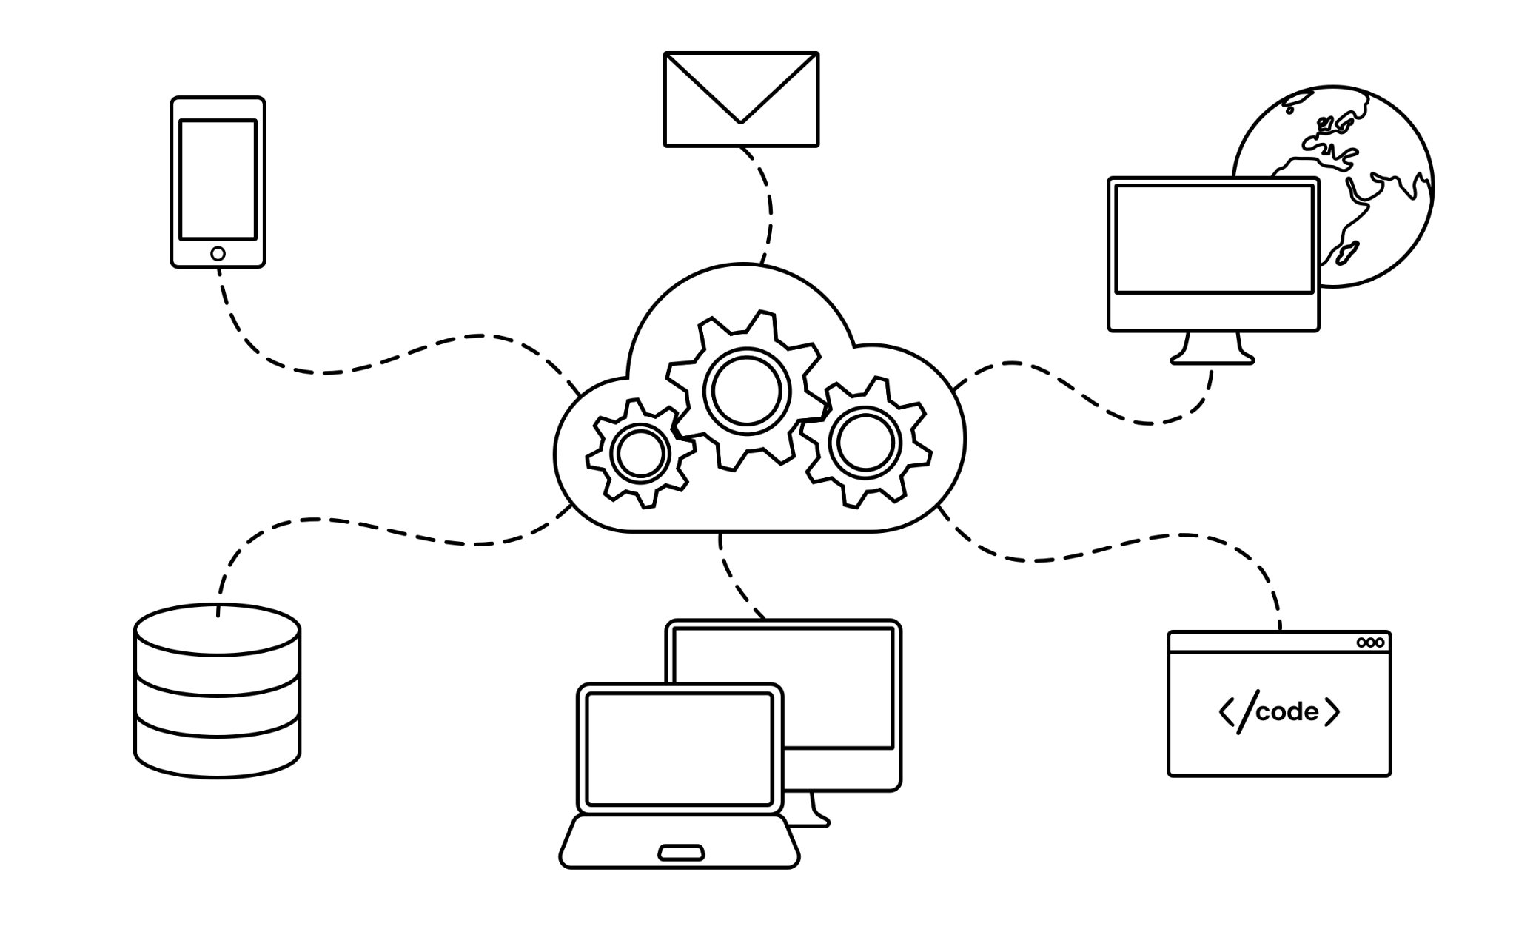
Seamless Integration of Technology
https://www.selesti.com/knowledge-hub/why-seamless-digital-integration-will-secure-a-commercially-sound-future
Funded by the European Union. Views and opinions expressed are however those of the author(s) only and do not necessarily reflect those of the European Union or the European Education and Culture Executive Agency (EACEA). Neither the European Union nor EACEA can be held responsible for them.

Slide 5
Data-Driven Personalisation
https://www.datahash.com/how-data-driven-personalization-can-impact-business/
Funded by the European Union. Views and opinions expressed are however those of the author(s) only and do not necessarily reflect those of the European Union or the European Education and Culture Executive Agency (EACEA). Neither the European Union nor EACEA can be held responsible for them.

Slide 6
Consistent Communication
https://www.freepik.es/foto-gratis/bodegon-concepto-redes-sociales_15694968.htm#fromView=search&page=1&position=0&uuid=e0edf348-3351-4fa0-b64a-0d769e21c2cd
Funded by the European Union. Views and opinions expressed are however those of the author(s) only and do not necessarily reflect those of the European Union or the European Education and Culture Executive Agency (EACEA). Neither the European Union nor EACEA can be held responsible for them.

Slide 7
Interactive and Collaborative Activities
https://www.freepik.es/foto-gratis/personas-que-trabajan-espacio-oficina-elegante-acogedor_29794537.htm#fromView=search&page=1&position=6&uuid=3a583d6c-b50f-49e8-a311-650b13706bc3
Funded by the European Union. Views and opinions expressed are however those of the author(s) only and do not necessarily reflect those of the European Union or the European Education and Culture Executive Agency (EACEA). Neither the European Union nor EACEA can be held responsible for them.

Slide 8
Ongoing Professional Development
https://www.freepik.es/vector-gratis/composicion-cultura-corporativa-ventanas-computadora-flechas-iconos-engranajes-copa-trofeo-personajes-garabatos-companeros-trabajo-ilustracion-vectorial_43869382.htm#fromView=search&page=1&position=4&uuid=b6d50ae8-4e5e-44c7-9fb5-3e5b9035f8b3
Funded by the European Union. Views and opinions expressed are however those of the author(s) only and do not necessarily reflect those of the European Union or the European Education and Culture Executive Agency (EACEA). Neither the European Union nor EACEA can be held responsible for them.

Slide 9
Examples of Good Practices in Blended Learning Models
EPAJE Project
Website: https://epale.ec.europa.eu/es
Funded by the European Union. Views and opinions expressed are however those of the author(s) only and do not necessarily reflect those of the European Union or the European Education and Culture Executive Agency (EACEA). Neither the European Union nor EACEA can be held responsible for them.

Slide 10
Maastricht University
Website: https://www.maastrichtuniversity.nl/
Funded by the European Union. Views and opinions expressed are however those of the author(s) only and do not necessarily reflect those of the European Union or the European Education and Culture Executive Agency (EACEA). Neither the European Union nor EACEA can be held responsible for them.

Slide 11
eTwinning Schools
Website: https://etwinning.es/en/
Funded by the European Union. Views and opinions expressed are however those of the author(s) only and do not necessarily reflect those of the European Union or the European Education and Culture Executive Agency (EACEA). Neither the European Union nor EACEA can be held responsible for them.

Slide 12
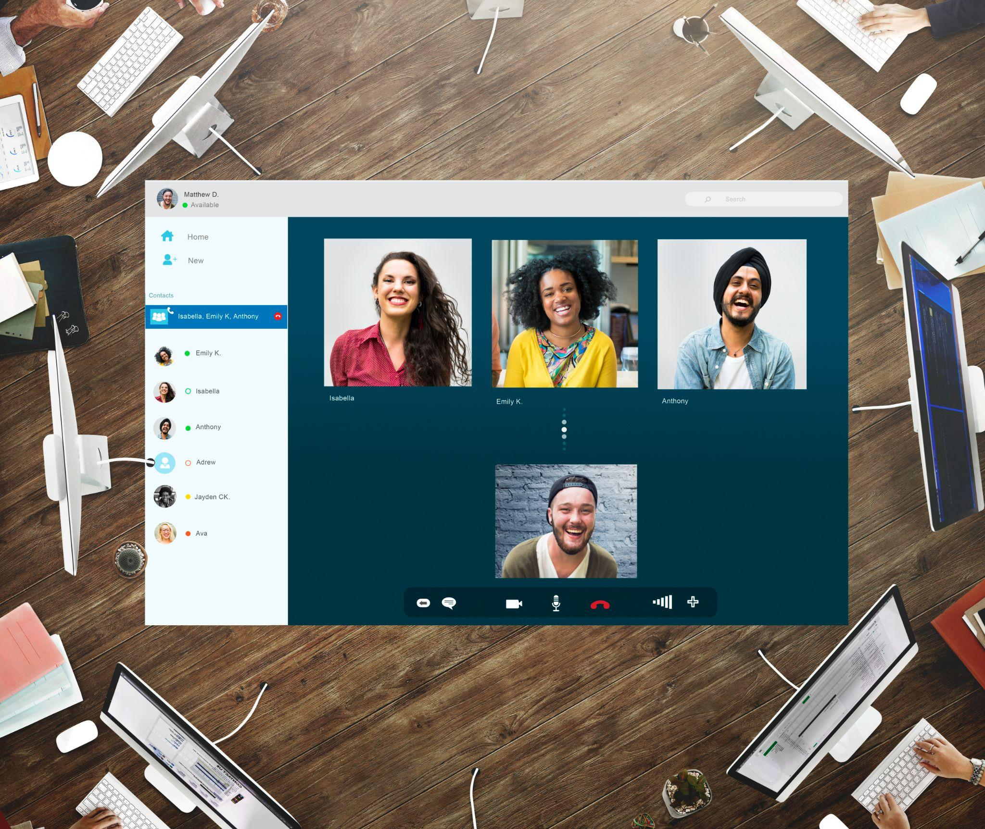
Useful Tools and Technologies for Collaborative Teaching
Communication and Collaboration:
Virtual Learning Platforms (LMS): Moodle, Google Classroom, Edmodo
Video Conferencing Tools: Zoom, Google Meet, Microsoft Teams
Instant messaging tools: WhatsApp, Telegram, Slack.
Project Management tools: Trello, Asana, Monday.com
https://www.freepik.es/foto-gratis/concepto-conexion-chat-video-amigos-grupo_16437931.htm#fromView=search&page=1&position=1&uuid=434d89ec-4b4b-463b-a8be-1652a76ba7d8
Funded by the European Union. Views and opinions expressed are however those of the author(s) only and do not necessarily reflect those of the European Union or the European Education and Culture Executive Agency (EACEA). Neither the European Union nor EACEA can be held responsible for them.

Slide 13
Useful Tools and Technologies for Collaborative Teaching
Sharing and creating content:
Cloud storage tools: Google Drive, Dropbox, OneDrive
Collaborative document creation tools: Google Docs, Microsoft Word Online, Zoho Writer
Presentation creation tools: Google Slides, Microsoft PowerPoint Online, Zoho Show
Tools for creating interactive whiteboards: Miro, Explain Everything, Limnu
https://www.freepik.es/vector-gratis/carga-imagen-pagina-destino-concepto_5757091.htm#fromView=search&page=1&position=10&uuid=c670ce8a-d43b-4824-899b-e49a8b77897f
Funded by the European Union. Views and opinions expressed are however those of the author(s) only and do not necessarily reflect those of the European Union or the European Education and Culture Executive Agency (EACEA). Neither the European Union nor EACEA can be held responsible for them.

Slide 14
Useful Tools and Technologies for Collaborative Teaching
Evaluation and Feedback:
Tools for creating forms and surveys: Google Forms, SurveyMonkey, Typeform
Online rubric tools: Rubistar, ClassDojo, EasyRubric
Digital portfolio tools: Mahara, Google Sites, Wix
https://www.freepik.es/foto-gratis/arreglo-vista-superior-diferentes-emociones_12558018.htm#fromView=search&page=1&position=1&uuid=198d6aa5-96e7-426a-b63f-df05ce011045
Funded by the European Union. Views and opinions expressed are however those of the author(s) only and do not necessarily reflect those of the European Union or the European Education and Culture Executive Agency (EACEA). Neither the European Union nor EACEA can be held responsible for them.

Slide 15
Useful Tools and Technologies for Collaborative Teaching
It is important to consider:
Ease of use
Accessibility
Security
Cost
Funded by the European Union. Views and opinions expressed are however those of the author(s) only and do not necessarily reflect those of the European Union or the European Education and Culture Executive Agency (EACEA). Neither the European Union nor EACEA can be held responsible for them.

Slide 16
Reflection Activity
Reflect on the good practices outlined for blended learning models and the examples provided. Consider the following questions:
How does regular communication between educators, students, and parents contribute to student success and support? What are some effective strategies for maintaining open channels of communication in blended learning settings?
Why is continuous learning essential for teachers to effectively implement blended learning practices? How can professional development opportunities such as workshops, online courses, and peer mentoring support educators in adapting to the demands of a mixed classroom?
Consider the examples of useful tools and technologies for collaborative teaching provided in the information. How can these tools enhance communication, collaboration, evaluation, and feedback in blended learning environments? What criteria should educators consider when selecting tools and technologies for their specific educational context?
Funded by the European Union. Views and opinions expressed are however those of the author(s) only and do not necessarily reflect those of the European Union or the European Education and Culture Executive Agency (EACEA). Neither the European Union nor EACEA can be held responsible for them.

