Slide 1
CollaboratiVET Curriculum for VET teachers/trainers/educators
MODULE 1 - Introduction to Blended Learning and Collaborative Teaching Methods
Unit 2 - Pedagogical Theories Supporting Blended and Collaborative Approaches
Funded by the European Union. Views and opinions expressed are however those of the author(s) only and do not necessarily reflect those of the European Union or the European Education and Culture Executive Agency (EACEA). Neither the European Union nor EACEA can be held responsible for them.

Slide 2
Learning Objectives
By the end of this Unit, you will be able to:
Explore and analyze various pedagogical theories that underpin Blended Learning methodologies.
Understand the principles and components of the Complex Adaptive Blended Learning System (CABLS).
Examine the application of the Community of Inquiry Framework within Blended Learning environments.
Comprehend the SAMR model and its significance in educational technology integration.
Critically evaluate the effectiveness and limitations of pedagogical theories in supporting Blended Learning approaches.

Slide 3
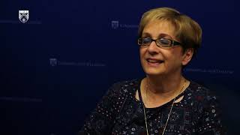
Pedagogical Theories supporting Blended and Collaborative Approaches
Funded by the European Union. Views and opinions expressed are however those of the author(s) only and do not necessarily reflect those of the European Union or the European Education and Culture Executive Agency (EACEA). Neither the European Union nor EACEA can be held responsible for them.

Slide 4
The Complex Adaptive Blended Learning System
Funded by the European Union. Views and opinions expressed are however those of the author(s) only and do not necessarily reflect those of the European Union or the European Education and Culture Executive Agency (EACEA). Neither the European Union nor EACEA can be held responsible for them.

Slide 5
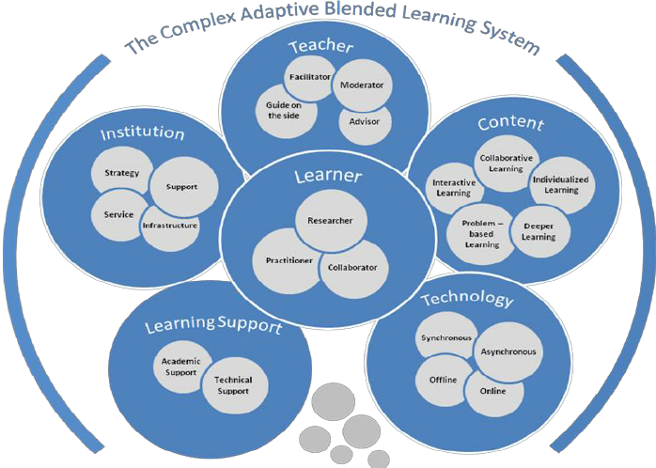
The Complex Adaptive Blended Learning System
Funded by the European Union. Views and opinions expressed are however those of the author(s) only and do not necessarily reflect those of the European Union or the European Education and Culture Executive Agency (EACEA). Neither the European Union nor EACEA can be held responsible for them.

Slide 6
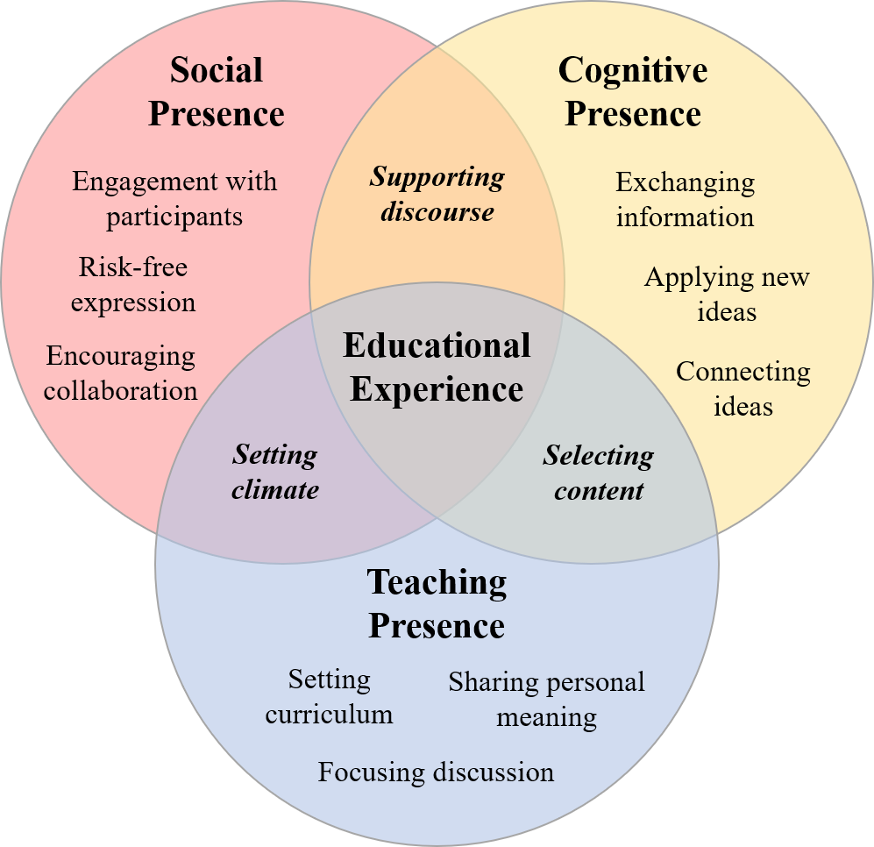
The Community of Inquiry Framework in Blended Learning
Funded by the European Union. Views and opinions expressed are however those of the author(s) only and do not necessarily reflect those of the European Union or the European Education and Culture Executive Agency (EACEA). Neither the European Union nor EACEA can be held responsible for them.

Slide 7
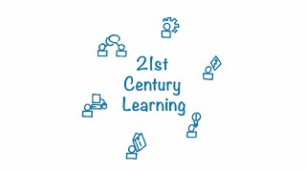
SAMR Model
Funded by the European Union. Views and opinions expressed are however those of the author(s) only and do not necessarily reflect those of the European Union or the European Education and Culture Executive Agency (EACEA). Neither the European Union nor EACEA can be held responsible for them.

Slide 8
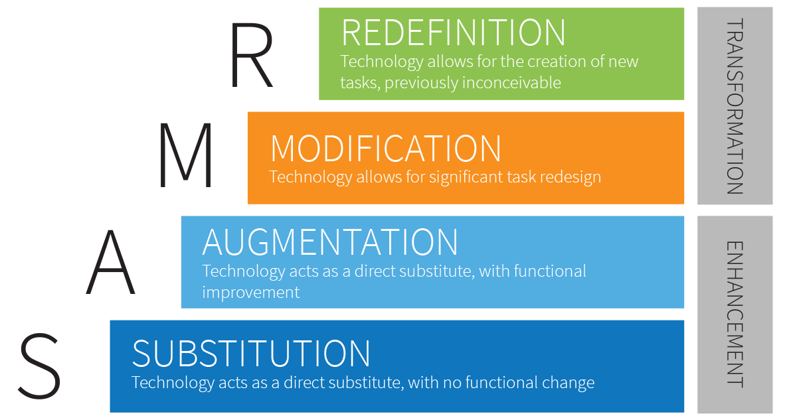
SAMR Model
Funded by the European Union. Views and opinions expressed are however those of the author(s) only and do not necessarily reflect those of the European Union or the European Education and Culture Executive Agency (EACEA). Neither the European Union nor EACEA can be held responsible for them.

Slide 9
SAMR Model - Substitution
Funded by the European Union. Views and opinions expressed are however those of the author(s) only and do not necessarily reflect those of the European Union or the European Education and Culture Executive Agency (EACEA). Neither the European Union nor EACEA can be held responsible for them.

Slide 10
SAMR Model - Augmentation
Funded by the European Union. Views and opinions expressed are however those of the author(s) only and do not necessarily reflect those of the European Union or the European Education and Culture Executive Agency (EACEA). Neither the European Union nor EACEA can be held responsible for them.

Slide 11
SAMR Model - Modification
Funded by the European Union. Views and opinions expressed are however those of the author(s) only and do not necessarily reflect those of the European Union or the European Education and Culture Executive Agency (EACEA). Neither the European Union nor EACEA can be held responsible for them.

Slide 12
SAMR Model - Redefinition
Funded by the European Union. Views and opinions expressed are however those of the author(s) only and do not necessarily reflect those of the European Union or the European Education and Culture Executive Agency (EACEA). Neither the European Union nor EACEA can be held responsible for them.

Slide 13
Reflection Activity
Reflect on the pedagogical theories supporting blended learning and collaborative approaches discussed in the provided information. Consider the following questions:
How do you currently integrate online and in-person instruction in your teaching practice, if at all?
Reflect on your own comfort and proficiency with integrating technology into your teaching practice. What are your strengths in this area, and what areas do you feel you could further develop?
How might you collaborate with colleagues to take advantage of pedagogical theories and technological tools to enhance student learning experiences in a blended environment?
Funded by the European Union. Views and opinions expressed are however those of the author(s) only and do not necessarily reflect those of the European Union or the European Education and Culture Executive Agency (EACEA). Neither the European Union nor EACEA can be held responsible for them.

