Slide 1
CollaboratiVET Curriculum for VET teachers/trainers/educators
MODULE 1 - Introduction to Blended Learning and Collaborative Teaching Methods
Unit 1 - Foundations of Blended Learning and Collaborative Teaching
Funded by the European Union. Views and opinions expressed are however those of the author(s) only and do not necessarily reflect those of the European Union or the European Education and Culture Executive Agency (EACEA). Neither the European Union nor EACEA can be held responsible for them.

Slide 2
Learning Objectives
By the end of this module, you will be able to:
Comprehend the concept of Blended Learning and its significance in contemporary educational practices.
Examine the contextual relevance of Blended Learning within the framework of the European Union.
Establish a foundational understanding of Blended Learning methodologies, strategies, and models.

Slide 3
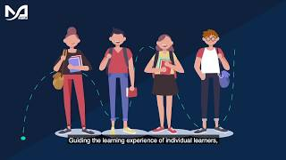
What is Blended Learning?
Funded by the European Union. Views and opinions expressed are however those of the author(s) only and do not necessarily reflect those of the European Union or the European Education and Culture Executive Agency (EACEA). Neither the European Union nor EACEA can be held responsible for them.

Slide 4
Context in the European Union
The European Commission also sees blended learning as a good method to implement, especially after the Covid-19 crisis. That is why they published the proposal for a Council Recommendation on blended learning to support high quality and inclusive primary and secondary education.
The Commission offers a plan for integrating learning environments and tools in primary and secondary education and training that can contribute to the development of more resilient education and training systems, in addition to short-term actions to address the most urgent gaps made worse by the COVID-19 pandemic.
Funded by the European Union. Views and opinions expressed are however those of the author(s) only and do not necessarily reflect those of the European Union or the European Education and Culture Executive Agency (EACEA). Neither the European Union nor EACEA can be held responsible for them.

Slide 5
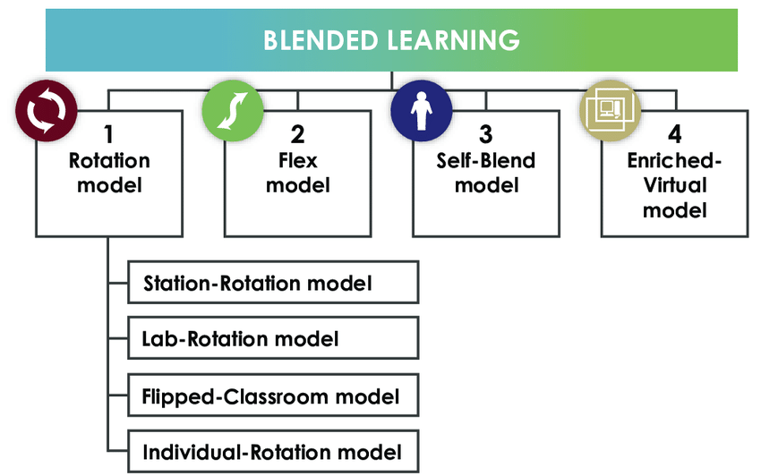
Foundations of Blended Learning
BLENDED LEARNING AND FEATURES OF THE USE OF THE ROTATION MODEL IN THE EDUCATIONAL PROCESS - Scientific Figure on ResearchGate. Available from: https://www.researchgate.net/figure/Blended-learning-models_fig4_324566949 [accessed 21 Oct 2024]
Funded by the European Union. Views and opinions expressed are however those of the author(s) only and do not necessarily reflect those of the European Union or the European Education and Culture Executive Agency (EACEA). Neither the European Union nor EACEA can be held responsible for them.

Slide 6
Station Rotation
Funded by the European Union. Views and opinions expressed are however those of the author(s) only and do not necessarily reflect those of the European Union or the European Education and Culture Executive Agency (EACEA). Neither the European Union nor EACEA can be held responsible for them.

Slide 7
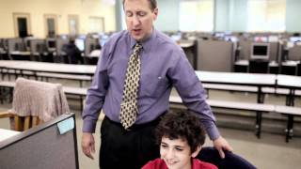
Individual Rotation
Funded by the European Union. Views and opinions expressed are however those of the author(s) only and do not necessarily reflect those of the European Union or the European Education and Culture Executive Agency (EACEA). Neither the European Union nor EACEA can be held responsible for them.

Slide 8
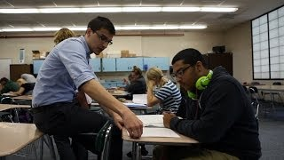
Flipped Classroom
Funded by the European Union. Views and opinions expressed are however those of the author(s) only and do not necessarily reflect those of the European Union or the European Education and Culture Executive Agency (EACEA). Neither the European Union nor EACEA can be held responsible for them.

Slide 9
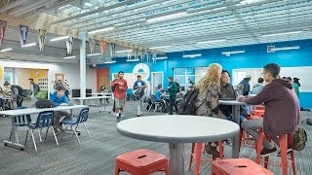
Flex
Funded by the European Union. Views and opinions expressed are however those of the author(s) only and do not necessarily reflect those of the European Union or the European Education and Culture Executive Agency (EACEA). Neither the European Union nor EACEA can be held responsible for them.

Slide 10
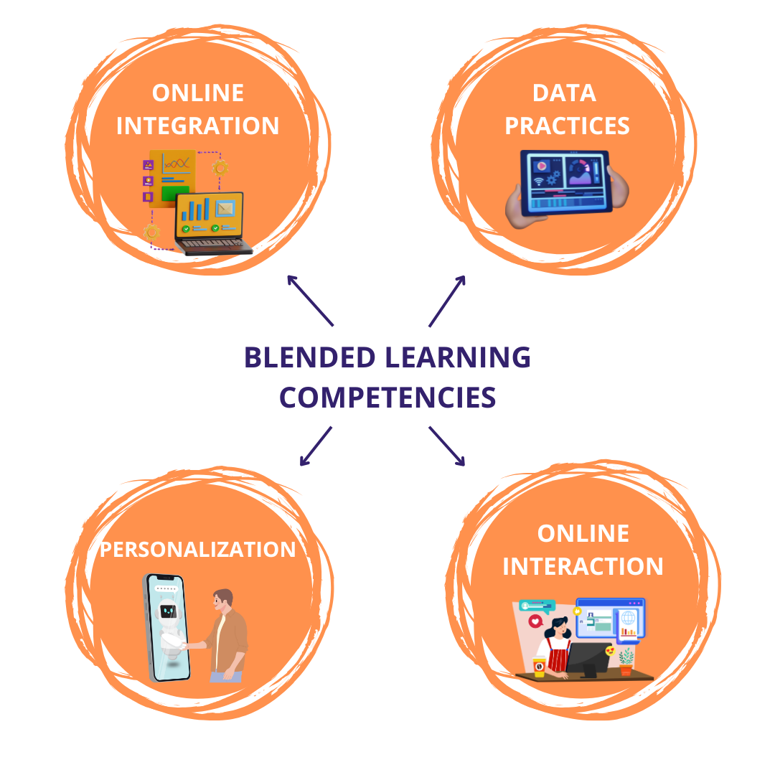
What are the competencies required in Blended Learning?
Funded by the European Union. Views and opinions expressed are however those of the author(s) only and do not necessarily reflect those of the European Union or the European Education and Culture Executive Agency (EACEA). Neither the European Union nor EACEA can be held responsible for them.

Slide 11
Collaborative Teaching
“Two heads are definitely better than one and by sourcing ideas from each other, you have a better chance of coming up with a strategy that will allow your business to overcome a setback or challenge.” - Richard Branson
Funded by the European Union. Views and opinions expressed are however those of the author(s) only and do not necessarily reflect those of the European Union or the European Education and Culture Executive Agency (EACEA). Neither the European Union nor EACEA can be held responsible for them.

Slide 12
How can you approach Collaborative Teaching in the right way?
Understand what the students’ needs are
Prepare the lessons together with other teacher
Talk to the teacher before classes
Define the objectives of the classes
Funded by the European Union. Views and opinions expressed are however those of the author(s) only and do not necessarily reflect those of the European Union or the European Education and Culture Executive Agency (EACEA). Neither the European Union nor EACEA can be held responsible for them.

Slide 13
Types of Collaborative Teaching
Six Approaches to Co-Teaching:
One Teach, One Observe
One Teach, One Assist
Parallel Teaching
Station Teaching
Alternative Teaching
Team Teaching
Funded by the European Union. Views and opinions expressed are however those of the author(s) only and do not necessarily reflect those of the European Union or the European Education and Culture Executive Agency (EACEA). Neither the European Union nor EACEA can be held responsible for them.

Slide 14
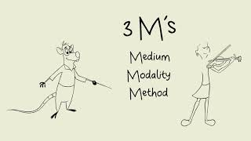
The Role of Digital Technologies in Education
Funded by the European Union. Views and opinions expressed are however those of the author(s) only and do not necessarily reflect those of the European Union or the European Education and Culture Executive Agency (EACEA). Neither the European Union nor EACEA can be held responsible for them.

Slide 15
Reflection Activity
Reflect on the information provided about Blended Learning, Collaborative Teaching, and the Role of Digital Technologies in Education. Consider the following questions:
Reflect on the guidelines for collaborative teaching. How might these strategies enhance student learning outcomes in your classroom?
Which approach to co-teaching (e.g., one teach, one observe; parallel teaching) do you think would work best in your teaching context? Why?
How have digital technologies transformed the educational landscape, especially in the context of the COVID-19 pandemic?
Reflect on your own use of digital tools in teaching. What benefits have you observed, and what challenges have you faced?
Funded by the European Union. Views and opinions expressed are however those of the author(s) only and do not necessarily reflect those of the European Union or the European Education and Culture Executive Agency (EACEA). Neither the European Union nor EACEA can be held responsible for them.

